Slide 1
Topic 6.
The Political and Economic Response to the Financial Crisis of 2008

Slide 2
Troubled Asset Relief Program (TARP) – Proposed 20 September 2008. As originally conceived, TARP allowed the Treasury Department to purchase illiquid, difficult-to-value assets from banks and other financial institutions. The targeted assets were mainly “toxic” mortgage securities (RMBS) which were sold in a booming market until 2007, when they were hit by widespread foreclosures on the underlying loans. TARP was intended to improve the liquidity of the banking system by buying these assets from participating institutions thereby stabilizing their balance sheets and avoiding further losses.

Slide 3
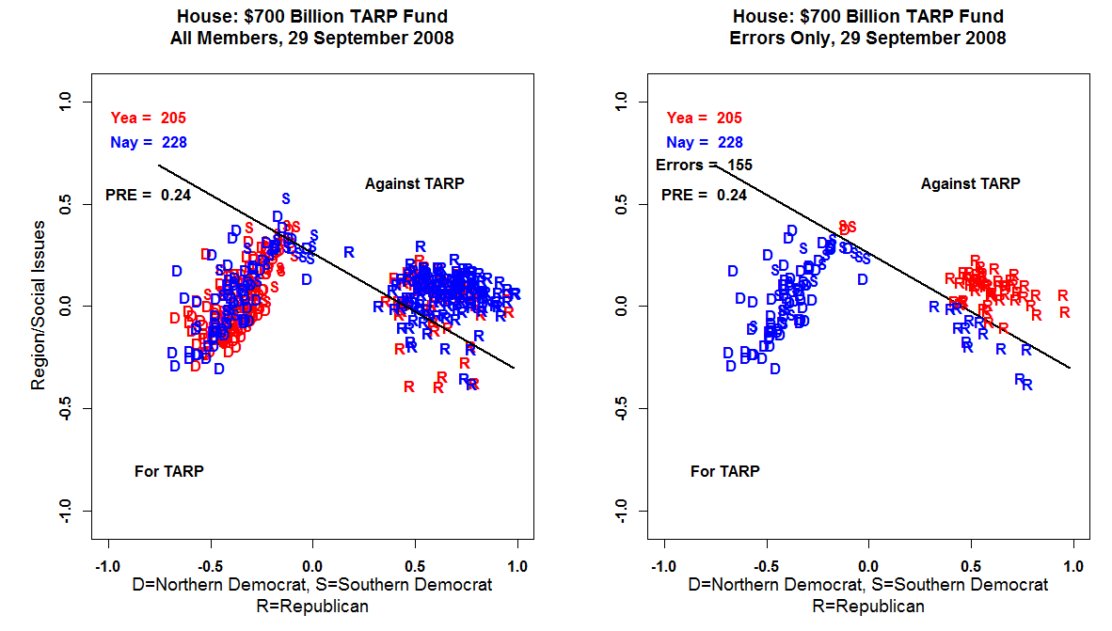

Slide 4
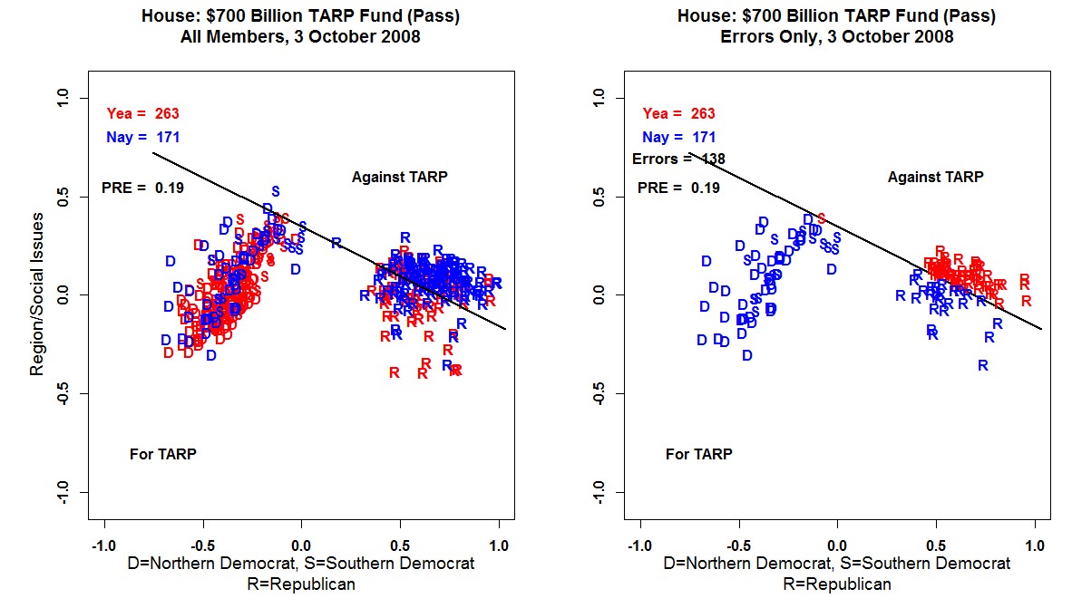

Slide 5
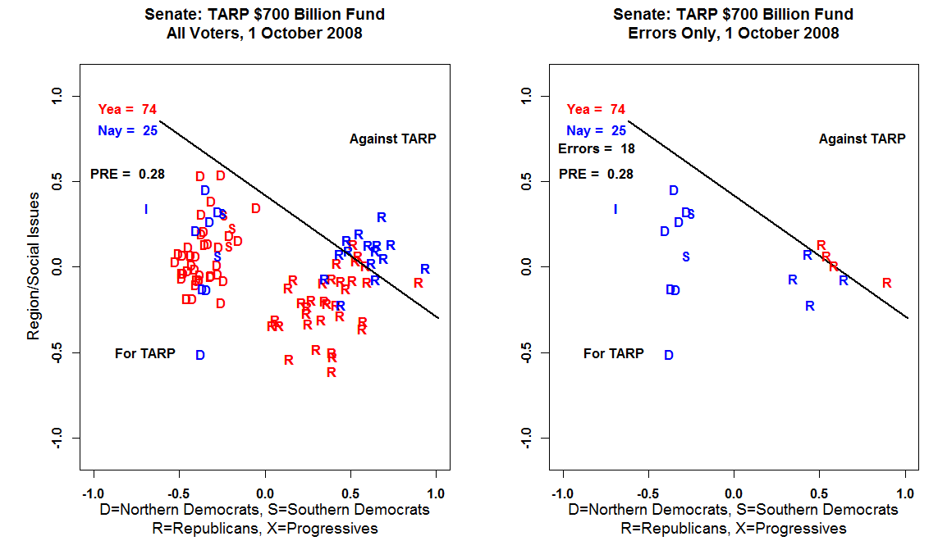

Slide 6
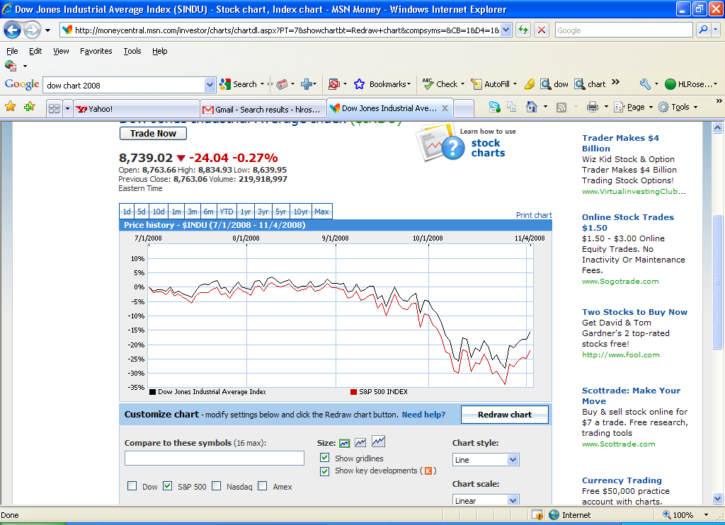

Slide 7
TARP was successful in stabilizing the banking system mainly by injecting billions directly into the major banks. About $500 Billion was spent and almost all of that has been paid back to the Treasury. However, the money used to bailout General Motors and Chrysler has not
been fully repaid and almost certainly never will be as it was used to stabilize the retirement and health care benefits of the United Auto Workers.

Slide 8
How to Waste a Crisis: The Dodd-Frank Act
President Obama’s top priority was Health Care reform. He did not try to mobilize public opinion to reform the financial system. Obama brought back the Clinton team and came down on the side of the Clinton team vis a vis Volcker.

Slide 9
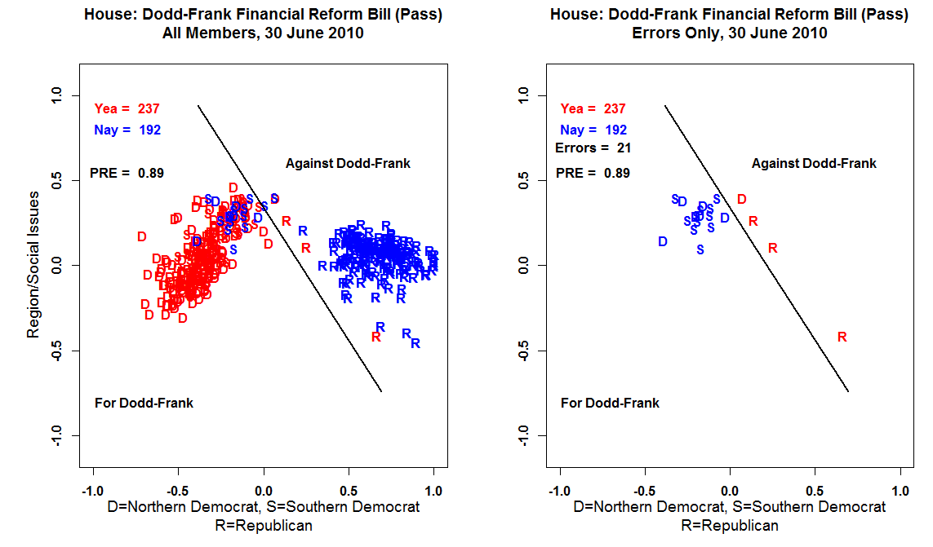

Slide 10
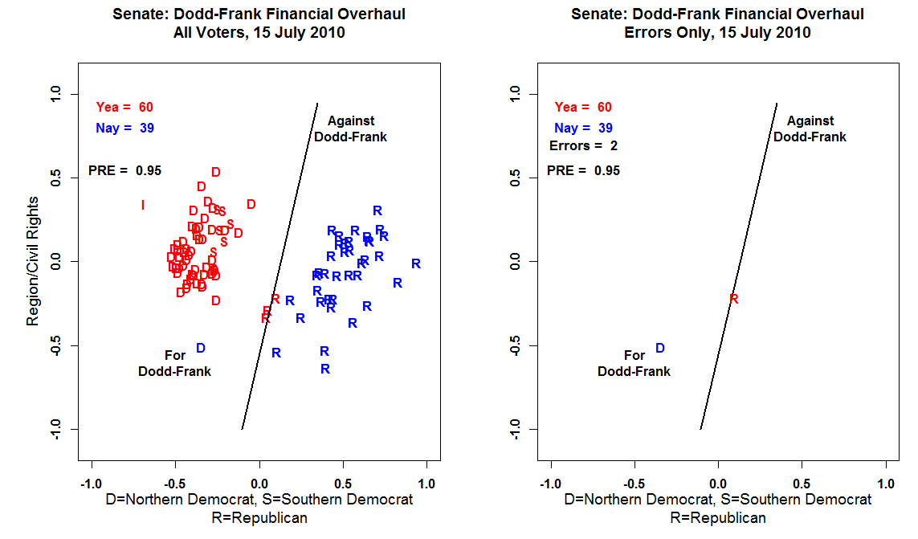

Slide 11
Problems With Dodd-Frank –
Too Big To Fail was not properly dealt with;
GSEs were not dealt with;
Consumer Protection was Dealt With but is a sore point with Republicans;
Tremendous Regulatory Complexity and Discretion – Glass-Steagall was 37 pages, D-F in 3,000 pages – Regulations to be drafted by numerous agencies;
Executive Compensation -- almost nothing done to curb excessive risk taking (ability to claw back some of the compensation);
Complexity.

Slide 12
Recommendations:
Set rules that account for political risk (Fannie and Freddie used their economic muscle to lobby regulators and members of Congress). Make the industry more segmented;
Limit Activities of Government Insured Firms – Volcker Rule -- The rule is often referred to as a ban on proprietary trading by commercial banks, whereby deposits are used to trade on the bank's own accounts, although a number of exceptions to this ban were included in the Dodd-Frank law;

Slide 13
3) Reform Compensation Practices – Financial gamblers have to cover a larger share of their own loses;
4) Make Financial Firms smaller so there is no TBTF;
5) Increase Regulatory and Prosecutorial Capacity – Give regulatory agencies the resources to compete with the financial firms in terms of information. Let States do more regulating.

