Slide 1
Topic 4. Part 3.
Reckless Endangerment – The Role of Fannie, Freddie, and Congress in Fueling the Bonfire

Slide 2
Fannie Mae, the Federal National Mortgage Association (FNMA), was founded in 1938 during the Great Depression as part of the New Deal. Fannie Mae was established to provide local banks with federal money by buying the home mortgages that they had issued. This was aimed at raising levels of home ownership and the availability of affordable housing.

Slide 3
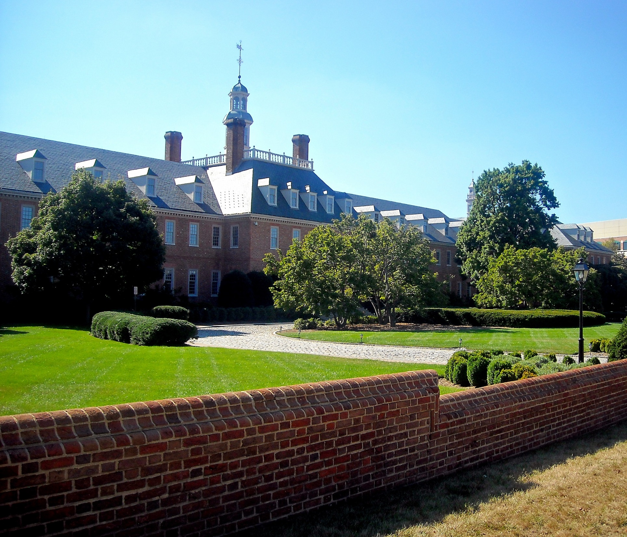

Slide 4
Freddie Mac, the Federal Home Loan Mortgage Corporation (FHLMC), was created in 1970 to expand the secondary market for mortgages in the US. Freddie Mac like Fannie Mae, buys mortgages on the secondary market, pools them, and sells them as mortgage-backed securities to investors on the open market. This secondary mortgage market increases the supply of money available for mortgage lending and increases the money available for new home purchases.

Slide 5
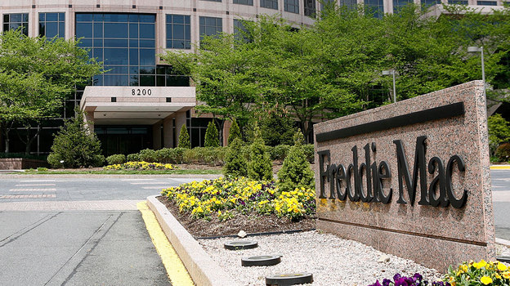

Slide 6
Fannie and Freddie are government-sponsored enterprises (GSEs). Fannie was “privatized” in 1968 so its debt was not on the Federal Government’s balance sheet (but everyone, correctly, assumed that it was backed by the Federal Government). In 1970 Fannie was allowed to buy mortgages from private issuers (it had been confined to those issued by the FHA). In 1970 Freddie was created to provide “competition” to Fannie.

Slide 7
The Housing and Community Development Act of 1992 Pushed the GSEs to buy low-income mortgages. This was, in part, motivated by the Community Reinvestment Act of 1977 which had outlawed Redlining by Banks.
Partly as a response to the 1992 Act, Fannie Mae and Freddie Mac (GSEs) started purchasing large amounts of subprime securities to expand the market for affordable housing. The FMs accounted for 40% of all subprime mortgage securities newly purchased and retained on investors’ balance sheets during 2003 and 2004.

Slide 8
(Political Bubbles, Ch. 5):“The bubble grew because egalitarian ideology, the ‘ownership society’ side of free market conservatism, converged with crony capitalism to produce a rare but dysfunctional instance of bipartisan policy consensus.”

Slide 9
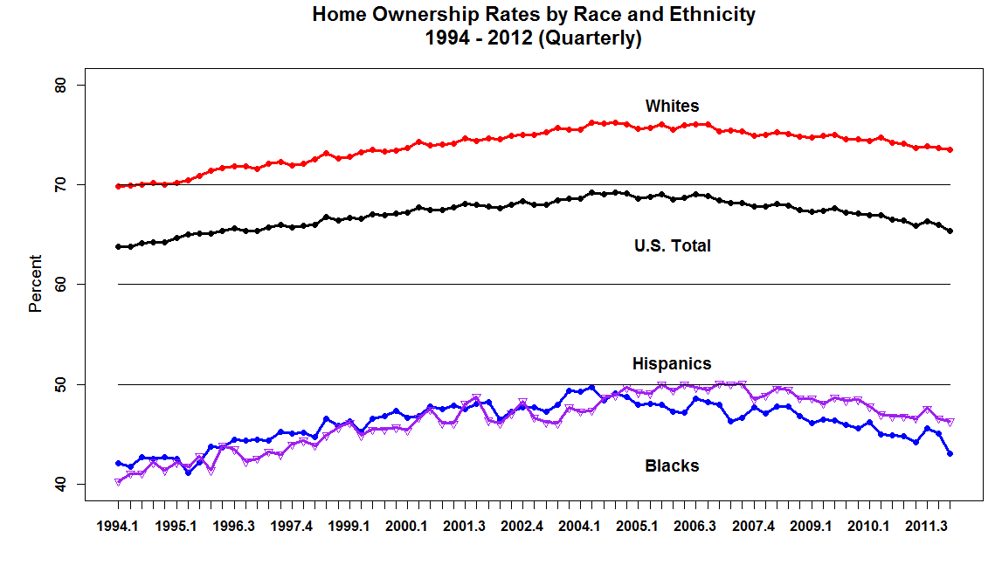
Figure 5.1 1 Homeownership Rates by Race and Ethnicity 1994-2012. Homeownership rates have continued to decline beyond the end of the 2007-09 recession. Homeownership rates in 2012 are lower for all groups than the rates in 2002. Black homeownership rates have had a particularly steep decline and have fallen back to the level in the mid 1990s. Source: Current Population Survey/Housing Vacancy Survey, Series H-111, Bureau of the Census.

Slide 10
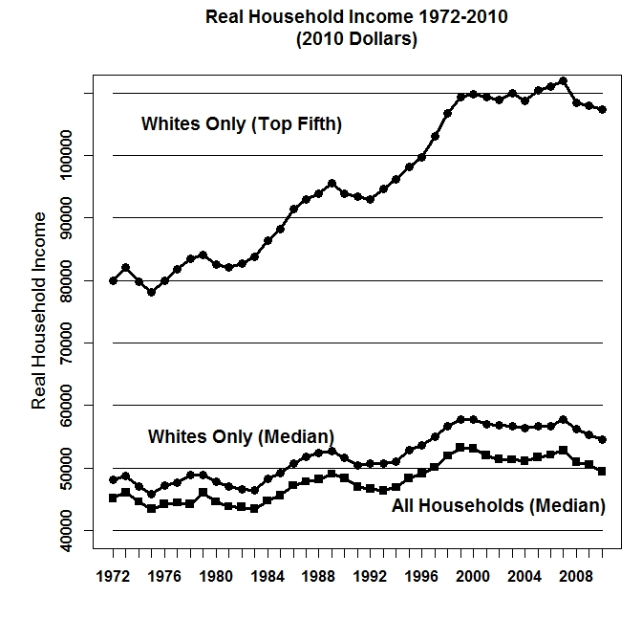
Figure 5.2 Median Household Income and Average Income of Top Quintile 1972 to 2010 (in 2010 Dollars). Income never recovered to the level it reached at the end of the twentieth century under President Clinton. During the eight years of the Bush presidency (2001-08) it recovered somewhat but then fell sharply during the first two years of the Obama presidency. Source: U.S. Census Bureau, Current Population Survey, Annual Social and Economic Supplements.

Slide 11
(p. xv, Reckless Endangerment) "...we are disturbed that so many who contributed to the mess are still in positions of power or have risen to even higher ranks. And while some architects of the crisis may no longer command center stage, they remain respected members of the business or
regulatory community. The failure to hold central figures accountable for their actions sets a dangerous precedent. A system where perpetrators of such a crime are allowed to slip quietly from the scene is just plain wrong."

Slide 12
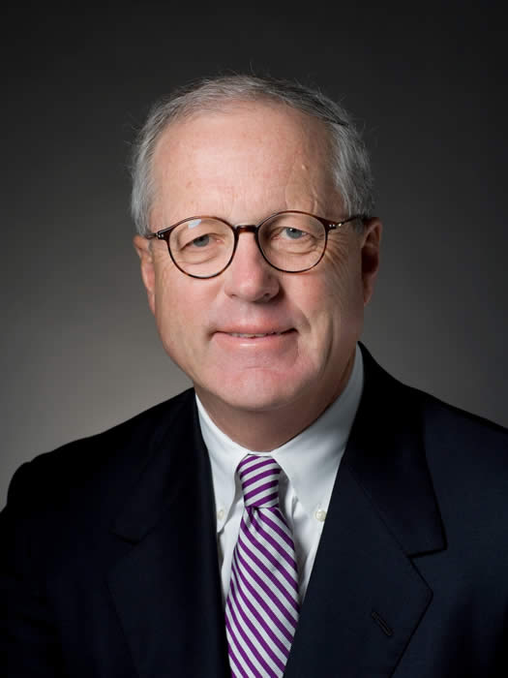
James A. Johnson, Head of Fannie Mae 1991 -- 1998

Slide 13
James A. Johnson (a well connected “Politician” who had worked for Walter Mondale) built Fannie Mae "into the largest and most powerful financial institution in the world.“
Fannie Mae was a political patronage machine, and with the machine’s earnings a function of its ability to expand the number of mortgages it encouraged with its policies.

Slide 14
Johnson built it into a formidable political force by having satellite offices throughout the country and courted powerful members of Congress of both Political Parties. “Fannie Mae spent roughly $100 million on lobbying and political contributions ... “Johnson was the financial industry’s leader in buying off Congress”.

Slide 15
Big name Democrats like Barney Frank and Big name Republicans like Newt Gingrich were strong supporters of Fannie Mae.

Slide 16
Fannie made sure to buy up academia too with well-compensated reports. Economists Joseph Stiglitz, Peter Orszag, and Jon Orszag authored a study that chided the GSEs’ critics for arguing that “both Fannie and Freddie posed significant risks for the taxpayer.” To them the possibility of a blowup was “substantially less than one in 500,000—and may be smaller than one in three million.” In 2003, Republican insider R. Glenn Hubbard wrote a paper “defending Fannie Mae’s risk management.”

Slide 17
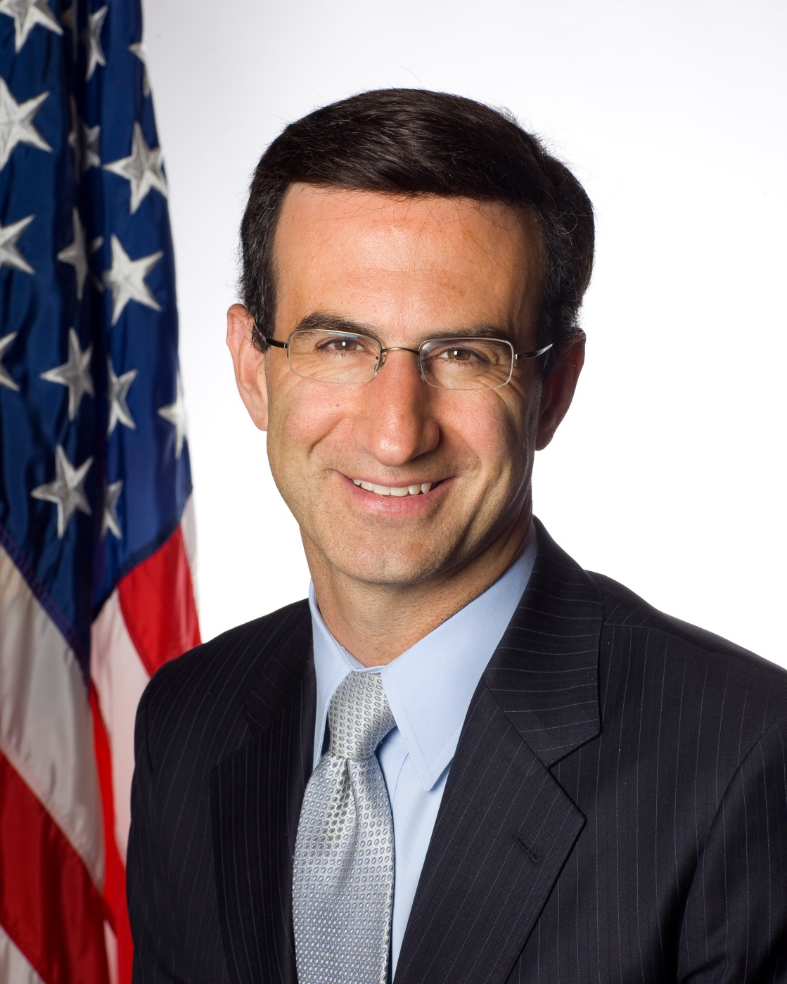
Peter Orszag,
Director of the Office of Management and Budget (OMB), 2009 -- 2011

Slide 18
Orszag went to work for CitiGroup. In an alimony lawsuit he was forced to state his income. “Last year (2013), he reportedly made $3.1milllion but he apparently expects to make $4million this year (2014).”

Slide 19
Mr. Orzag was married to Cameron Kennedy, whose maiden name Hamill but has since adopted her mother's name, until 2006 and the couple had two children together.
At the time, they agreed that he would fund a $400,000 trust that would cover school tuition for their children and other unidentified major expenses.
It is not clear if they had a separate alimony agreement but Ms. Hamill has not been reliant on him for money as The Washington Post reports that she is a consultant for McKinsey and makes $350,000 on her own.
The children's fund has been depleted over the past eight years between tuition at Georgetown Day School which ranges from $32,100 for pre-kindergarten to $36,890 for seniors in high school.

Slide 20
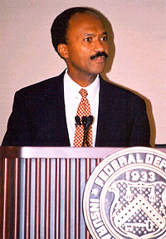
Franklin Raines, Head of Fannie Mae, 1999 -- 2004

Slide 21
James Johnson changed Fannie's executive compensation plan to be based on volume not quality and earned over $200 Million dollars while working at Fannie Mae.
An Office of Federal Housing Enterprise Oversight (OFHEO) report from September 2004 found that, during Johnson's tenure as CEO, Fannie Mae had improperly deferred $200
million in expenses. This enabled top executives, including Johnson and his successor, Franklin Raines, to receive substantial bonuses in 1998.

Slide 22
The Office of Federal Housing Enterprise Oversight (OFHEO) in 2004 accused Raines of abetting widespread accounting errors, which included the shifting of losses so senior executives, such as himself, could earn large bonuses.
Civil charges were filed against Raines and two other former Executives – J. Timothy Howard, Fannie’s former chief financial officer and Leanne G. Spencer, Fannie’s former controller by the OFHEO in which the OFHEO sought $110 million in penalties and $115 million in returned bonuses from the three accused.

Slide 23
On 18 April 2008, the government announced a settlement with Raines together with J. Timothy Howard, Fannie's former chief financial officer, and Leanne G. Spencer, Fannie's former controller -- dismissing its charges. The three executives maintained their denial of the charges but agreed to the payment of fines totaling about $3 million, which were paid by Fannie's insurance policies.

Slide 24
There simply is no question that Fannie and Freddie played an important role in causing the meltdown of the financial system in 2008. The Financial Crisis Inquiry Commission (FCIC – formed in 2009 and issued its report in January, 2011) found that the GSE's "contributed to the crisis, but were not a primary cause."

Slide 25
The FCIC found that the GSE's were late to the subprime lending game, entering the market in a substantial way in 2005. The GSE's followed rather than led the race to purchase subprime loan securities. The GSE's increased their involvement in the subprime securitization market because they were significantly losing market share and were feeling less relevant in the mortgage lending marketplace.

Slide 26
(p. 263) "Of all the partners in the homeownership push, no industry contributed more to the corruption of the lending process than Wall Street. If mortgage originators like NovaStar or Countrywide were the equivalent of drug pushers hanging around a schoolyard and the ratings
agencies were the narcotics cops looking the other way, brokerage firms providing capital to the anything-goes lenders were the overseers of the cartel."

Slide 27
(p. 263) "Just as drug lords know that their products pose hazards to their customers, the Wall Street firms packaging and selling mortgage pools to investors knew well before their customers did that the loans inside the securities had begun to go bad."

