Slide 1
Topic 4. Part 2.
The Big Short – Why did no one “catch on” to the looming disaster?

Slide 2
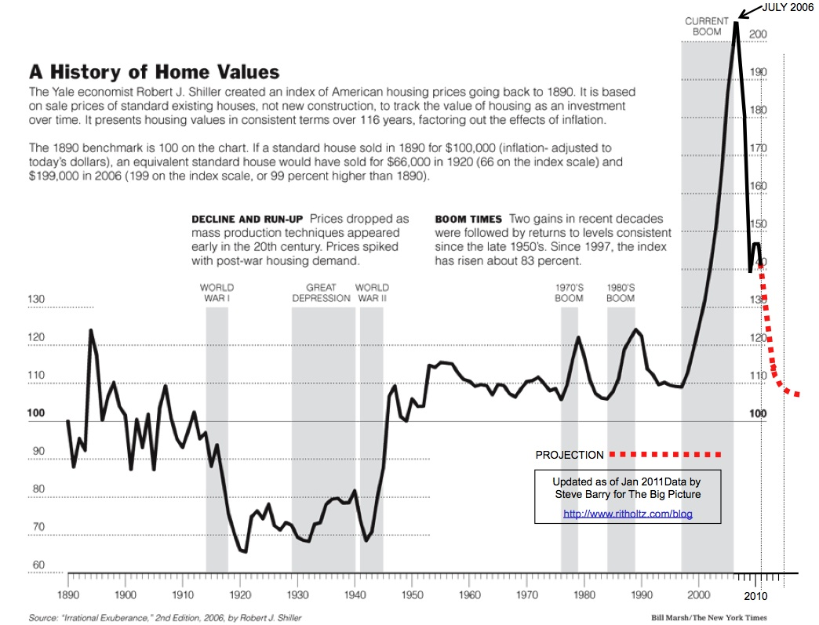

Slide 3
When the Housing Bubble Popped it triggered a classic Bank Run.
Only it was a Run on the Shadow Banking System.
This Brought the Economy Down.

Slide 4
What is a Bubble??
“This Dance Can go on Forever”
Basically – “If it is too good to be true…..it ain’t”

Slide 5
Asset Bubbles and Political Bubbles are shaped by: Ideologies (Beliefs); Institutions; and Interests

Slide 6
Economic Bubbles
Stock Market c. 1927 – 1929.
  “Irrational Exuberance”
Dot Com Bubble in the late 1990s.
  New Information Economy was emerging. “Bricks and Mortar” will be a thing of the past.
Housing Bubble late 1990s – 2006.
  Globalization and a Savings Glut from Developing countries could drive interest rates to permanently low levels.

Slide 7
Political Bubbles
Stock Market c. 1927 – 1929.
  Not the Government’s Business.
Dot Com Bubble late 1990s
  If the information economy is the wave of the future it would be Luddism to tighten standards for public offerings or pricing of stock options.
Housing Bubble late 1990s – 2006.
  Markets self-correct (rational expectations). If savings glut reduces interest rates it would be folly for monetary policy to interfere.

Slide 8
Almost Everyone Believes……
THIS TIME IS DIFFERENT!

Slide 9
The Ideologies at Work in the latest Crisis
Free Market Conservatism
Fundamentalist Free Market Conservatism
Egalitarianism

Slide 10
Michael Lewis (p. xviii): "Wall Street investment banks are like Las Vegas casinos: They set the odds. The customer who plays zero-sum games against them may win from time to time but never systematically..." Yet John Paulson had made $20 Billion betting against the Casinos. "Who else had noticed before the casino caught on, that the roulette wheel had become predictable? Who else inside the black box of modern finance had grasped the flaws of its machinery?"

Slide 11
Steve Eisman and Vincent (Vinny) Daniel Of Oppenheimer and Company:
In 1997 researched, using a Moody's database, subprime mortgage loans and concluded that the subprime lending companies were basically Ponzi Schemes.
In c. 2004-05 Eisman listened to a pitch by Greg Lippmann (using an analysis by Eugene Xu) to Short Subprime Paper through the use of Credit Default Swaps.

Slide 12
In 2006 Eisman, Vinny, and Danny Moses did a trade with Lippman investing in Credit Default Swaps against the subprime issues that Lippman said to bet against.
Eisman then realized (late 2006/early 2007) that any securities with a high amount of "no doc" loans were almost certain to go bad and he started betting against all of those with CDS's (On the list that Lippman sent Eisman there were no issues with LESS THAN 50% NO DOCs).

Slide 13
Eisman and his partners figured out that the worst mortgage bonds to short were:
1) Concentrated in California, Florida, Nevada, and
Arizona.
2) The Loans were made by the most dubious of the mortgage
Lenders.
3) The Mortgage pools would have a higher than average
number of low-doc or no-doc loans.

Slide 14
(p. 97) "In Bakersfield, California, a Mexican strawberry picker with an income of $14,000 and no English was lent every penny he needed to buy a house for $724,000."

Slide 15
In the summer of 2006 Vinny and Danny go to Orlando, Florida for a conference of people/firms that were involved in the subprime mortgage business. They meet with a woman from Moody's and discover that the ratings people were, in effect, giving triple A ratings to almost
everything. They later went to a Conference in Las Vegas and discovered it was even worse than they thought. Eisman discovered that the Market Maker in CDS’s (AIG had pulled out of the market) held none of the paper himself but was happy to match buyers and sellers.

Slide 16
Michael Burry – A Value Investor (think Warren Buffet) ran a hedge fund from 2000 to 2008 called Scion Capital LLC. In 2005, he changed from value investing to focus on the subprime market because he actually read the prospectus’s for various subprime mortgage bonds and realized they were junk.

Slide 17
He correctly forecast a bubble would collapse as early as 2007. Burry's research on the runaway values of residential real estate convinced him that subprime
mortgages, especially those with "teaser" rates, and the bonds based on these mortgages would begin losing value when the original rates reset, often in as little as two years after initiation.

Slide 18
This conclusion led Burry to short the market by persuading Goldman Sachs to sell him credit default swaps against subprime deals he saw as vulnerable. This analysis proved correct, and Burry profited accordingly. Though he suffered an investor revolt before his predictions came true, he earned a personal profit of $100 million and
a profit for his remaining investors of more than $700 million.

Slide 19
Scion Capital ultimately recorded returns of 489.34 percent (net of fees and expenses) between its November 1, 2000 inception and June 2008. The S&P 500 returned just over two percent over the same period.
IT SPEAKS VOLUMES THAT HIS RICH, “SOPHISTICATED”, INVESTORS COULD NOT SEE WHAT HE SAW!!! THEY DID NOT UNDERSTAND THAT THE WHOLE DOOMSDAY MACHINE WAS GOING TO CRASH AND PULL THEM DOWN WITH IT.

Slide 20
Jamie Mai and Charlie Ledley founded Cornwall Capital Management in 2003 with a Schwab account containing $110,000.00. They first invested in options to buy stock (which they thoroughly researched). Later they were later joined by Ben Hockett who knew more about how derivatives worked than they did.

Slide 21
Ben managed to talk Deutsche Bank into making an agreement with them dubbed a "hunting license" or ISDA. With an ISDA you could trade with the big Wall Street Firms which meant that they could get into the business of buying CDS against bad mortgage bonds. They began doing the investments in late 2006. Just in Time as it turned out.

Slide 22
(p. 132) "On October 16, 2006, they bought from Greg Lippmann's trading desk $7.5 million in Credit Default Swaps on the double-A tranche of a CDO named ... Pine Mountain. Four days later, Bear Stearns sold them $50 million more. 'They knew Ace somehow,' said the bear Stearns credit default swap salesman. 'So we wound up dealing with them.'"

Slide 23
The founders of Cornwall Capital, who started a hedge fund in their garage with $110,000, built it into $135 million when the market crashed.

Slide 24
(p. 244) "The big Wall Street firms, seemingly so shrewd and self-interested, had somehow become the dumb money. The people who ran them did not understand their own businesses, and their regulators obviously knew even less. Charlie [Ledley] and Jamie [Mai] had always sort of assumed that there was some grown-up in charge of the financial system whom they had never met; now they saw there was not." (September, 2008)

