Slide 1
Topic 4. Part 1.
Securitization and The Shadow Banking System (The Road to Hell is Paved With Good Intentions)

Slide 2
Types of Securitization
Collateralized Debt Obligations (CDO)
Asset Back Securities (ABS)
Commercial Mortgage Backed Securities (CMBS)
Residential Mortgage Backed Securities (RMBS)

Slide 3
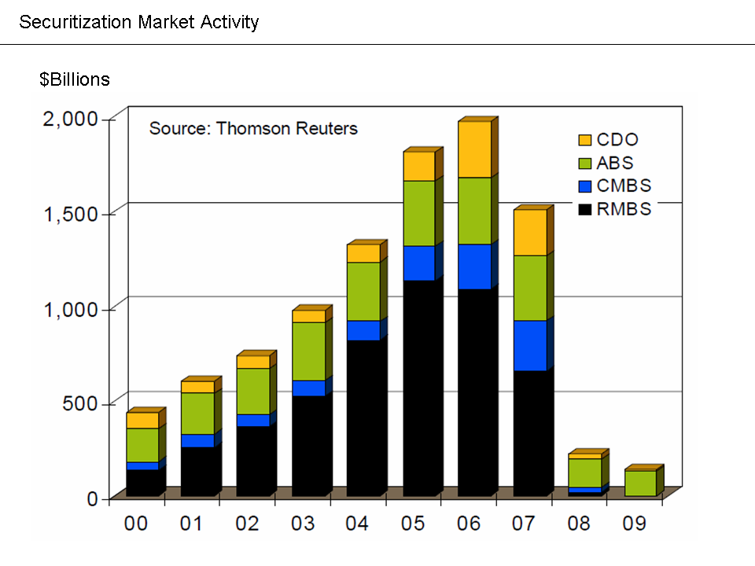

Slide 4
The Three Pillars of the financial crisis (THE DOOMSDAY MACHINE)
a. First, bad paper was widely written in the form of sub-prime mortgages.
b. Second, these mortgages were securitized; the securities, endorsed by egregious evaluations by ratings agencies and marketing by financial institutions, were pushed to investors around the world (Lots of Extra Money Floating Around due to World Economic Development in the 1990s).

Slide 5
c. Third, the securities – mainly RMBS’s -- insured by credit default swaps. AIG was the dominant insurer. SECURITIZATION – These securities were used [ALONG WITH MANY OTHER SECURITIES] as collateral in the shadow banking system.
d. The three pillars promoted a housing market bubble.

Slide 6
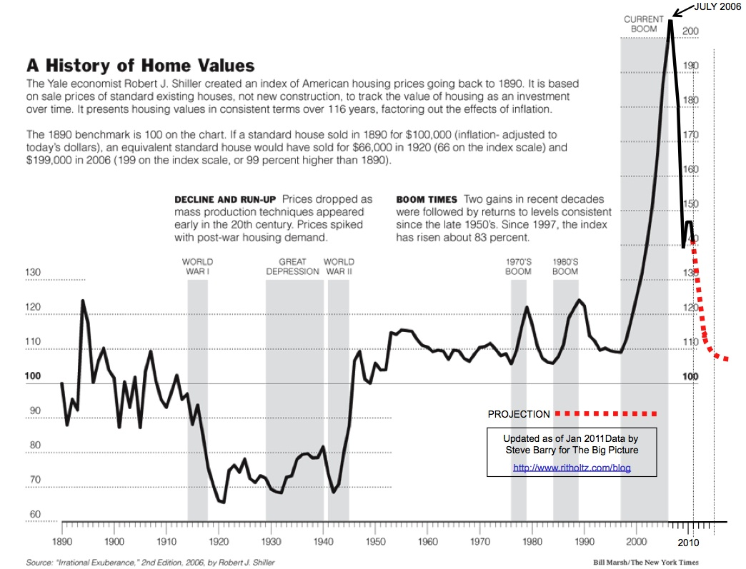

Slide 7
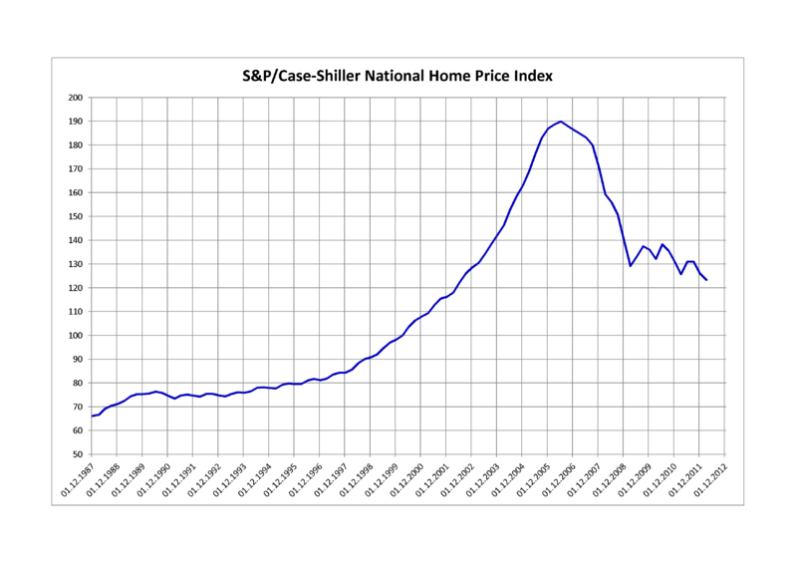

Slide 8
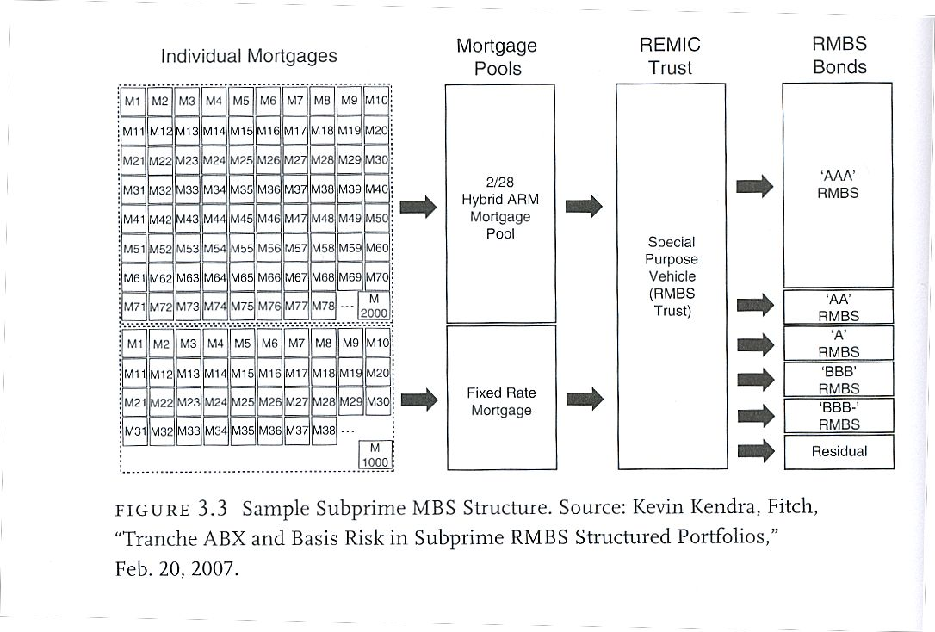

Slide 9
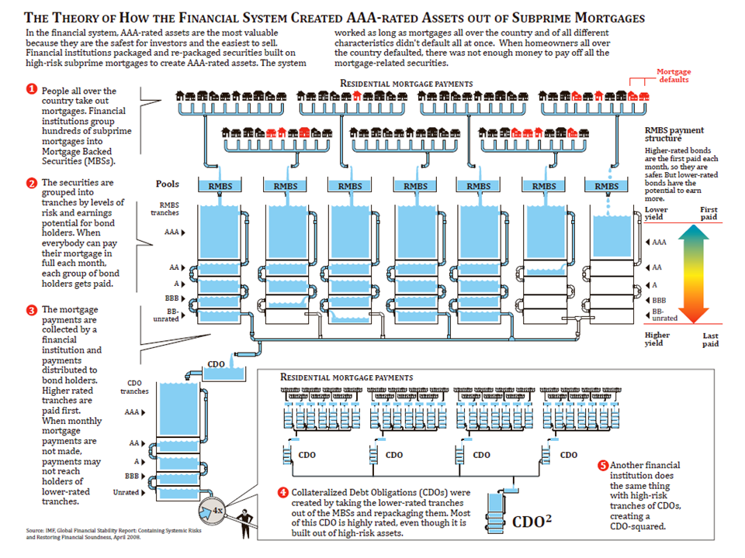

Slide 10
1. Securitization, plus … 2. Huge World Capital Surplus produced … The Shadow Banking System

Slide 11
Securitization and the Shadow Banking System
These securities (along with many other securities – private & Fannie Mae and Freddie Mac) were used as collateral in the Shadow Banking System.
Sale and Repurchase Market (“REPO”) – The essence of “Shadow” Banking. Shadow Banks (1) do not take deposits; (2) provide credit and liquidity; (3) no access to central bank funding or the FDIC.

Slide 12
“REPO” Market
This Market only works if you have access to Collateral that is seen as “Good as Gold.”
The Collateral must be SAFE – so safe that you do not have to worry about it or make much of an effort to investigate it.

Slide 13
Timeline of Deregulation of Financial Markets
1978 | Supreme Court deregulates consumer interest rates on credit cards; Maine allows entry of out-of-state banks. Similar laws passed in all states except Hawaii by 1992.
1980 | Depository Institutions Deregulatory and Monetary Control Act. Eliminates regulation of interest rates.
1982 | Garn–St. Germain Act. Allows for adjustable rate mortgages and interstate acquisitions of troubled banks.
1983 | Federal Reserve, bank holding companies can acquire discount securities brokers.
1984 | Secondary Mortgage Market Enhancement Act. Facilitates private issuance of mortgage-backed securities. Preemption of state regulation.
1987, 1989, 1996 | Fed expands securities underwriting capacity of banks.
1989 | FIRREA passed to resolve savings and loan crisis, weak regulatory structure implemented.

Slide 14
1994 | Riegle-Neal Interstate Banking and Branching Efficiency Act of 1994. Interstate acquisitions and branching permitted.
1999 | Gramm-Leach-Bliley Financial Services Modernization Act. Repeals Glass-Steagall separation of investment and commercial banking.
2000 | Commodity Futures Modernization Act. Deregulates derivatives markets. American Homeownership and Economic Opportunity Act.
2003 | American Dream Down payment Assistance Act.
2004 | SEC allows investment banks to expand leverage.
2005 | Congressional impasse on predatory lending. Republicans seek to eliminate state regulation, Democrats seek stronger regulation.

Slide 15
Timeline of Minority and Low-income Housing Legislation
1977 | Community Reinvestment Act. Bans redlining. Used to increase -low-income loans of banks seeking merger approval.
1990 | Cranston-Gonzalez National Affordable Housing Act (the HOME Investment Partnerships Act).
1992 | Housing and Community Development Act—Section VIII: Federal Housing Enterprises Financial Safety and Soundness Act. Lowered down-payment requirements.
1996 | Housing Opportunity Program Extension Act of 1996.
2000 | American Homeownership and Economic Opportunity Act.
2003 | American Dream Down Payment Assistance Act.

