Slide 1
Topic 2. Part 4.
Post-Civil War Financial Panics: The Panic of 1907

Slide 2
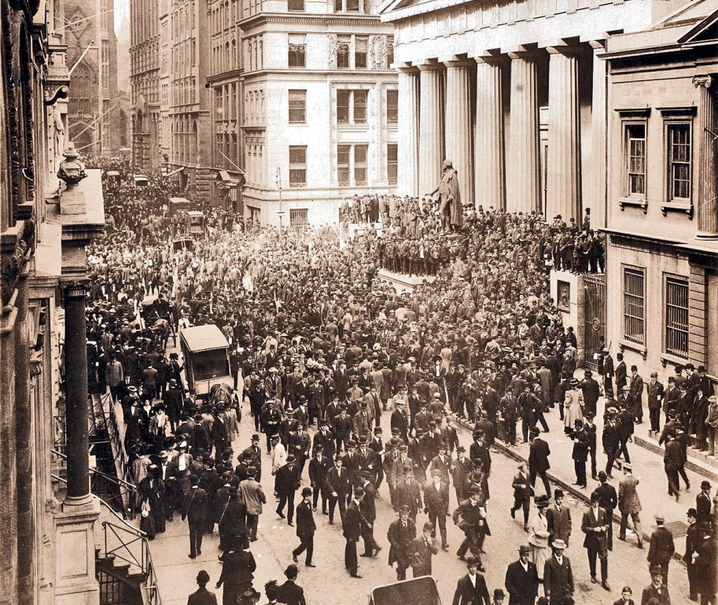
Confined to USA. Bank Runs

Slide 3
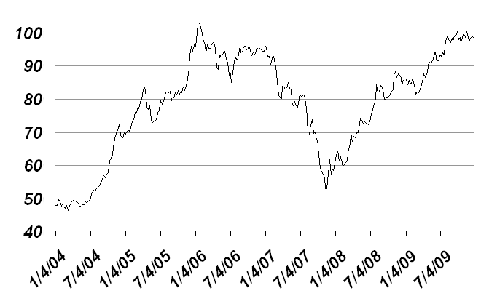
Dow-Jones Industrial Average: 1904 -- 1909

Slide 4
The Panic of 1907 was triggered by the failed attempt in October 1907 to corner the market on stock of the United Copper Company. When this bid failed, banks that had lent money to the cornering scheme suffered runs that later spread to affiliated banks and trusts, leading a week later to the downfall of the Knickerbocker Trust Company—New York City's third-largest trust.

Slide 5
The collapse of the Knickerbocker Trust spread fear throughout the city's trusts as regional banks withdrew reserves from New York City banks. Panic extended across the nation as vast numbers of people withdrew deposits from their regional banks.

Slide 6
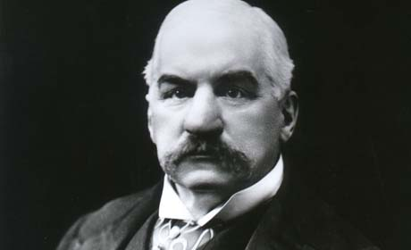
John Pierpont Morgan
17 April 1837 – 31 March 1913

Slide 7
On 19 October 1907 Morgan returned to New York City to see what could be done to stem the panic. On the morning of the 20th the library of Morgan's brownstone at Madison Avenue and 36th St. had become a revolving door of New York City bank and trust company presidents arriving to share information about (and seek help surviving) the impending crisis.

Slide 8
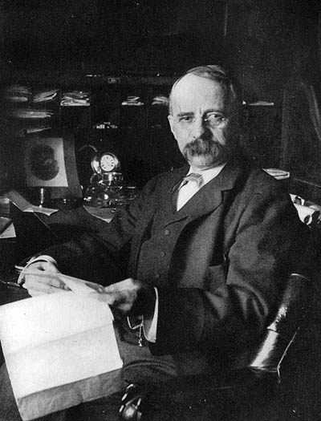
Edward Henry Harriman
20 February 1848 – 9 September 1909

Slide 9
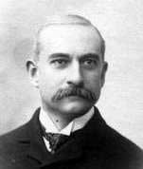
James Jewett Stillman, Head of National City Bank
9 June 1850 – 15 March 1918

Slide 10
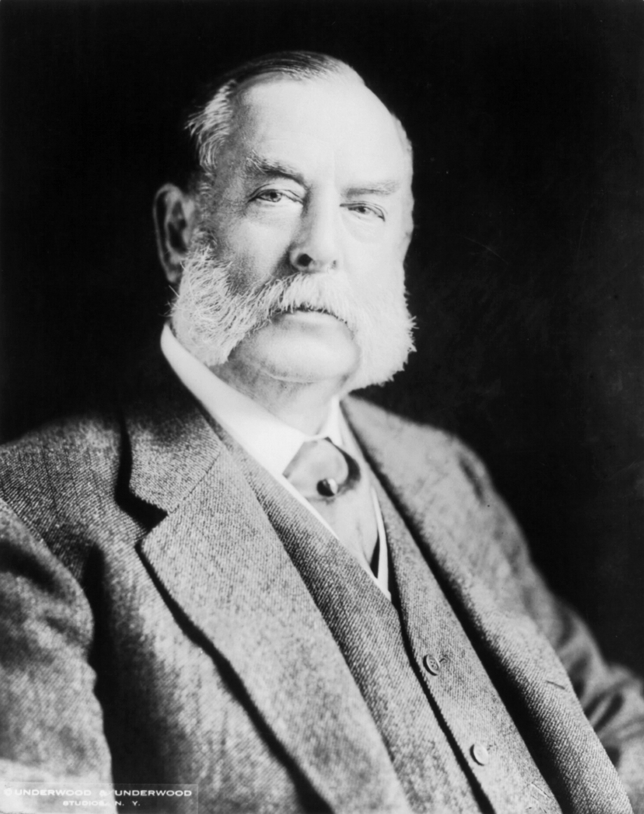
George Fisher Baker
Head of First National Bank of New York City
27 March 1840 – 2 May 1931

Slide 11
Morgan formed a group of talented associates and during Monday through Tuesday Morning (October 22) they examined the books of the Knickerbocker Trust, and decided it was insolvent so did not intervene to stop the run.
Its failure, however, triggered runs on even healthy trusts, prompting Morgan to take charge of the rescue operation. On the afternoon of Tuesday, October 22, the president of the Trust Company of America asked Morgan for assistance.

Slide 12
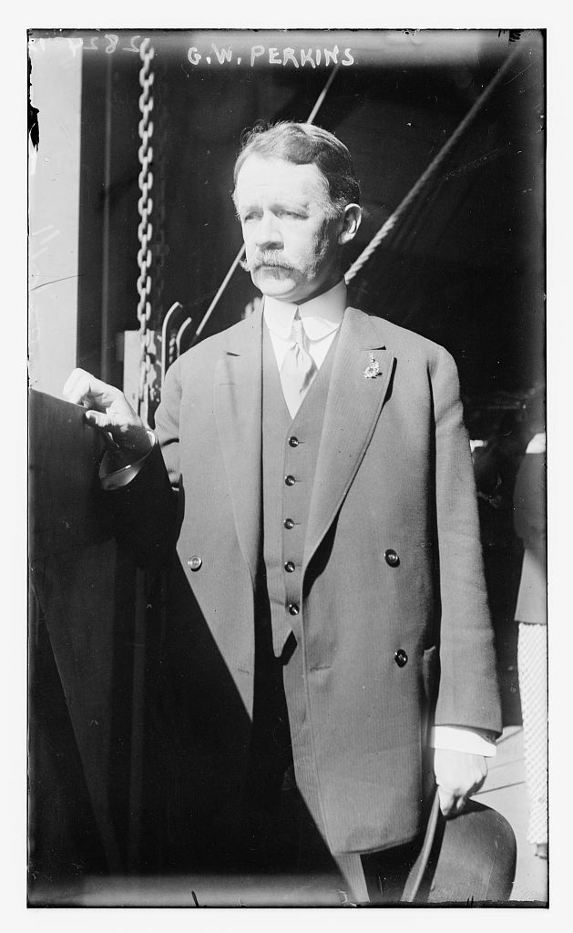
George Walbridge Perkins, Sr.
Top Aide to J. P. Morgan and later a Partner and a Leading Business man
31 January 1862 – 18 June 1920

Slide 13
That evening (October 22) Morgan conferred with George F. Baker, the president of First National Bank, James Stillman of the National City Bank of New York (the ancestor of Citibank), and the United States Secretary of the Treasury, George B. Cortelyou. Cortelyou said that he was ready to deposit government money in the banks to help shore up their deposits. After an overnight audit of the Trust Company of America showed the institution to be sound, on Wednesday afternoon (23 October 1907) Morgan declared, "This is the place to stop the trouble, then."

Slide 14
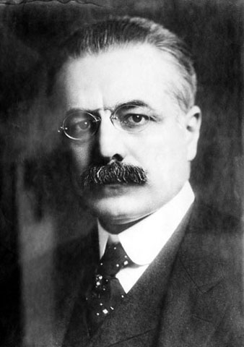
George B. Cortelyou
Secretary of the Treasury 4 March 1907 – 7 March 1909
26 July 1862 – 23 October 1940

Slide 15
As a run began on the Trust Company of America and October 23, Morgan worked with Stillman and Baker to liquidate the company's assets to allow the bank to pay depositors. The bank survived to the close of business, but Morgan knew that additional money would be needed to keep it solvent through the following day. That night he assembled the presidents of the other trust companies and held them in a meeting until midnight when they agreed to provide loans of $8.25 million to allow the Trust Company of America to stay open the next day.

Slide 16
On Thursday morning October 24 Secretary of the Treasury Cortelyou deposited around $25 million into a number of New York banks. John D. Rockefeller, the wealthiest man in America, deposited a further $10 million in Stillman's National City Bank. Rockefeller's massive deposit left the National City Bank with the deepest reserves of any bank in the city.

Slide 17
On Thursday 24 October 1907 a Stock Panic began on the New York Stock Exchange. Brokers’ Loans had dried up and the Exchange was in danger of closing. Morgan summoned the presidents of the city's banks to his office. They started to arrive at 2 p.m.; Morgan informed them that as many as 50 stock exchange houses would fail unless $25 million was raised in 10 minutes.

Slide 18
By 2:16 p.m. on Thursday 24 October 1907, 14 bank presidents had pledged $23.6 million to keep the stock exchange afloat. The money reached the market at 2:30 p.m., in time to finish the day's trading, and by the 3 o'clock market close, $19 million had been loaned out. Disaster was averted. Morgan usually eschewed the press, but as he left his offices that night he made a statement to reporters: "If people will keep their money in the banks, everything will be all right."

Slide 19
Friday 25 October 1907, saw more panic on the exchange. Morgan again approached the bank presidents, but this time was only able to convince them to pledge $9.7 million. In order for this money to keep the exchange open, Morgan decided the money could not be used for margin sales. The volume of trading on Friday was 2/3 that of Thursday. The markets again narrowly made it to the closing bell.

Slide 20
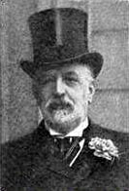
Nathan Mayer Rothschild (Lord Rothschild)
Leading European Banker in 1907
8 November 1840 – 31 March 1915

Slide 21
On Sunday 27 October 1907, Morgan's associate, George Perkins, was informed that the City of New York required at least $20 million by November 1 or it would go bankrupt. The city tried to raise money through a standard bond issue, but failed to gather enough financing. On Monday and again on Tuesday, New York Mayor George McClellan approached Morgan for assistance. In an effort to avoid the disastrous signal that a New York City bankruptcy would send, Morgan contracted to purchase $30 million worth of city bonds.

Slide 22
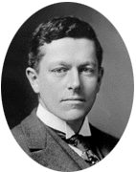
George B. McClellan, Jr.
Mayor of New York City, 1 January 1904 – 31 December 1909
23 November 1865 – 30 November 1940

Slide 23
Although calm was largely restored in New York by Saturday, November 2, yet another crisis loomed. One of the exchange's largest brokerage firms, Moore & Schley, was heavily in debt and in danger of collapse. The firm had borrowed heavily, using shares of the Tennessee Coal, Iron and Railroad Company (TC&I) as collateral.

Slide 24
With the value of the thinly traded stock under pressure, many banks would likely call the loans of Moore & Schley on Monday November 4 and force an en masse liquidation of the firm's stock. If that occurred it would send TC&I shares plummeting, devastating Moore and Schley and triggering further panic in the market.

Slide 25
On Sunday afternoon November 3 and into the evening, Morgan, Perkins, Baker and Stillman, along with U.S. Steel's Gary and Henry Clay Frick, worked at the library to finalize the deal for U.S. Steel to buy TC&I and by Sunday night had a plan for acquisition. But one obstacle remained: the anti-trust crusading President Theodore Roosevelt, who had made breaking up monopolies a focus of his presidency.

Slide 26
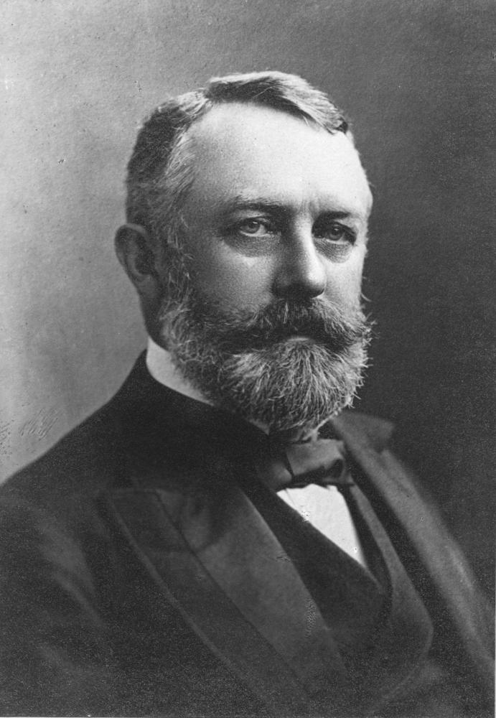
Henry Clay Frick
19 December 1849 – 2 December 1919

Slide 27
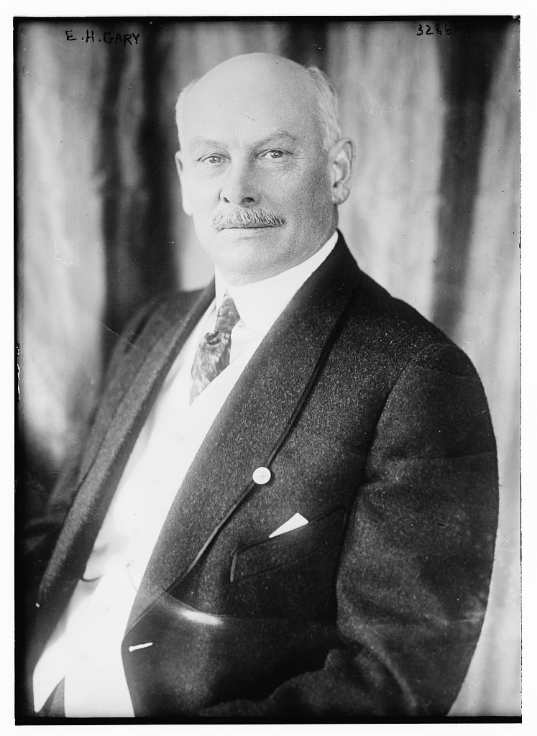
Elbert Henry Gary
Chairman of the Board, U.S. Steel Corporation 1901 – 1904
8 October 1846 – 15 August 1927

Slide 28
Frick and Gary traveled overnight (November 3) by train to the White House to implore Roosevelt to set aside the application of the Sherman Antitrust Act and allow—before the market opened—a company that already held a 60% share of the steel market to make a large acquisition. With less than an hour before the Stock Exchange opened on Monday November 4, Roosevelt and Secretary of State Elihu Root began to review the proposed takeover and appreciate the crash likely to ensue if the merger was not approved. Roosevelt approved just before the exchanges opened, and the crisis was over.

Slide 29
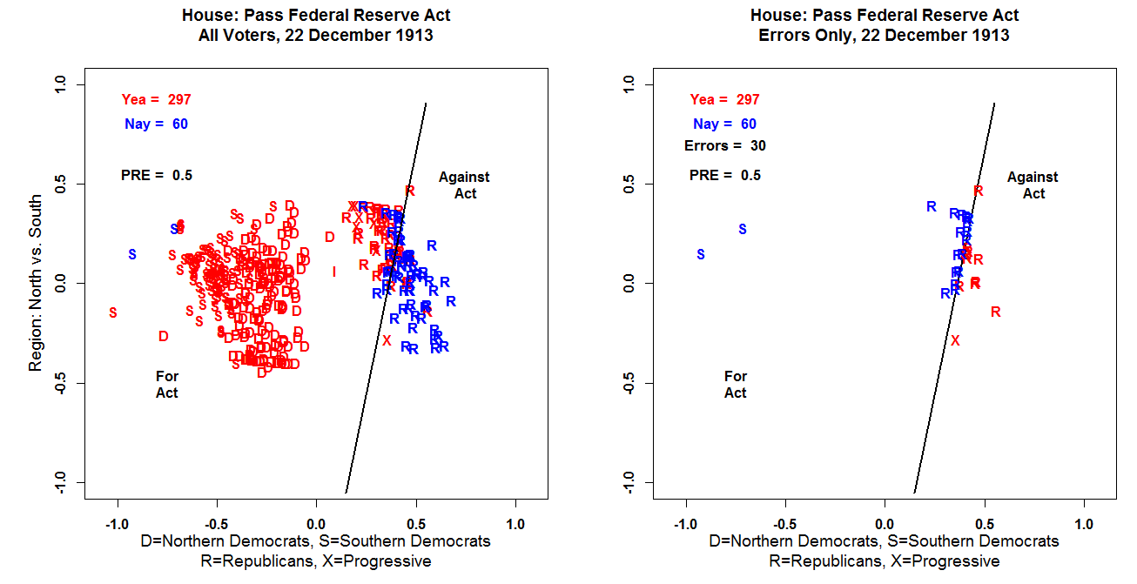

Slide 30
