Slide 1
Topic 2. Part 2.
Post-Civil War Financial Panics: The Panic of 1873

Slide 2
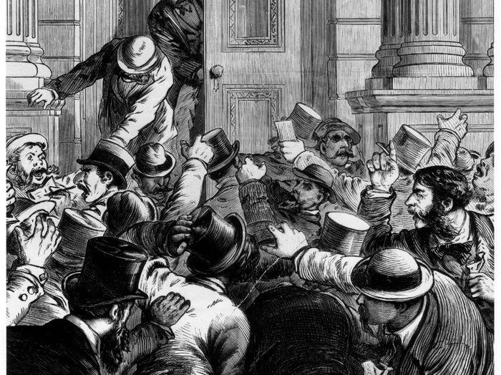
The Panic of 1873
A Bubble in US Railroad Construction and a Bubble in Land in Europe, Bank Runs, and an International Crisis

Slide 3
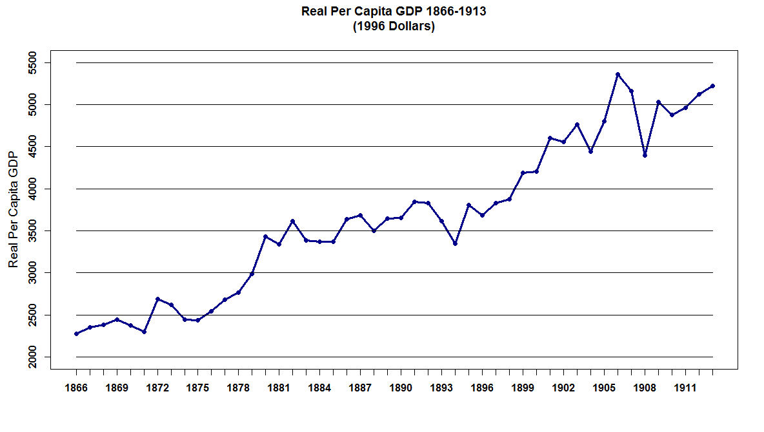

Slide 4
The Panic of 1873 Triggered a Depression in the USA and Europe.
In the USA, the Civil War was followed by a boom in railroad construction. About 33,000 miles of new track were laid across the country between 1868 and 1873 much of which was in the Midwestern Farm belt and the long Transcontinental Railroads built to the West Coast. Much of the craze in railroad investment was driven by government land grants and subsidies to the railroads.

Slide 5
At that time, the railroad industry was the nation's largest employer outside of agriculture, and it involved large amounts of money and risk. A large infusion of cash from speculators caused abnormal growth in the industry as well as overbuilding of docks, factories and ancillary facilities. At the same time, too much capital was involved in projects offering no immediate or early returns. American Economic Historians have dubbed this “Building Ahead of Demand.”

Slide 6
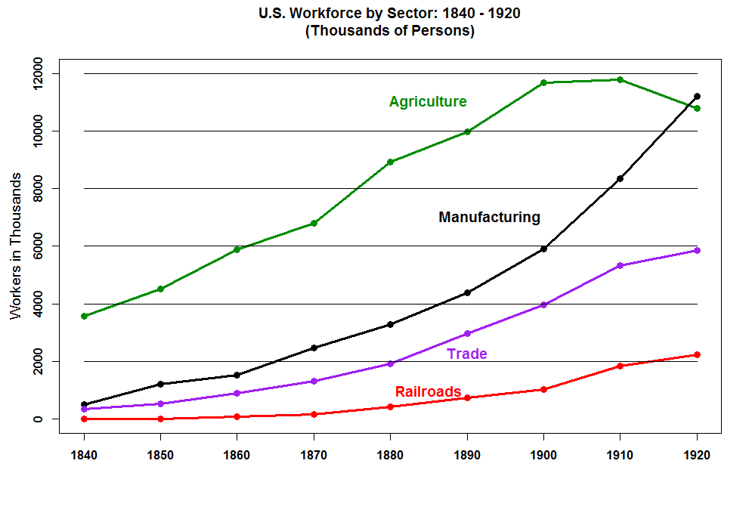

Slide 7
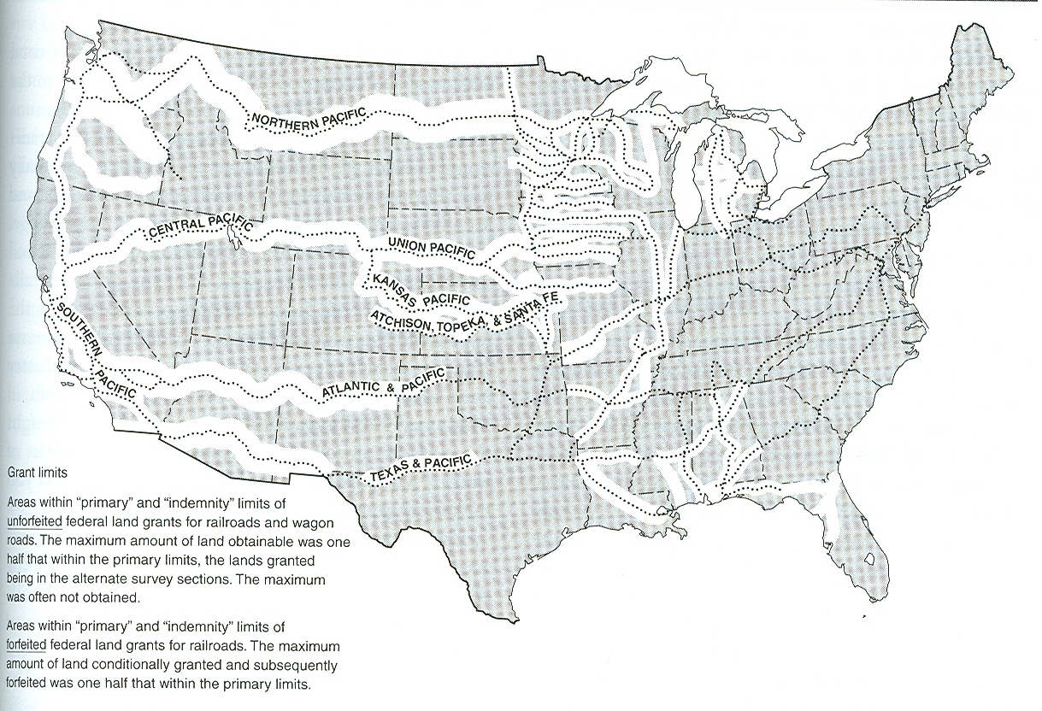

Slide 8
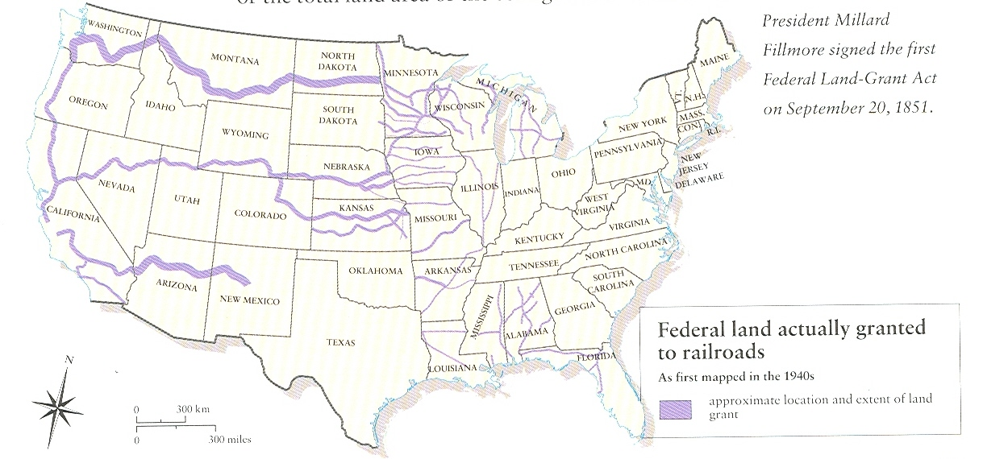
Land Grants Actually Used by the Railroads

Slide 9
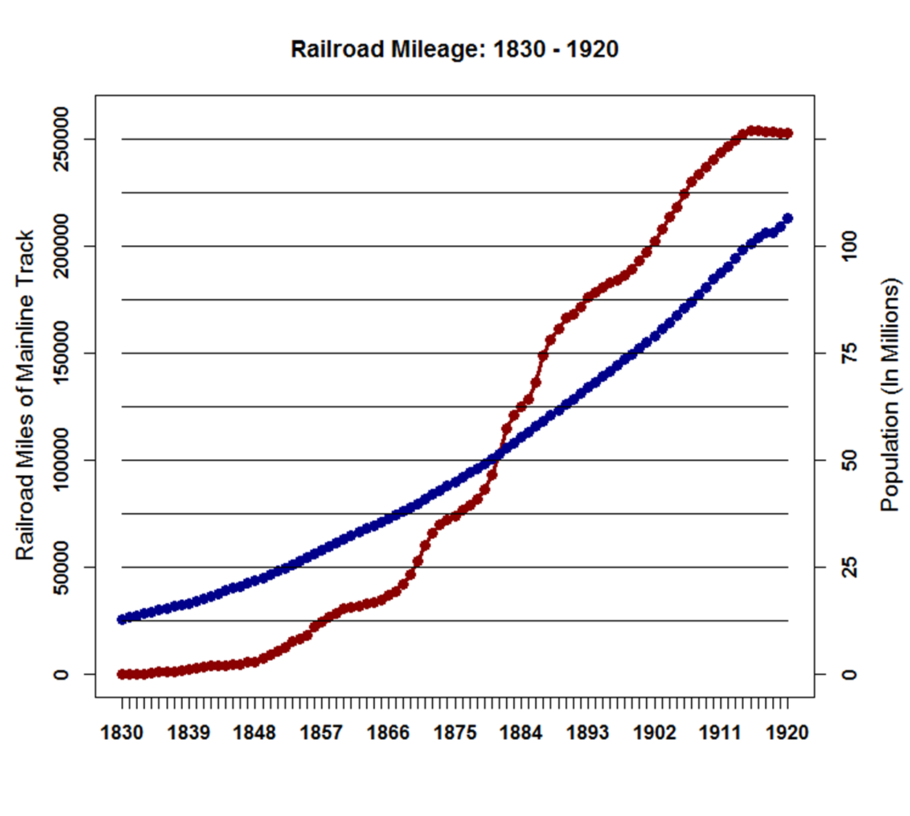

Slide 10
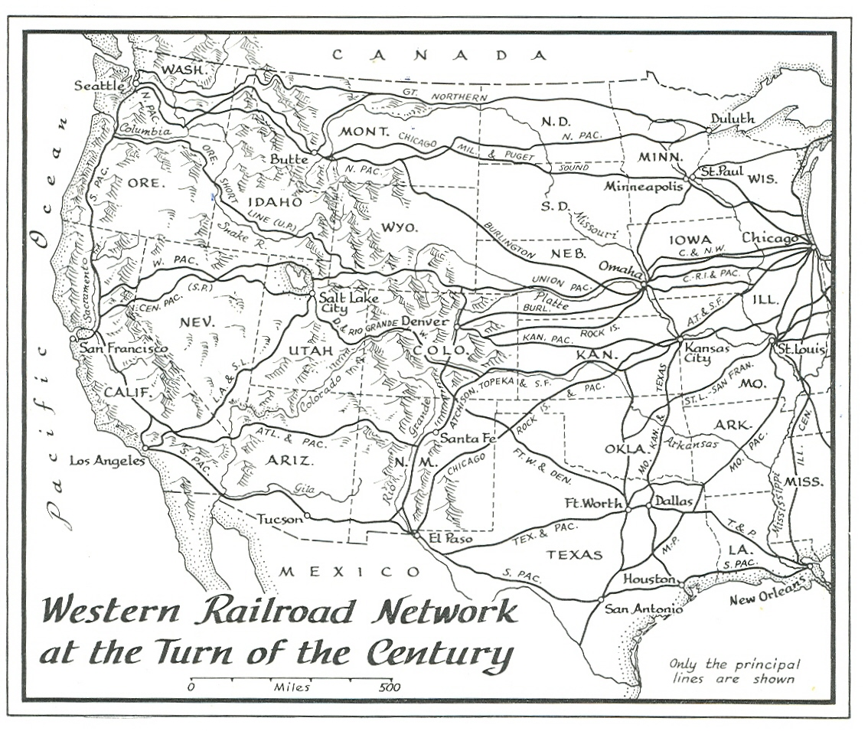

Slide 11
The Panic of 1873 actually began in Europe with a Stock Market Panic in Vienna in May of 1873. In Vienna, Berlin, and Paris there had been a construction boom beginning in the late 1860s. This produced a land bubble in areas of Europe. In 1871, Germany ended the use of silver as a monetary metal. While placing the deutschmark on the "gold standard" instantly increased the value of Germany's money, relative to other currencies, it also meant a rising worldwide supply of silver.

Slide 12
Adding to European economic problems was an influx of cheap American Wheat, Kerosene, and other products which put pressure on the European Economies. British Banks began to hold bank loans causing interest rates to jump sharply throughout Europe.

Slide 13
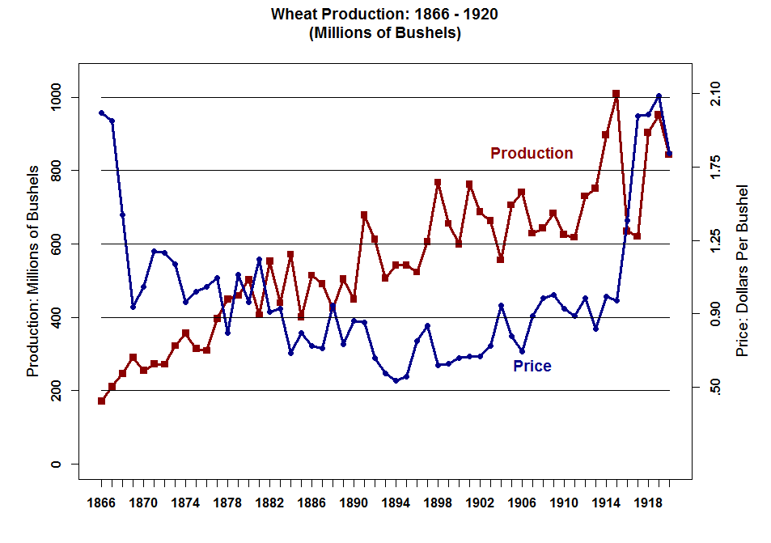

Slide 14
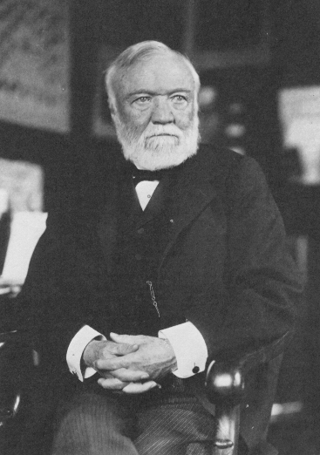
Andrew Carnegie
25 November 1835 – 11 August 1919

Slide 15
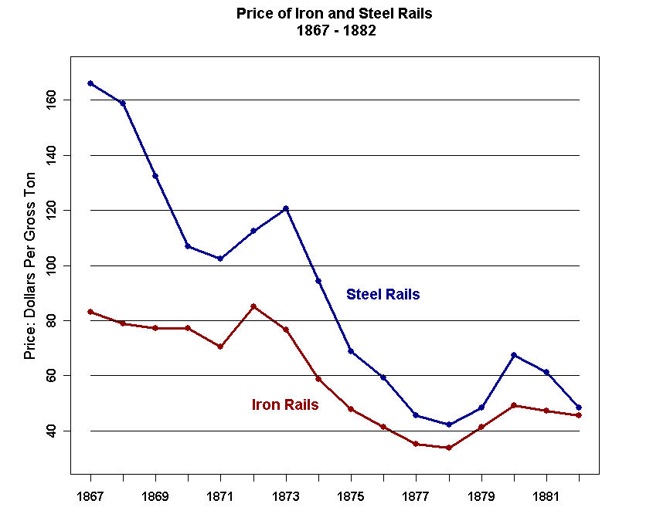

Slide 16
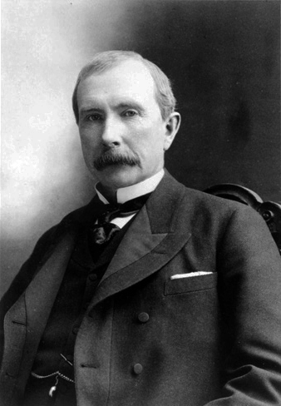
John D. Rockefeller
8 July 1839 – 23 May 1937

Slide 17
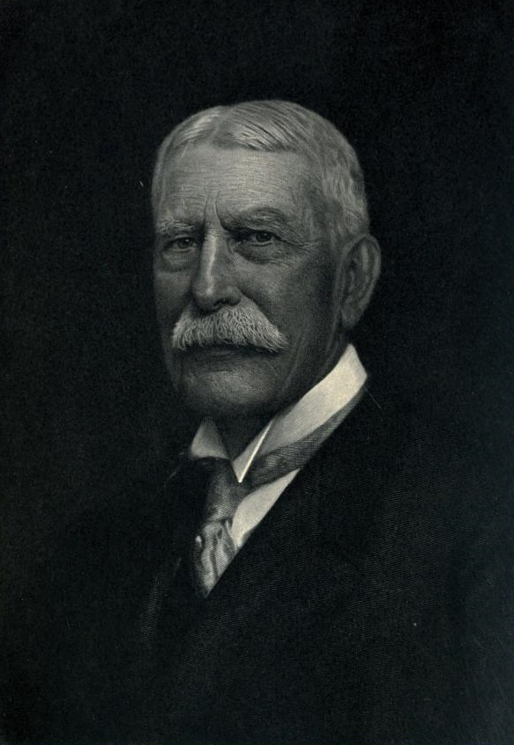
Henry Flagler
2 January 1830 – 20 May 1913

Slide 18
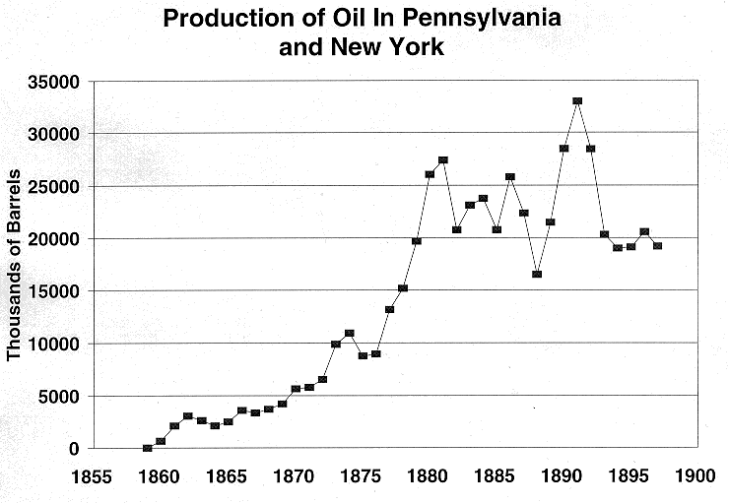

Slide 19
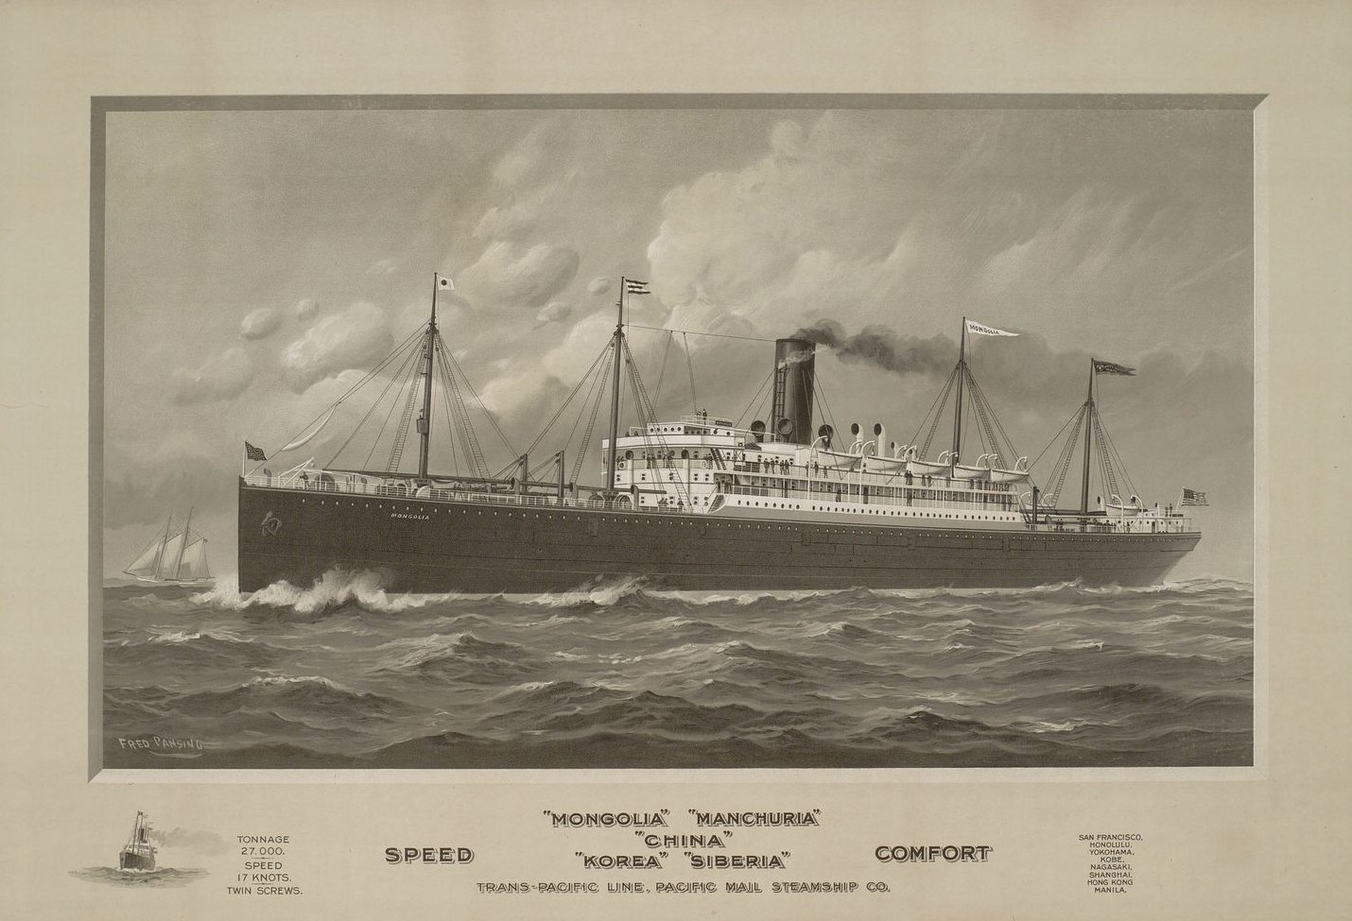
SS Mongolia c. 1875, Twin Screw Driven Propellers, Iron Hulled Steamship

Slide 20
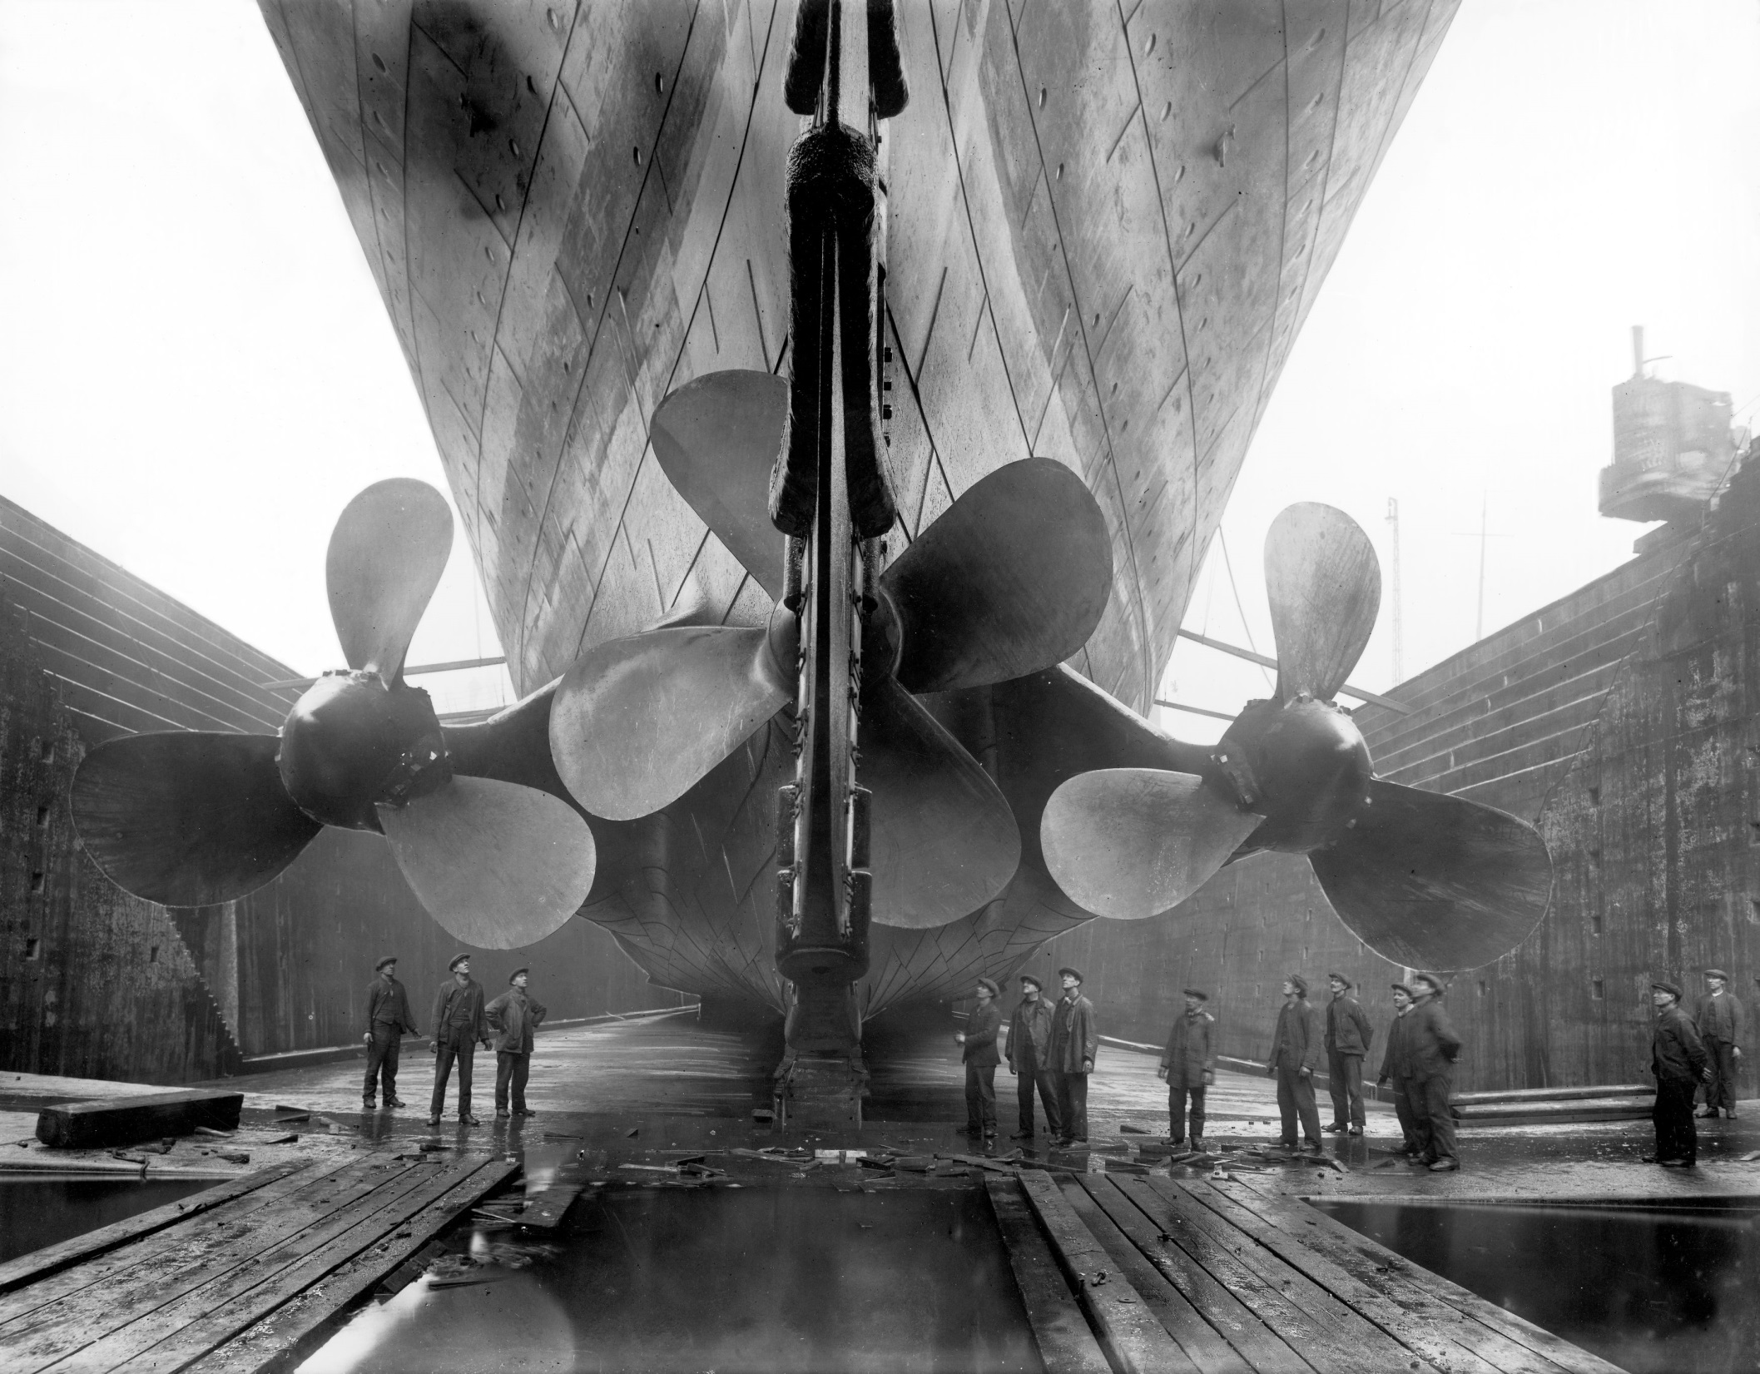

Slide 21
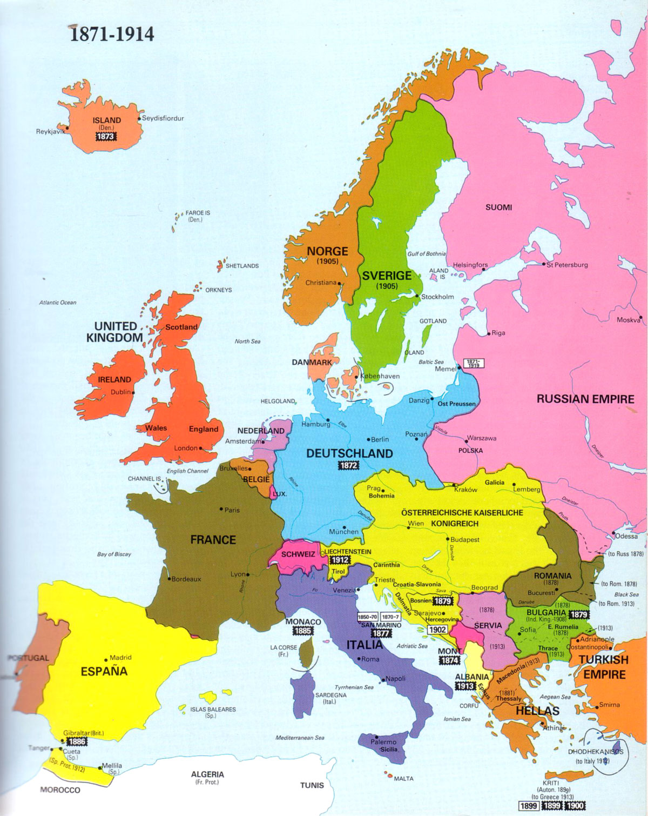

Slide 22
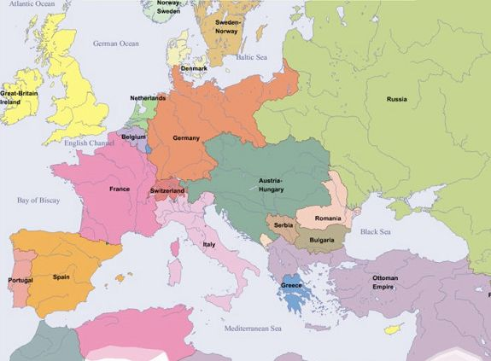
Europe in 1900

Slide 23
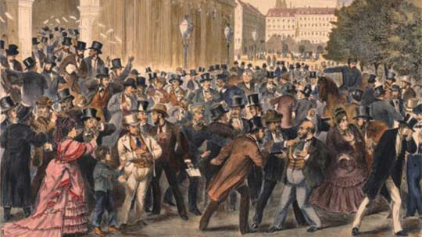
Stock Market Panic in Vienna, Austria
9 May 1873

Slide 24
USA: The investment firm of Jay Cooke and Company went bankrupt in September 1873 as a result of rampant speculation in railroads. The stock market dropped sharply and caused numerous businesses to fail. Bank reserves plummeted in New York City during September and October 1873 from $50 million to $17 million.

Slide 25
Adding to the Problems in the USA is the fact that Silver had been demonetized by an Act of Congress in February, 1873. So like Germany, the USA went to unitary specie Standard – Gold. This later became known as “The Crime of 73”.
  Deflation caused great Political-Economic strain. Debtors, especially farmers, demanded that steps be taken to inflate the money supply mainly through the coining of silver.
  In the 1840s and 1850s Gold was plentiful and Silver relatively scarce.

Slide 26
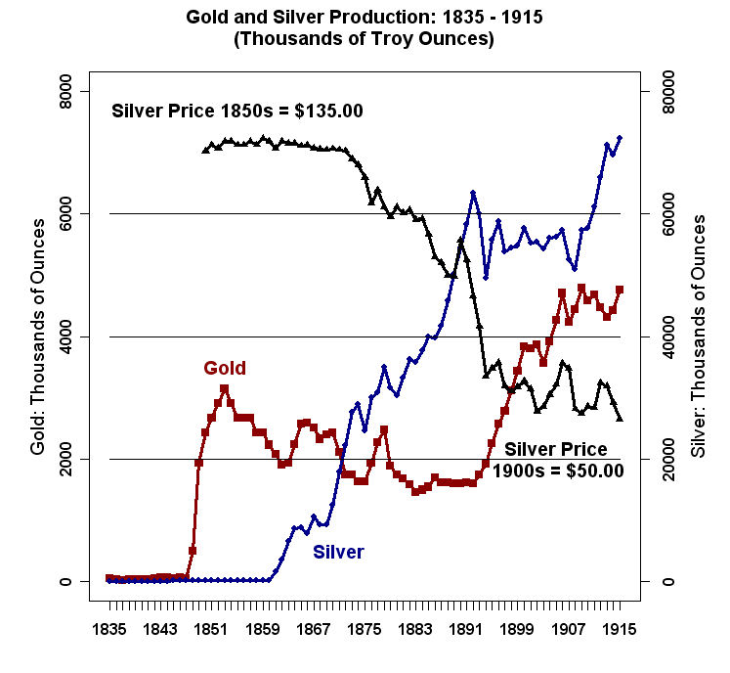

Slide 27
  The "Crime of 73" -- Silver was demonetized by an act of Congress just as the Western mines came on line
  Bland-Allison Act of 1878 -- Passed with the support of a coalition of farmers and mining interests. Obligated the Treasury to purchase $2m to $4m of silver bullion per month and coin it into dollars. Treasury always purchased the minimum amount and the price of silver kept falling.

Slide 28
On “The Crime of 1873”
John Sherman (1823–1900)
(1895)
When the war was over the Republican party sought to restore specie payment as soon as practicable. In March, 1869, it pledged the faith of the nation to payment in coin, or its equivalent, of all bonds of the United States, and to redeem the United States notes at the earliest practical moment in coin.
In order to carry out this pledge it became necessary to revise the various coinage laws of the United States. This was promptly and very carefully done by a bill framed in the treasury department while Mr. Boutwell was secretary. It was thoroughly considered by the events of that department, and was printed and submitted to all persons in the United States who were supposed to be familiar with the coinage laws. The bill, containing sixty-seven sections, accompanied by a mass of information that fills a volume, was sent to Congress, April 25, 1870, by Secretary Boutwell, and its passage was strongly recommended by him.

Slide 29
This bill omitted from the coins of the United States the silver dollar, precisely as was done in 1853, but provided for the coinage of the fractional parts of the dollar in accordance with the act of that year. This bill was pending in Congress for three years, was carefully considered in both houses and special attention was called to the omission of the 412.5 grains silver dollar, which was never in the bill at any stage, and the reason for this omission given. It was finally determined at the urgent request of members from the Pacific coast to insert among the silver coins a trade dollar containing 420 grains of standard silver; but this dollar was made, like the silver coins, a legal tender for $5 only. There was but one yea and nay vote on the bill, and that was on the proposition to repeal the charge made by the mints for the coinage of gold. I voted against this appeal.
The bill passed both houses and became a law February 12, 1873, by practically a unanimous vote of both parties, and was specially supported and voted for by the senators and members from the silver States. This has been called the “Crime of 1873,” and as the bill was under my charge in the Senate I was held to be the chief criminal. It was, in fact, a wise measure of public policy, carefully discussed and considered during three years.

Slide 30
  Sherman Silver Purchase Act of 1890 -- Passed as the result of a deal to get the McKinley Tariff Bill passed. Obligated the Treasury to purchase 4.5m ounces of silver per month (essentially the entire output of the silver mines). The silver bullion was paid for with U.S. Notes. The Notes were redeemable in either gold or silver coin. Because the price of silver was falling relative to gold, the arbitrage opportunity was too good to pass up: Sell silver to get the notes; cash the notes for gold; use gold to buy silver; etc.

Slide 31
  Sherman Silver Purchase Act repealed in 1893. The Depression and the outflow of gold came very close to bankrupting the U.S. Government.
  Beginning in 1896 the development of the cyanide leaching process and discoveries of gold in the Yukon, South Africa, and Australia produced a sharp increase in the world-wide supply of gold.

Slide 32
