Slide 1
Topic 1. Part 7.
The Political-Economy of Financial Panics and Bankruptcy 1837-1860
Part 3

Slide 2
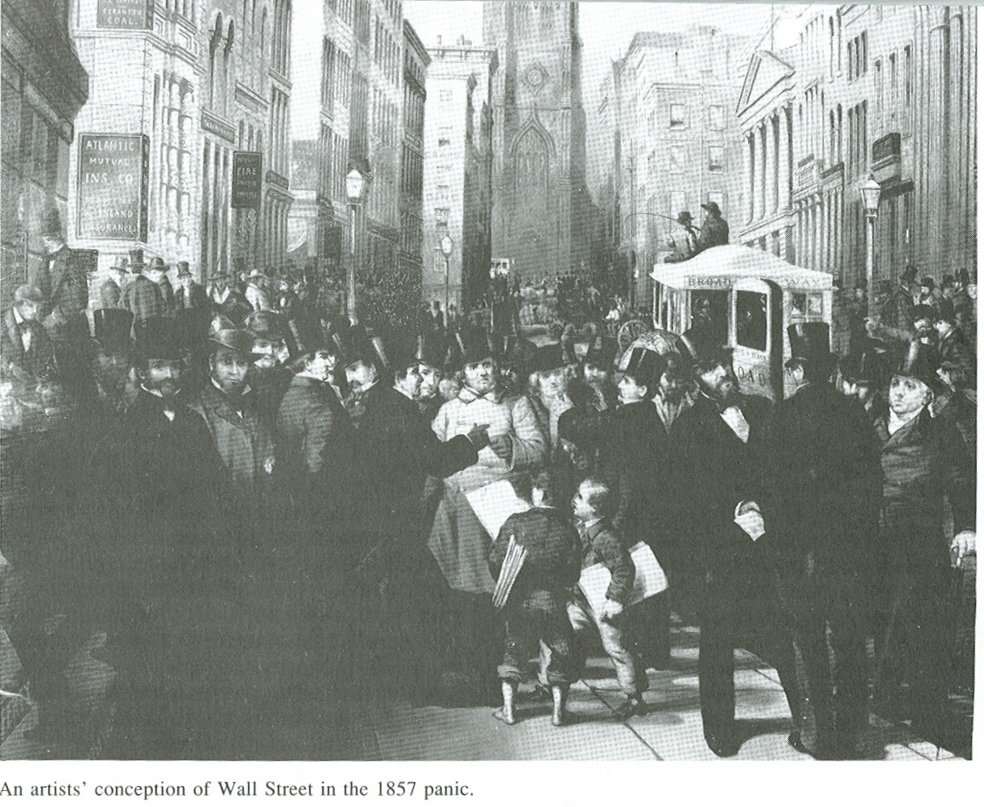
The Panic of 1857: Bank Runs and an International Crisis

Slide 3
The immediate event that touched off the panic in the USA was the failure of the New York branch of the Ohio Life Insurance and Trust Co. on 24 August 1857, a major financial force that collapsed following massive embezzlement. This caused the parent bank to fail in Ohio as well. Because Ohio Life Insurance and Trust Co. did much business in New York City it impacted New York Banks as well.

Slide 4
Hard on the heels of the Ohio Bank failure a number of other difficulties quickly followed:
In England a Number of the “American Houses” experienced great difficulty there. However, an Economic Downturn was already underway in Britain by 1857 due to a complex series of events including the English Government cutting its Expenditures at the end of the Crimean War in 1855.

Slide 5
2) Banking Problems in England spread to the Continent but the problems in Europe were nowhere as severe as those in the United States.
3) British investors erred on the side of caution and removed funds from American banks which raised questions about overall soundness of the American Banks.

Slide 6
4) Grain prices in the USA fell spreading economic misery into rural areas.
5) Manufactured goods began to pile up in warehouses, leading to massive layoffs.
6) The badly over-built USA Railroad system caused a number of railroad failures.
7) Land speculation programs related to the routes of the railroads collapsed ruining thousands of investors.

Slide 7
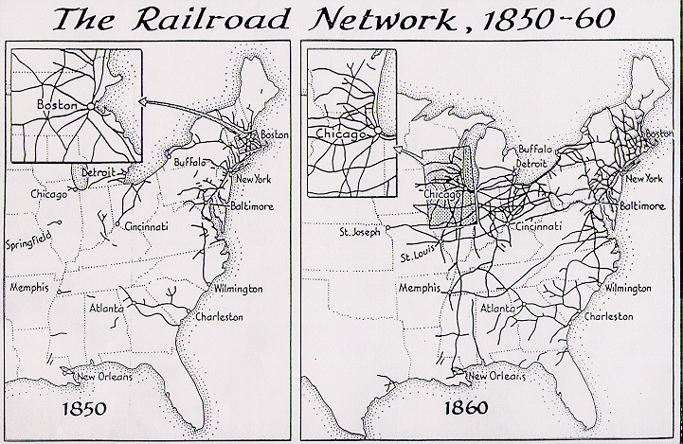

Slide 8
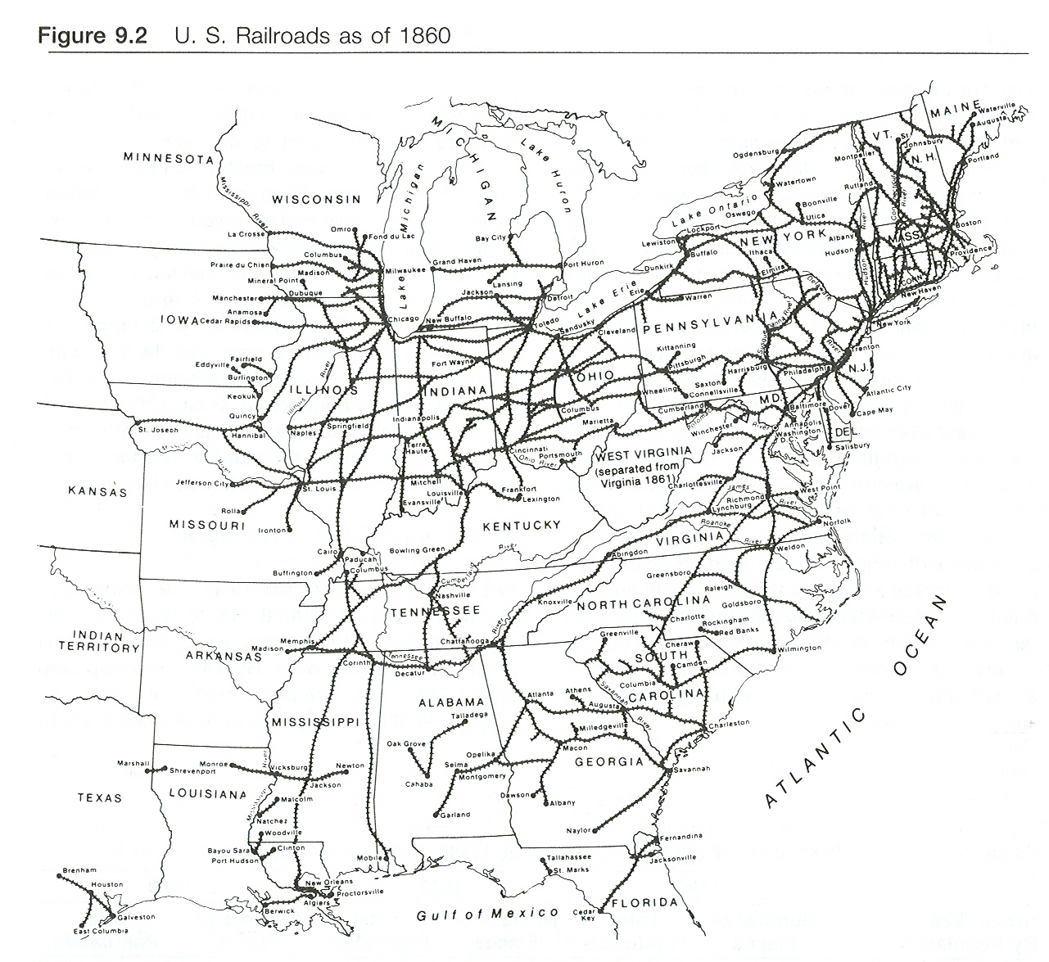

Slide 9
Confidence was further shaken in September when about 30,000 pounds of gold were lost at sea in a shipment from the San Francisco Mint to eastern banks (worth about $500,000,000.00 in todays dollars). The 30,000 pounds of gold aboard the SS Central America was equal to about 20% of the gold held in New York banks at the time.

Slide 10
More than 400 lives were lost as well as public confidence in the government's ability to back its paper currency (US Bonds) with specie. The SS Central America sank during a Category 2 Hurricane 160 miles offshore from Charleston, South Carolina, where the ocean depth is 8,500 feet.

Slide 11
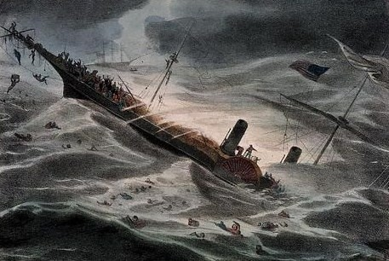
SS Central America, sunk in a hurricane, 12 September 1857

Slide 12

Some of the Gold recovered from the wreck in 1987

Slide 13
In October 1857, a bank holiday was declared in New England and New York in a vain effort to avert bank runs. No recovery was evident in the United States for a year and a half and the full impact did not dissipate until the Civil War.

Slide 14
Political Effects of the Panic of 1857 – It furnished the newly emerged Republican Party with two issues of immense importance in the Presidential Election of 1860 – Free Homesteads (FREE SOIL, FREE MEN) of 160 Acres; and a Higher Protective Tariff -- Economic arguments were used to persuade Northerners--unfair competition from slave labor, Western settlement threatened for free farmers.

Slide 15
The South was largely unaffected by the Panic of 1857 because its Cotton was exported directly to Europe and Southern Planters dealt with European firms that were not affected by the fluctuations of the New York Money markets. This reinforced its faith in KING COTTON.
The South also feared the High Tariffs proposed by the Emerging Republican Party. The Panic of 1857 had the effect of SHARPENING REGIONAL DIFFERENCES.

