Slide 1
Topic 1. Part 6.
The Political-Economy of Financial Panics and Bankruptcy 1837-1860
Part 1

Slide 2
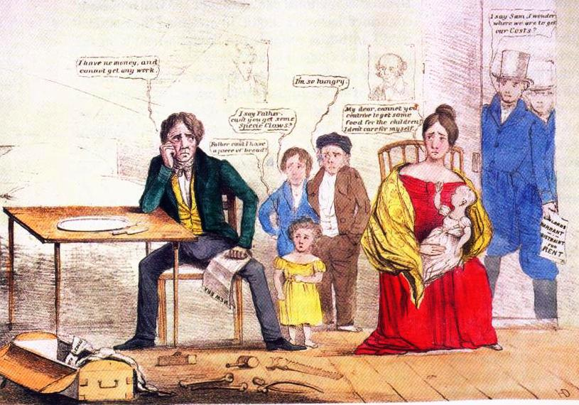
The Panic of 1837
A Land Bubble, Bank Runs, and an International Crisis

Slide 3
The Panic of 1837 was triggered by a combination of factors including the failure of wheat crops in Britain, a collapse in cotton prices, economic problems in Britain, rapid speculation in land in the US, and problems resulting from the variety of currency in circulation in the US. And, last but not least, the BANK WAR between President Andrew Jackson and Nicholas Biddle that contributed to the land and currency problems.

Slide 4
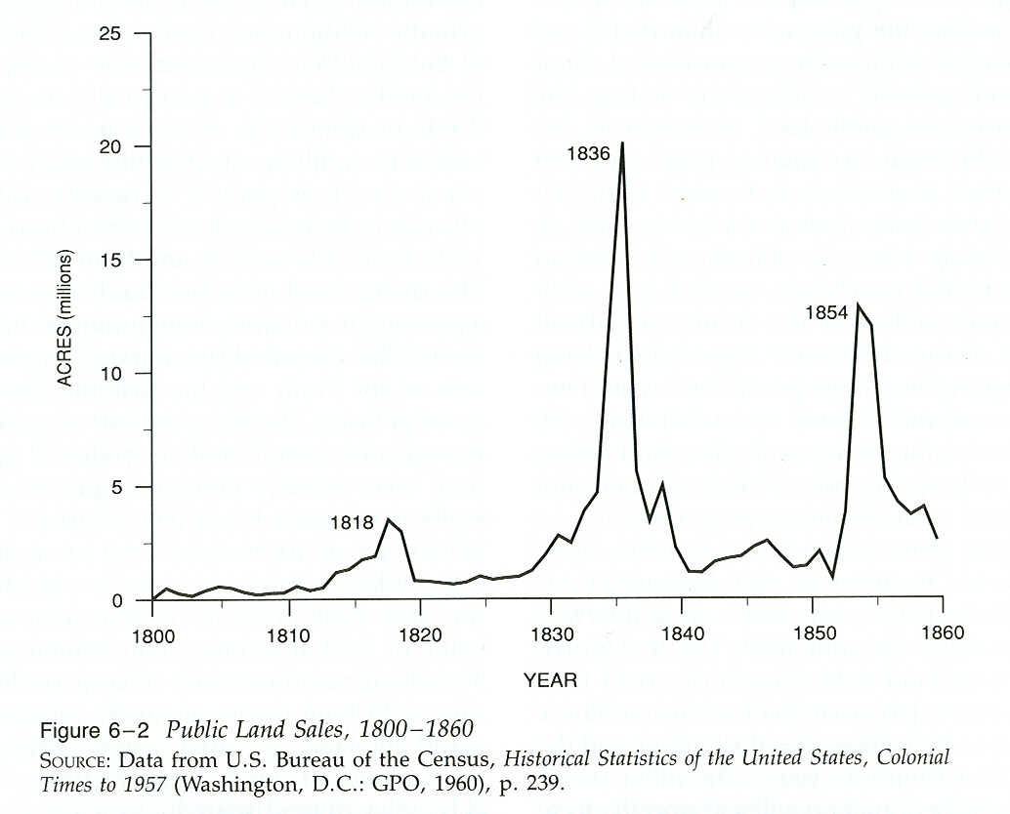

Slide 5
Hammond (p. 1): “The [Second] Bank of the United States-the B.U.S. as Biddle and others often called it-was a national institution of complex beginnings, for its establishment in 1816 derived from the extreme fiscal needs of the federal government, the disorder of an unregulated currency, and the promotional ambitions of businessmen. The bank had an immense amount of private business-as all central banks then had and as many still have-yet it was even more definitely a government bank than was the Bank of England, the Bank of France, or any other similar institution at the time.”

Slide 6
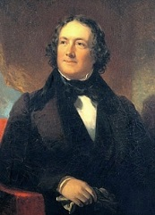
Nicholas Biddle
(8 January 1786 – 27 February 1844)
3rd President BUS 1822-1836 (1839)

Slide 7
On 10 July 1832 President Jackson vetoed a bill to re-charter the 2nd Bank of the U.S. In Jackson's veto message that the bank should be abolished because:
1) It concentrated the nation's financial strength in a single institution,
2) It exposed the government to control by foreign interests,
3) It served mainly to make the rich richer,
4) It exercised too much control over members of Congress,
5)It favored northeastern states over southern and western states.
Banks are controlled by a few select families.

Slide 8
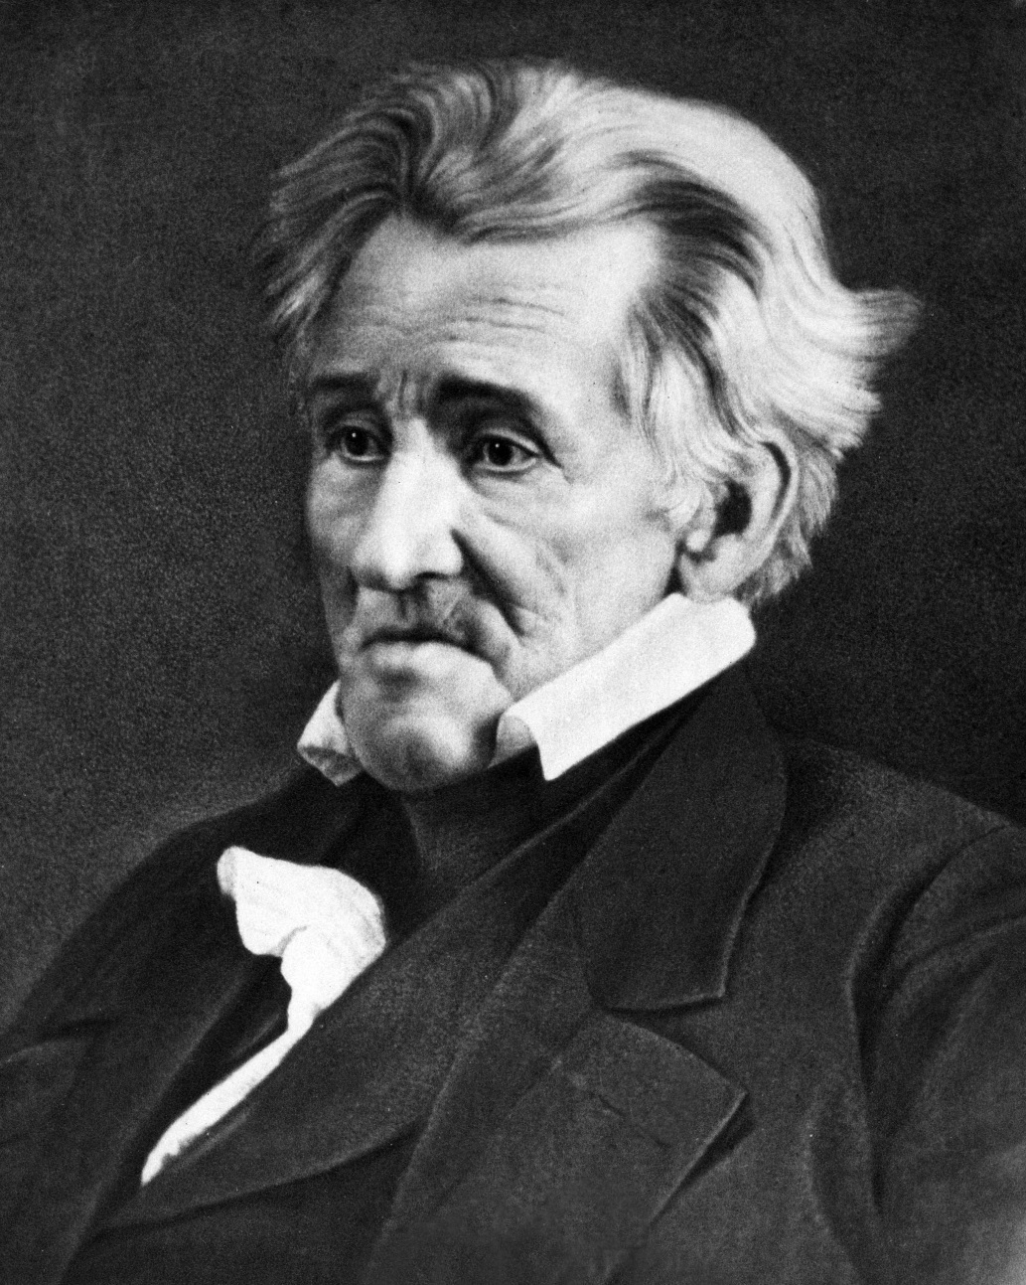
Andrew Jackson, (15 March 1767 – 8 June 1845)
President 4 March 1829 – 4 March 1837

Slide 9
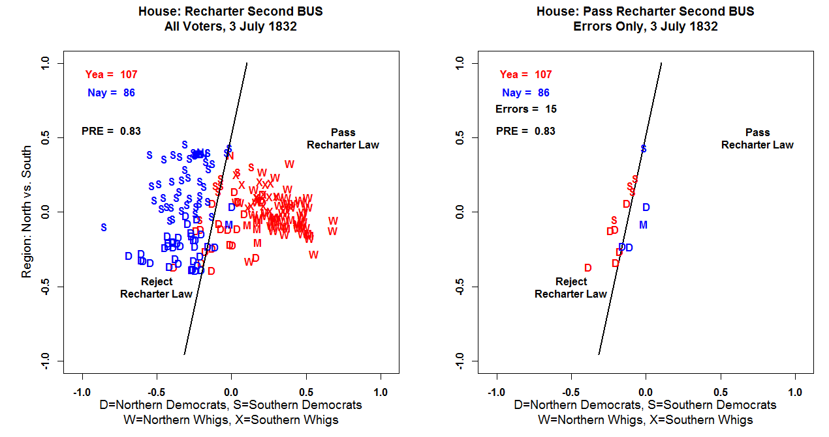

Slide 10
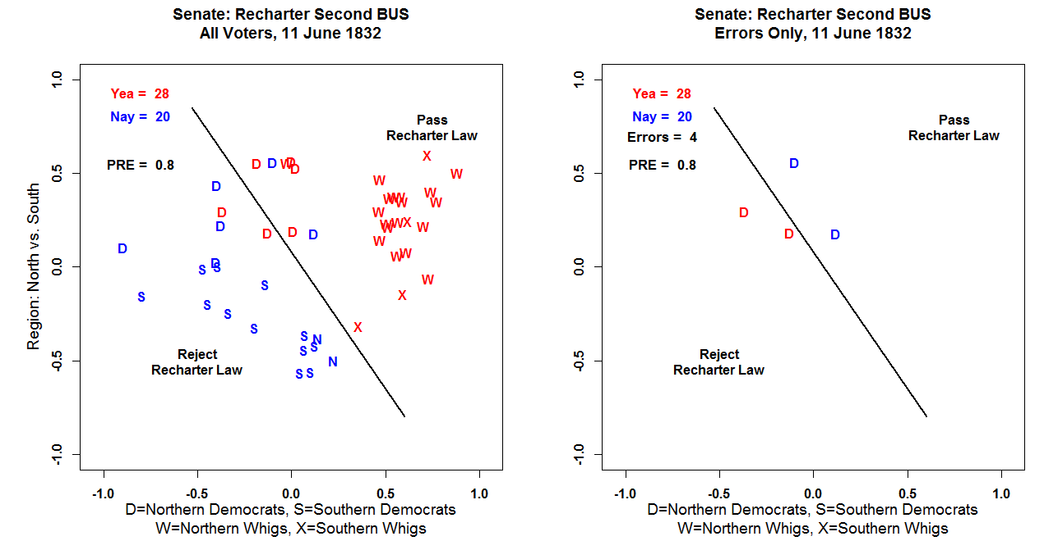

Slide 11
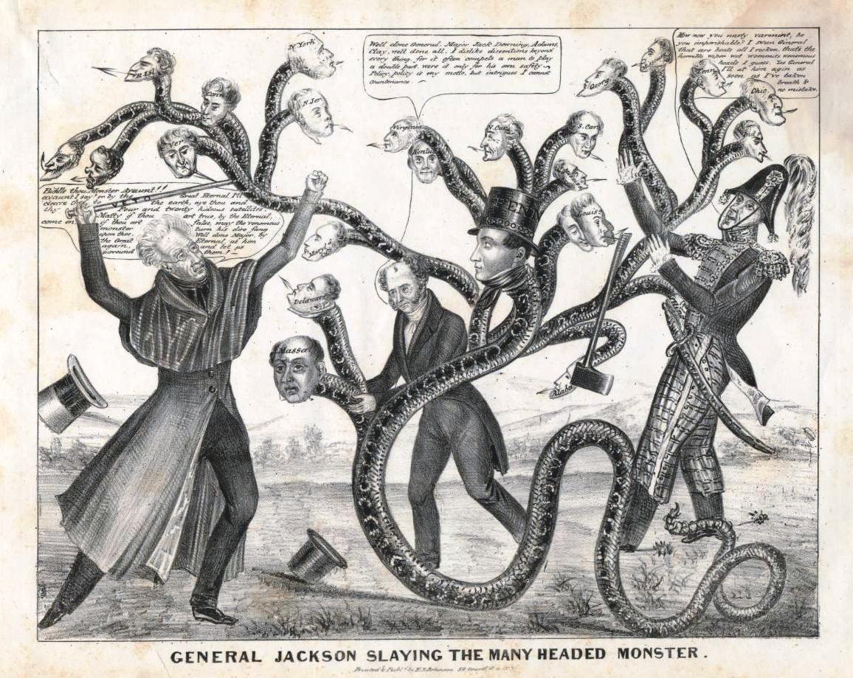

Slide 12
John Gerring (1998): Anti-Jacksons-Whigs-Republicans – valorized work and social harmony; mercantilists – the state had an important role in ensuring economic development; statists – believed in strong government which properly channeled the voice of the masses through institutions rather than direct expression; order – against unrestrained individualism;

Slide 13
Yankee Protestants – believed that human had a responsibility to reform themselves; Nationalists – preeminence of American interests and ideals. Favored aggressive trade policies, internal improvements, and industrial policies to stimulate economic growth.

Slide 14
John Gerring (1998): Democrats: “From 1828 to 1892, Democratic leaders steadfastly defended a pre-industrial economic order, limited government, and the liberties of white people. Forged from the unlikely combination of racism, anti-statism, and civil republicanism, this ideology is most accurately and concisely described as Jeffersonian.” Democrats did not condone slavery – rather, they were pro-White.

Slide 15
“Throughout most of the century, Democratic leaders adopted tight fiscal, currency, and monetary policies: hard currencies (gold and/or silver), balanced budgets, little government borrowing (and quick repayment), low spending and low tariffs.” Democrats opposed the National Bank and Internal Improvements – such policies FAVORED BUSINESS AND THE MERCHANT CLASSES. Democrats opposed Tariffs because they were a TAX (ALSO HURT THE SOUTHERNERS).

Slide 16
Democrats favored state and local government because they saw them as being more under popular control. The Federal Government was remote and should be small and should protect private property. They opposed an activist Federal government. The party was anti-corporate and anti-capitalist – the protector of the common people. “…the economic philosophy of the early Democratic party is perhaps more accurately encapsulated in the terms agrarianism, producerism, or … civic republicanism …”

Slide 17
After he was reelected, Jackson asked Congress to investigate whether or not the BUS was a safe depository for “the people’s money.” The House of Representatives, controlled by the Democrats conducted an inquiry, and submitted a divided committee report (4-3) that declared the deposits perfectly safe. The committee’s minority faction, under Jacksonian James K. Polk, issued a scathing dissent, but the House approved the majority findings on March 1833, 109-46.

Slide 18
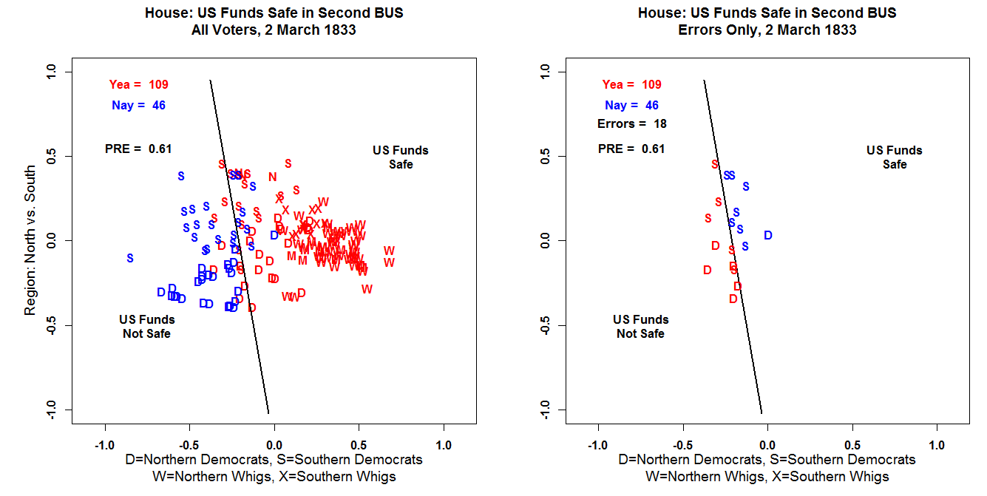

Slide 19
Jackson, infuriated by being rebuffed by the House of Representatives, decided to proceed with the removal of the U.S. deposits in the BUS by executive action alone. Vice-President Martin Van Buren tacitly approved the maneuver, but declined to publicly identify himself with the operation, for fear of compromising his anticipated presidential run in 1836.

Slide 20
Treasury Secretary Louis McLane balked at the removal of the funds, saying that “tampering” with the funds would cause “an economic catastrophe”, and reminded Jackson that Congress had declared the deposits secure. Jackson then “Kicked McLane Upstairs” by making him Secretary of State. In his place he appointed William J. Duane.

Slide 21
Under the Bank charter terms of 1816, the US Secretary of the Treasury was empowered, with Congress, to make all decisions regarding the federal deposits. Treasury Secretary Duane felt that Congress should be consulted to determine the Bank’s fate. Duane was forced out and Attorney General Taney was immediately designated Secretary of the Treasury in order to authorize the transfers to the State Banks.

Slide 22
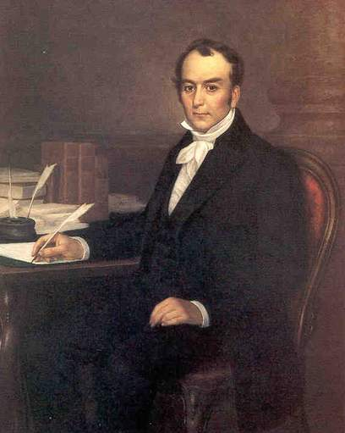
Louis McLane, 28 May 1786 – 7 October 1857.
Treasury Secretary 8 August 1831 – 29 May 1833 (Made Secretary of State)

Slide 23
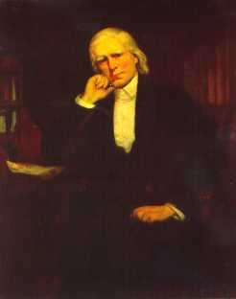
William J. Duane, 9 May 1780 – 27 September 1865
Treasury Secretary 29 May 1833 – 22 September 1833
Dismissed by Jackson

Slide 24
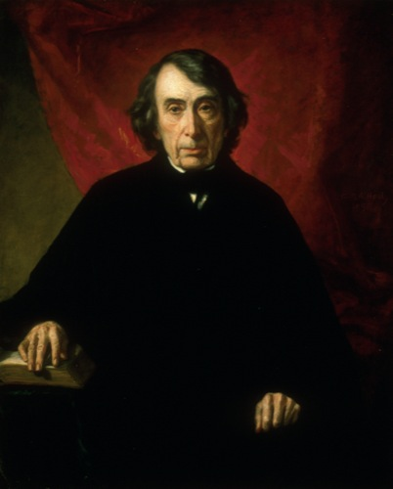
Roger Taney, 17 March 1777 – 12 October 1864
Treasury Secretary 23 September 1833 – 25 June 1834
Succeeded John Marshall as Chief Justice on 15 March 1836

Slide 25
During September 1833, President Jackson issued an executive order that ended the deposit of government funds into the Bank of the United States. After September 1833, these deposits were placed in the state chartered banks, commonly referred to as Jackson’s “pet banks”.

Slide 26
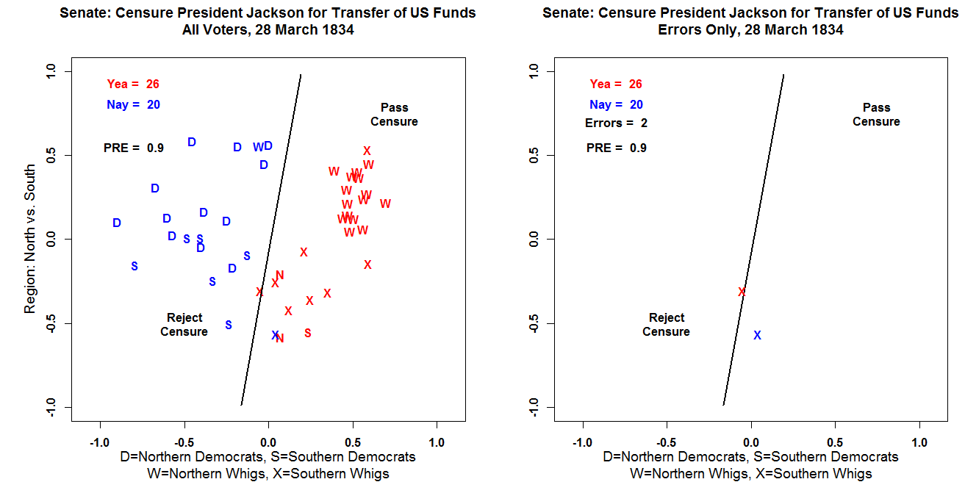

Slide 27
In the 1830s Before the Democratic Party had completely jelled, the Party was Split between Hard Money and Soft Money wings. Many of Jackson’s supporters were Ex-Federalists!

Slide 28
Hammond (p. 6): “There was also a pro-bank, ‘paper-money wing,’ which harbored the Democratic party's less spiritual virtues. Its strength lay with free enterprise, that is, with the new generation of businessmen, promoters, and speculators, who found the old Hamiltonian order of the Federalists too stodgy and confining. These were "Democrats by trade," as distinguished from "Democrats in principle…”

Slide 29
As Jackson withdrew money from the Bank to invest it in other banks, land sales, canal construction, cotton production, and manufacturing initially boomed.
The State Banks, freed of all constraints loaned money on easy terms and the Federal Government poured gasoline on the fire by accepting State Bank notes in payment for Federal Lands.

Slide 30
On 11 July 1836, President Jackson issued and executive order dubbed the Specie Circular backed by his “Hard Money” supporters. After 15 August 1836 the government refused to take anything but gold and silver in exchange for public lands. The executive order did allow for “legitimate” settlers (non-speculators) to use paper Bank Notes until December 1836.

Slide 31
The Specie Circular was an attempt to stop the Speculation in the sale of public lands. A classic Land Bubble! The sale of public lands increased by a factor of five between 1834 and 1836. Speculators paid for these purchases with depreciating paper money. Technically, the Federal Government required that land purchases be completed with specie or paper notes from specie-backed banks. However, a large portion of buyers used paper money from state banks not backed by hard money.

Slide 32
The Panic of 1837 “began May 10 and involved all the banks in the country, about 800 in number, with an aggregate circulation of $150,000,000 and deposits of $125,000,000. It precipitated three distinct monetary programs-one of hard money by the anti-bank administration in Washington, one of easy money by Biddle in Philadelphia, and one of convertibility by the banks of Wall Street under the sage but incongruous leadership of the venerable Jeffersonian, Albert Gallatin.”

Slide 33
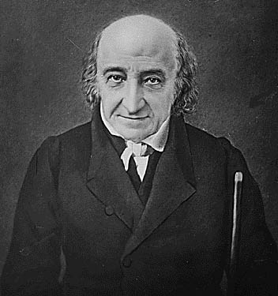
Albert Gallatin 29 January 1761 – 12 August 1849
Treasury Secretary 14 May 1801 – 8 February 1814
Minister to France 16 July 1816 – 16 May 1823
Minister to the U.K. 1 September 1826 – 4 October 1827

Slide 34
The Panic of 1837 was also an international crisis. The Bank of England announced in 1836 that would gradually raise interest rates from 3 to 5 percent. Poor wheat harvests over the previous few years forced Great Britain to import food causing an outflow of specie. Because Britain was the center of the World Financial System this forced other countries including the New York Banks to raise interest rates as well.
Finally, the economic slowdown caused a sharp decline in Cotton Prices and Several States in the Midwest defaulted on their Bonds (used mainly for internal improvements).

