Slide 1
Topic 1. Part 3A.
The Growth of State Banking to 1860

Slide 2
American Economic Development in the 19th Century was driven by the fact that the US was Long on Resources but Short on Population.
This meant that Economic Development was Capital Intensive.
Hence, the need for robust financial markets to finance entrepreneurs, machines, and complex construction projects.

Slide 3
The U.S. economy in 19th Century was unique because:
1) expansion of the economy over space;
2) invention & adoption of capital-intensive technology in transportation, manufacturing, and construction;
3) And by the 1860s (and especially by the 1890s), an integration into one national economy.

Slide 4
This required a ROBUST financial system capable of raising the large sums required to develop all the economic infrastructure required for a rapidly growing population and increasingly sophisticated division of labor.

Slide 5
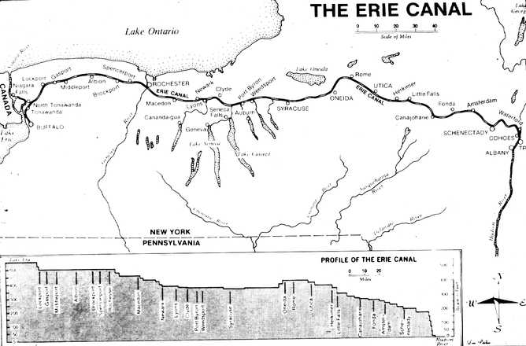

Slide 6
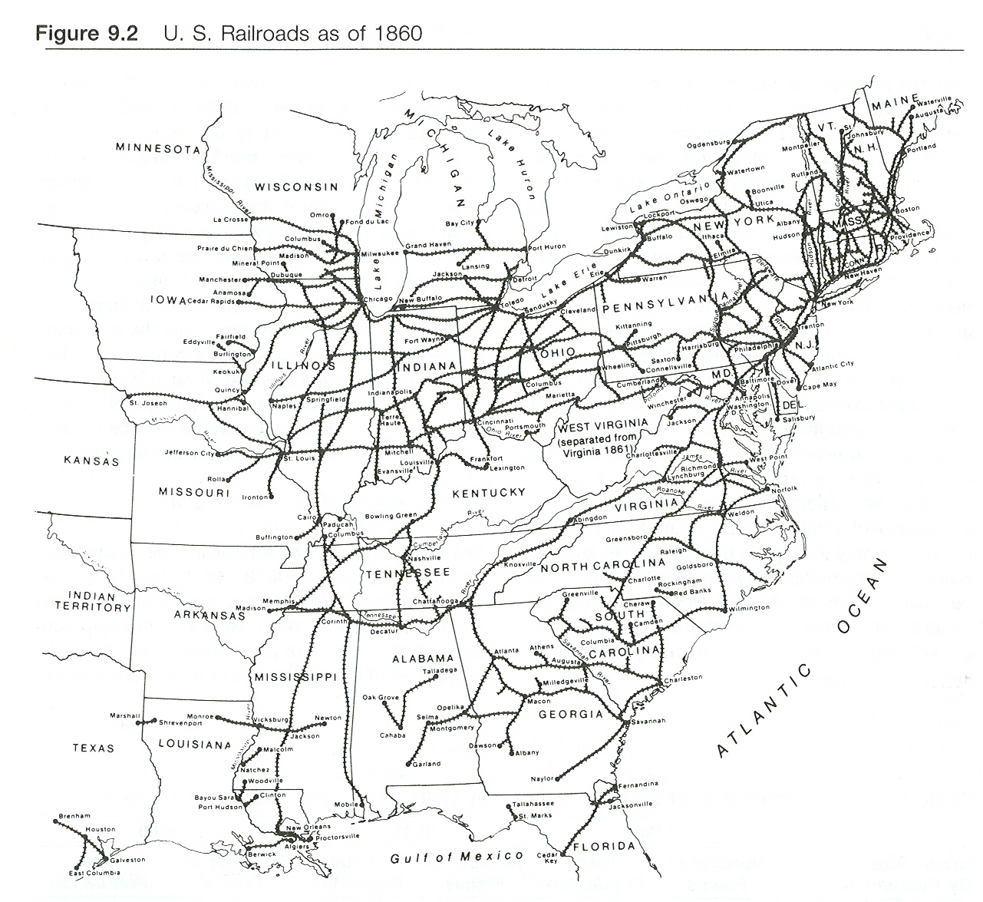

Slide 7
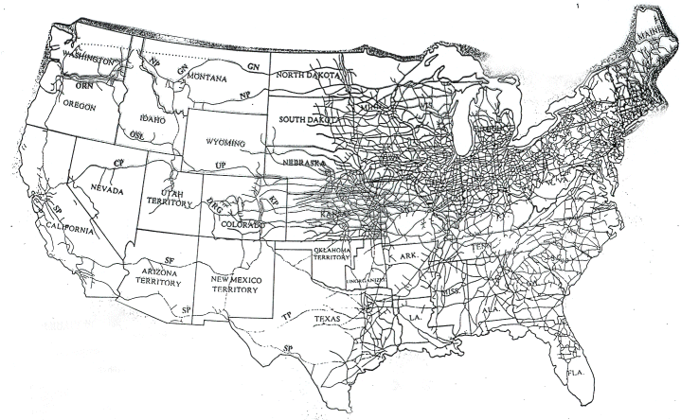

Slide 8
To have a Robust Financial System You Must have Financial Intermediaries
Definition -- FINANCIAL INTERMEDIARY: An entity that acts as the middleman between two parties in a financial transaction. While a commercial bank is a typical financial intermediary, this category also includes other financial institutions such as investment banks, insurance companies, broker-dealers, mutual funds and pension funds.

Slide 9
Financial Intermediaries: Purpose is to "...allocate financial resources efficiently by gathering them from savers and distributing them to the most qualified investors." ... "...banks differ from other intermediaries in that their liabilities also commonly serve as money ... [and] "...under a fractional reserve system of banking, banks are the only private institutions which can create money...“ (Sylla, 1971, Explorations in Economic History)

Slide 10
Wikipedia (edited): Fractional-reserve banking is the practice whereby a bank retains reserves in an amount equal to only a portion of the amount of its customers' deposits to satisfy potential demands for withdrawals. Reserves are held at the bank as currency, or as deposits in the bank's accounts at the central bank. The remainder of customer-deposited funds are used to fund investments or loans that the bank makes to other customers.
THIS HAS THE EFFECT OF INCREASING THE MONEY SUPPLY!

Slide 11
Because Banks Can Create Money Government Must Have a Regulatory Role!
To mitigate the risks of bank or systemic crises, the governments of most countries regulate and oversee commercial banks, provide deposit insurance and act as lender of last resort to commercial banks. The central bank regulates bank credit creation, imposing reserve requirements and other capital adequacy ratios. This limits the amount of money creation that occurs in the commercial banking system, and helps ensure that banks have enough funds to meet the demand for withdrawals.

Slide 12
Rousseau & Sylla: “What the Americans did, uniquely when they did it, was to charter so many banking corporations that they had to compete with one another rather than enjoy monopolistic privileges.”

Slide 13
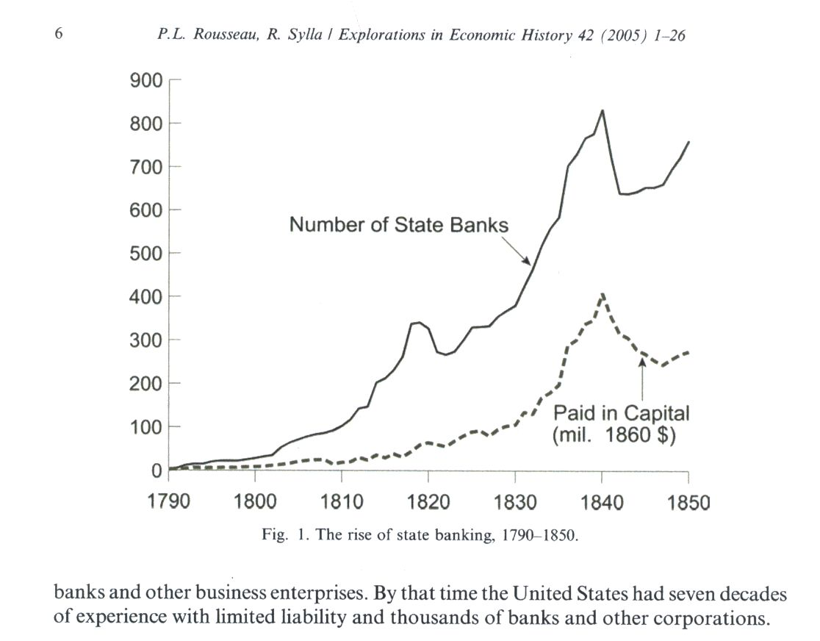

Slide 14
What was unique about the U.S. economy in 19th Century was:
1) expansion of the economy over space;
2) invention & adoption of capital-intensive technology in transportation, manufacturing, and construction;
3) And by the 1860s (and especially by the 1890s), an integration into one national economy.

Slide 15
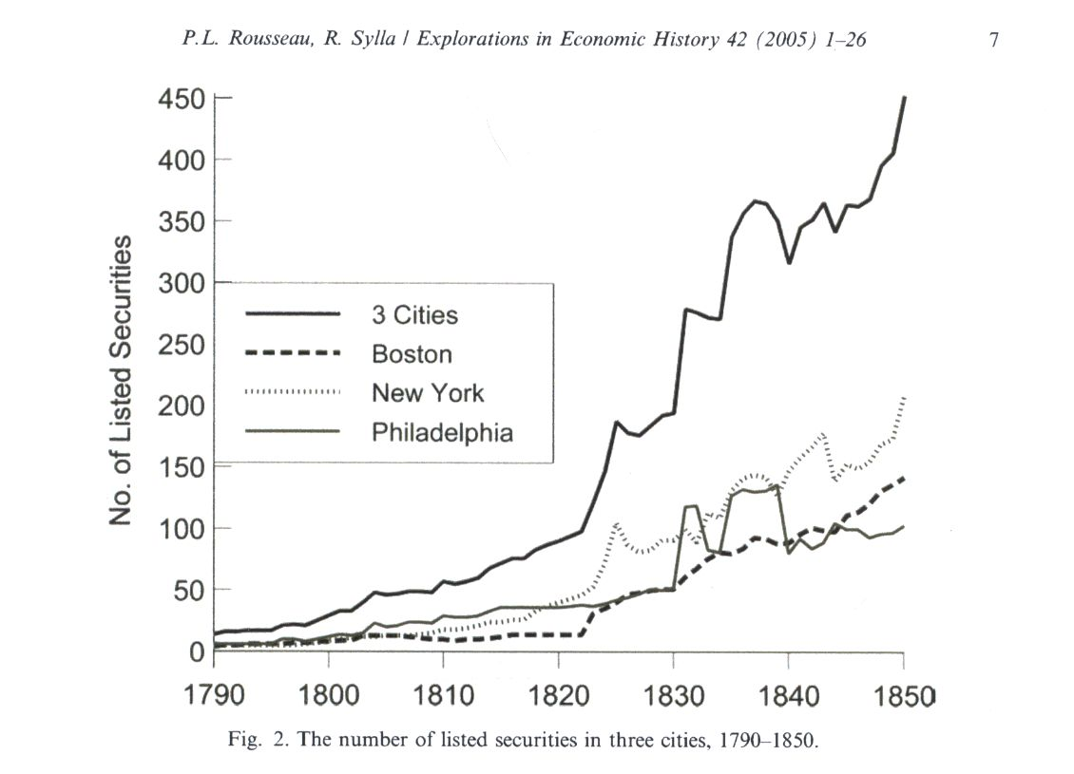

Slide 16
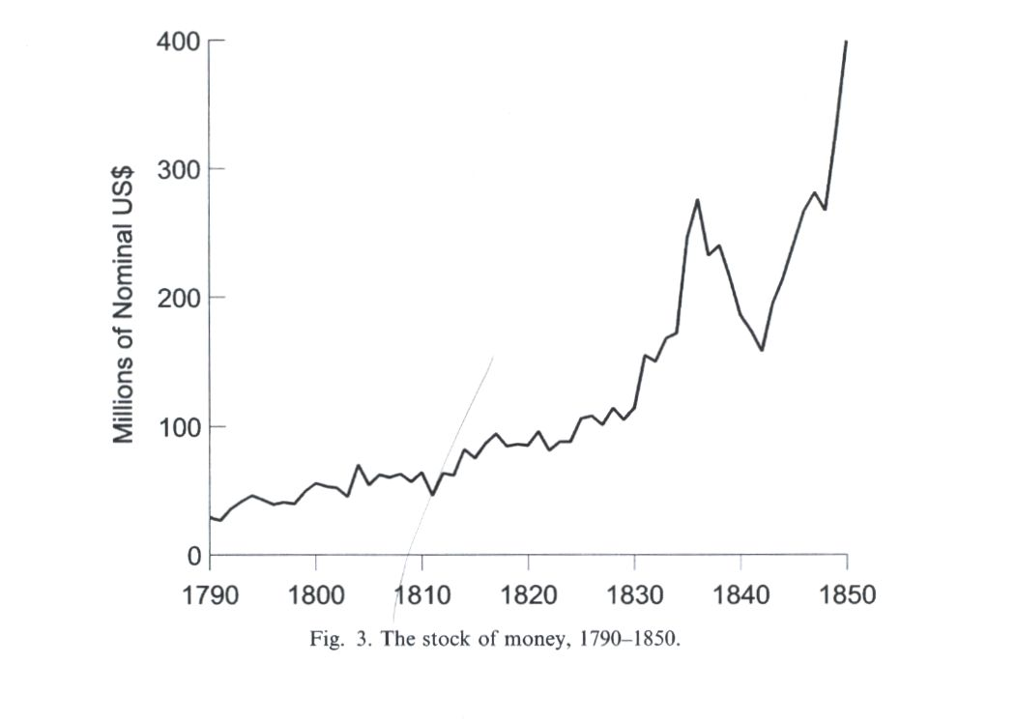

Slide 17
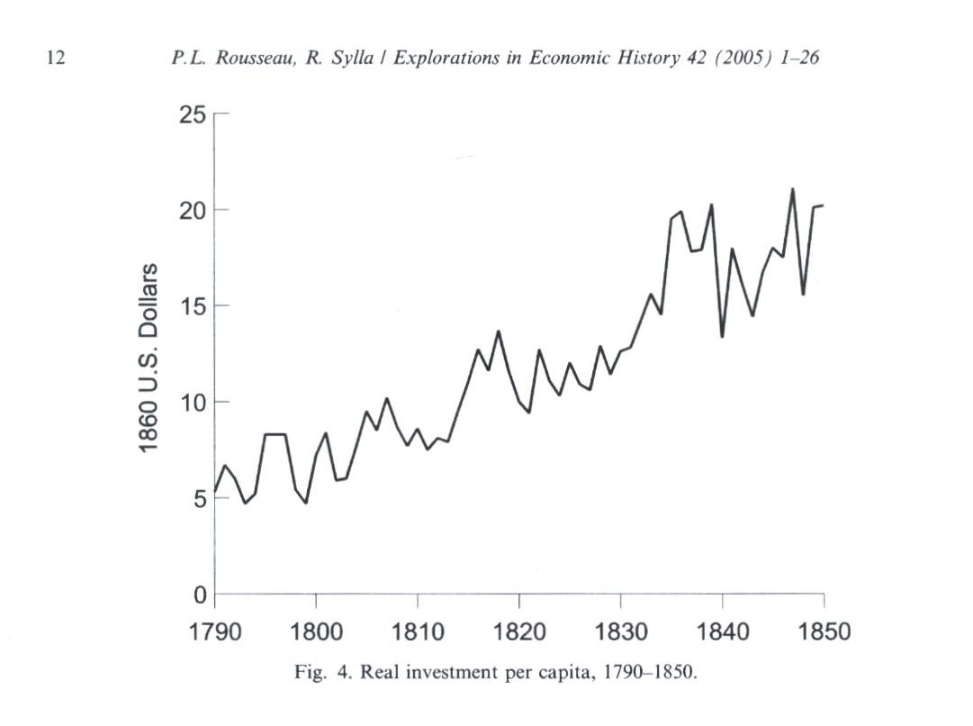

Slide 18
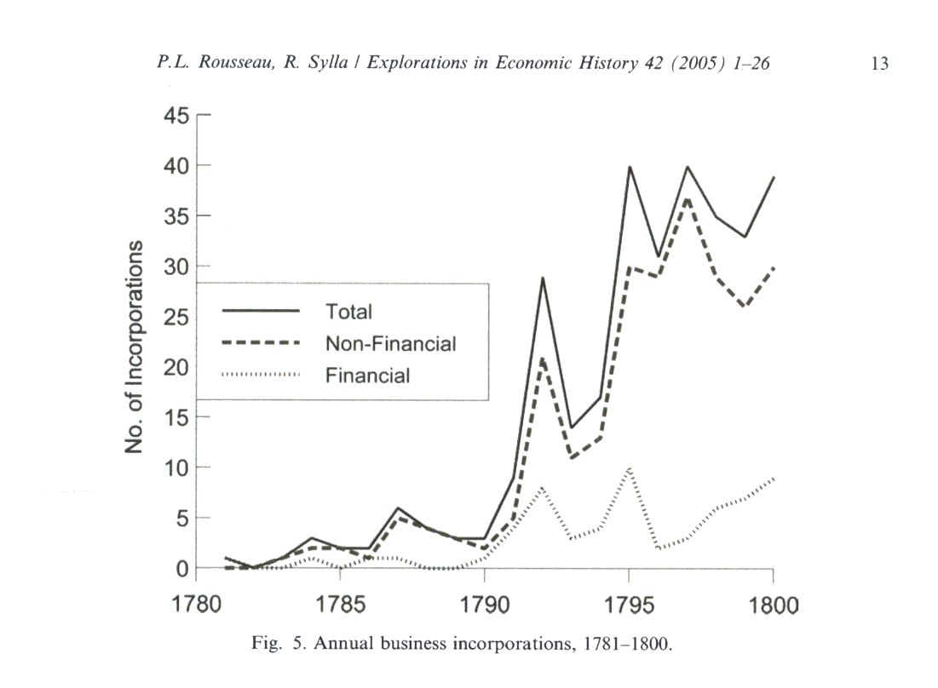

Slide 19
