Slide 1
Topic 1. Part 3.
Banking and Financial Developments to 1824

Slide 2
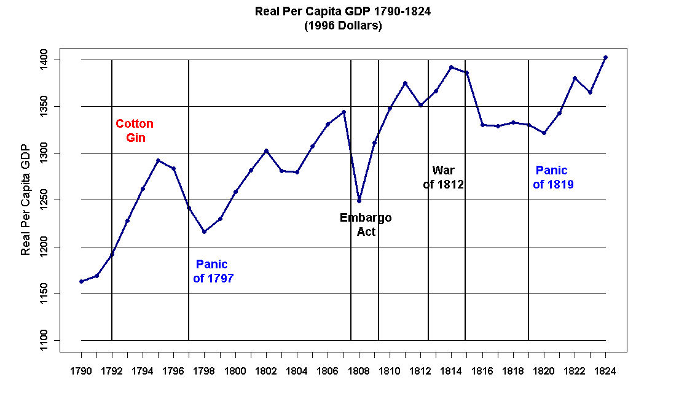

Slide 3
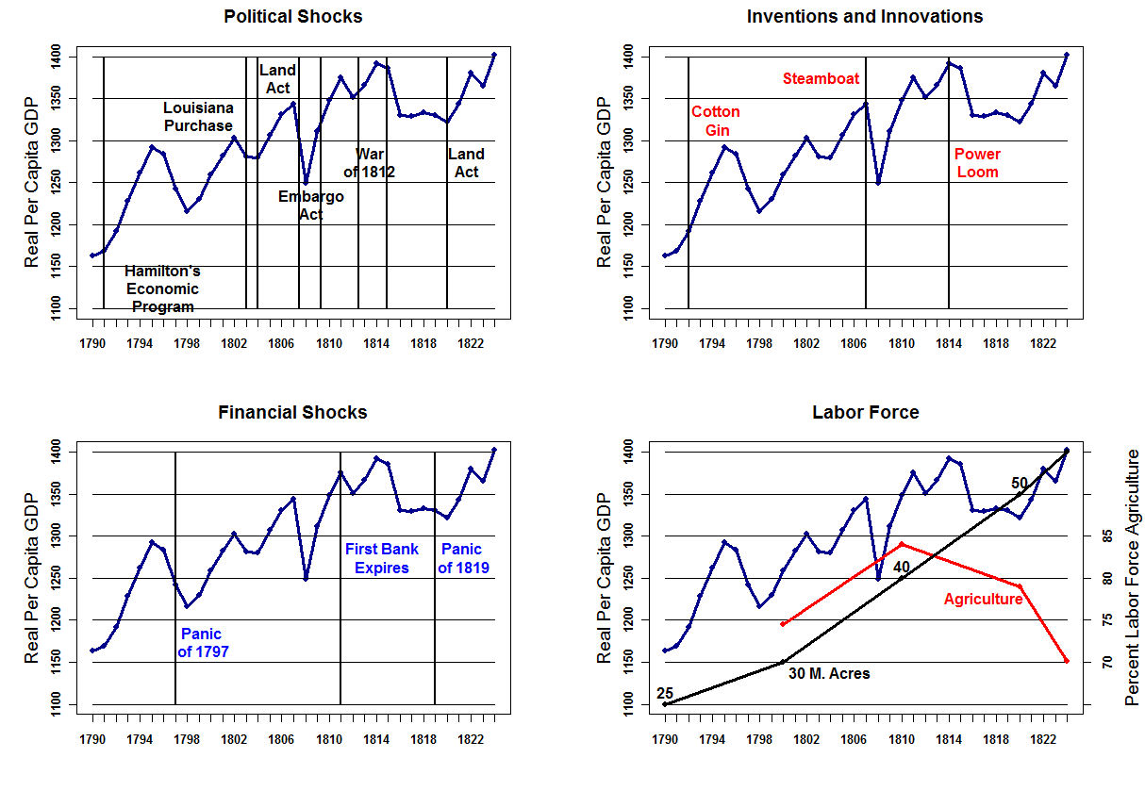

Slide 4
Sylla, Legler, & Wallis (1987)
The U.S. Constitution, by taking away the power of the states to issue paper money, removed a major source of flexibility in state public finance. In their search for new sources of revenue and fiscal flexibility, the states discovered that the banks they chartered could fill the gap.

Slide 5
A Corporation is a fictitious person created by law and endowed with many of the functions of a human being. It may possess property and a treasury distinct from its members, and debts due to or by the corporation are not debts due to or by the individuals composing it. Corporations can sue and be sued and they can be criminally prosecuted, fined, and dissolved by the sovereign. In U.S. law the Supreme Court has extended portions of the Bill of Rights to corporations (e.g., within limits, freedom of speech).

Slide 6
Suppose you are a dry goods dealer in Pittsburgh in the period before the railroads. Every six months you must travel to New York City to buy goods from wholesalers. You personally inspect the goods – caveat emptor – after which you could not (for the most part) complain. How did you pay for the goods? There was no national currency after 1836 save for gold and silver coins and there was no national bank. Consequently, you paid with some form of promissory note equal to the value of the goods purchased plus interest (reflecting the risk taken by the wholesaler that you might not be able to pay the note when it was due).

Slide 7
There are three means of payment available to merchants: barter, cash, and deferred payment. There are two means of deferred payment – letters obligatory which evolved into commercial paper and promissory notes, and bills of exchange.

Slide 8
Letters obligatory originated in the Dutch market center of
Antwerp.
Initially they were literally an IOU and were a written promise
to pay an individual or company a certain amount of money on a
future date. The amount was equal to the price of
whatever was being purchased plus interest/risk factor.

Slide 9
These quickly evolved into an I.O. [Payable to Bearer] so they could be used in a 2nd transaction. For example, I buy a good from person B and give him an IOPTB for the price of the good plus a premium. The IOPTB gives a date after which I am obligated to pay the face value of the IOPTB to the bearer of the note upon presentation.
Person B can use my IOPTB to purchase a good from Person C but note that Person C will insist upon discounting
the note to reflect the risk. That is, the face value of the IOPTB might be $1100 payable on 1 January 1825 but Person C will only sell Person B $1000 worth of goods in exchange for the good.

Slide 10
Eventually the IOPTB winds its way back to me and I pay the current bearer of the note. However, suppose I were to say to the bearer that I was bankrupt and could not pay! As a legal matter, in order to make this system work the government has to legalize endorsement. That is, Person B has to sign the back of the IOPTB when he passes it to Person C. His signature obligates him to repay Person C should I fail to pay the bearer of the note. This law is necessary so that IOPTBs can be freely used as money! By 1537 it became law in the Netherlands and it was still standard business practice in the 1800s (it survives to this day when you sign the back of a check you deposit into your checking account!).

Slide 11
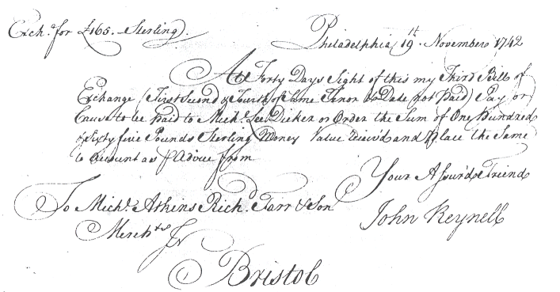

Slide 12
Bills of Exchange – These are very similar to letters obligatory and were invented by the Italian traders around the 15th Century. These were the medium of foreign exchange during the Colonial era. For example, a representative of a British tobacco merchant travels to the Chesapeake Bay region and buys tobacco directly from the planters. The factor buys the tobacco with a Sterling Bill of Exchange that is, in effect, a receipt for gold. Upon presentation at the merchant’s place of business in London, you were paid in gold on the spot.

Slide 13
These bills of exchange were the way international trade was financed because once the trading firm’s reputation was established, they were literally as good as gold. This quickly led to the development of deposit banking. Smaller merchants place funds on deposit with larger and more famous firms and in exchange for a small fee, were able to draw bills of exchange on the larger firm. This considerably increased the efficiency of trade.

Slide 14
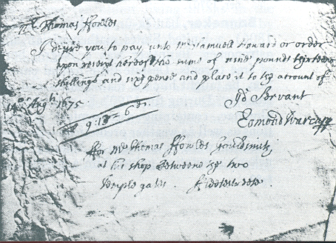

Slide 15
In 1860, just before the outbreak of the Civil War, the U.S. banking system consisted of about 1500 State chartered banks. There was no national bank after 1836 and, aside from gold and silver coins, there was no national currency in the U.S. The only other circulating medium was state bank notes – paper money.

Slide 16
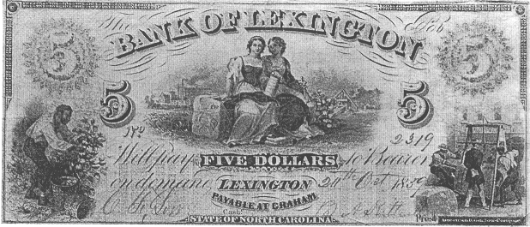

Slide 17
Suppose you owned a saw mill, business was good, and you wanted to expand production for which you needed some capital. What you did is go to your local bank and exchange a promissory note for say, $1000, for $950 worth of the bank’s notes (the discount rate is 5 percent in this example). You then used these notes to buy the goods and services you needed to expand the sawmill.

Slide 18
Note that as long as everyone accepts the bank notes, they are indistinguishable from modern paper money and perform the same task. Technically the bank notes were redeemable in specie but there was no way to prevent an unscrupulous bank from issuing loans in excess of its deposits.

Slide 19
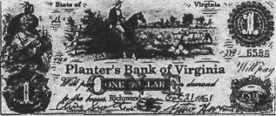

Slide 20
Paper money had been used by the Colonies/States before the Constitution because “the cumbersome and protracted collection of traditional taxes on property and polls was not feasible.”
In addition, property and poll taxes were very unpopular!

Slide 21
However, the States greatly benefited from the Constitution: “Most of their debts, legacies of the Revolution, were assumed by the new federal government in accordance with Hamilton's plan.”

Slide 22
The Solution for the States’ Financial Needs: Banks!
“A substitute for currency finance soon appeared, however, and was adopted quickly by some of the states and more slowly by others. The substitute was banks.”

Slide 23
Early American states turned the banks they chartered into instruments of state finance in two broad ways-by investing in banks and by taxing them.
“For all states and all years surveyed here, about one-fifth of state revenues were derived from banks.”

Slide 24
