Slide 1
The Fourth Political Party System: 1932 - 2014
The Democrat-Republican Political Party System, Early 1990s to Date

Slide 2
Current Lineup of Groups 1990s - Now
DEMOCRATS
1) Blacks (All Regions)
2) Hispanics (Except Cubans, but they are shifting)
3) Most Catholics (see (2))
4) Organized Labor
5) Non-Religious
6) College Graduates
7) Women (Especially Single Women)
8) Jews
9) Urban Areas
REPUBLICANS
1) Whites (Especially the South and Rural Areas in General)
2) Most Protestants (See (1))
3) Religious (Except Jews)
4) Men
5) Rural Areas

Slide 3
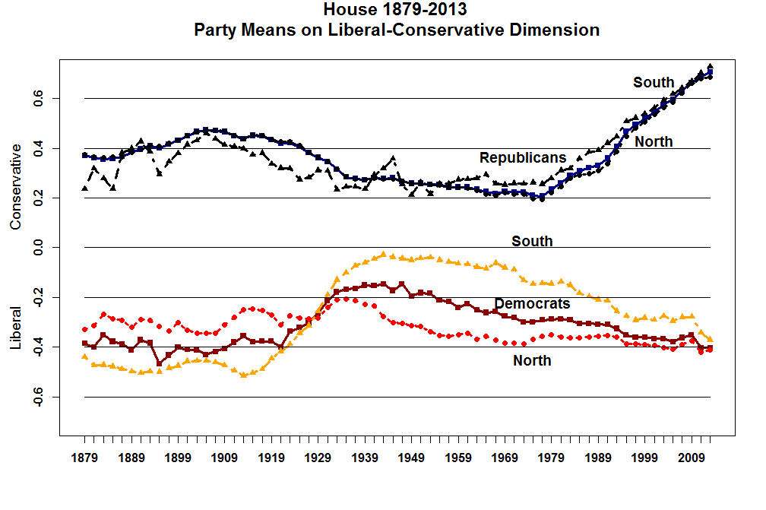

Slide 4
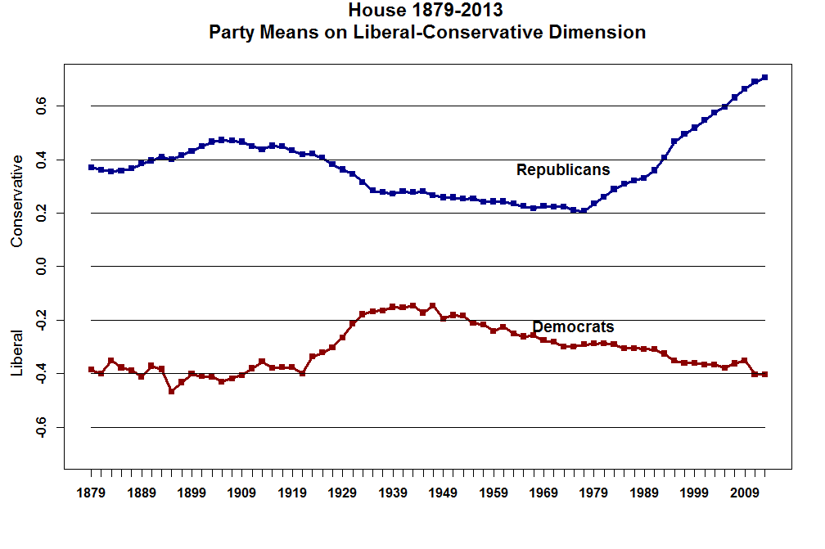

Slide 5
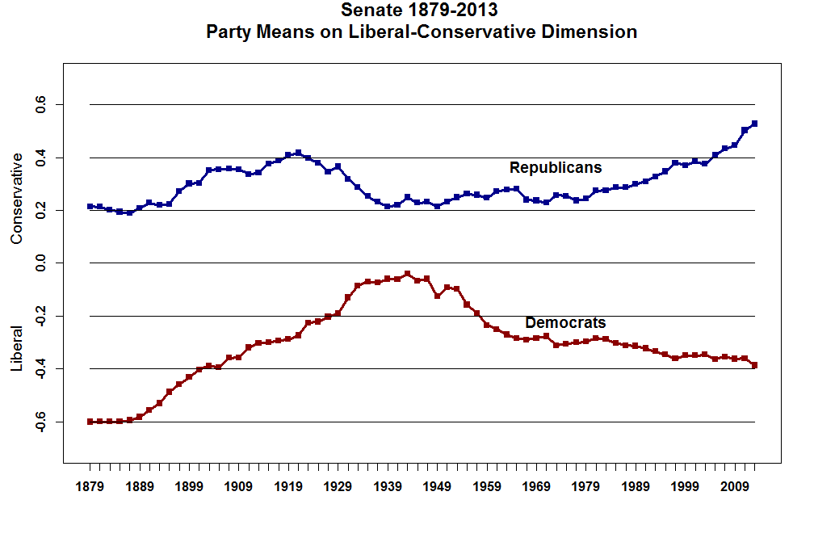

Slide 6
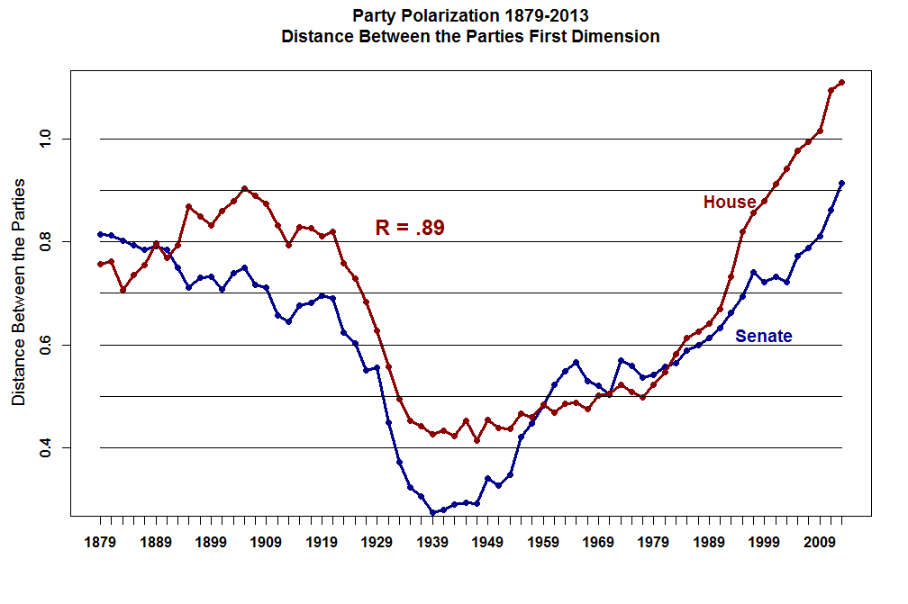

Slide 7
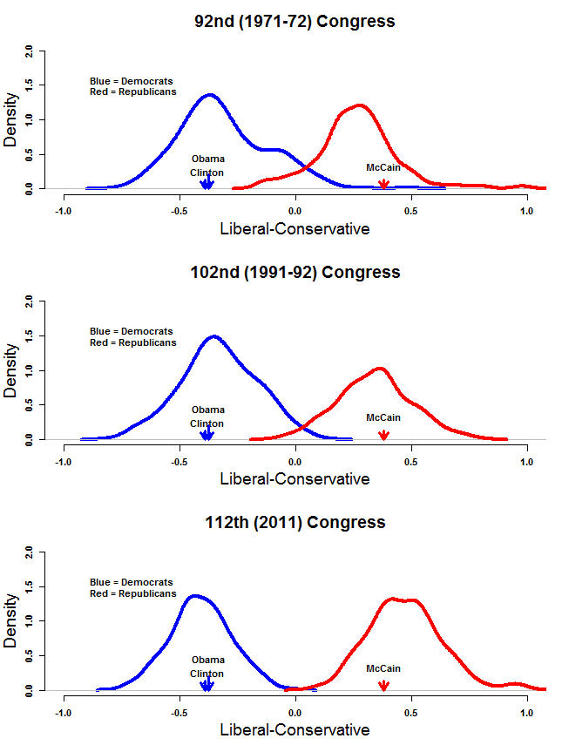

Slide 8
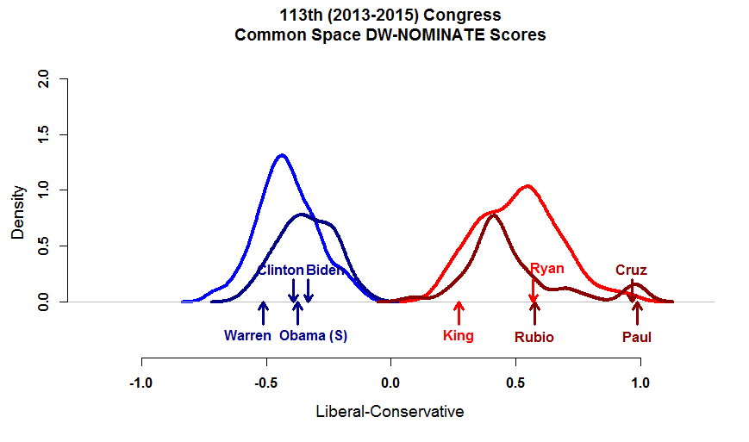

Slide 9
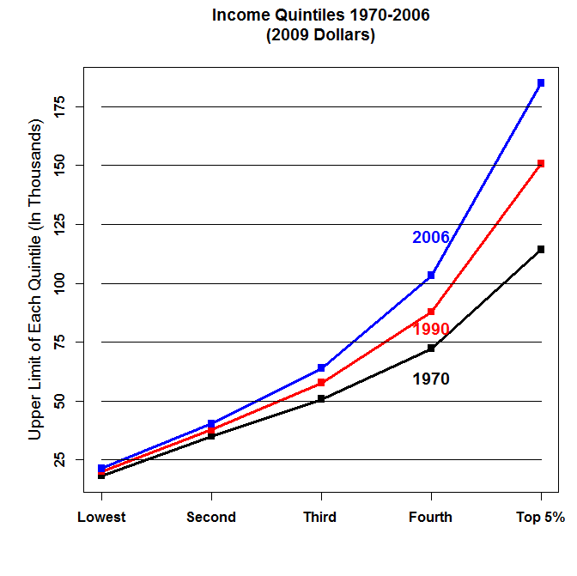

Slide 10
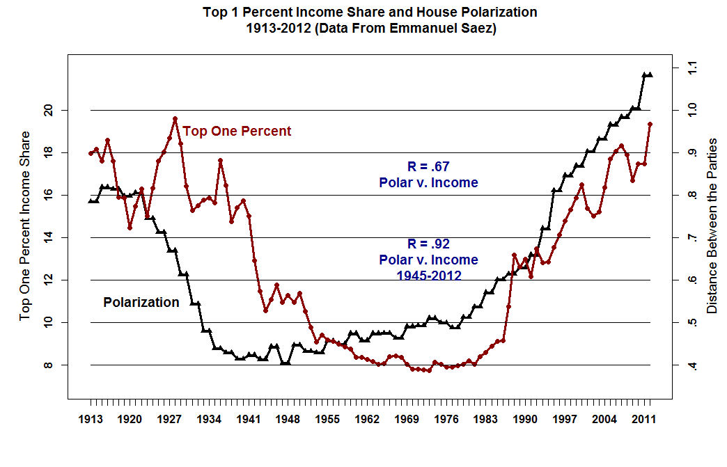

Slide 11
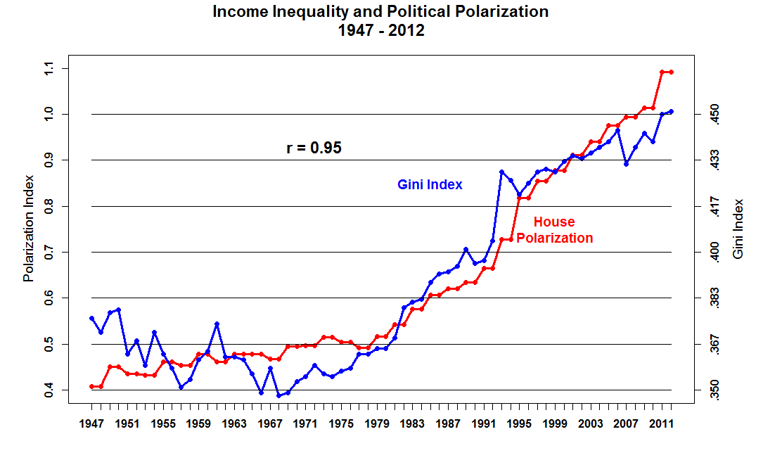

Slide 12
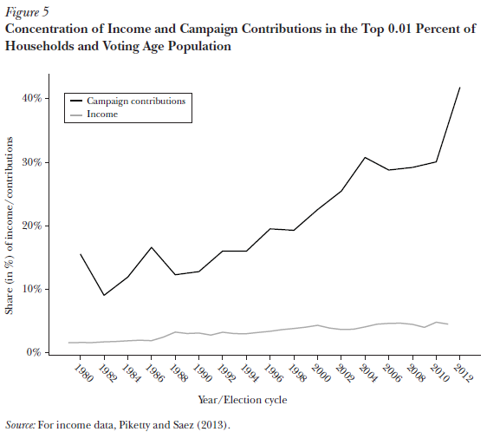

Slide 13
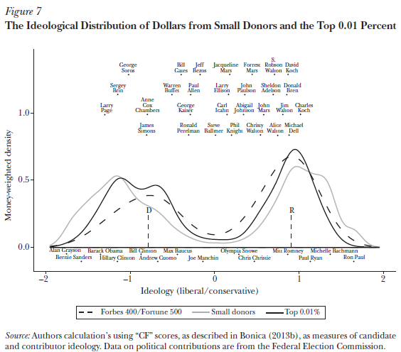

Slide 14
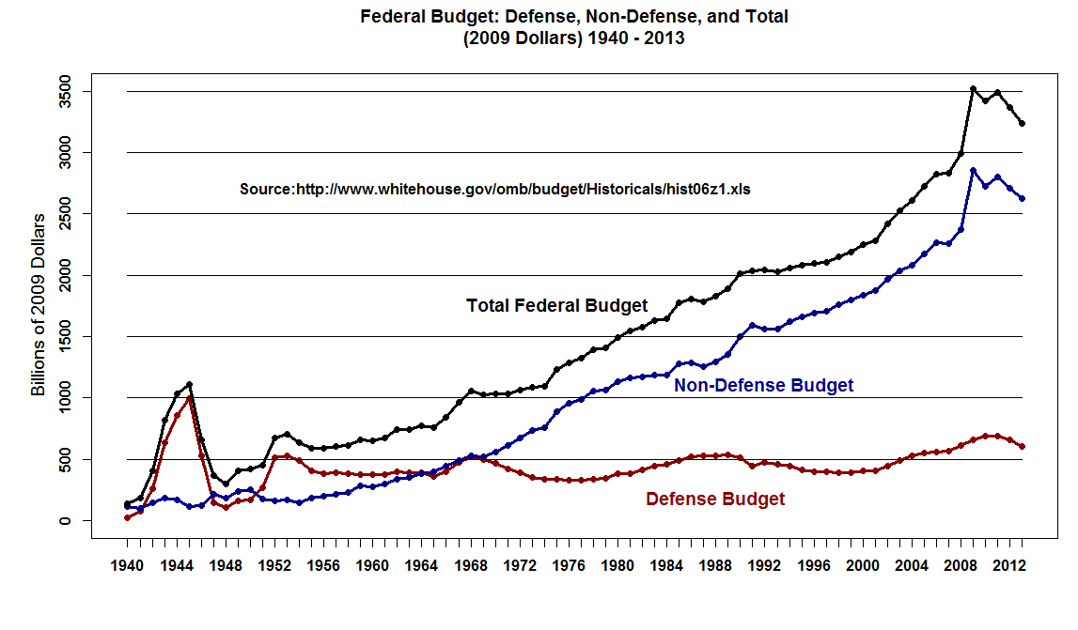

Slide 15
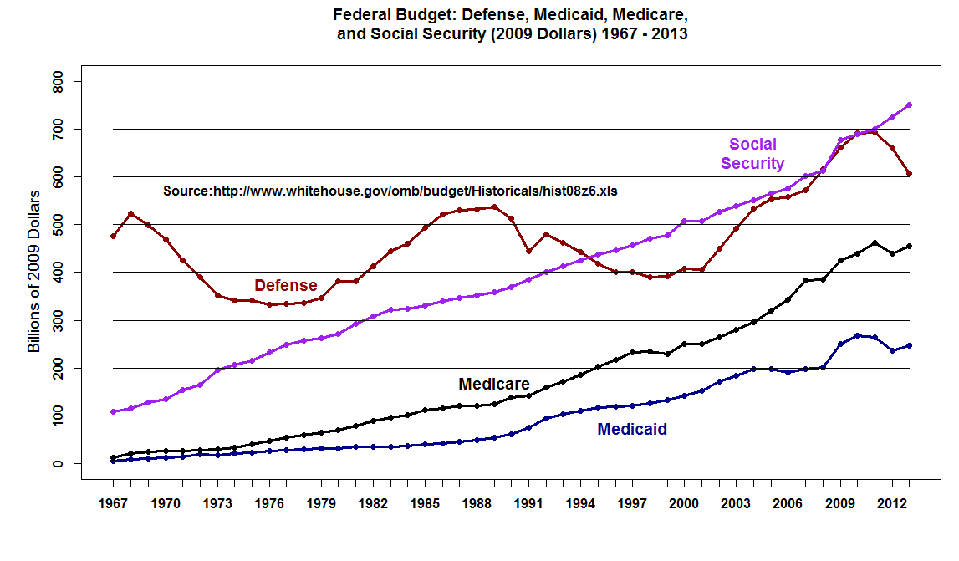

Slide 16
