Slide 1
The Fourth Political Party System: 1932 - 2014
The Democrat-Republican Political Party System, Late 1930s - Late 1980s to Early 1990s

Slide 2
Divisions Began to Appear Between Northern
and Southern Democrats in 1936 over:
1) Roosevelt’s “Court Packing” Scheme of 1937
2) The Fair Labor Standards Act of 1937
3) Roosevelt’s Attempt to “Purge” Some Southern
Democrats in the 1938 Elections.
4) General unease with the 1935 Wagner Act (National
Labor Relations Act) in the South

Slide 3
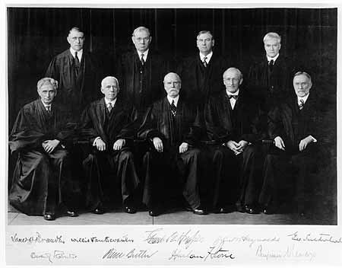
The Court Under Chief Justice Hughes: 1932 – 1937
“The Switch in Time That Saved 9”

Slide 4
In 1937-38 Voting on the Fair Labor Standards Act (Minimum Wages) Opened a serious Split between Northern and Southern Democrats. Southerners did not want Southern
Agriculture to be constrained by the minimum wage because many of the Laborers were Black.

Slide 5
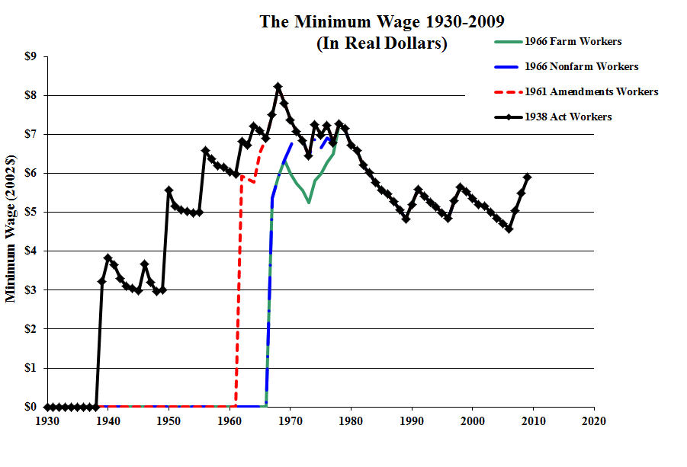

Slide 6
The Attempt to Purge Conservative Democrats in the 1938 Primaries
The Purge was an effort led by President Roosevelt to target certain conservative senators for defeat in Democratic primaries, including Walter George of Georgia, Millard Tydings of Maryland and Ellison Smith of South Carolina, along with the chairman of the House Rules Committee, John J. O'Connor of New York. The Southern Democrats were outraged by Roosevelt’s actions.

Slide 7
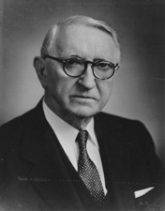
Walter F. George
U.S. Senator from Georgia,
22 November 1922 – 2 January 1957
29 January 1878 – 4 August 1957

Slide 8
George supported some programs that he saw as beneficial to Georgia, primarily the Tennessee Valley Authority, Social Security, the Rural Electrification Administration, and the Agricultural Adjustment Act. In Roosevelt’s first term he supported 34 New Deal bills that went through the Senate, opposing only 10.

Slide 9
During Roosevelt's second term, George opposed rigorous regulation of utility companies, the Wealth Tax Act, and Roosevelt's attempt to pack the U.S. Supreme Court with justices favorable to his New Deal policies.
During World War II George strongly supported Roosevelt’s War policies and shifted his views to be something of an Internationalist. He supported the establishment of the United Nations.

Slide 10
The National Labor Relations Act of 1935 (also known as the Wagner Act after New York Senator Robert F. Wagner) guarantees basic rights of private sector employees to organize into trade unions, engage in collective bargaining for better terms and conditions at work, and
take collective action including a strike if necessary.
The act also created the National Labor Relations Board, which conducts elections that can require employers to engage in collective bargaining with labor unions.

Slide 11
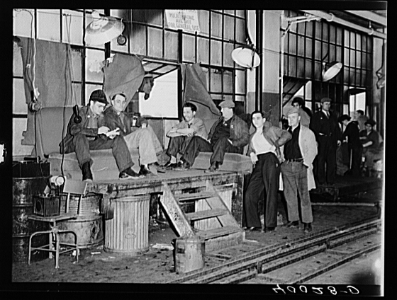
The “Sit Down” Strike at the General Motors Plant in Flint, MI,
30 December 1936 -- 11 February 1937

Slide 13
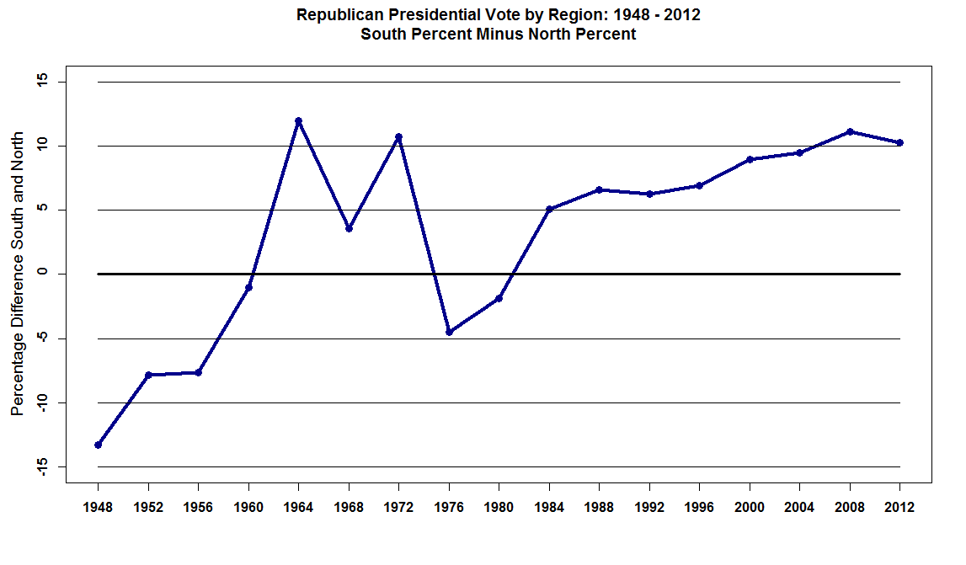

Slide 14
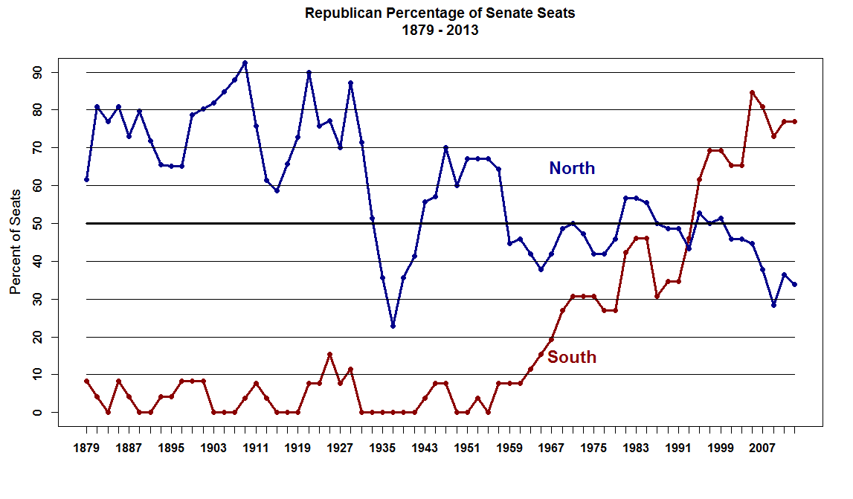

Slide 15
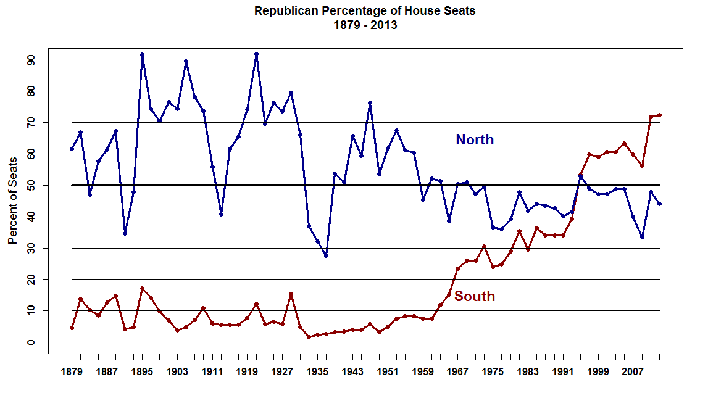

Slide 16
