Slide 1
The Fourth Political Party System: 1932 - 2014
The Great Depression and the Initial Realignment

Slide 2
The Lead up to the Depression: 1) The Road Building Boom
1) As late as 1921 No Highway in the United States had a Number. 2) Chains on all 4 Wheels and a shovel with a collapsible handle were necessary equipment for all cars. 3) Between 1921 and the Depression Government expenditure for Streets and Highways exceeded the capital outlays for most Private Industries. 4) These expenditures were a "Hidden" Subsidy for the Automobile Industry and had the effect of Stimulating the Economy in general.

Slide 3
The Lead up to the Depression: 2) The Housing Industry 1) Housing Construction boomed between the end of World War I and 1926. After 1926 it slowly dropped off. 2) Rapid Population Growth and Pent-up Demand because of WWI produced strong demand. 3) The Fact that Real Wages were not Rising as fast as Productivity Suggests that Demand for Housing was Exhausted by the late 1920s.

Slide 4
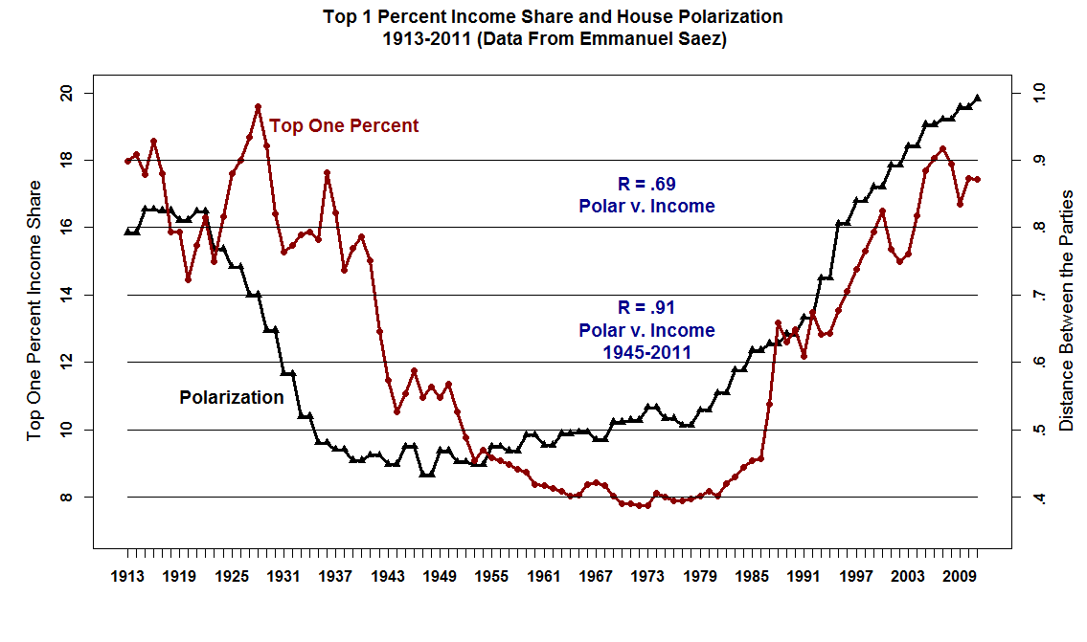

Slide 5
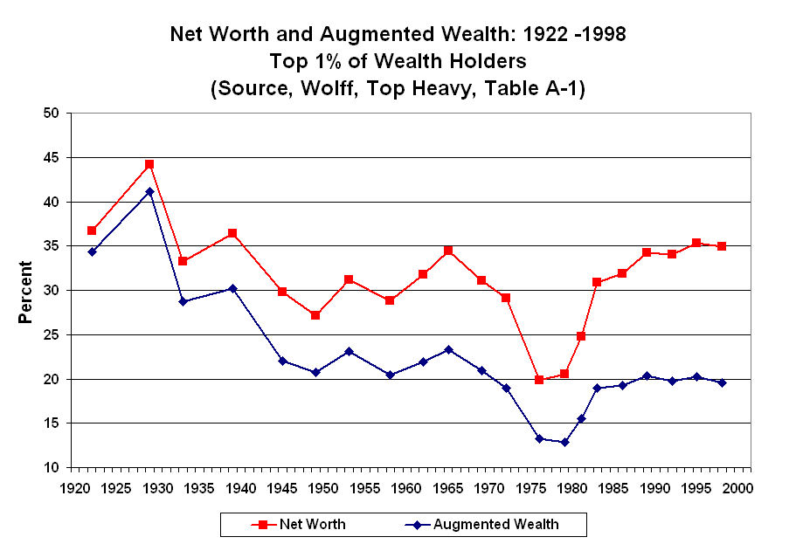

Slide 6
The Great Bubble: Suppose You had $100 to invest
in the Stock Market in July 1926
July 1926 $100
July 1927 112
July 1928 148
January 1929 193
September 1929 216
December 1929 147
December 1930 102
July 1932 34

Slide 7
1) Many People and Corporations had bought stocks on Margin
from Brokers -- usually 10% down and 90% borrowed. 2) Brokers in Turn borrowed Money from non-Bank Sources.
Many Corporations invested their Surplus Profits in
these Endeavors. 3) The Bubble was also Fueled by Investment Trusts. These
sold their own debt instruments and then used the money
to buy stock. 4) The craze became so Intense that it looked like it could
go on forever.

Slide 8
Herbert Hoover (early 1929): "We in America are nearer to the final triumph over poverty than ever before in the history of any land ... We have not reached the goal, but given a chance to go forward with the policies of the last eight years, we shall soon with the help of God be in sight of the day when poverty will be banished from this nation."

Slide 9
John J. Raskob (Chairman of the Democratic Party, Summer 1929): "If a man saves $15 a week, and invests in good common stocks, and allows the dividends and rights to accumulate, at the end of twenty years he will have at least $80,000 and an income from investments of around $400 a month. He will be rich. And because income can do that, I am firm in my belief that anyone not only can be rich, but ought to be rich."

Slide 11
Four Distinct Periods:
1930 - 1933: Steep Decline
1933 - 1937: Steep Recovery
1937 - 1938: Recession
1938 - 1941: Tooling up for World War II

Slide 12
Initial Realignment of Various Groups 1930 - 1937
DEMOCRATS
1) Lower to Lower Middle Class -- In Particular the Working Class (Especially Urban Areas)
2) Lower Income in General
3) White Ethnic Groups: Catholics, Jews, Poles, Irish, Slavs, Italians
4) Organized Labor
5) White Southerners
6) New Voters -- Especially Immigrants who entered before 1924
7) Northern Blacks
REPUBLICANS
1) Upper Middle to Upper Class
2) Middle to Higher Income in General
3) White Protestants
4) Business
5) Professionals
6) Southern Blacks

Slide 13
Summary -- Realignment of the 1930s (to late 1930s) -- Neither Party Replaced 1. Breadth and Depth of the Underlying Grievance – Economic Disaster. Sudden and Unexpected and the Republicans were blamed for it. 2. Capacity to Provoke Resistance – Haves vs. the Have Nots. 3. Leadership – Lagged Behind the General Public. The Republicans were unable to adapt. 4. Division of Polar Forces Between the Two Parties – Affected Mainly the Republicans. They were Reduced to a fraction of their former Support. 5. Strength of Existing Party Attachments – Strong, but overwhelmed by the sheer Magnitude of the Economic Disaster.

Slide 14
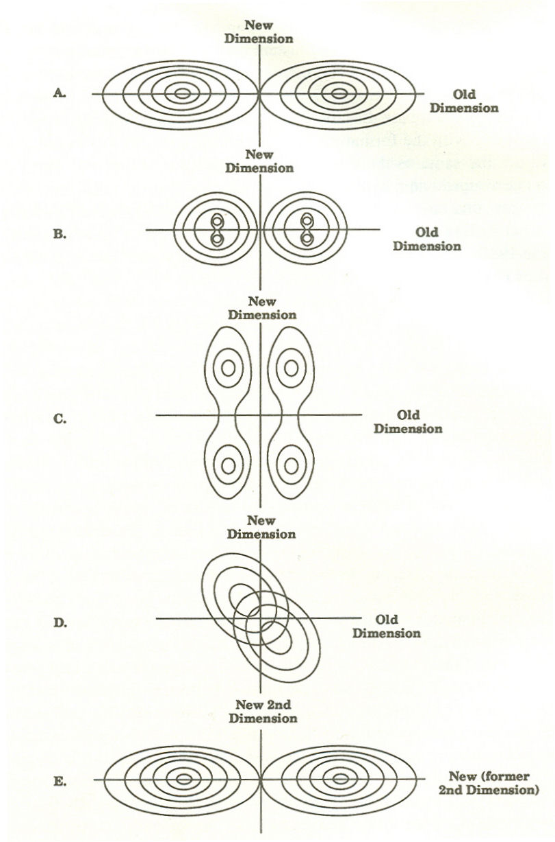
SUMMARY – Realignment of the 1930s (to late 1930s) -- The Realignment Scenario Clearly Type 2 -- Realignment in which Neither Party is Replaced. The System Stays in State A With a Dramatic Shift of the Electorate to the Democratic Party.

