Slide 1
The Fourth Political Party System: 1932 - 2014
Overview

Slide 2
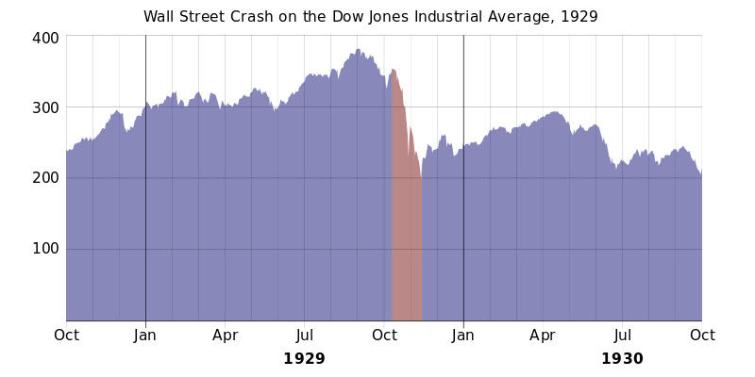

Slide 3
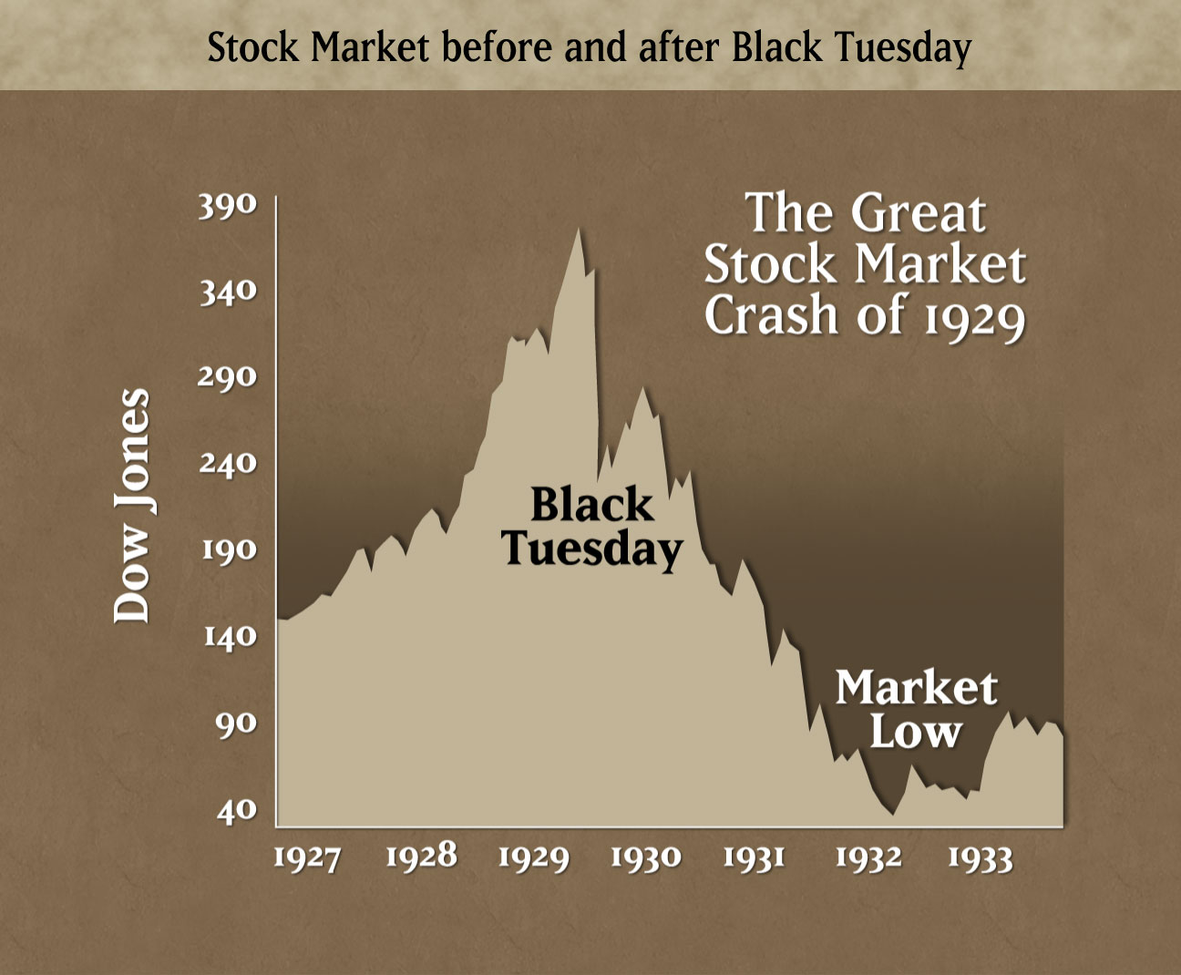

Slide 4
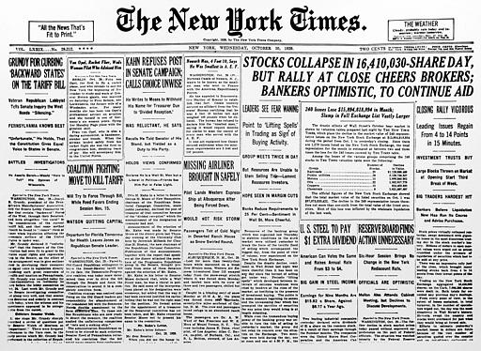
New York Times, Wednesday, 30 October 1929

Slide 5
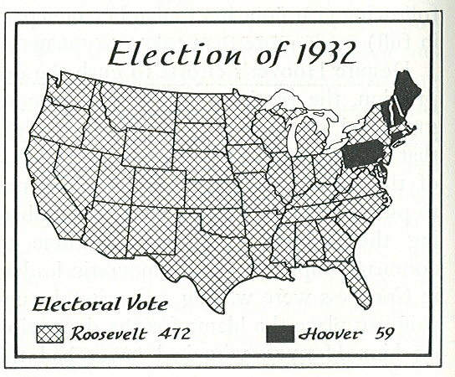

Slide 6
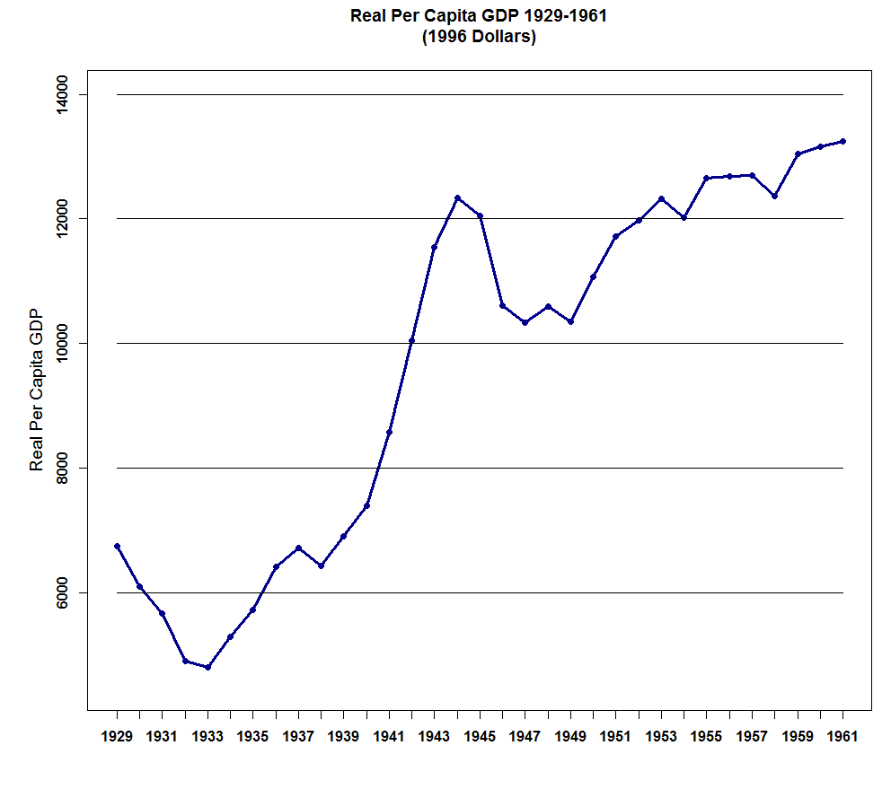

Slide 8
Presidential Election Results: 1932 - 2012

Slide 10
The Democrat-Republican Political Party System,
1930 - Late 1930s: Overview
The Main Organizing Dimension was Economics -- The
Degree of Government Intervention in the Economy
The Effect of the Depression was to Shift the Entire
Distribution of Voters to the Left on the Existing
Dimension. Greater Control over the Economy and
Direct Cash Payments to Individuals Became Accepted
Policy. 3. The Democrats Became Overwhelmingly Dominate -- The Most
Lopsided Two-Party System in American History. Many
Scholars Referred to it as a One-and-a-Half
Party System.

Slide 11
The Democrat-Republican Political Party System, Late 1930s - Early 1990s: Overview 1. In 1937-38 Voting on the Fair Labor Standards Act (Minimum Wages) Opened a serious Split between Northern and Southern Democrats. Southerners did not want Southern Agriculture to be constrained by the minimum wage because many of the Laborers were Black.
2. During the Second World War Voting on whether or not to Use Federal Law as Opposed to State Law to Determine Voter Eligibility in the Armed Forces Further Exacerbated the Split Between Northern and Southern Democrats. Southern Democrats did not want Blacks serving in the Armed Forces to be able to vote in Southern elections.

Slide 12
3. This conflict culminated in the Passage of the 1964 Civil Rights Act, the 1965 Voting Rights Act, and the 1968 Open Housing Act. Collectively, these laws ended legal segregation.
4. The Passage of the Civil Rights Laws triggered a slow Realignment of the White South into the Republican Party. Aided by President Richard Nixon's "Southern Strategy", the Southern states began voting for Republican Presidential candidates. Eventually Southern States began electing Republican Senators, then Republican Representatives, and finally state and local officials switched to the Republican Party.
5. Economic Growth and In-migration of people and businesses into the Right-to-Work States of the South also had a big role in the switch to the rise of the Republican Party.

Slide 13
The Democrat-Republican Political Party System,
Early 1990s - 2014: Overview
The Main Organizing Dimension was Economics -- The
Degree of Government Intervention in the Economy
2. The Rise of Social/Life-Style Issues
3. Increasing Political and Social Polarization

