Slide 1
The Third Political Party System: 1897 - 1928
Introduction: An Era of Prosperity and Republican Dominance

Slide 4
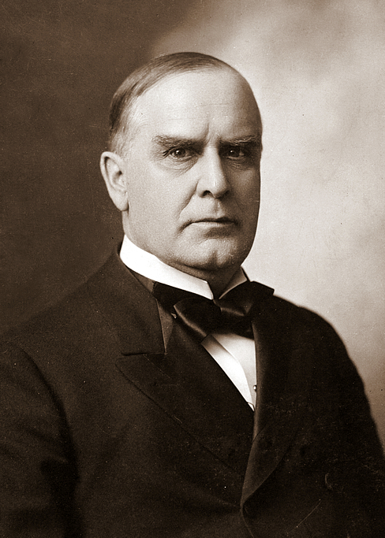
William McKinley, President of the United States
4 March 1897 – 14 September 1901
29 January 1843 – 14 September 1901

Slide 5
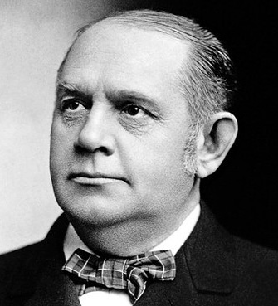
Marcus Alonzo "Mark" Hanna
President McKinley’s Campaign Chairman and Fundraiser
Senator From Ohio 5 March 1897 – 15 February 1904
24 September 1837 – 15 February 1904

Slide 6
THE ACCIDENTS OF LEADERSHIP
Why was there no realignment (or major political upheaval) during the Progressive Era of 1898-1917? Sundquist (p. 177): "...the one [factor] that appears to have been crucial was leadership."
Democrats were to remain on the Populist/Progressive Left and it appeared that the Republicans would be the semi-permanent Conservative Party. This changed with the assassination of President McKinley and the elevation of Theodore Roosevelt to the Presidency.

Slide 7
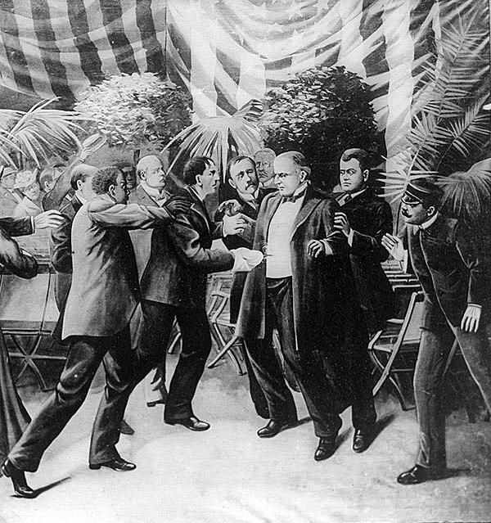
The Shooting of President McKinley by Leon Czolgosz on 6 September 1901

Slide 8
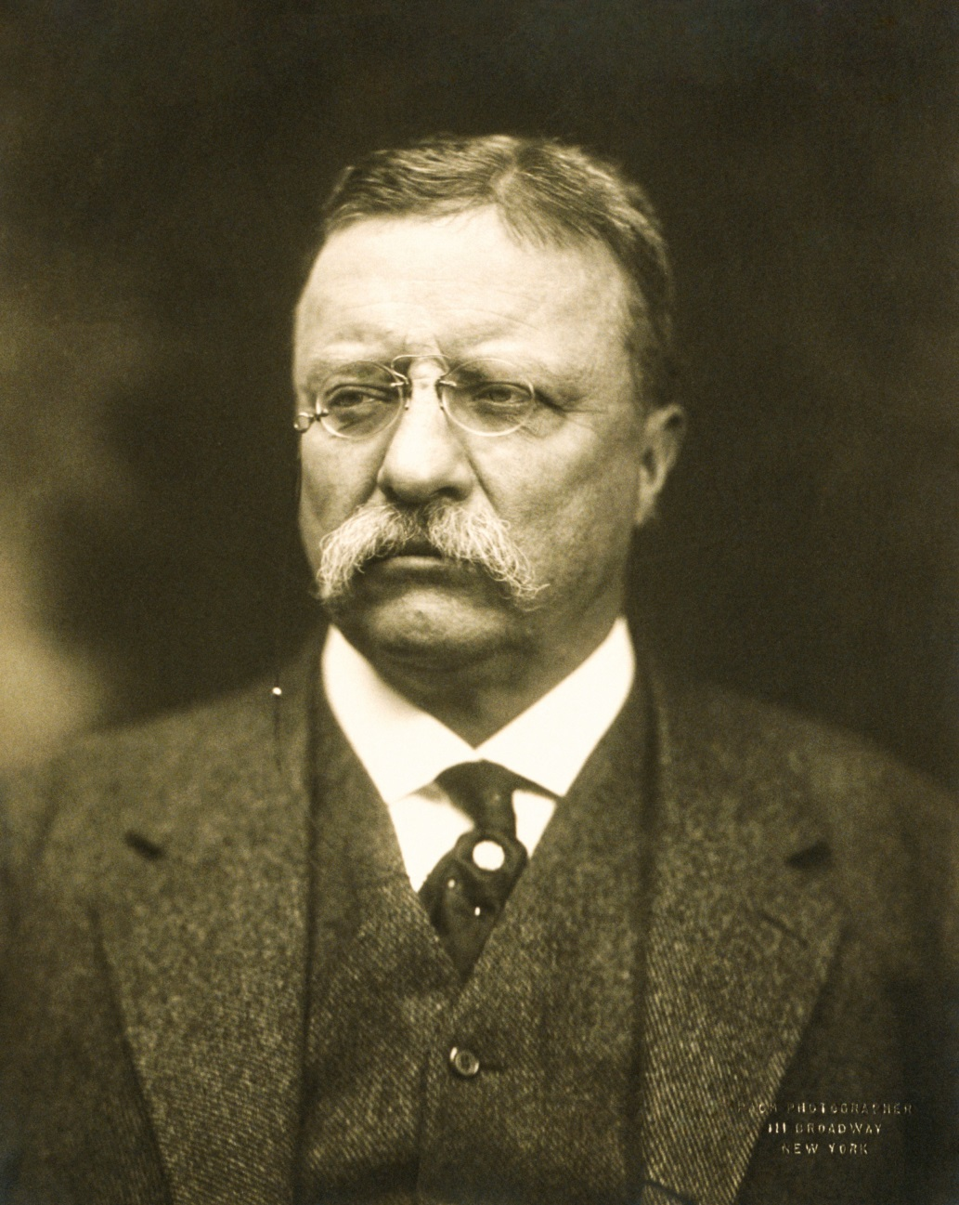
Theodore Roosevelt, President of the United States
14 September 1901 – 4 March 1909
27 October 1858 – 6 January 1919

Slide 9
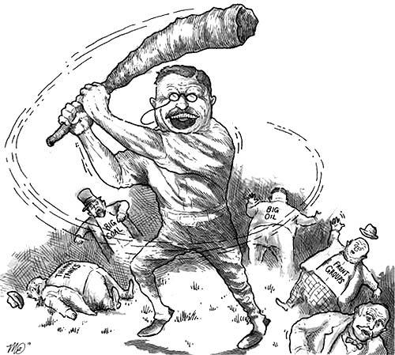
Teddy Roosevelt, The Trust Buster

Slide 10
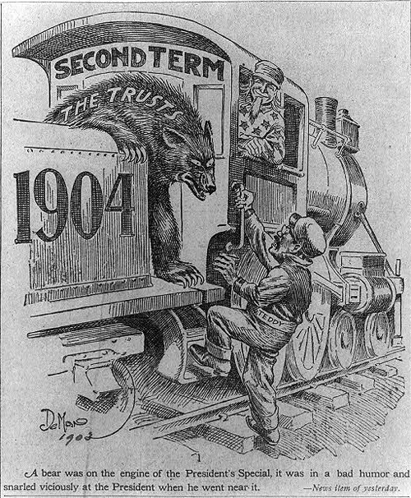

Slide 11
President Theodore Roosevelt in a speech at Provincetown, Mass (20 August 1907), accused the “Trusts” of causing the financial “panic” of 1907 (The Real Panic began in October but by August the Market was down over 20%):
“…but it may well be that the determination of the Government (in which, gentlemen, it will not waver), to punish certain malefactors of great wealth, has been responsible for something of the trouble; at least to the extent of having caused these men combine to bring about as much financial stress as possible, in order to

Slide 12
discredit the policy of the government and thereby secure a reversal of that policy, so that they may enjoy unmolested the fruits of their own evil-doing. . . I regard this contest as one to determine who shall rule this free country—the people through their governmental agents, or a few ruthless and domineering men whose wealth makes them peculiarly formidable because they hide behind the breastworks of corporate organization.”

Slide 13
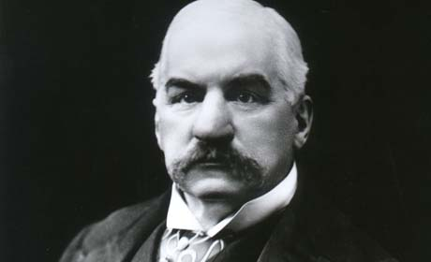
John Pierpont Morgan
17 April 1837 – 31 March 1913

Slide 14
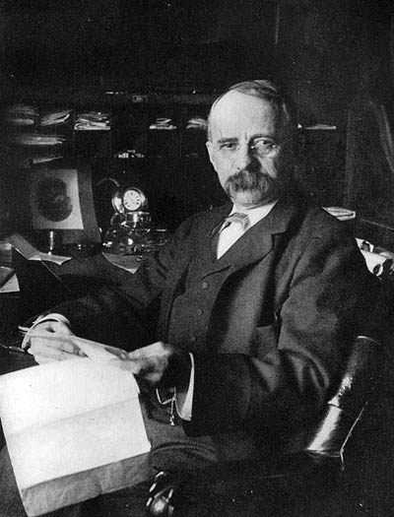
Edward Henry Harriman
20 February 1848 – 9 September 1909

Slide 15
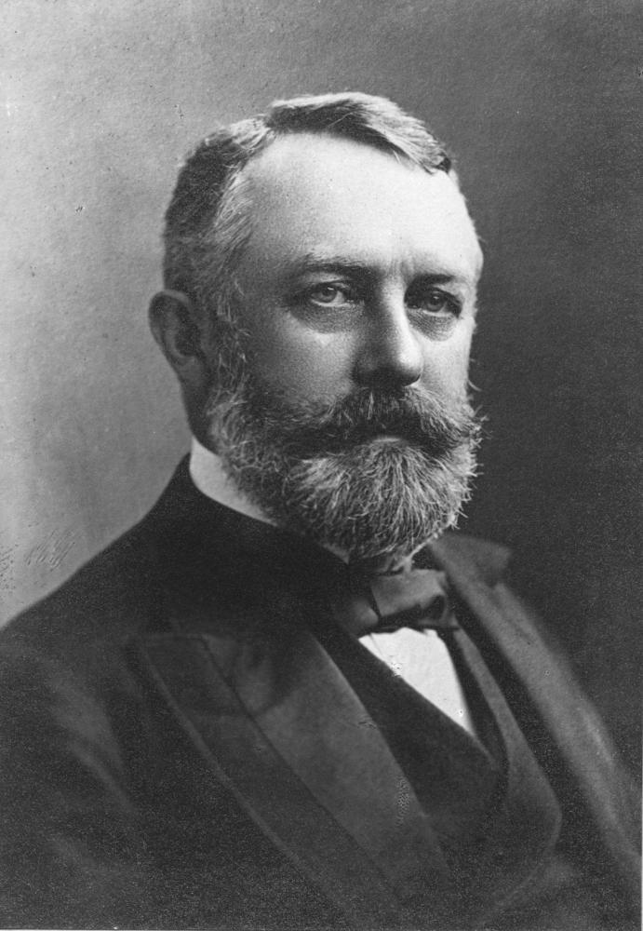
Henry Clay Frick
19 December 1849 – 2 December 1919

Slide 16
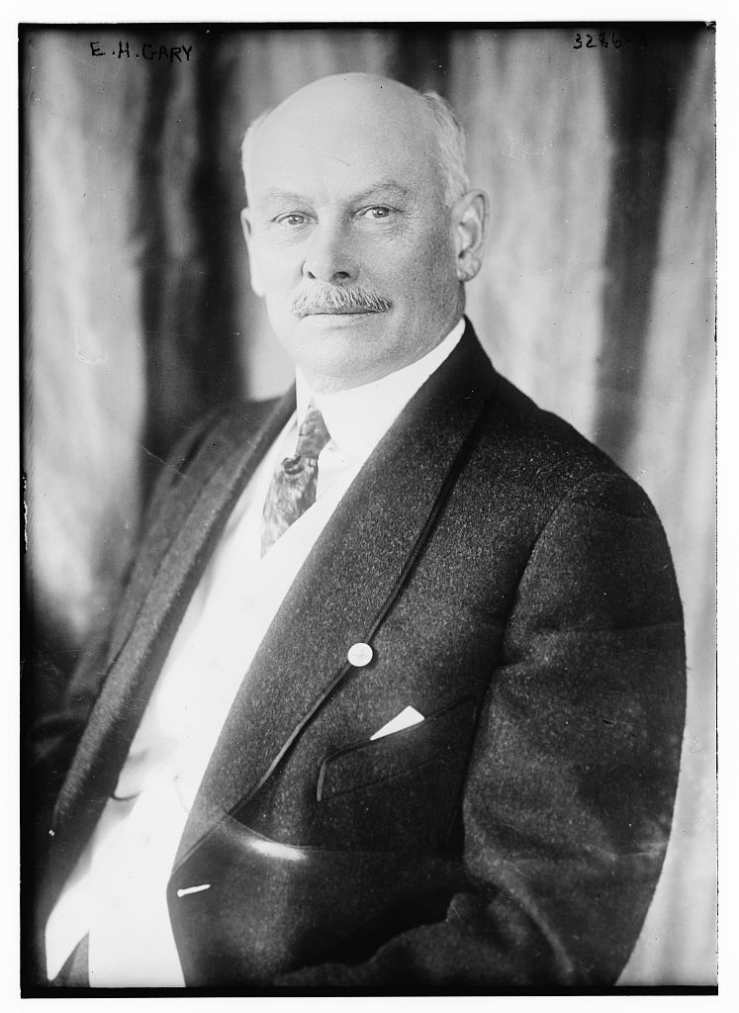
Elbert Henry Gary
Chairman of the Board, U.S. Steel Corporation 1901 – 1904
8 October 1846 – 15 August 1927

Slide 17
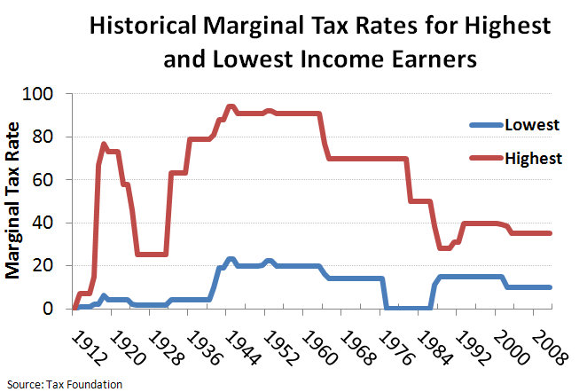
The 16th Amendment: Allowed Taxes on Income
Ratified 3 February 1913

Slide 18
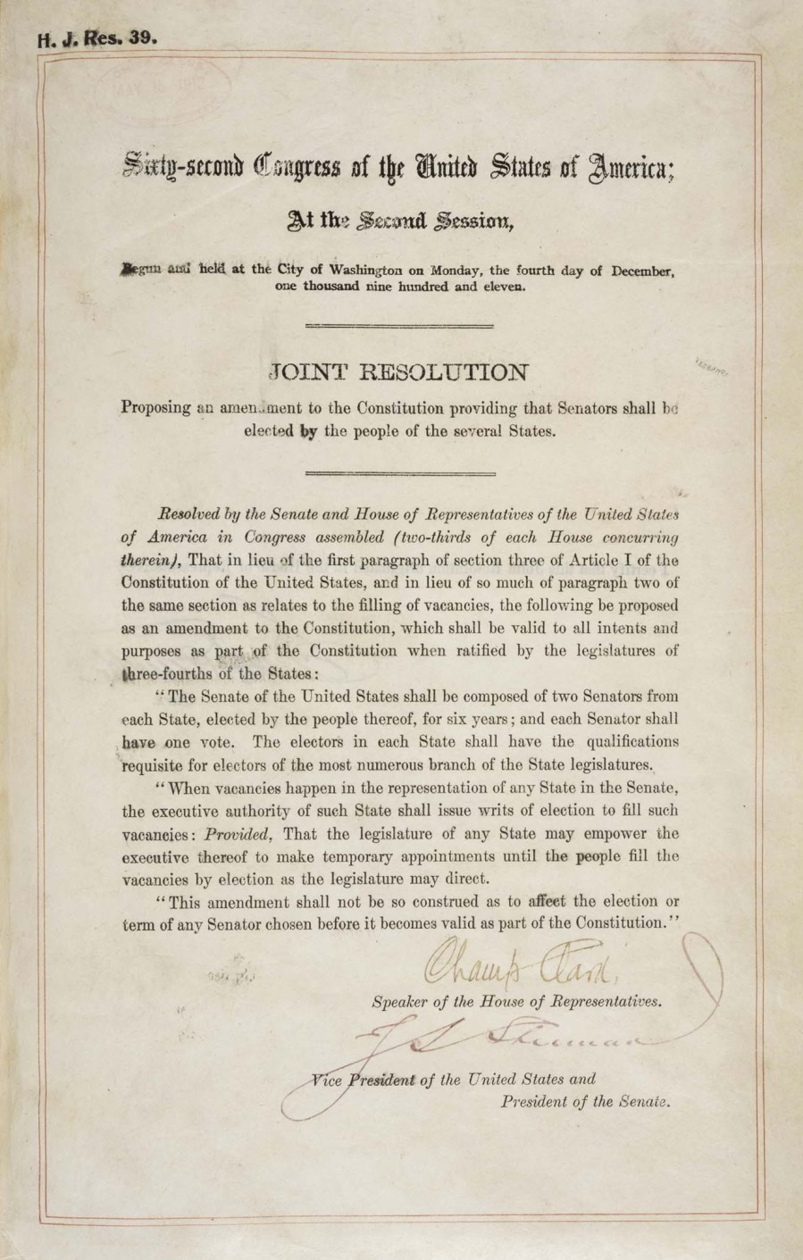
The 17th Amendment: The Popular Election of Senators
Ratified 8 April 1913

Slide 19
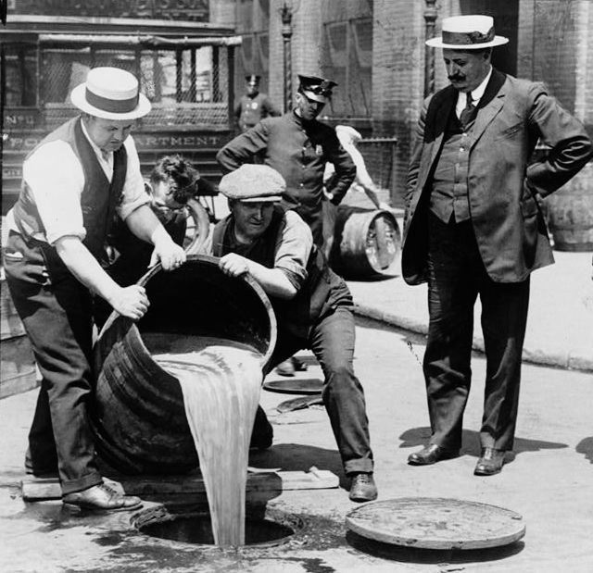
The 18th Amendment: Banning Intoxicating Liquors
Ratified 16 January 1919

Slide 20
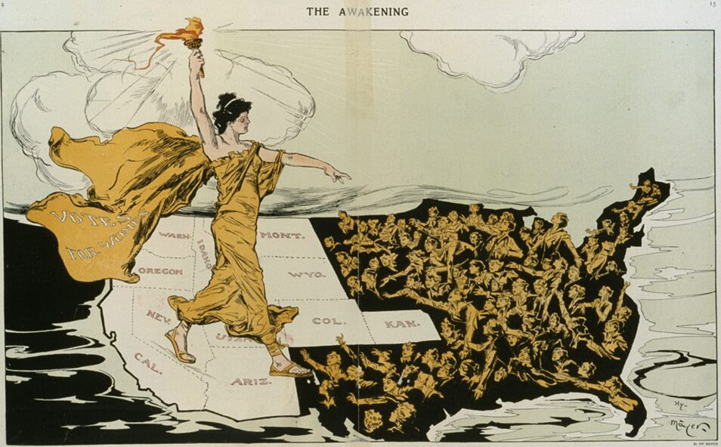
The 19th Amendment: The Right of Women to Vote.
Ratified on 26 August 1920

Slide 21

The Jungle, a novel by Upton Sinclair, one of the “Muckrakers”, was published in 1906. It lead to the passage of the Pure Food and Drug Act and the Meat Inspection Acts of 1906.

