Slide 1
The Second Political Party System: 1856 - 1896
The Presidential Election of 1896

Slide 2
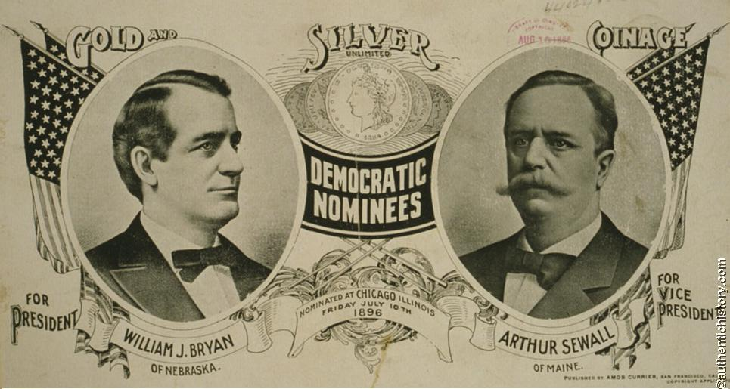
The Election of 1896

Slide 3
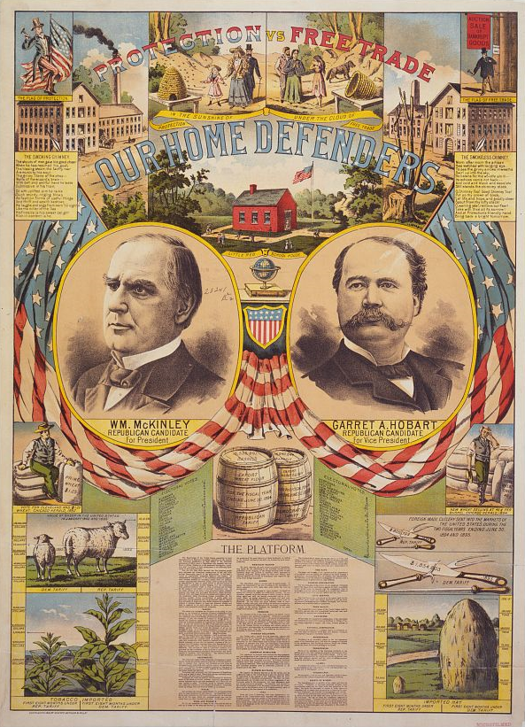

Slide 5
Presidential Elections: 1864 - 1896
Democrat Republican
---------------------------------------------------------------------------
1864 McClellan 21 1,836,072 44.91 Lincoln 212 2,220,846 55.08*
1868 Seymour 80 2,708,744 47.29 Grant 214 3,013,650 52.70*
1872 Greeley --- 2,835,315 43.82 Grant 286 3,598,468 55.63*
1876 Tilden 184 4,288,191 51.01* Hayes 185 4,033,497 47.87
1880 Hancock 155 4,445,526 48.21 Garfield 214 4,453,611 48.31
1884 Cleveland 219 4,915,586 48.49 Blaine 182 4,852,916 48.26
1888 Cleveland 168 5,539,118 48.68 Harrison 233 5,449,825 47.79
1892 Cleveland 277 5,554,617 46.07 Harrison 145 5,186,793 42.92
1896 Bryan 176 6,370,897 46.70 McKinley 271 7,105,144 51.02*
---------------------------------------------------------------------------

Slide 6
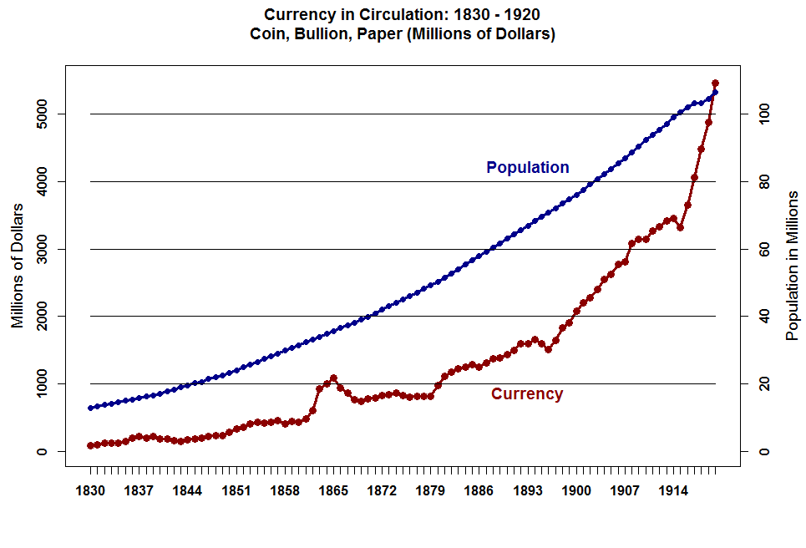

Slide 7
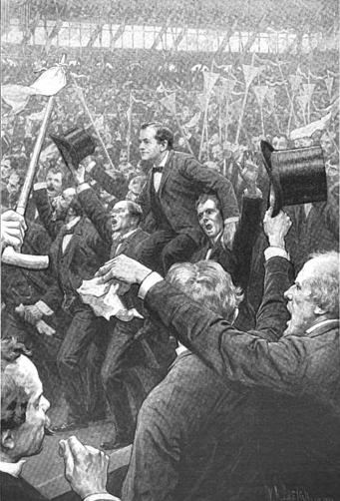
Bryan after Delivering his “Cross of Gold” Speech

Slide 8
Having behind us the producing masses of this nation and the world, supported by the commercial interests, the laboring interests, and the toilers everywhere, we will answer their demand for a gold standard by saying to them: "You shall not press down upon the brow of labor this crown of thorns; you shall not crucify mankind upon a cross of gold."

Slide 9
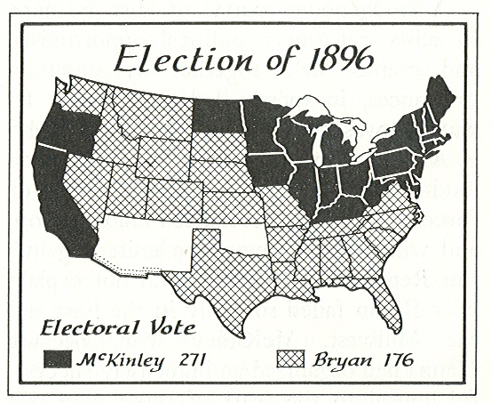

Slide 10
Summary -- Realignment of the 1890s -- Neither Party Replaced
1. Breadth and Depth of the Underlying Grievance – Not too great. The Farmers and the Labor Unions were angry but the Bi-Metalism Issue did not have the power that Slavery had and Inflation after 1895 negated the issue.
2. Capacity to Provoke Resistance – Farmers had many successes.
3. Leadership – Held firm in the Republican Party but the Democratic Party was split internally.
4. Division of Polar Forces Between the Two Parties – Affected Mainly the Democrats.
Strength of Existing Party Attachments – Strong, especially for Republicans. The Silver Republicans stayed in the Party while the Gold Democrats switched to the Republican Party.

Slide 11
5. Strength of Existing Party Attachments – Strong, especially for Republicans. The Silver Republicans stayed in the Party while the Gold Democrats switched to the Republican Party.

Slide 12
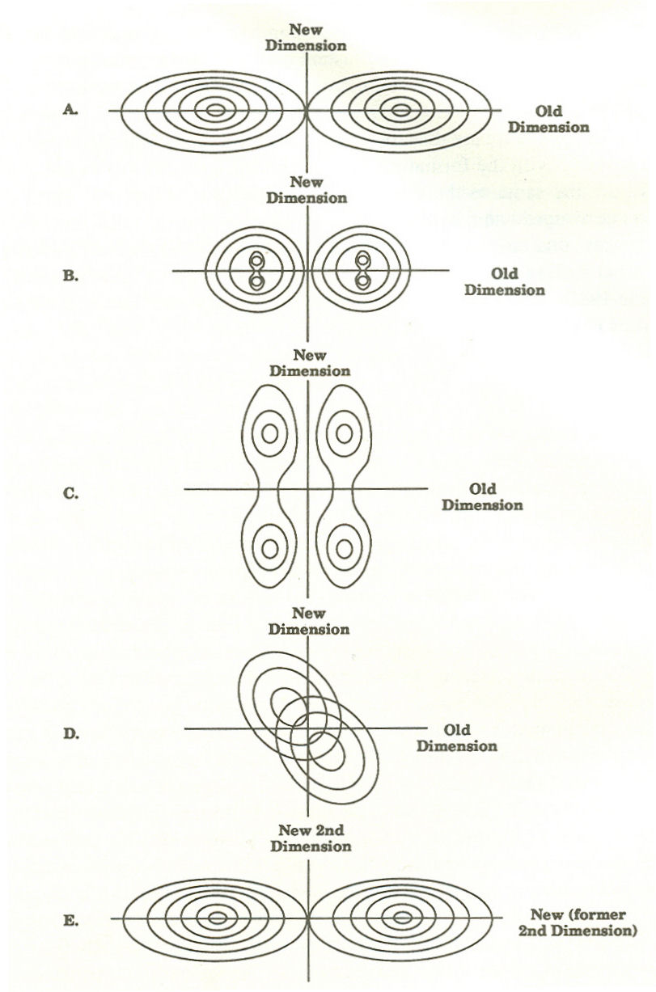
SUMMARY – Realignment of the 1890s -- The Realignment Scenario
Clearly Type 2 -- Realignment in which Neither Party is Replaced.
The System evolves from State A to State B/C and snaps back into State A.

