Slide 1
The Second Political Party System: 1856 - 1896
The Economy After the Civil War:
The Labor Movement

Slide 2
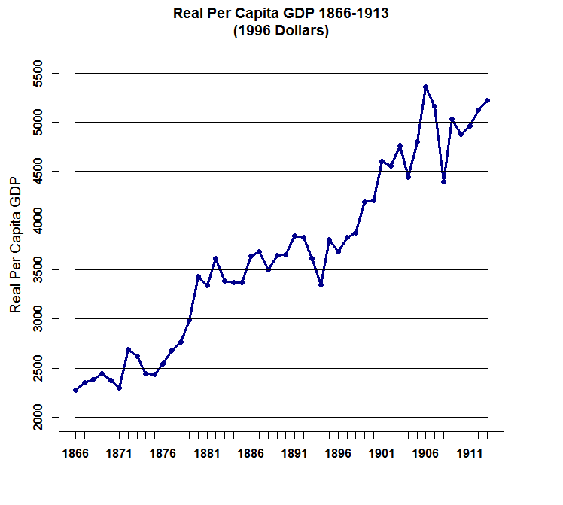

Slide 3
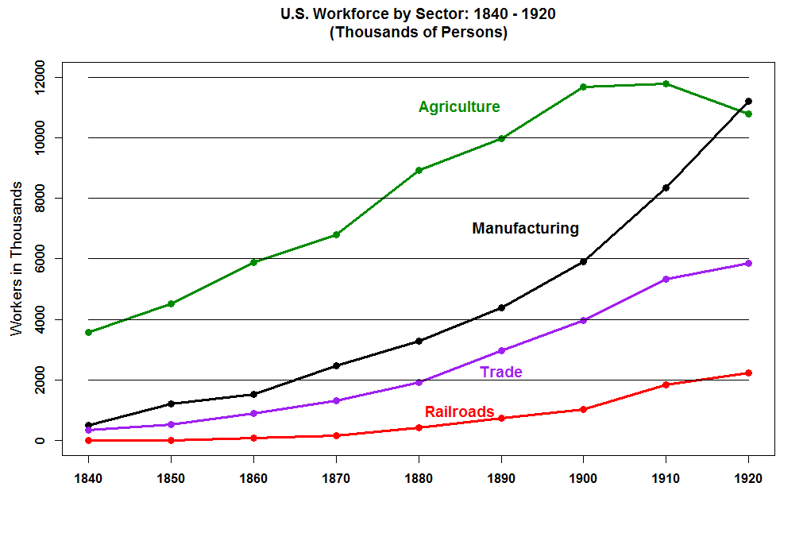

Slide 4
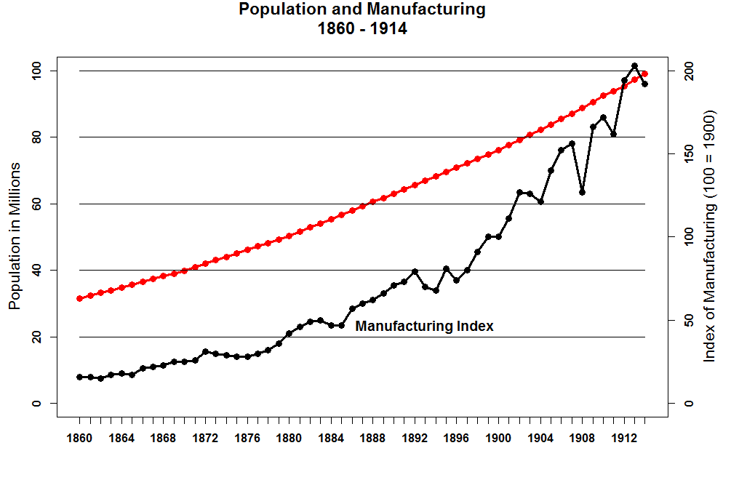

Slide 5
Labor history different in the U.S. vs. Europe
More violent but less Socialist.
Split between skilled and unskilled workers – craft unions vs. unskilled.

Slide 6
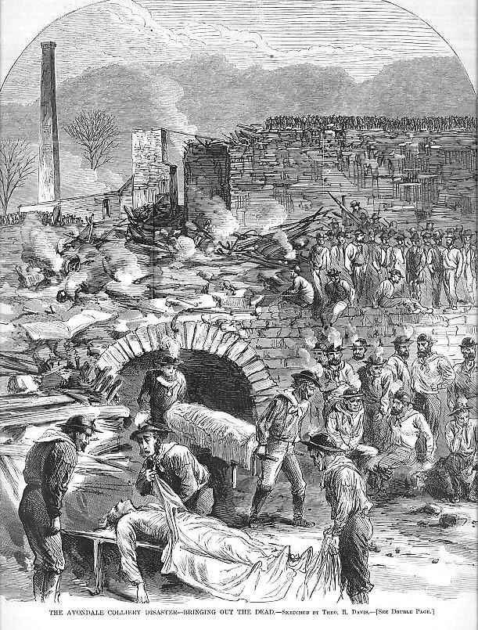
Violence in the Anthracite Coal Regions of Northeast Pennsylvania: 1860s and 1870s

Slide 7
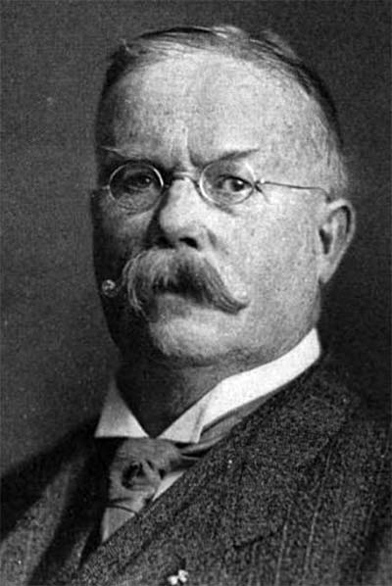
James McParland, Pinkerton Detective
b. 1843 – 18 May 1919

Slide 8
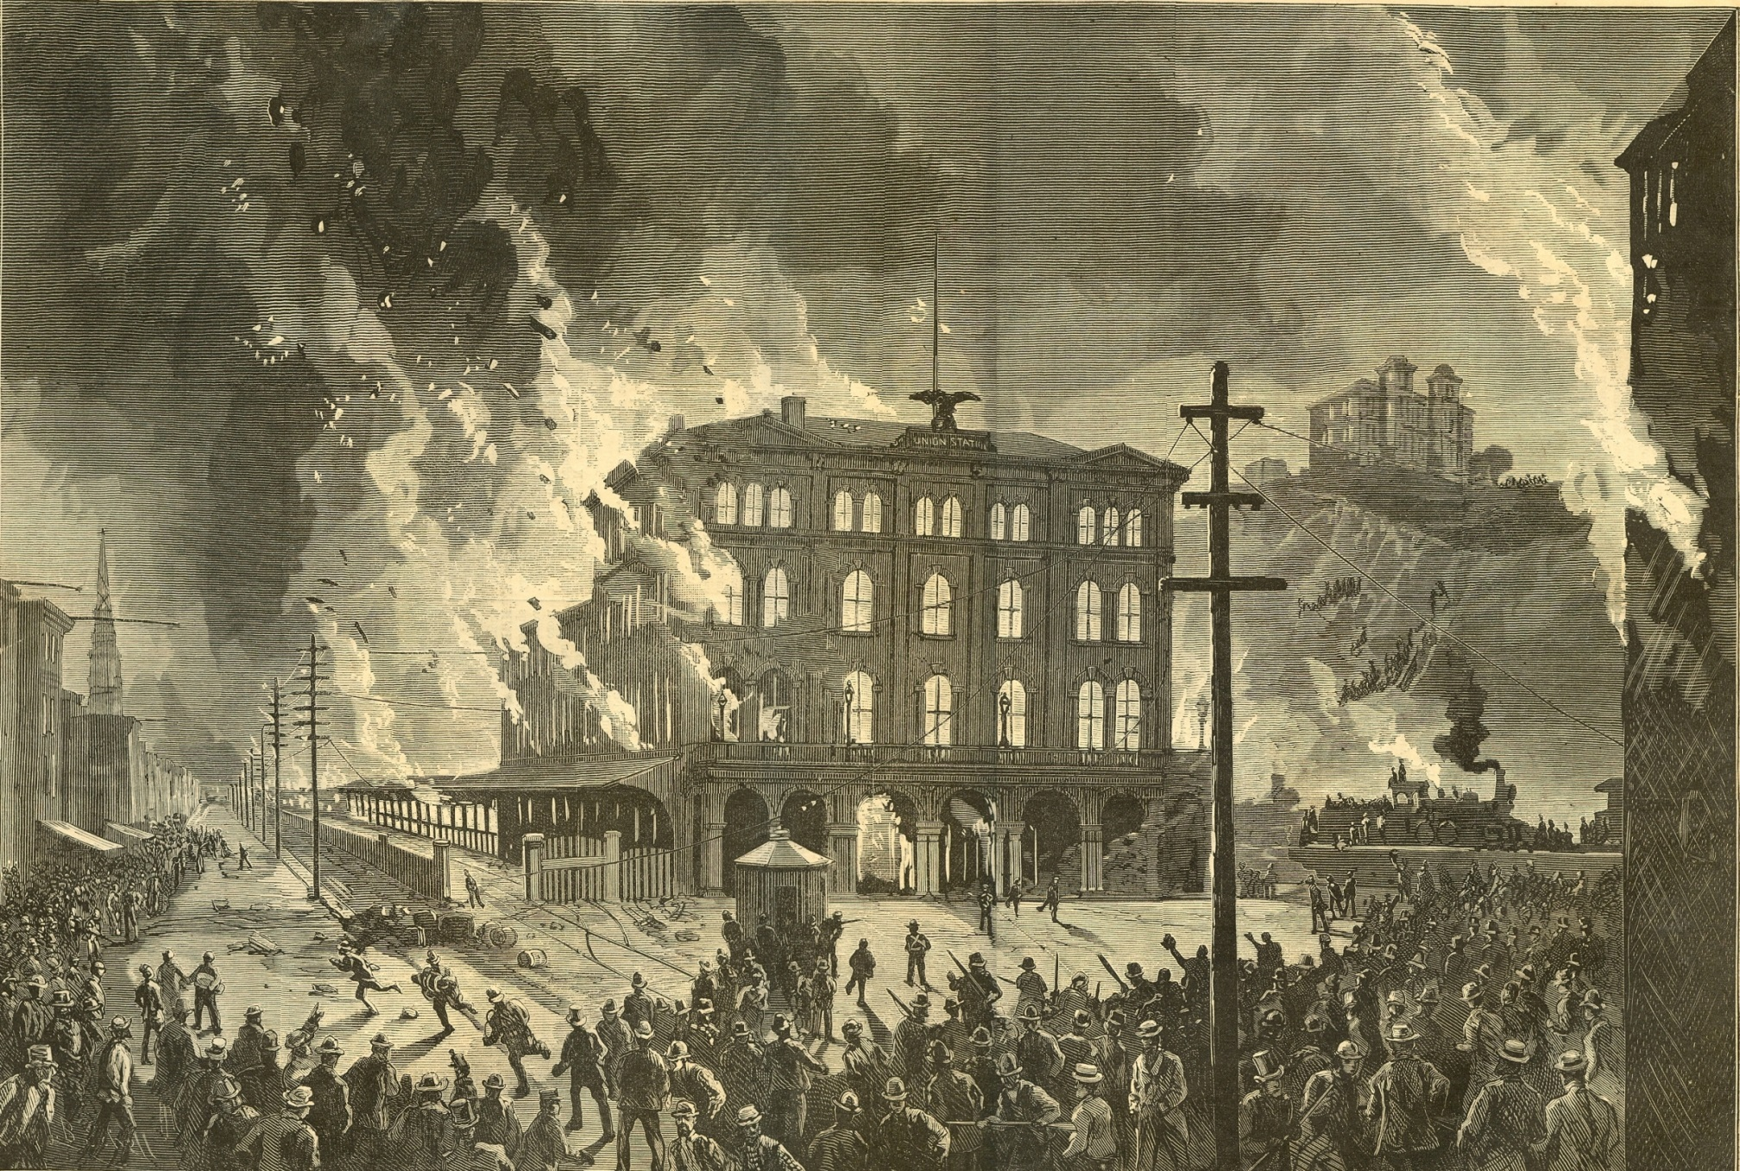
The Railroad Strikes of 1877

Slide 9
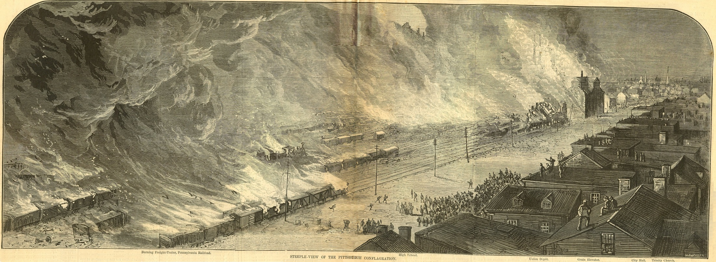
Pittsburgh, PA
Destruction of the Pennsylvania Railroad Facilities

Slide 10
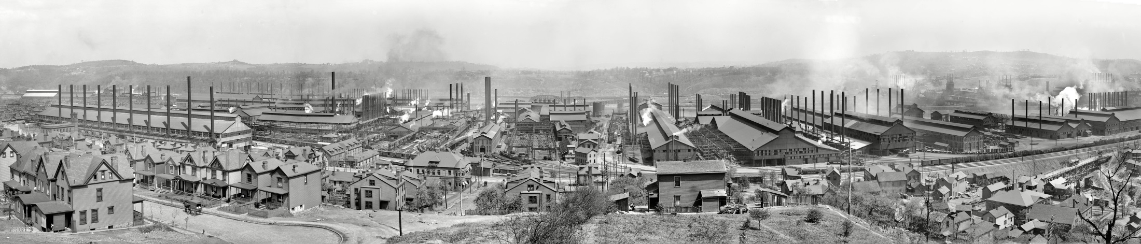
The Homestead Steel Strike of 1892

Slide 11
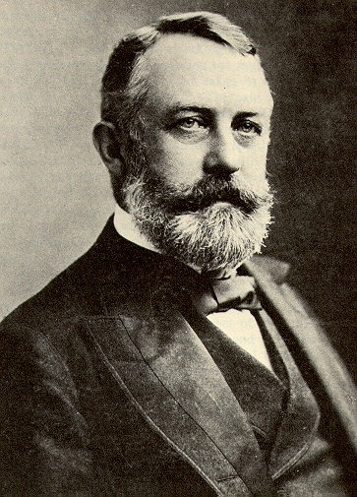
Henry Clay Frick
19 December 1849 – 2 December 1919

Slide 12
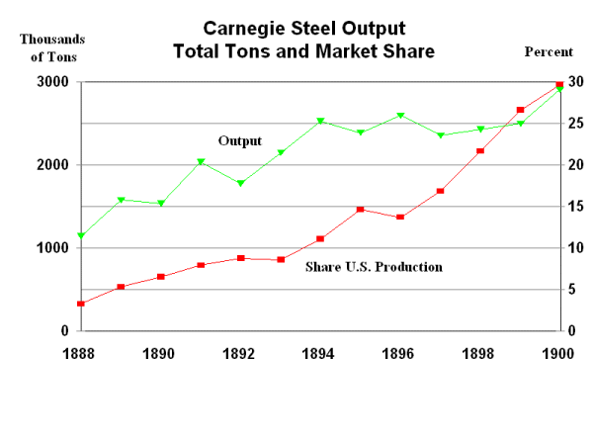

Slide 13
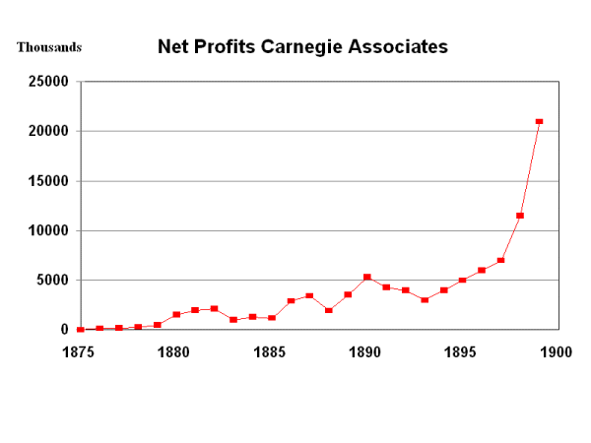

Slide 14
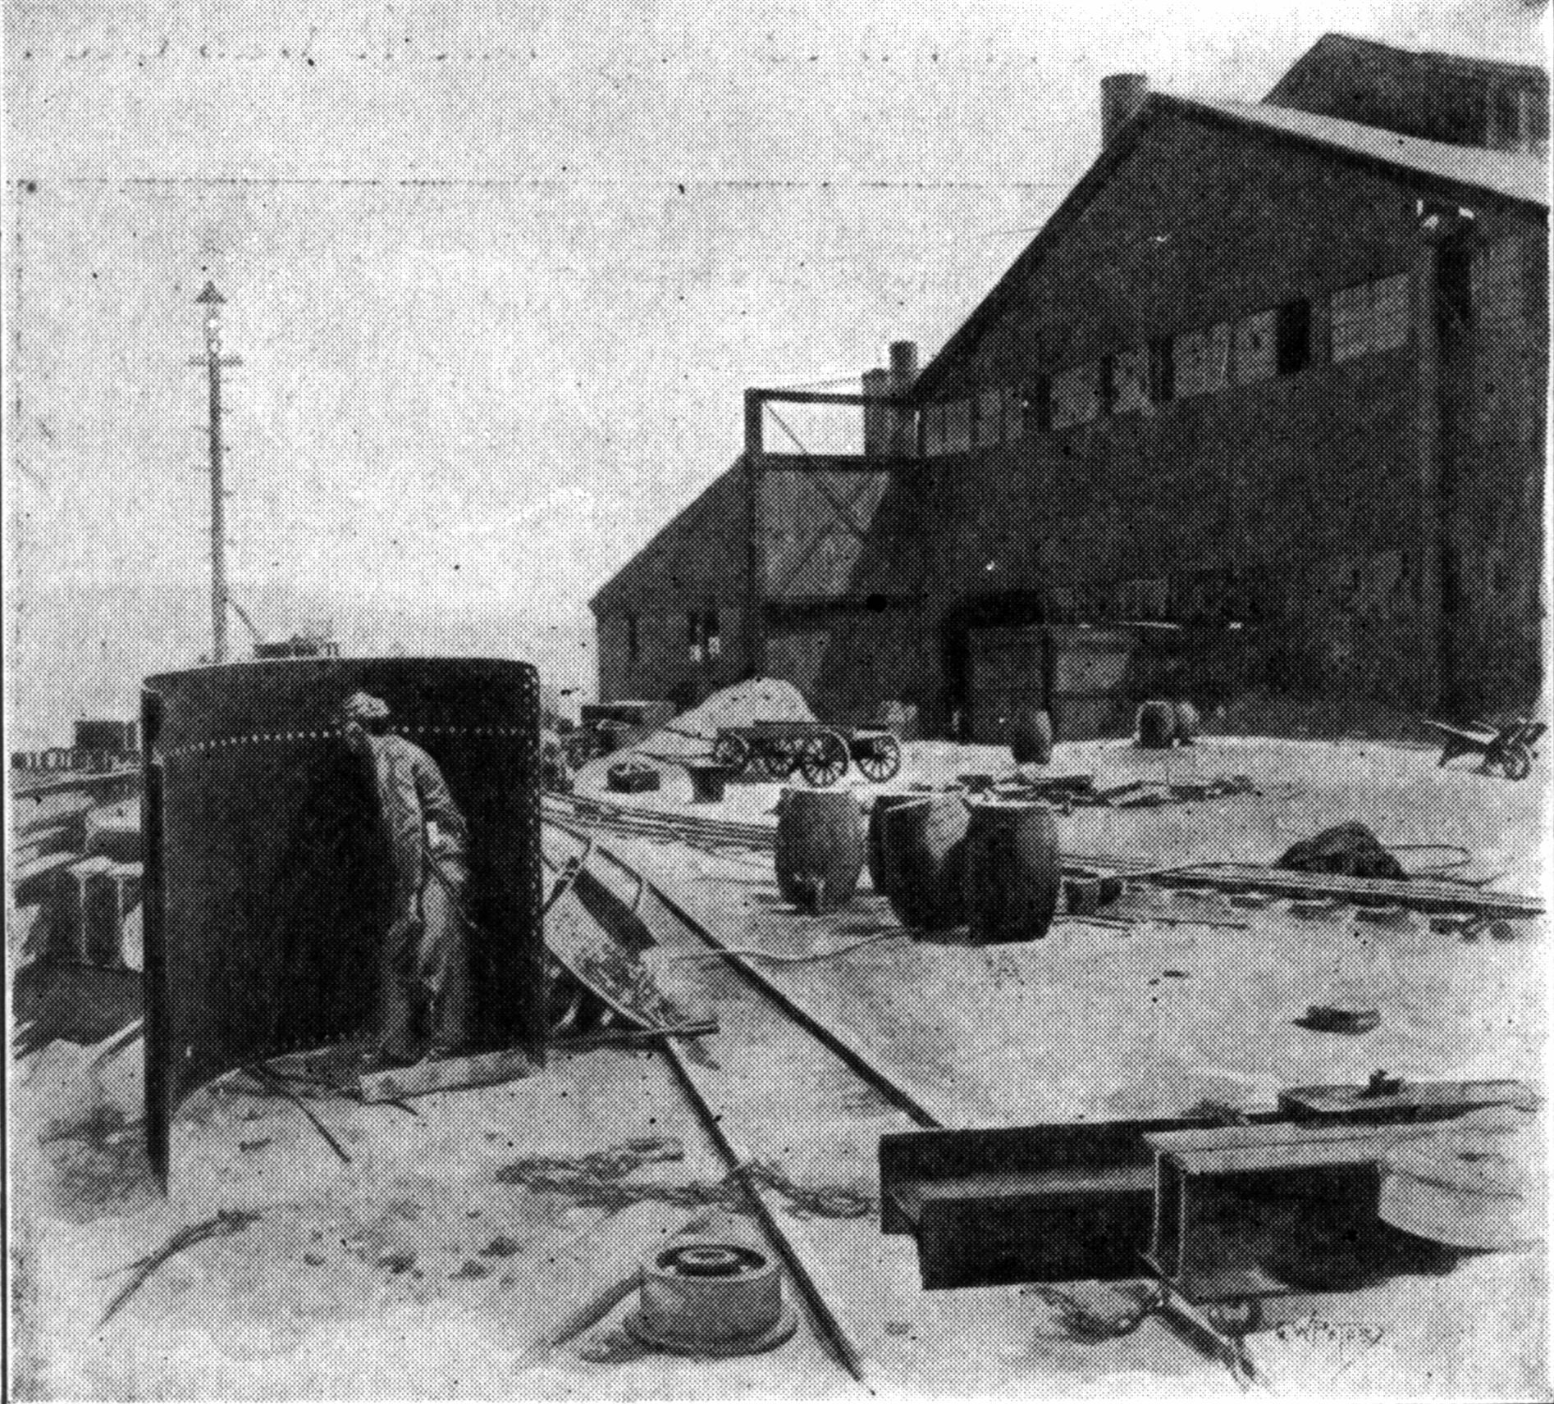
Homestead Workers Hold the High Ground Against the Pinkertons
6 July 1892

Slide 15
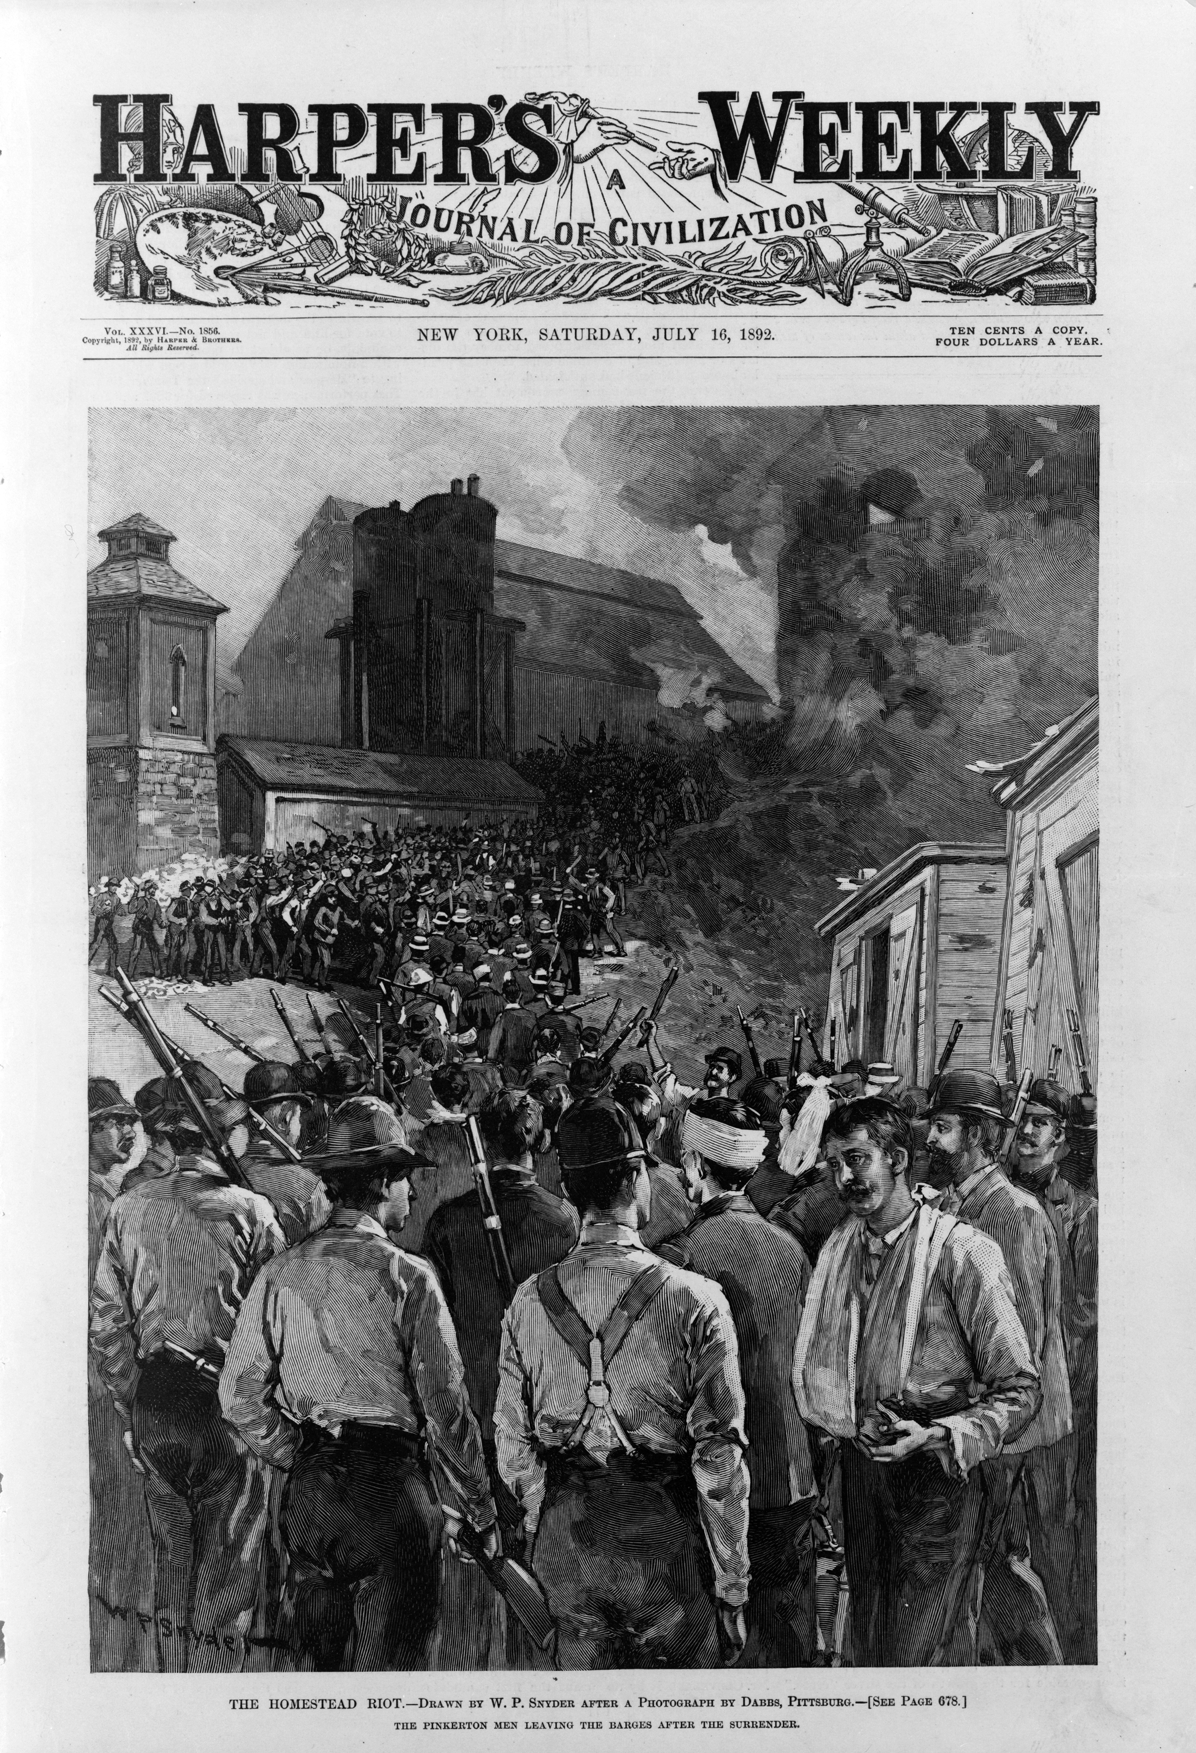
Pinkertons Surrender
7 July 1892

Slide 16
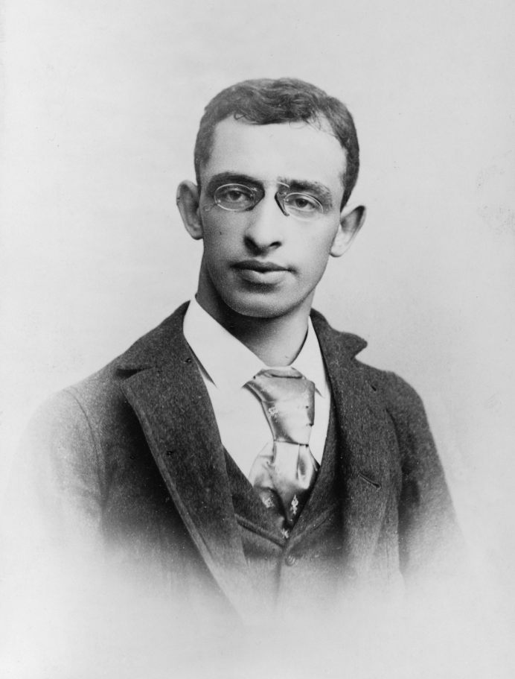
Alexander Berkman
21 November 1870 – 28 June 1936

Slide 17
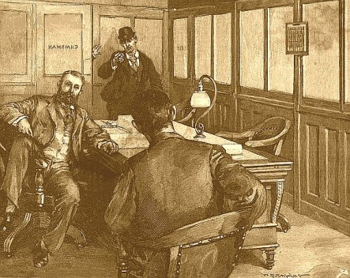
Berkman’s Assassination Attempt on Frick
23 July 1892

Slide 18
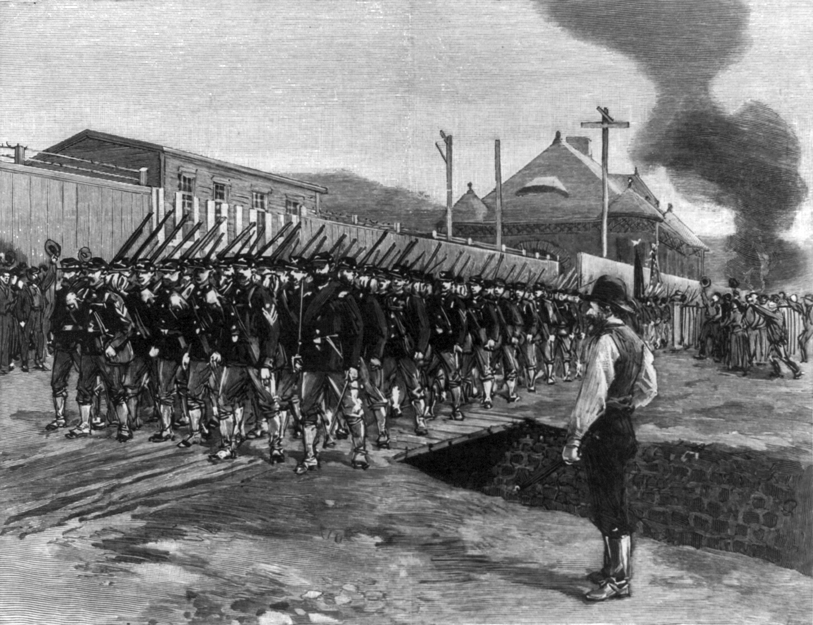
Troops Arrive to Restore Order

