Slide 1
The Second Political Party System: 1856 - 1896
The Economy After the Civil War
Part 1: Overview and the Rise of Coal and Steel Production

Slide 2
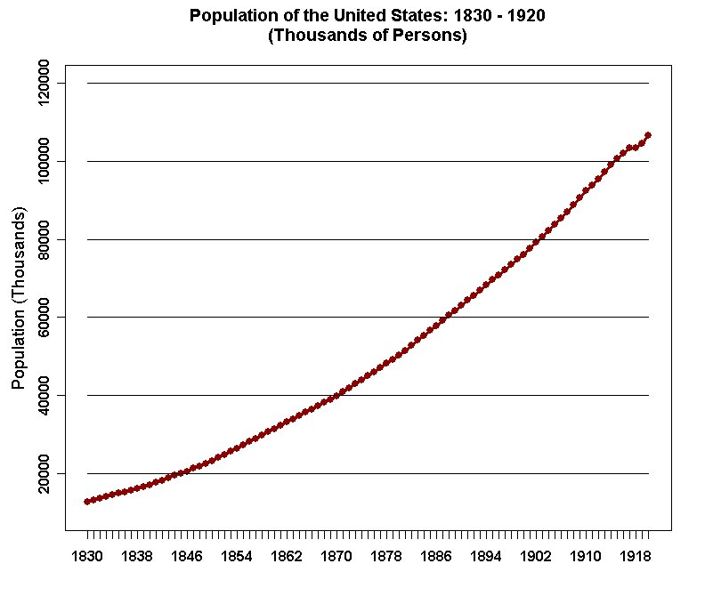

Slide 3


Slide 4
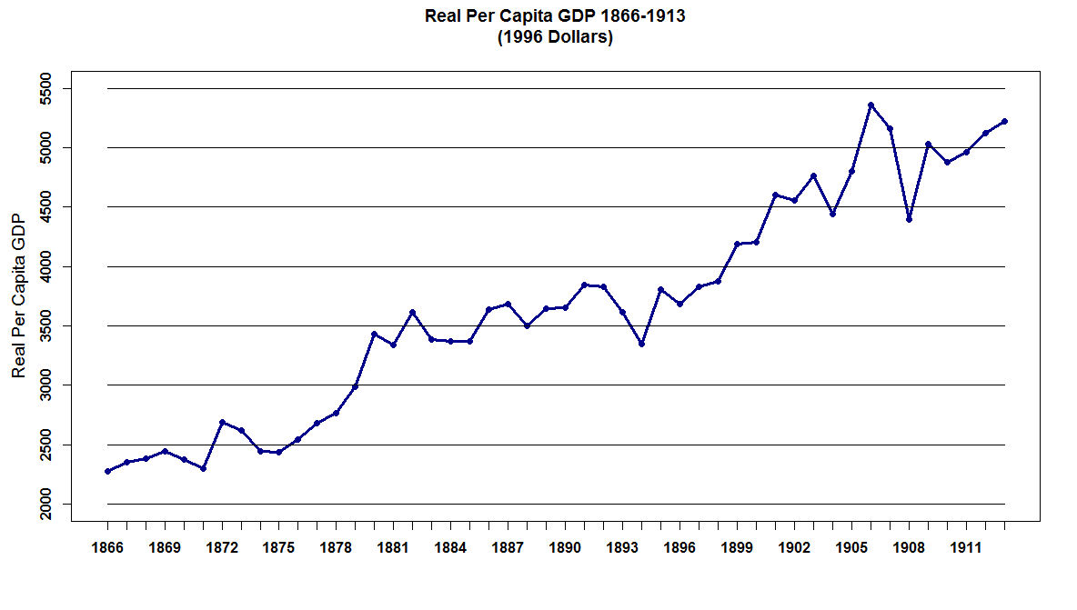

Slide 5
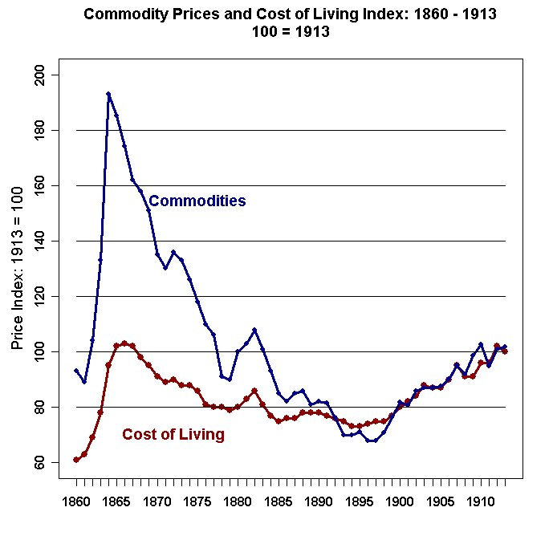

Slide 6
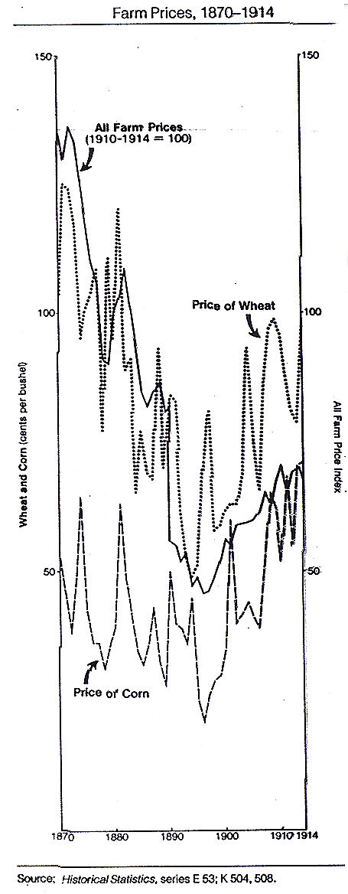

Slide 7


Slide 8
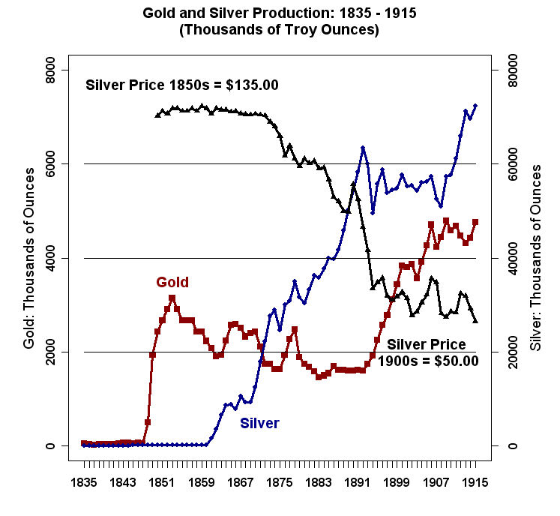

Slide 9
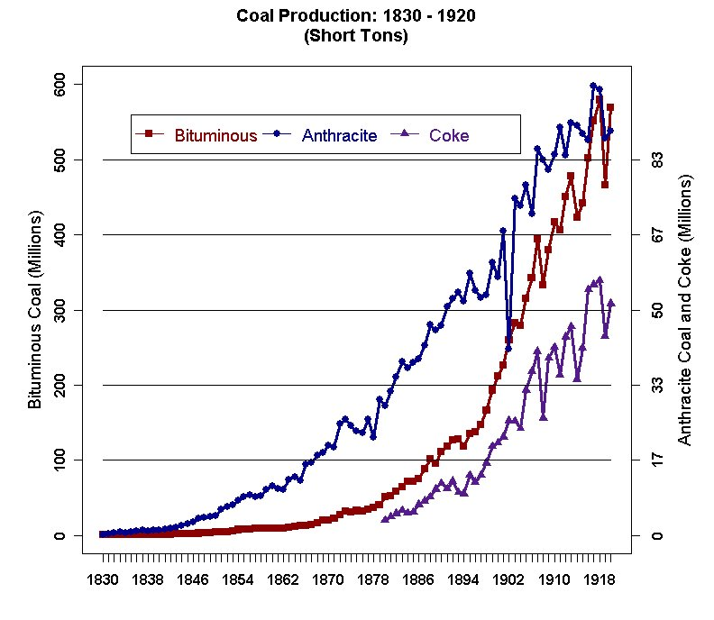

Slide 10
Destructive Distillation of Coal
When coal is heated without air, it does not burn but produces many by-products. This process of heating coal in the absence of air is called destructive distillation of coal.
The main by products are:
coke – Used to make Iron and Steel
coal tar – Used to make a variety of industrial chemicals
amino acids – Used in fertilizers, foods
coal gas – Used for illumination in the 19th Century

Slide 11
Coal gas contains small amount of other gases like ethene (a colorless flammable gas which is widely used in the chemical industry) and hydrogen sulphide (a colorless gas with the characteristic foul odor of rotten eggs; it is heavier than air, very poisonous, corrosive, flammable and explosive; it is used in many industrial processes). Coal Gas usually contains about 10% carbon monoxide, 30% methane and 50% hydrogen.
Coal gas is a potent fuel by virtue of its gaseous components that support combustion. It is also a clean and more efficient fuel than other solid fuels like coal.

Slide 12
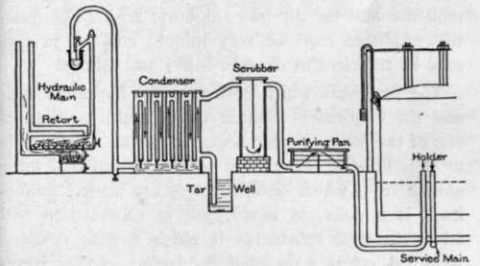
An Early Coal Gas Plant

Slide 13

Street Lamp Powered by Coal Gas

Slide 14
Coal tar can be made to undergo further fractional distillation since it is a mixture of over two hundred substances. Some of the substances that distillates are:
naphthalene
benzene
tuelene
phenol
which are important chemicals used in the synthesis of industrial products like plastics, paints, insecticides, explosives and dyes.

Slide 15
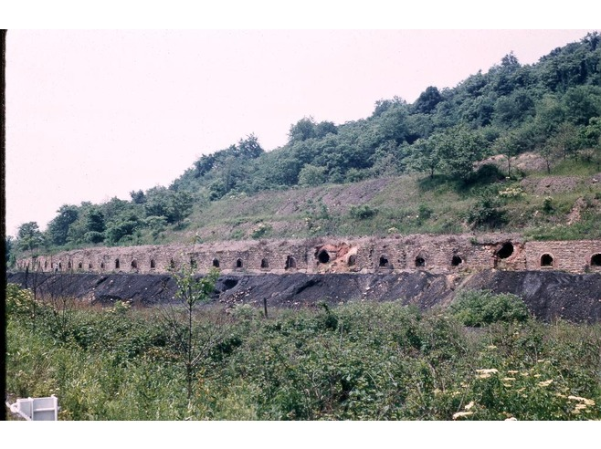
Beehive Coke Ovens Near Connellsville, PA

Slide 16
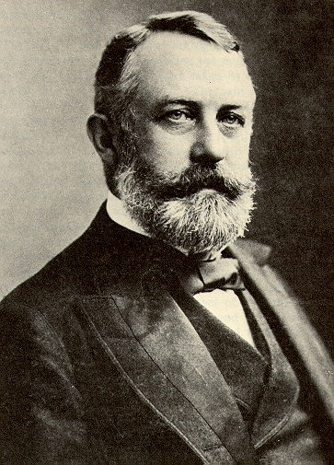
Henry Clay Frick
19 December 1849 – 2 December 1919

Slide 17
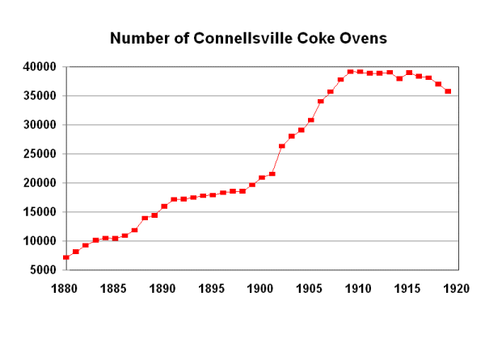

Slide 18
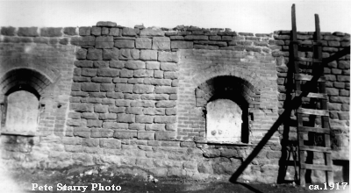
Beehive Coke Ovens Near Connellsville, PA

Slide 19
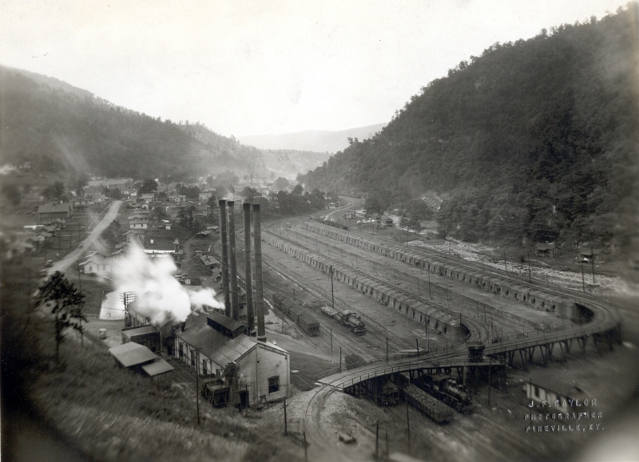
A Large Coke Plant in Kentucky in the Early 20th Century.

Slide 20
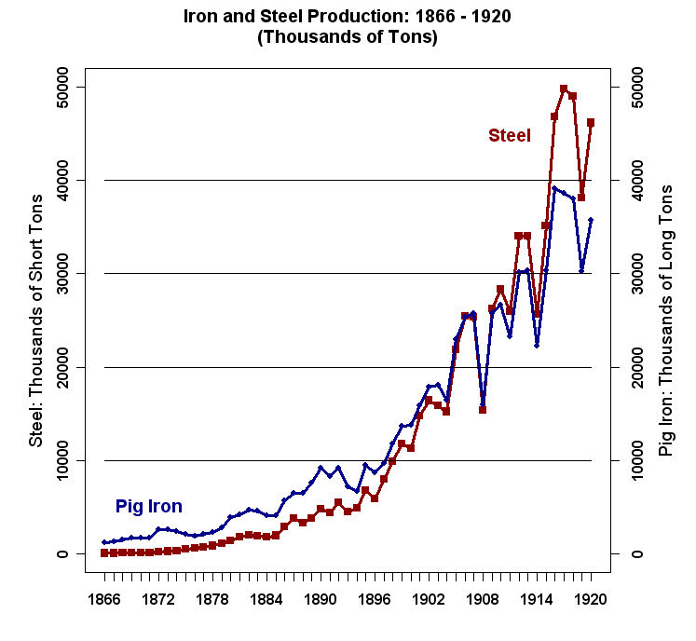

Slide 21
Pig iron is the intermediate product of smelting iron ore with a high-carbon fuel such as coke, usually with limestone as a flux. Pig iron has a very high carbon content, typically 3.5–4.5%, which makes it very brittle and not that useful as a material except for limited applications.

Slide 22
The traditional shape of the molds used for these ingots was a branching structure formed in sand, with many individual ingots at right angles to a central channel or runner. Such a configuration is similar in appearance to a litter of piglets suckling on a sow. When the metal had cooled and hardened, the smaller ingots (the pigs) were simply broken from the much thinner runner (the sow), hence the name pig iron. As pig iron is intended for remelting, the uneven size of the ingots and inclusion of small amounts of sand was insignificant compared to the ease of casting and of handling.

Slide 23
Steel is iron that has most of the impurities removed. Steel also has a consistent concentration of carbon throughout (0.5 to 1.5 percent). Impurities like silica, phosphorous and sulfur weaken steel tremendously, so they must be eliminated. The advantage of steel over iron is greatly improved strength.

Slide 24
The terminology relating to the classification of different steel types is not precise. Broadly speaking steels are described as:
Mild Steels up to 0.3% Carbon
Medium Carbon Steels (or simply Carbon Steels) 0.3 to 0.6 % carbon
High Carbon Steels over 0.6% Carbon
If the Carbon Content is too high then you get Cast Iron which is very brittle.

Slide 25
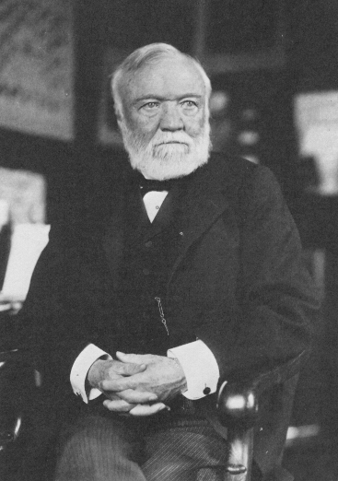
Andrew Carnegie
25 November 1835 – 11 August 1919

Slide 26
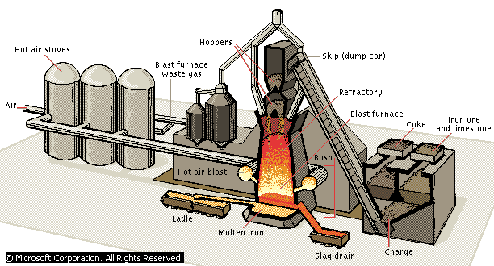

Slide 27
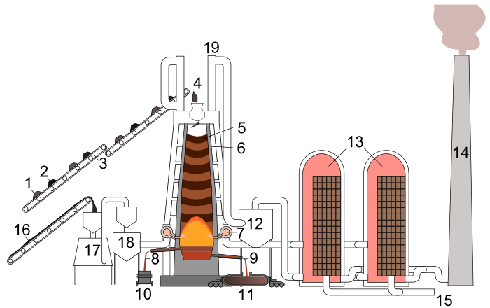
Blast Furnace

Slide 28
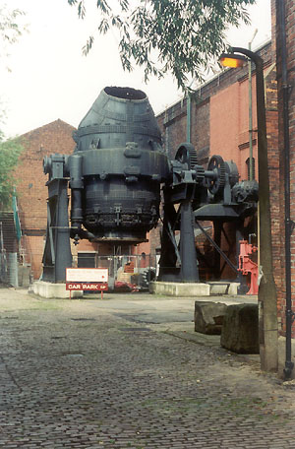
A Bessemer Converter On Display in England

Slide 29
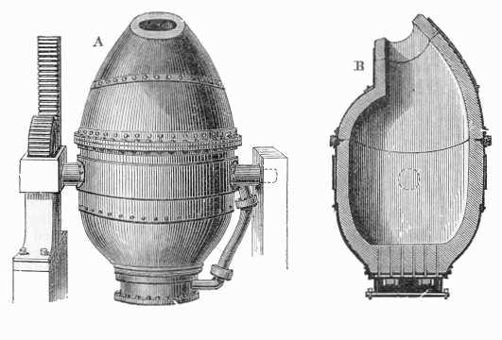
Cross-Section of a Bessemer Converter

Slide 30
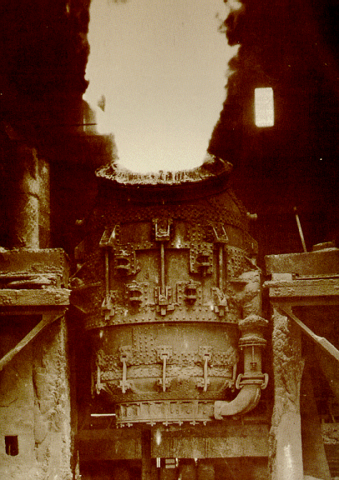
Bessemer Converter Under Blast

Slide 31
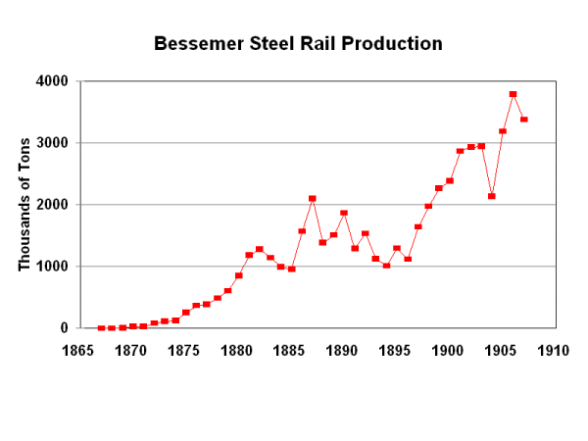

Slide 32
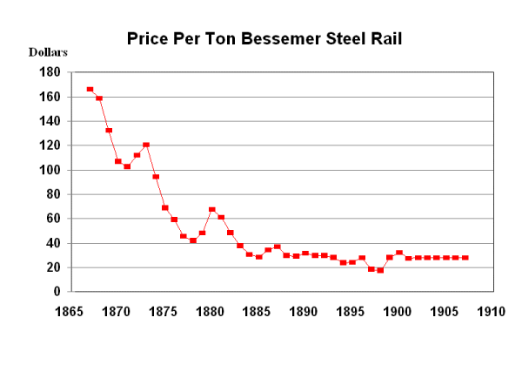

Slide 33
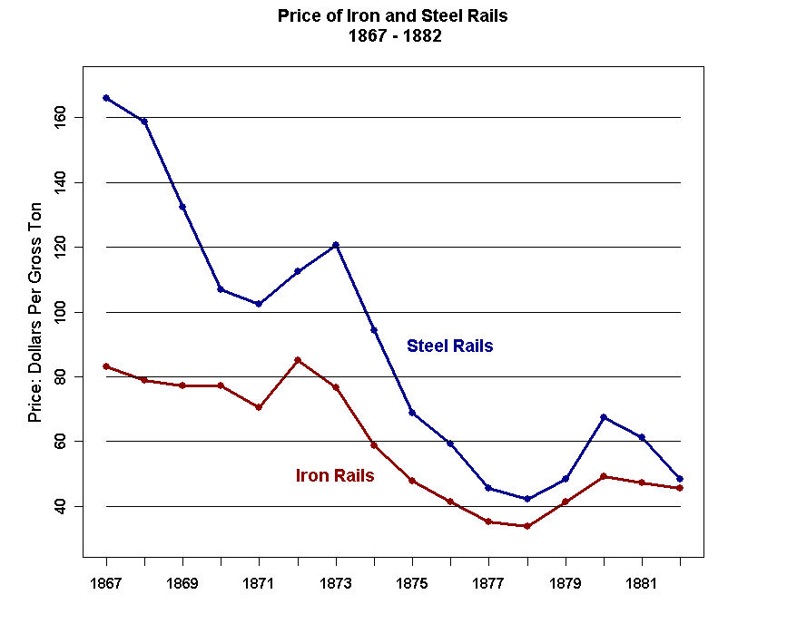

Slide 34
