Slide 1
The Second Political Party System: 1856 - 1896
The Economic Costs of The Civil War

Slide 2
DIMENSIONS OF THE WAR
1) Largest Land Armies assembled in Human history -- by 1863 the North had 1,000,000 men under arms and the South 650,000. 2) Battles involving over 100,000 men were commonplace and some reached 200,000. 3) In one day, nearly 5,000 men were killed at Antietam and 20,000 wounded. It is still the most American soldiers killed in one day. 4) Total Dead: 360,000 North + 258,000 South = 618,000 with at least 500,000 wounded.

Slide 3
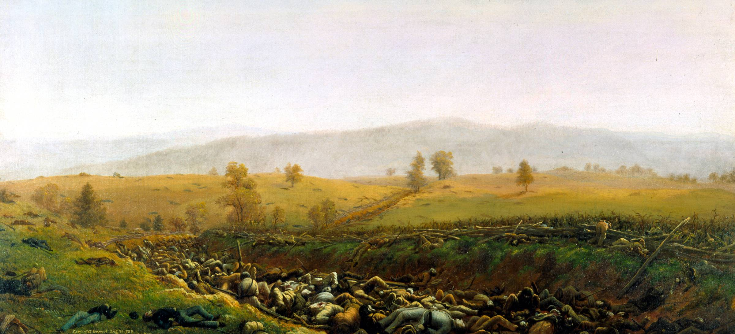
The Aftermath at Bloody Lane by Captain James Hope

Slide 4
Direct Costs of the War for North & South
Direct Cost = All War Spending by Government + Destroyed Physical Capital + Destroyed Human Capital.
Summary of Direct Costs (From Goldin and Lewis)
NORTH SOUTH
Government 2,292 1,011
Draft 11(162,000 men) 20(300,000 men)
Physical Capital Destruction -- 1,487
Human Capital
Destruction: Killed 955 684
: Wounded 365 261
Risk Premiums -256 -178
TOTAL $3.367b $3.285b
GRAND TOTAL $6,652,000,000

Slide 5
Magnitude of Direct Costs: 4 times all government expenditures, 1789 to 1860; 17 times 1860 export earnings; could have purchased all the Slaves at prevailing market prices, given each family 40 acres and a mule, and still have $3.5 billion left over.

Slide 6
Indirect Costs: Hypothetical (consumption if no War) versus actual consumption over time discounted by prevailing interest rate. This shows that the costs for the North were $5.2b and the South $9.5b for a total of $14.7b.

Slide 7
Long-Run Impact of the War on American Life
The North Became an Industrial Superpower -- The Northern United States became the largest Economy in the World in 1892
The South Became a Third World Country within the Geographic Boundaries of the United States. No Significant Economic Activity until Oil was Struck at Spindletop, Texas, on 10 January 1901.

Slide 8
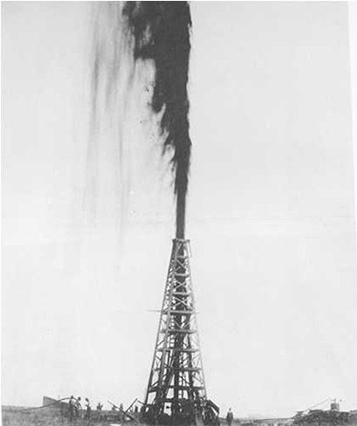
The Discovery of Oil at Spindletop, Texas, 10 January 1901

Slide 9
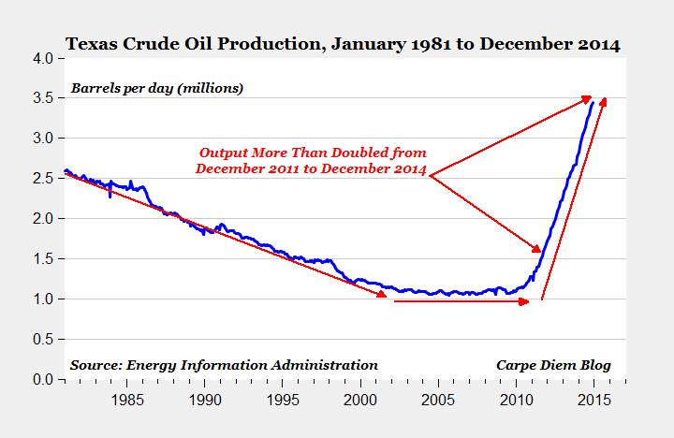

Slide 10
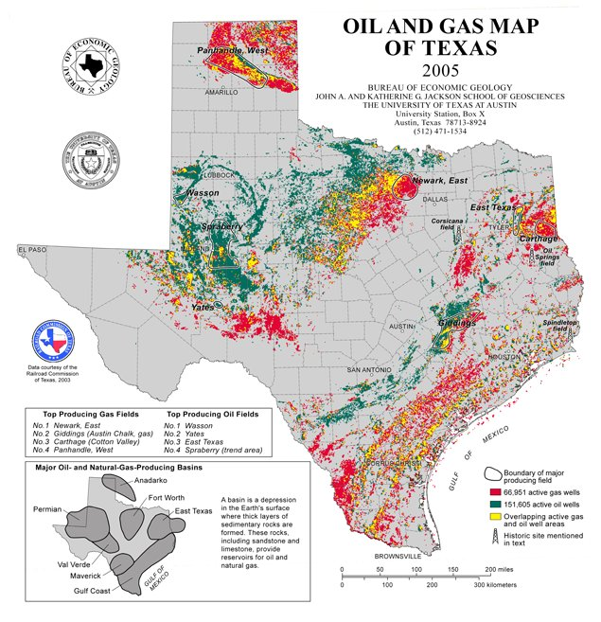

Slide 11
Presidential Elections: 1864 - 1896
Democrat Republican
---------------------------------------------------------------------------
1864 McClellan 21 1,836,072 44.91 Lincoln 212 2,220,846 55.08*
1868 Seymour 80 2,708,744 47.29 Grant 214 3,013,650 52.70*
1872 Greeley --- 2,835,315 43.82 Grant 286 3,598,468 55.63*
1876 Tilden 184 4,288,191 51.01* Hayes 185 4,033,497 47.87
1880 Hancock 155 4,445,526 48.21 Garfield 214 4,453,611 48.31
1884 Cleveland 219 4,915,586 48.49 Blaine 182 4,852,916 48.26
1888 Cleveland 168 5,539,118 48.68 Harrison 233 5,449,825 47.79
1892 Cleveland 277 5,554,617 46.07 Harrison 145 5,186,793 42.92
1896 Bryan 176 6,370,897 46.70 McKinley 271 7,105,144 51.02*
---------------------------------------------------------------------------

Slide 13
