Slide 1
The First Political Party System: 1829 - 1852
The Crisis Over the Extension of Slavery to the Territories

Slide 2
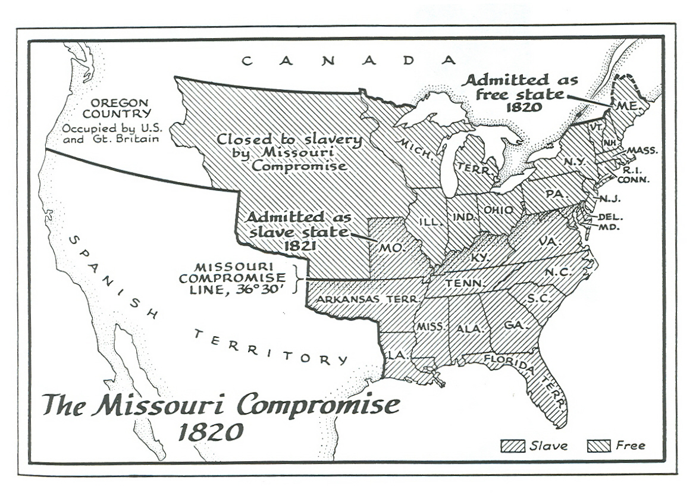

Slide 3
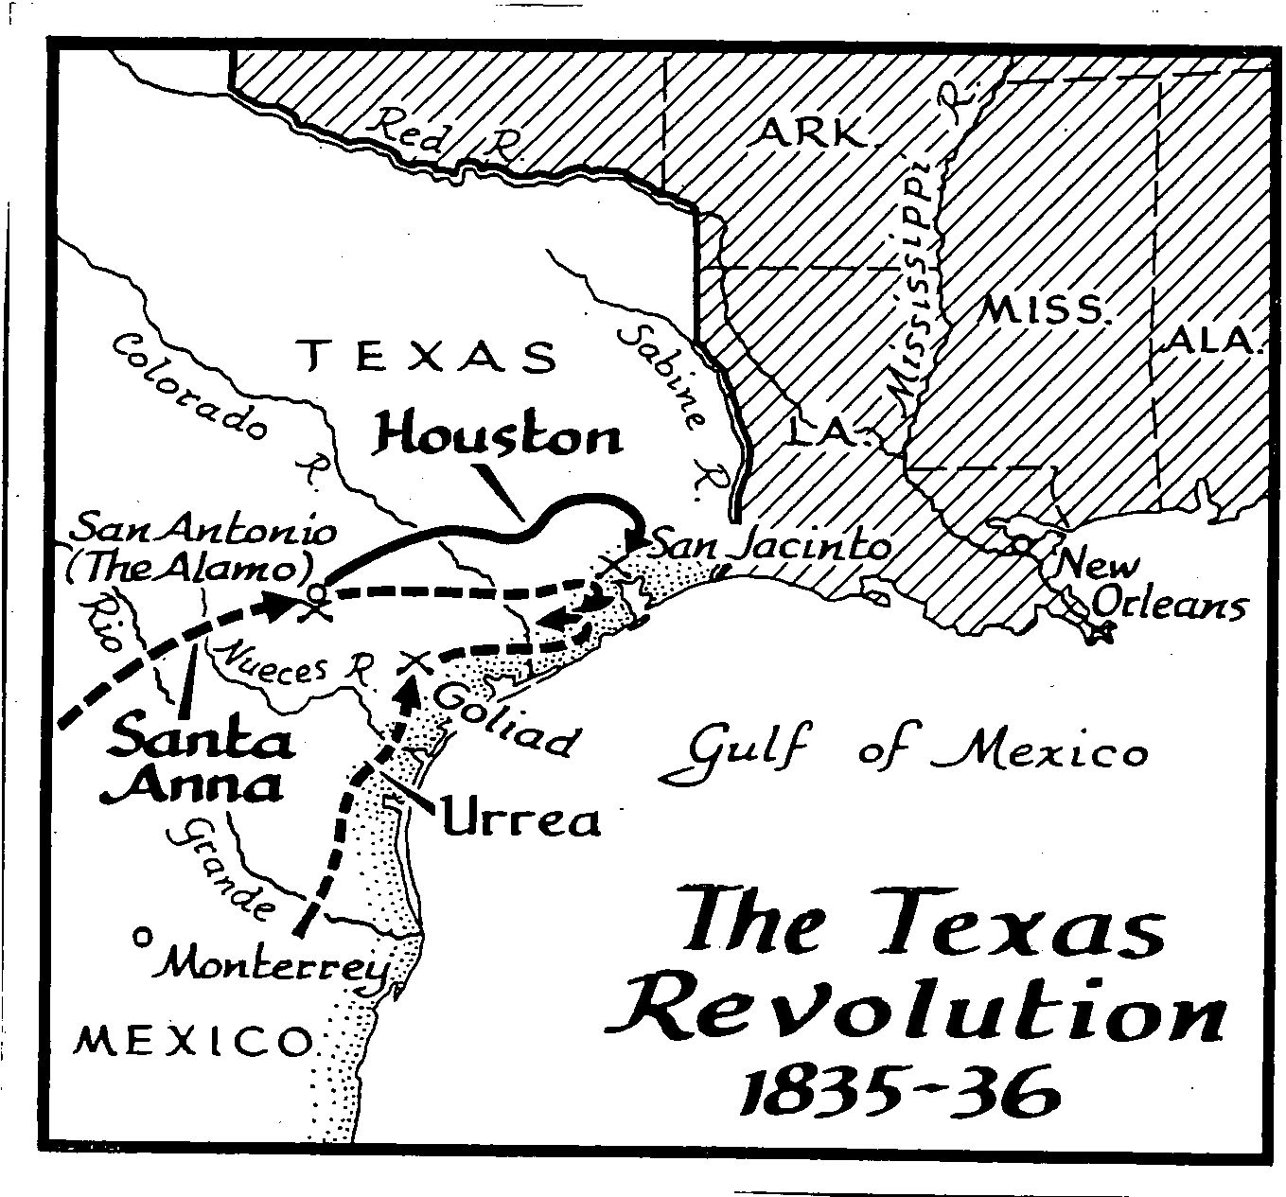

Slide 4
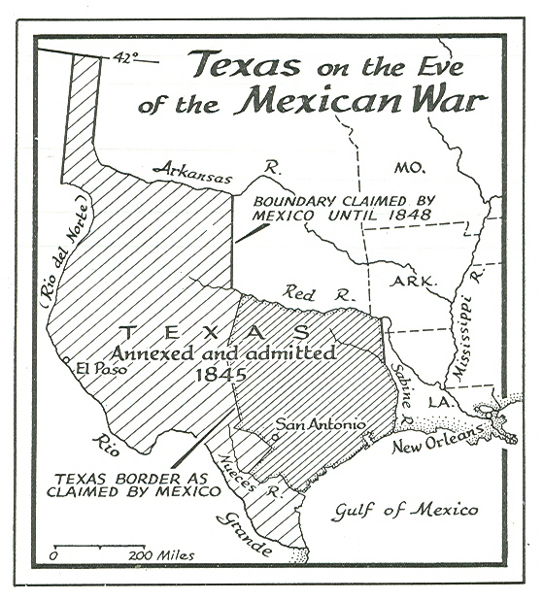

Slide 5
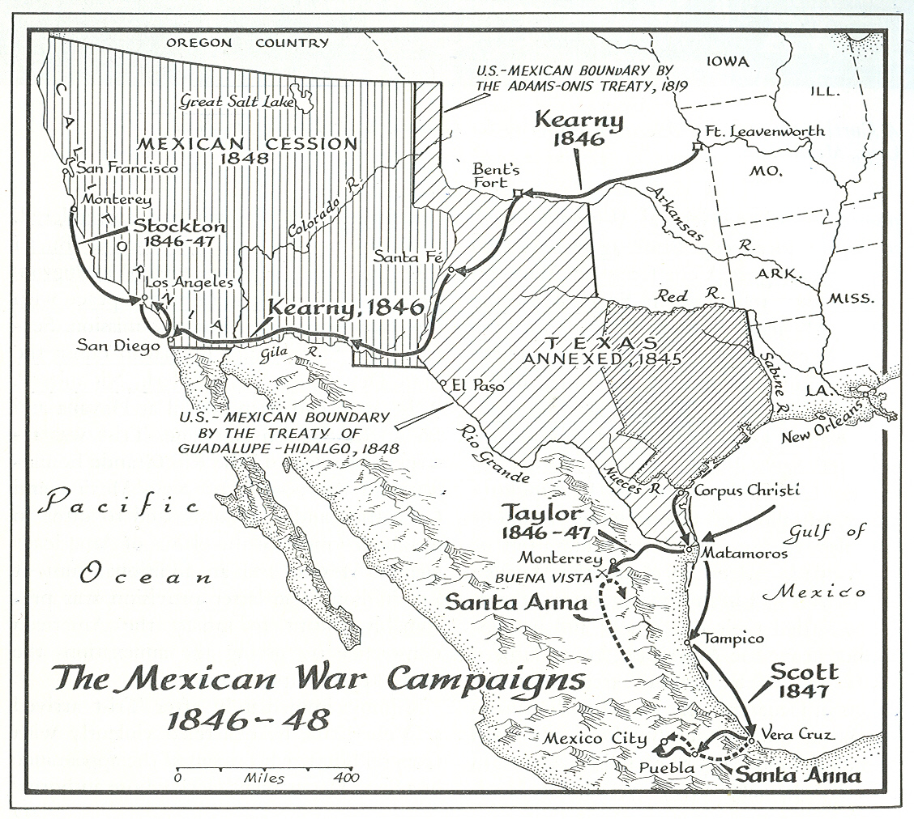
The War with Mexico -- 13 May 1846 to 13 January 1847

Slide 6
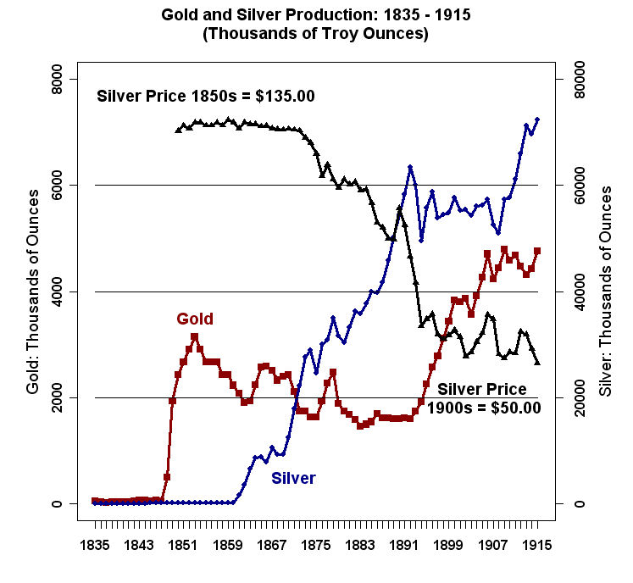

Slide 7
THE COMPROMISE OF 1850
California to be Admitted as a Free State – 24 January 1848 Gold Discovered in California at Sutter’s Mill.
b. Part of Texas Given to the New Mexico Territory in exchange for the U.S. assuming its public debt.
c. The Slave Trade was Abolished in the District of Columbia.
d. A Fugitive Slave Law.
e. Utah and New Mexico Were Organized as Territories – Popular Sovereignty.

Slide 8
The Compromise of 1850 – Passed by a Coalition of Northern and Southern Democrats + Southern Whigs. Northern Whigs either opposed or abstained in the voting. Key Supporters: Henry Clay (Whig-KY), Stephen A. Douglas (Dem-IL), Daniel Webster (Whig-MA), Millard Fillmore (Whig, Vice-President and President as of 9 July 1850).

Slide 9
Opposed, Zachary Taylor (Whig), President (died, 9 July 1850), Jefferson Davis (Dem-MS), William Seward (Whig/Free Soil-NY), Salmon P. Chase (Free Soil-OH), Charles Sumner (Free Soil-MA), John C. Calhoun (Dem-SC) – Made speech against and shortly thereafter died, 31 March 1850 (Vice President under John Quincy Adams and Andrew Jackson’s first term).

Slide 10
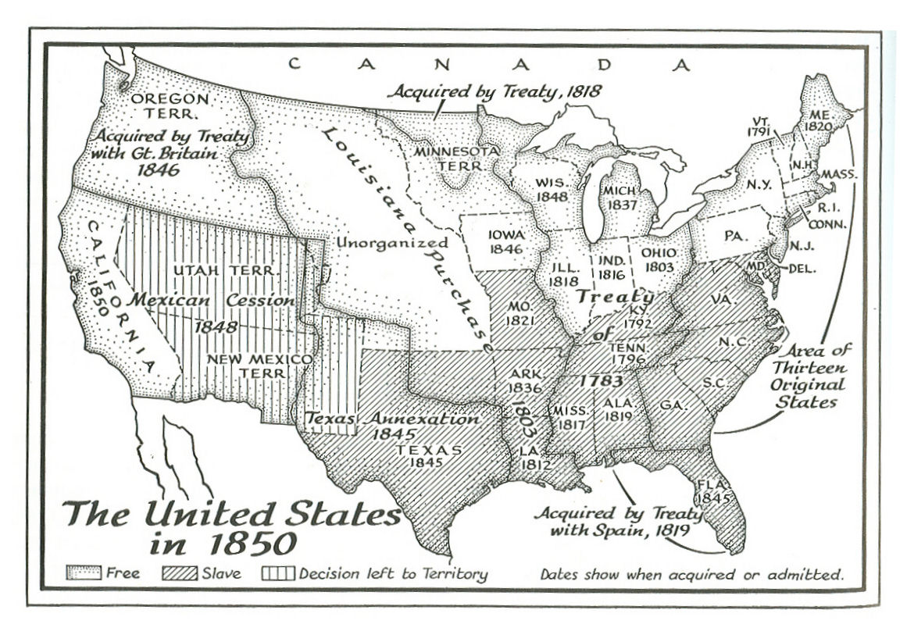

Slide 11
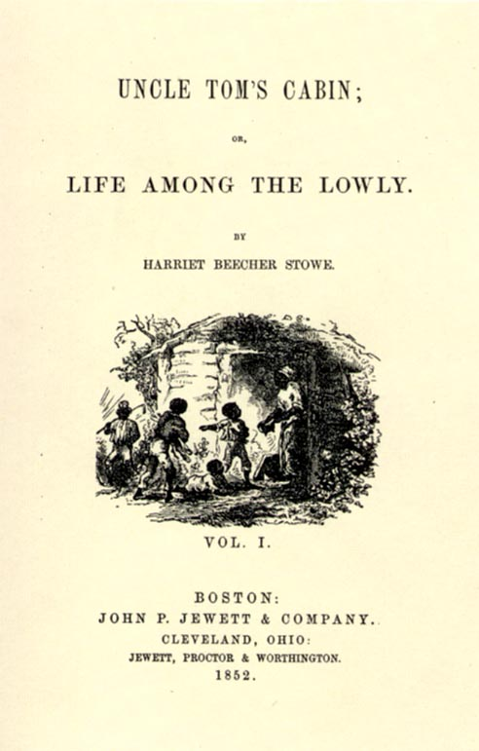
The Publication of Uncle Tom's Cabin in 1852. Written by Harriet Beecher Stowe,
it sold 300,000 copies during its first year of publication. It was turned into a
stage play that was performed throughout the North. It helped fuel Northern
Resistance to the Fugitive Slave Law.

Slide 12
Stephen A. Douglas and the Kansas-Nebraska Act of 30 May 1854.
The Kansas-Nebraska Act Repealed the Missouri Compromise of 1820 and declared "that all questions pertaining to slavery in the territories, and in the new States to be formed there from, are to be left to the people residing therein, through their appropriate representatives." It organized the Kansas and Nebraska Territories.

Slide 13
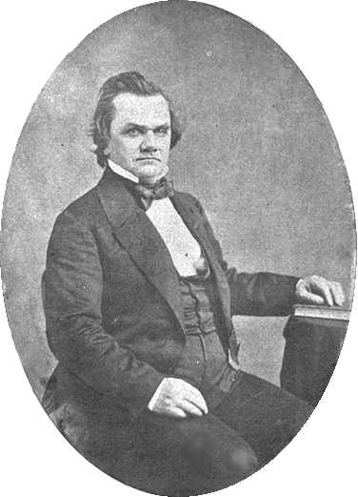
Stephen A. Douglas, 23 April 1813 – 3 June 1861

Slide 14
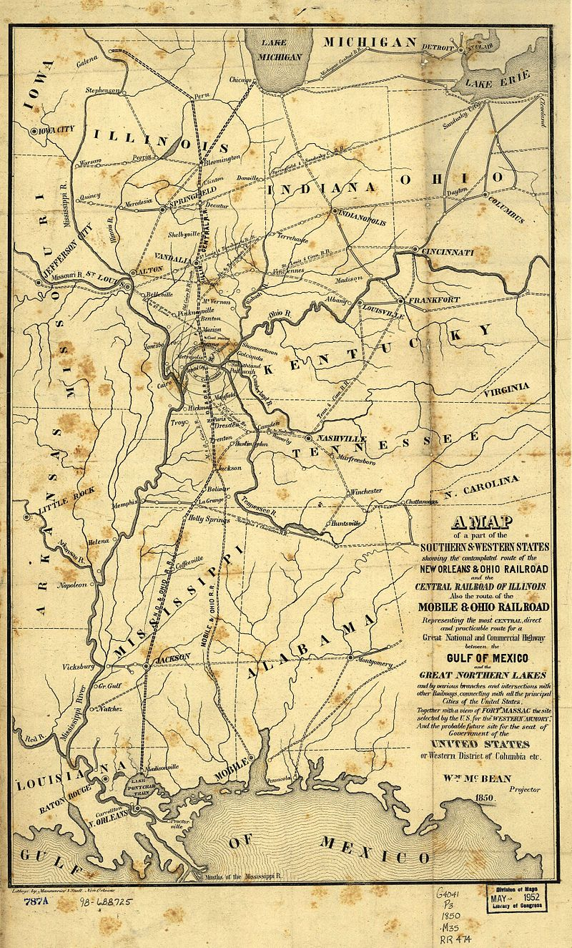
1850 Map of the Proposed Route of the Illinois Central Railroad

Slide 15
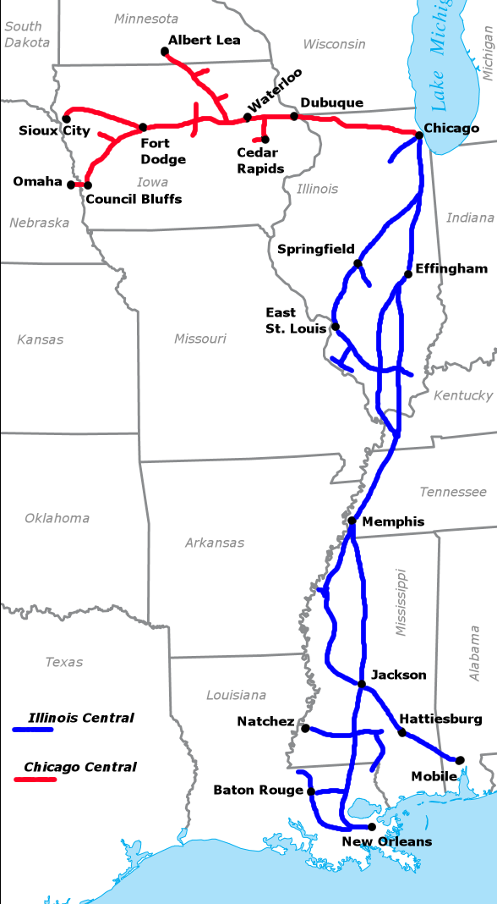
Illinois Central Railroad

Slide 16
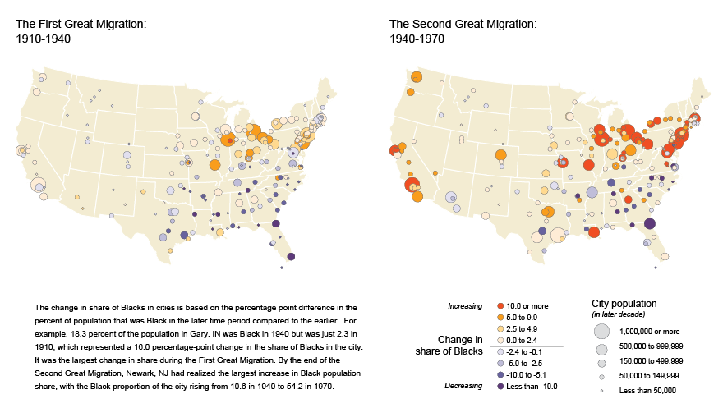

Slide 17
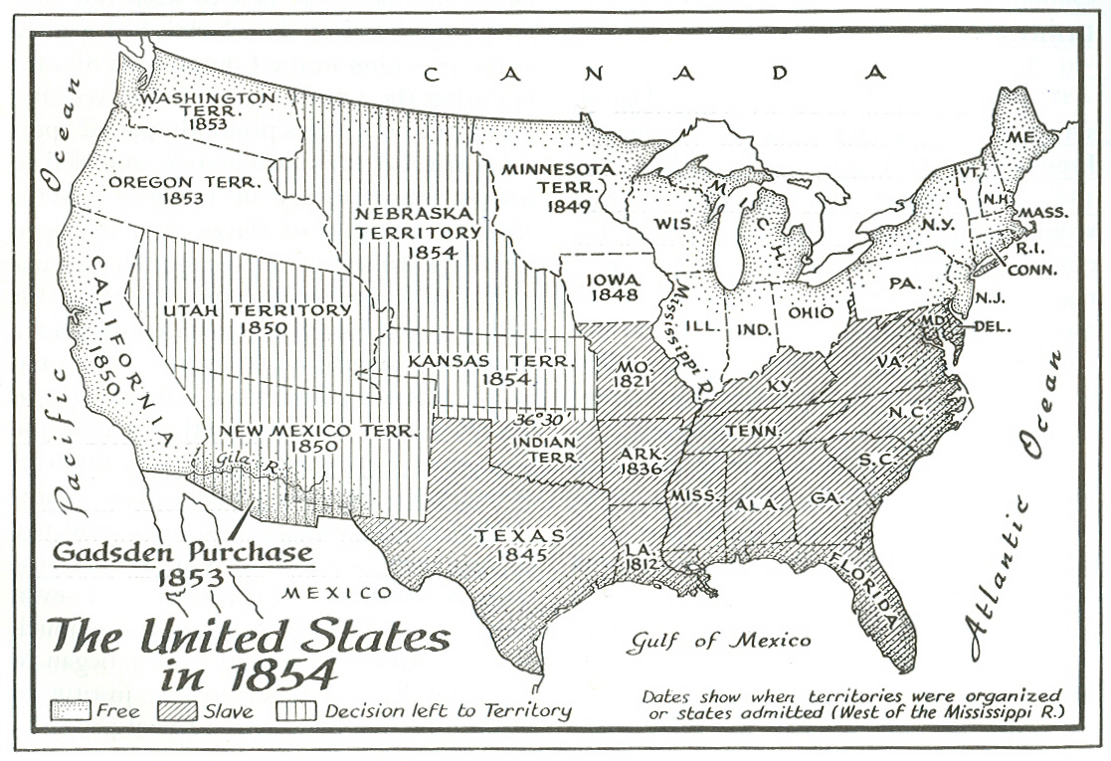

Slide 18
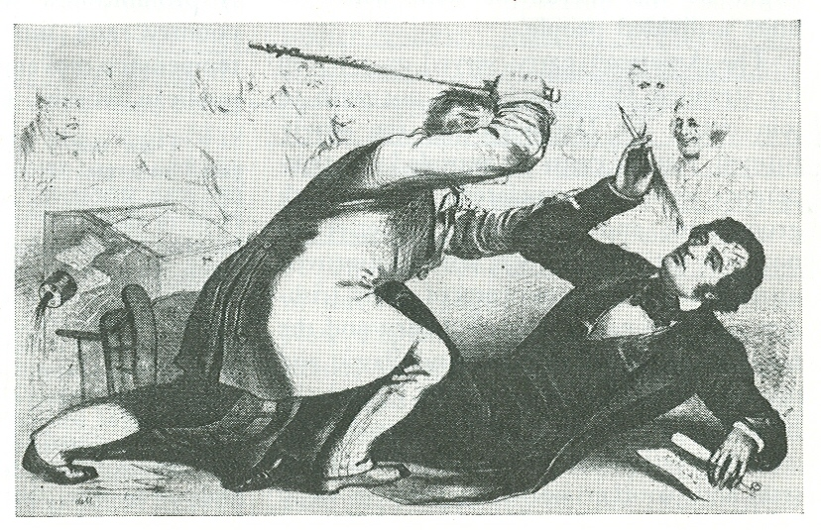
Preston (Bully) Brooks' Attack on Charles Sumner
on the Senate Floor on 22 May 1856 after Sumner's two day speech "The Crime Against Kansas."

Slide 19
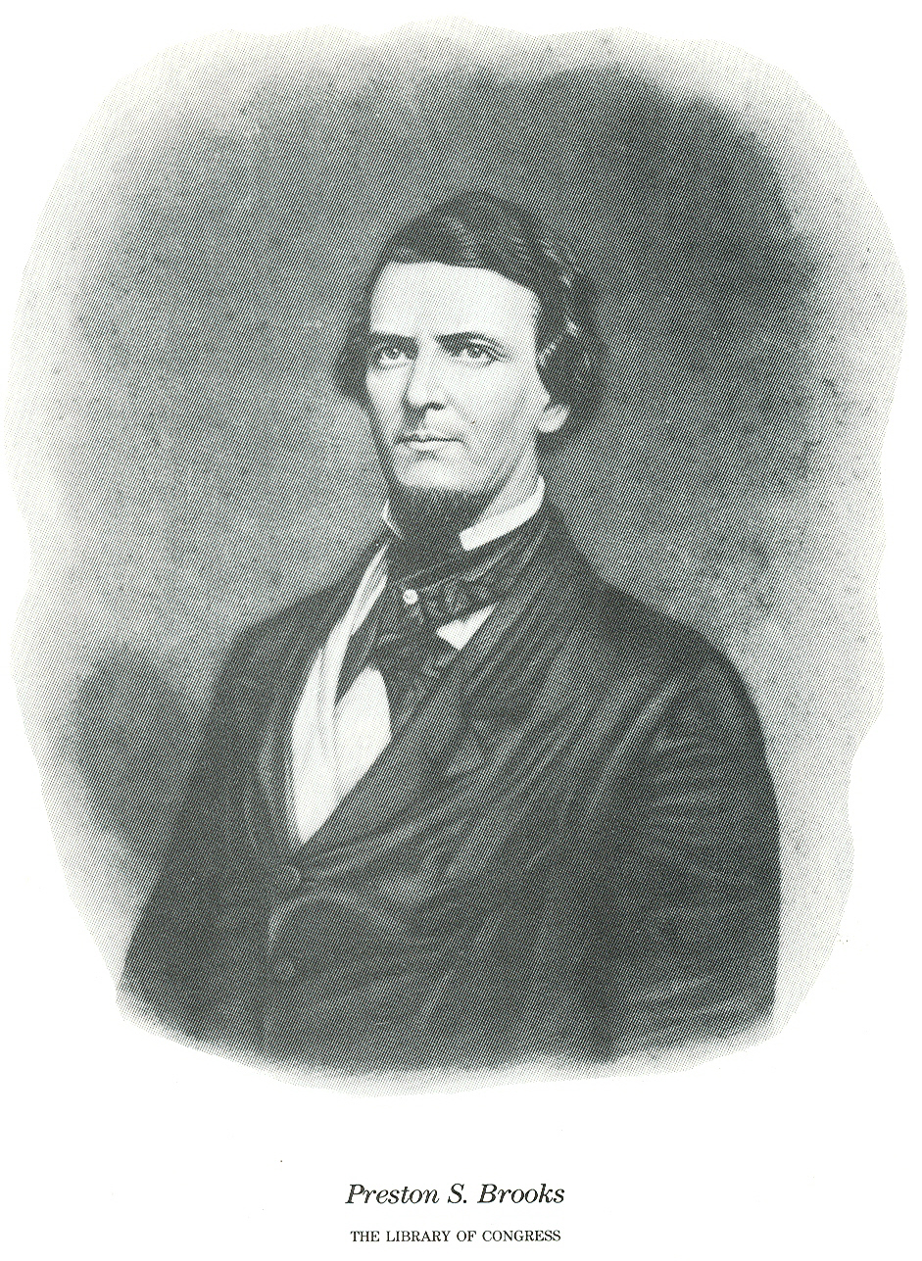
5 August 1819 – 27 January 1857

Slide 20
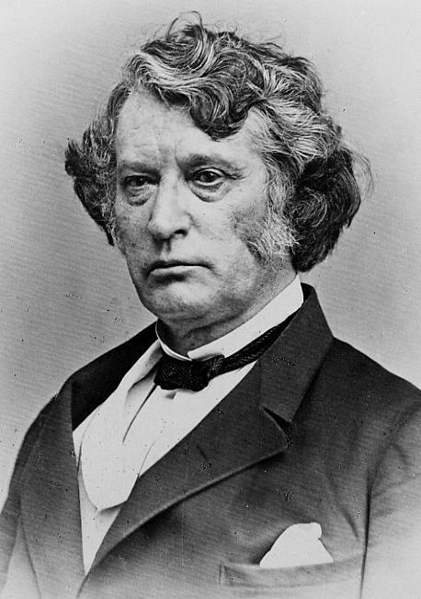
Charles Sumner, 6 January 1811 – 11 March 1874

Slide 21
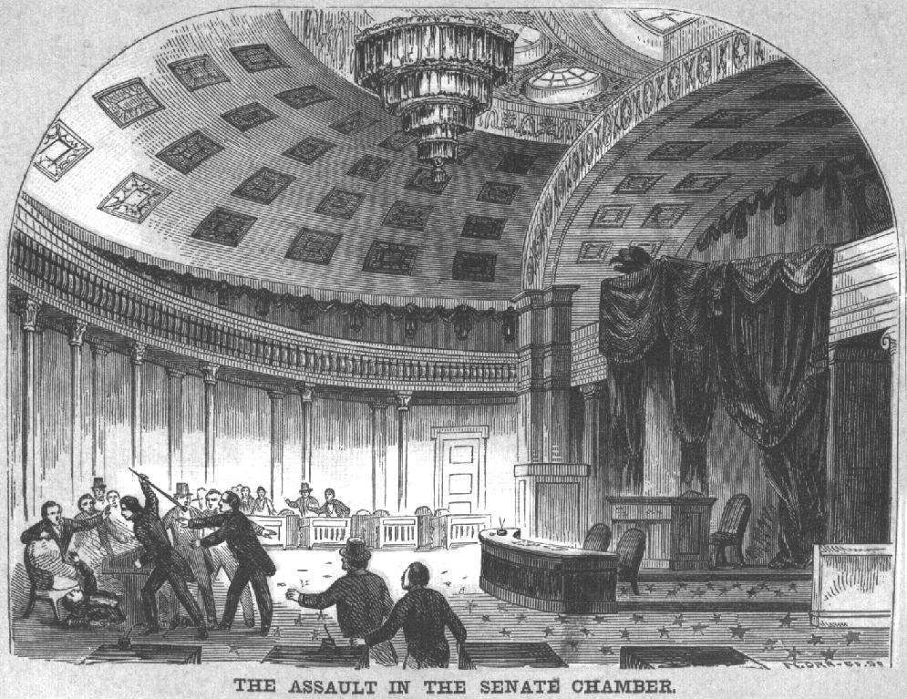

Slide 22
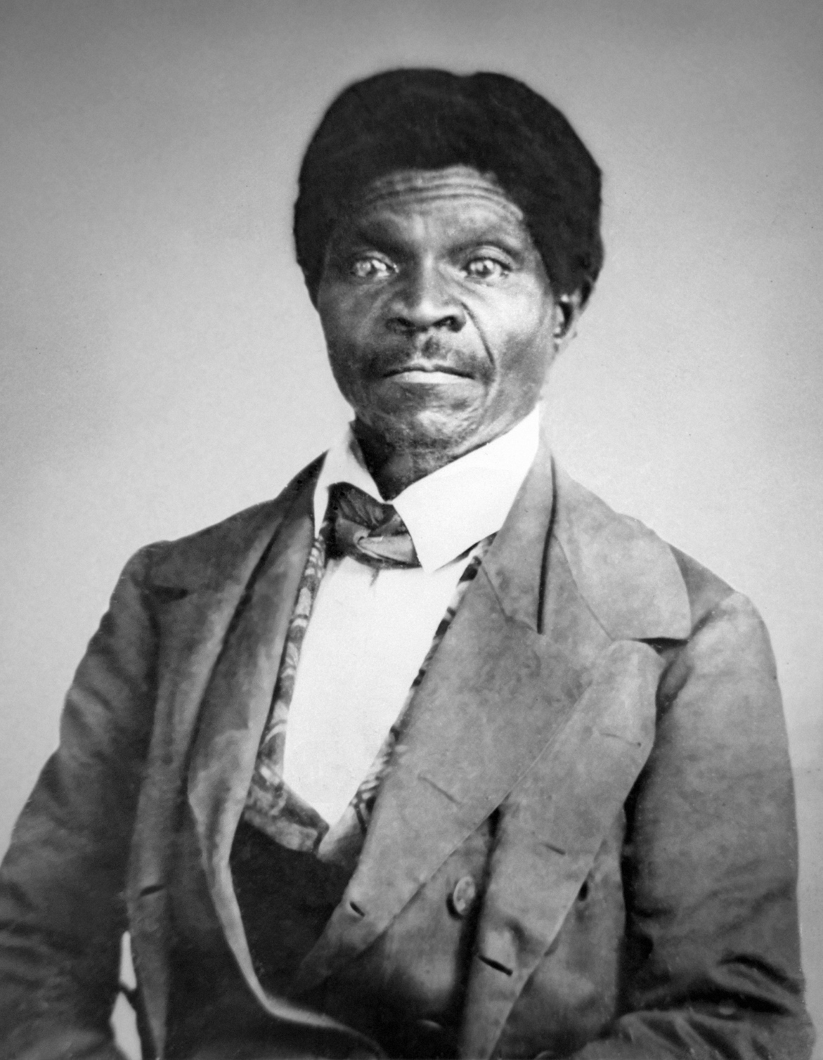
Dred Scott, c. 1795 – 17 September 1858

Slide 23
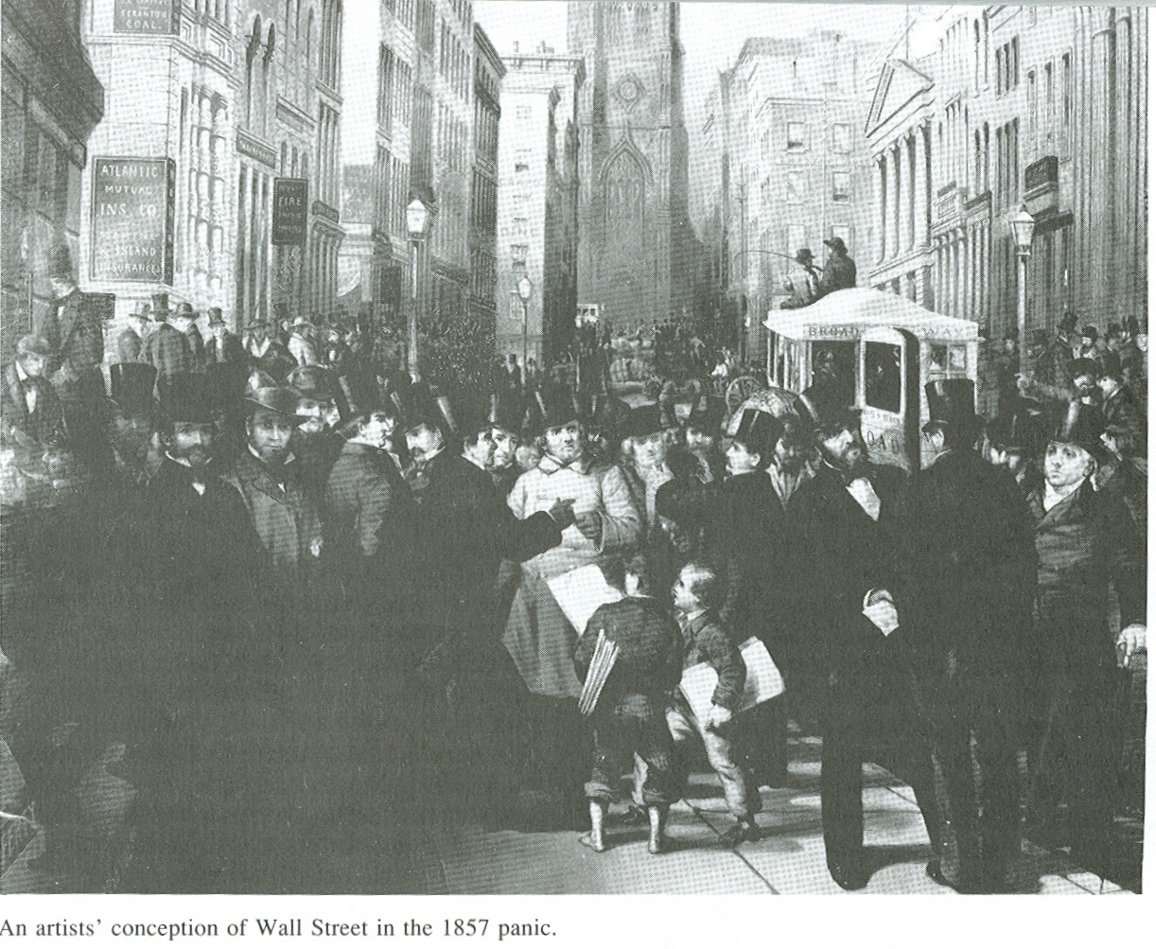

Slide 24
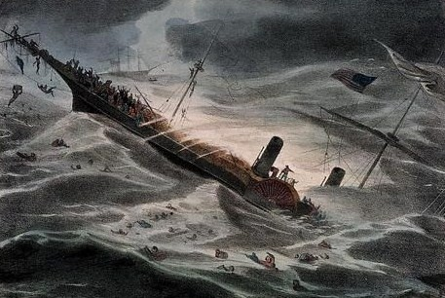
SS Central America, sunk in a hurricane, 12 September 1857

Slide 25
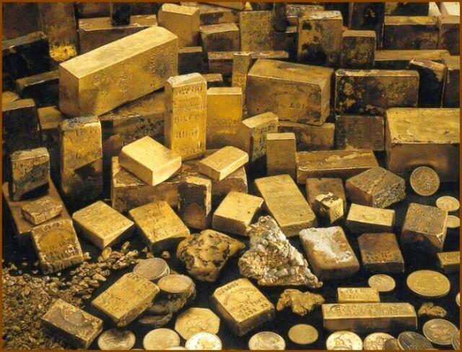
Some of the Gold recovered from the wreck in 1987

Slide 26
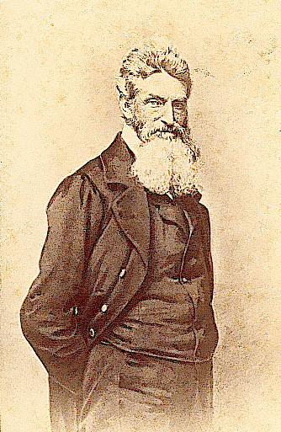
John Brown, 9 May 1800 - 2 December 1859

Slide 27
"Now, if it is deemed necessary that I should forfeit my life for the furtherance of the ends of justice, and mingle my blood further with the blood of my children and with the blood of millions in this slave country whose rights are disregarded by wicked, cruel, and unjust enactments, I say, let it be done." (Speech from scaffold, 2 December 1859)

Slide 28
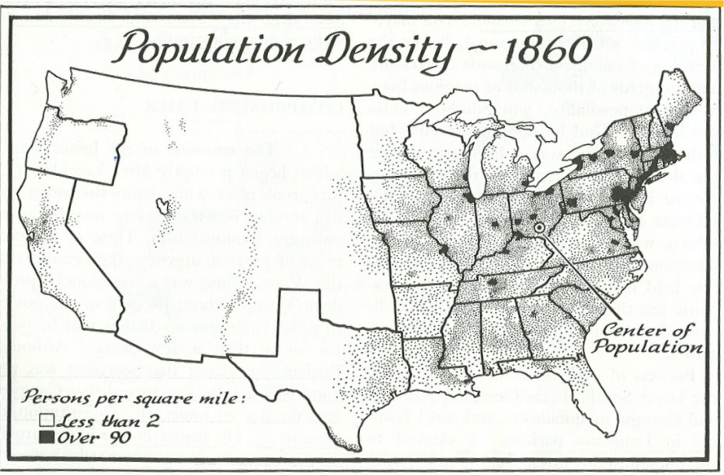

Slide 29
Douglas 12 1,004,042 21.47% Northern Democrat
Lincoln 180 1,855,276 39.67% Republican
Breckinridge 72 672,601 14.38% Southern Democrat
Bell 39 590,980 12.64% Unionist
(Fusion) 0 553,570 11.84% Misc. Fusion Tick.

Slide 30
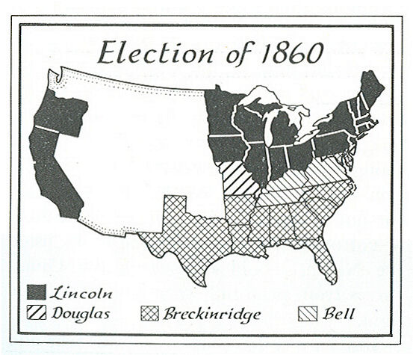

Slide 31
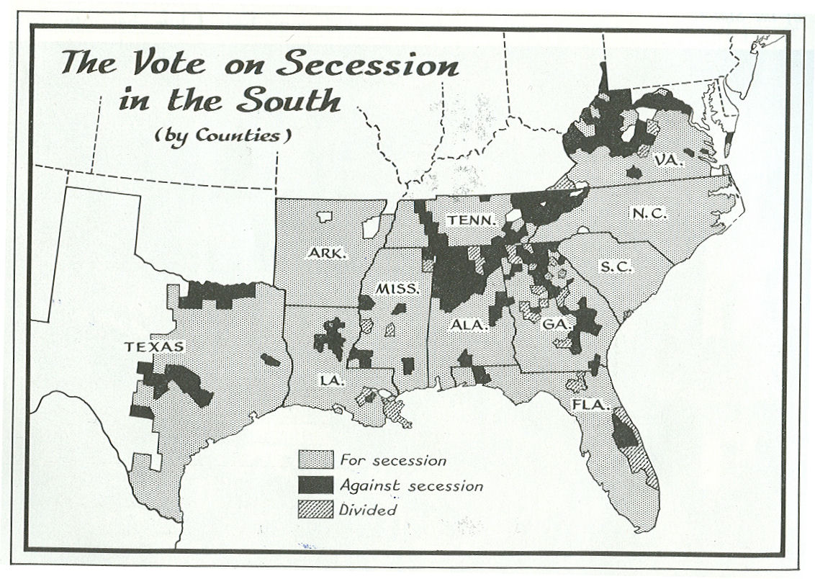

Slide 32
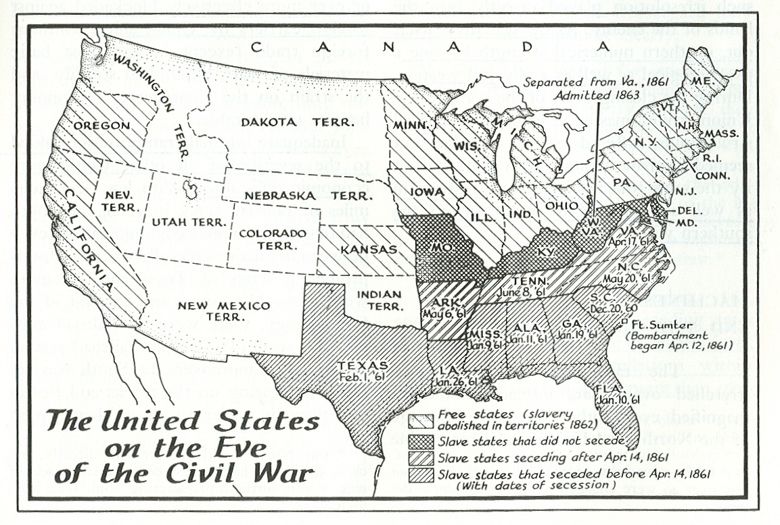

Slide 34
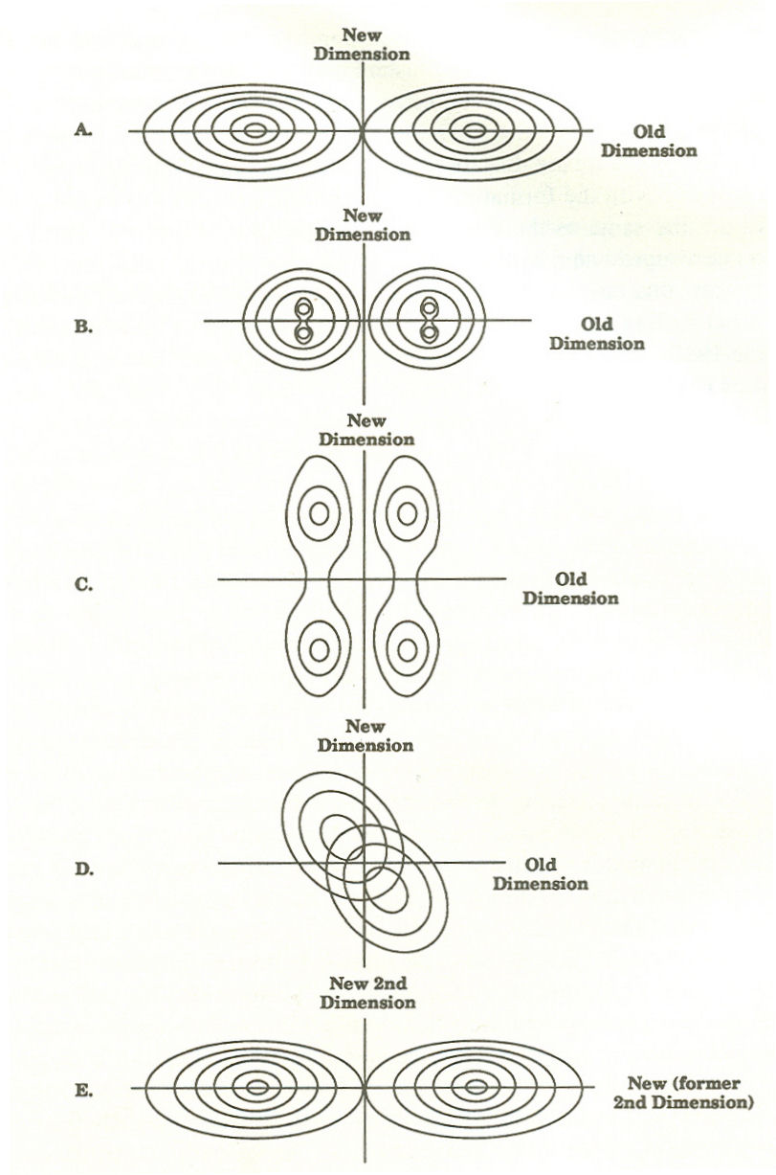
SUMMARY – Realignment of the 1850s -- The Realignment Scenario
Clearly Type 4 -- Realignment in which One Party is Replaced.
The System evolves from State A to State E.

