Slide 1
The First Political Party System: 1829 - 1852
The Different Economies and The Politics of the Expansion of Slavery Lead to the Collapse of the Whigs

Slide 2
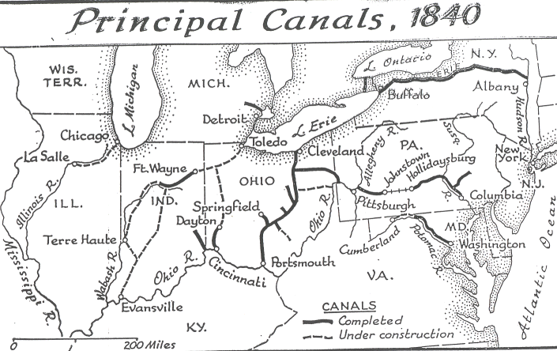
The Success of the Erie Canal Leads to a Canal Building Boom

Slide 8
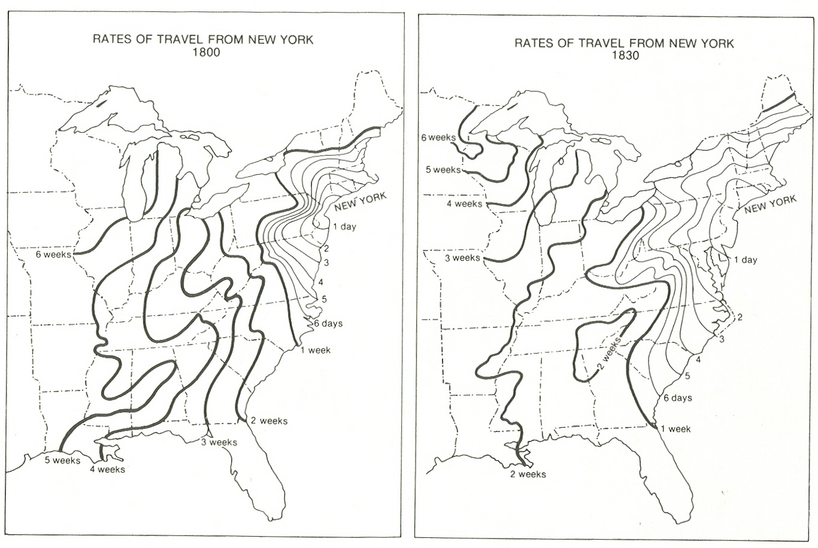

Slide 9
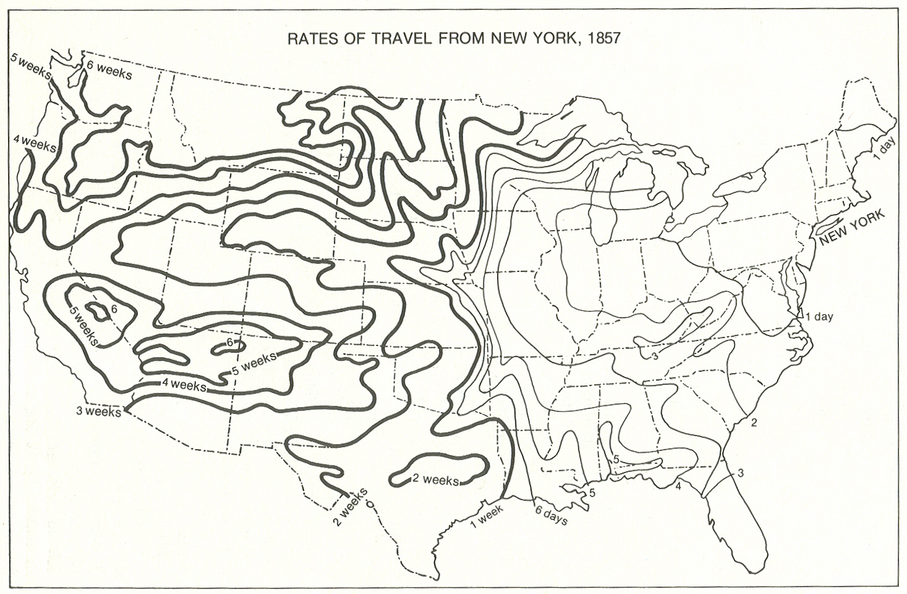

Slide 11
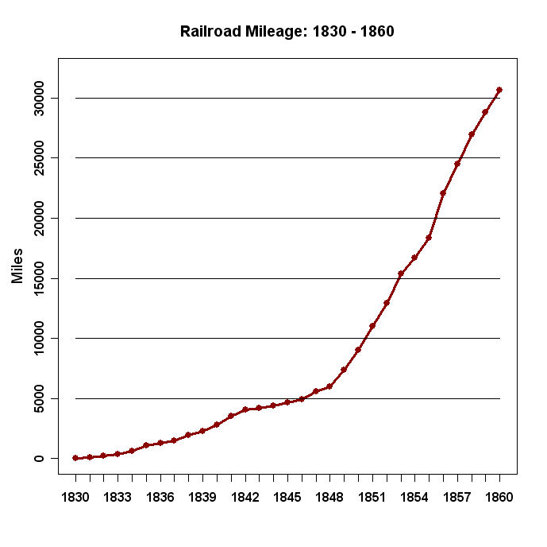

Slide 12
