Slide 1
The Missouri Compromise of 1820
How Far Would Slavery Extend?

Slide 2
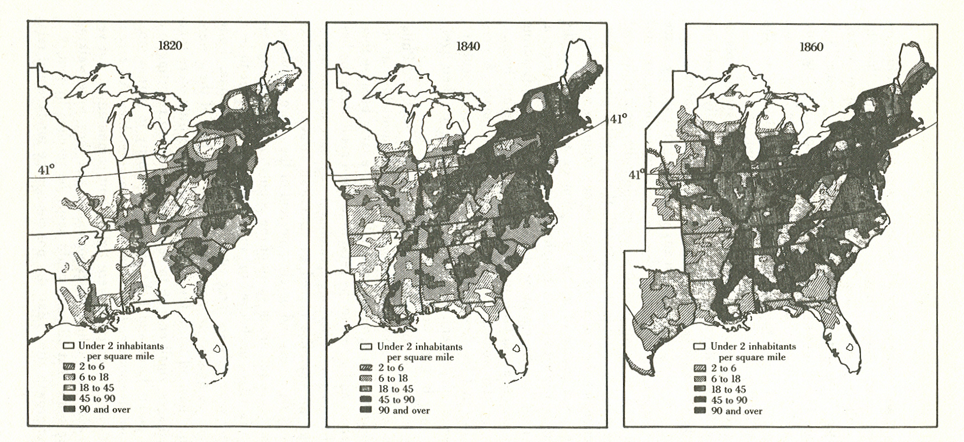

Slide 3
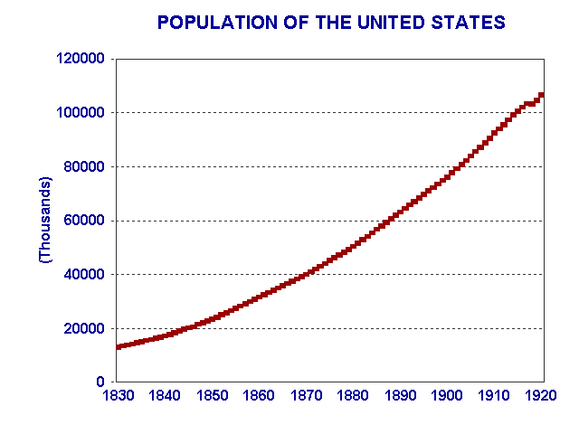

Slide 4
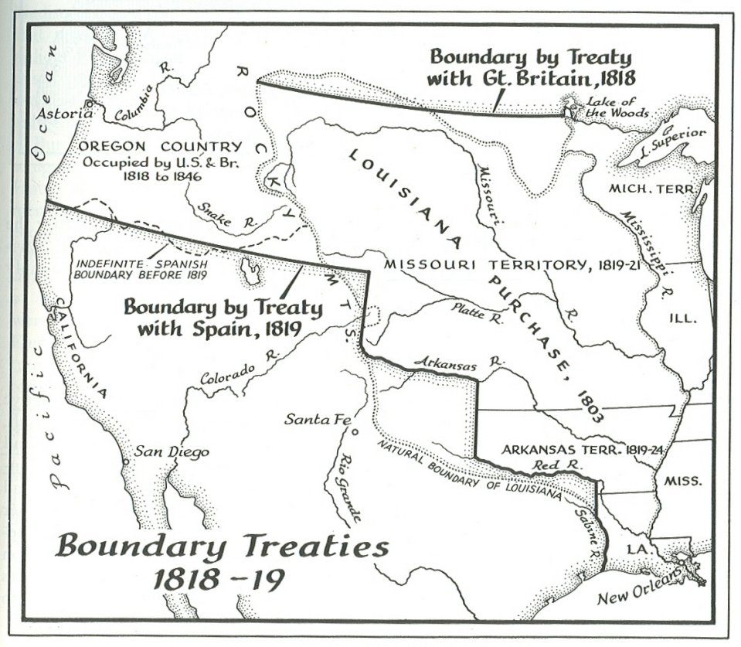

Slide 5
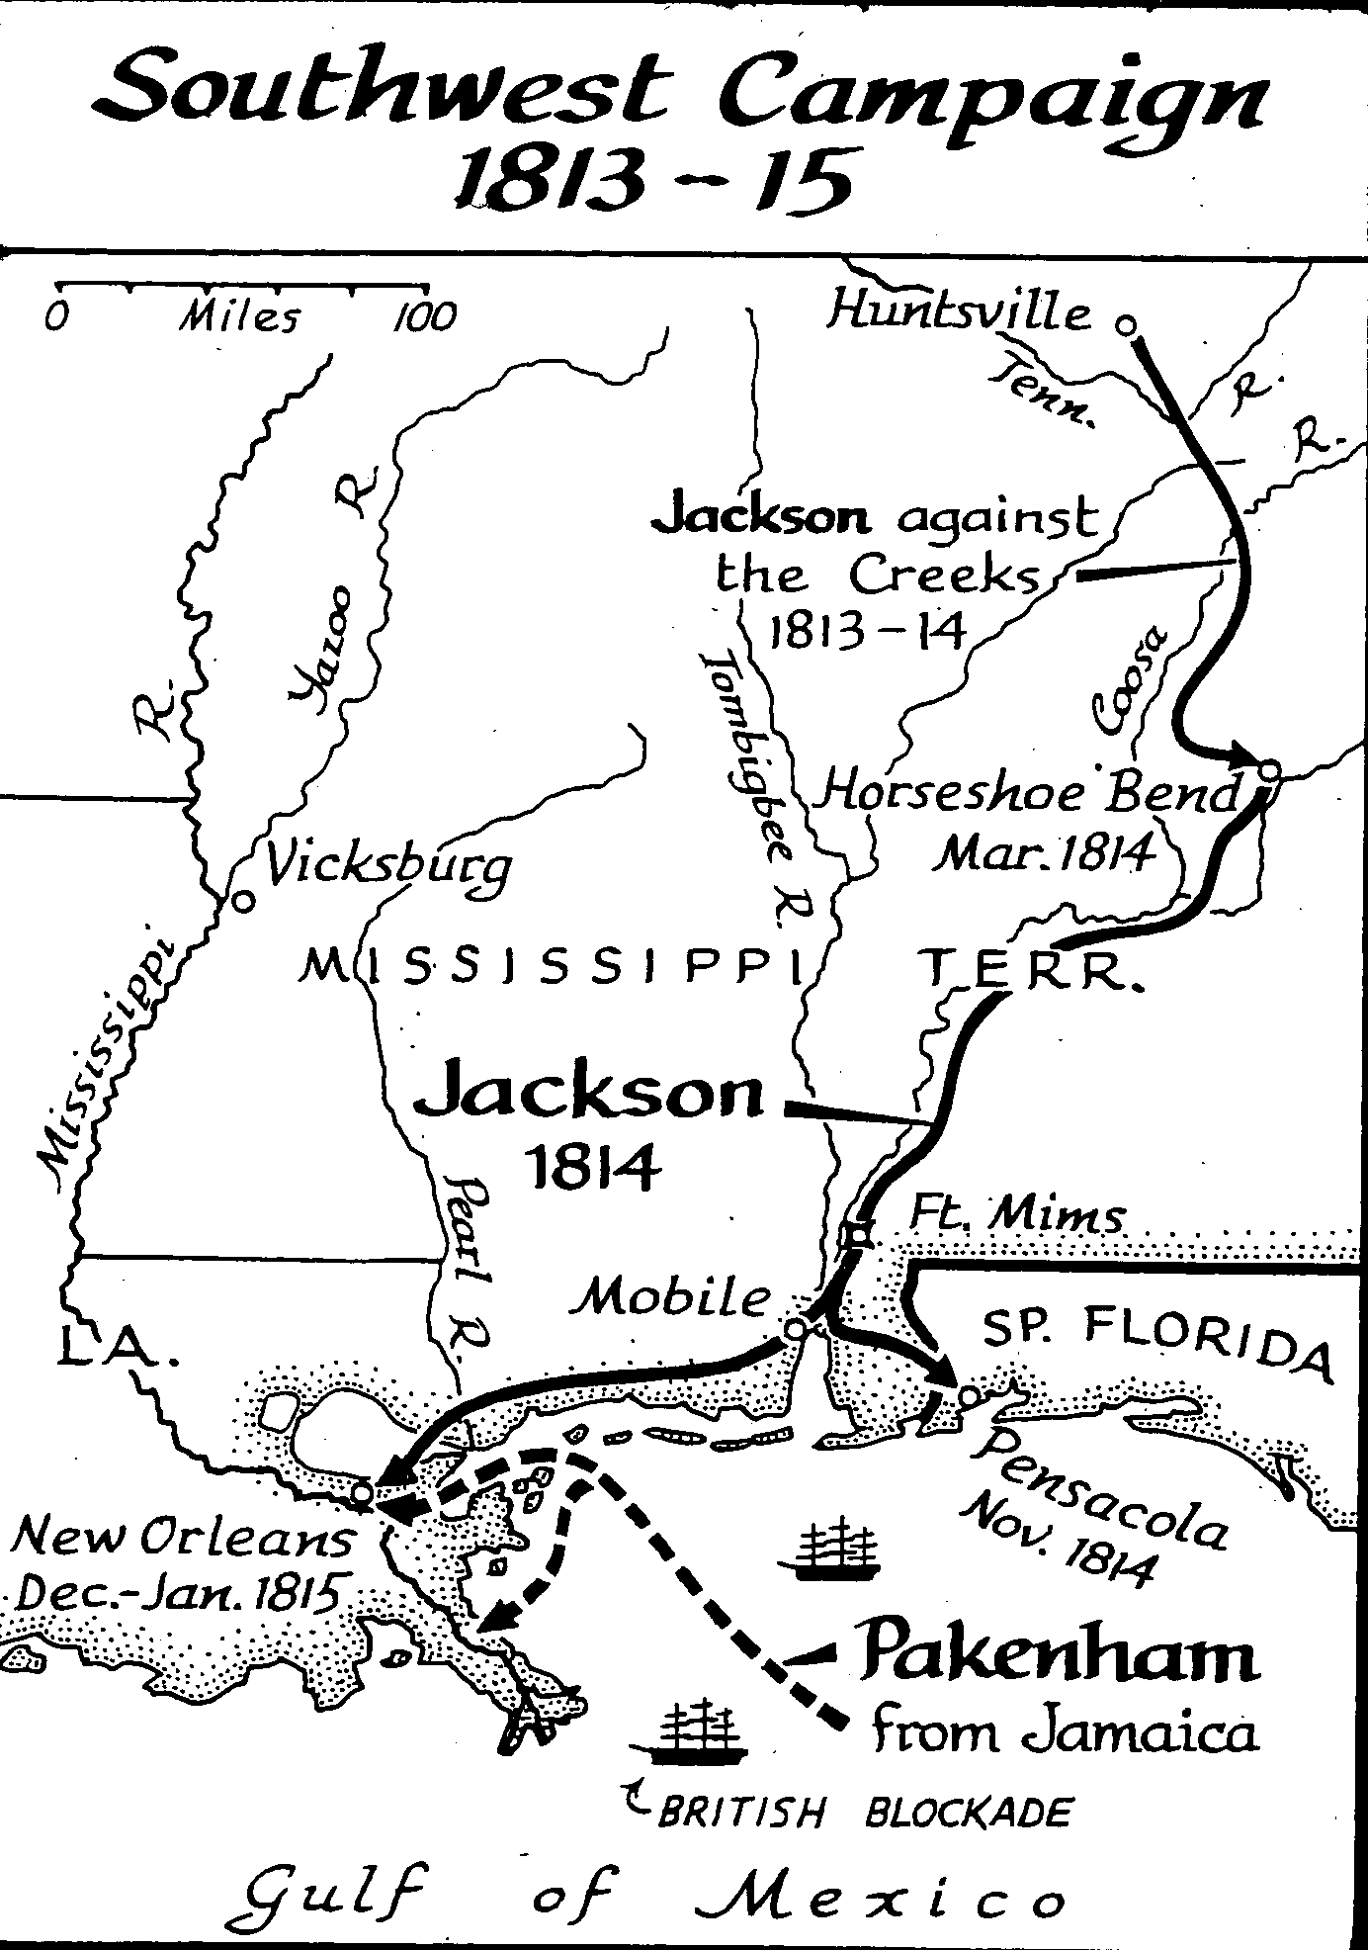

Slide 6
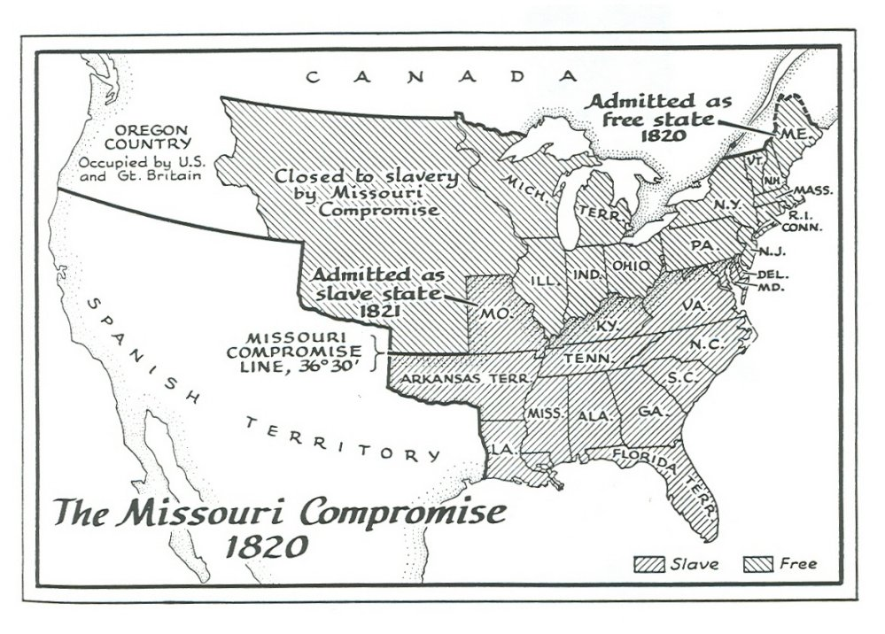

Slide 7
Bad Deal for the South -- In the 40-year period between
the admission of Missouri and the outbreak of the
Civil War, only 3 slave states south of the 36°30´ latitude were admitted to the Union. In contrast, 6 free states,
including 3 in the area closed to slavery by the Missouri
Compromise, were admitted by 1859.

Slide 8
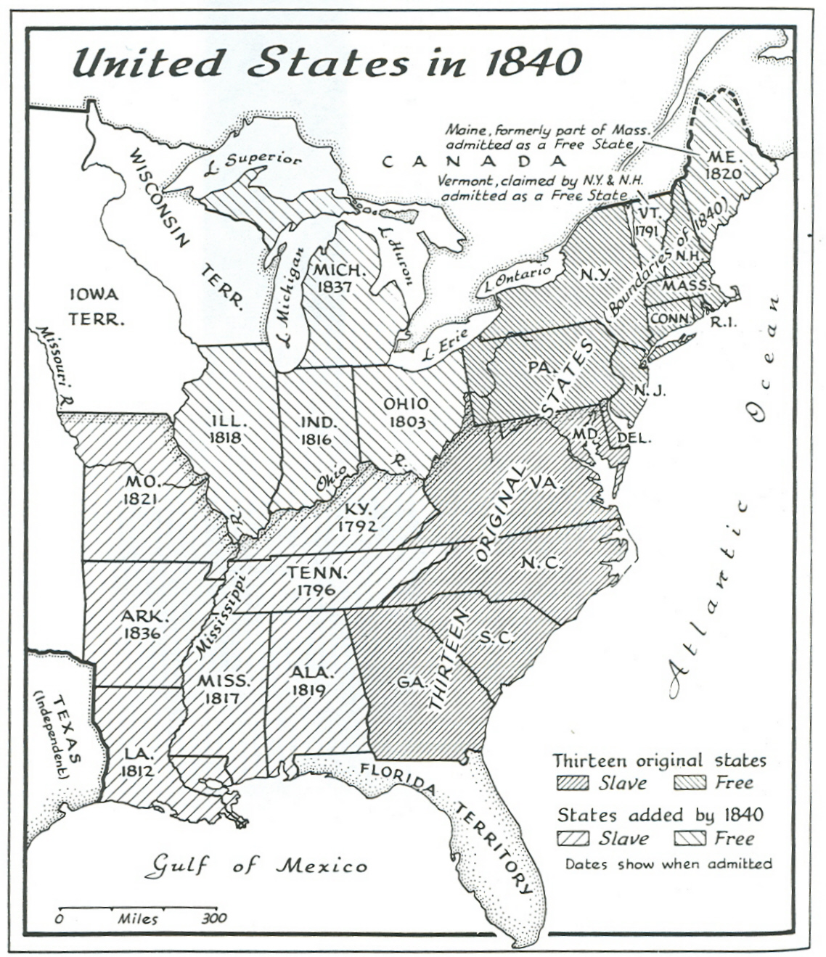

Slide 9
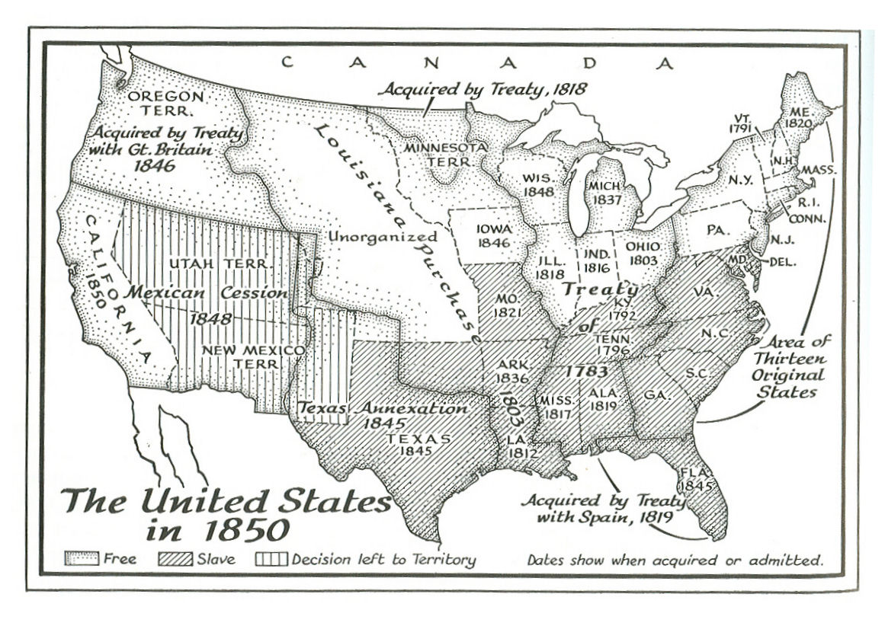

Slide 10
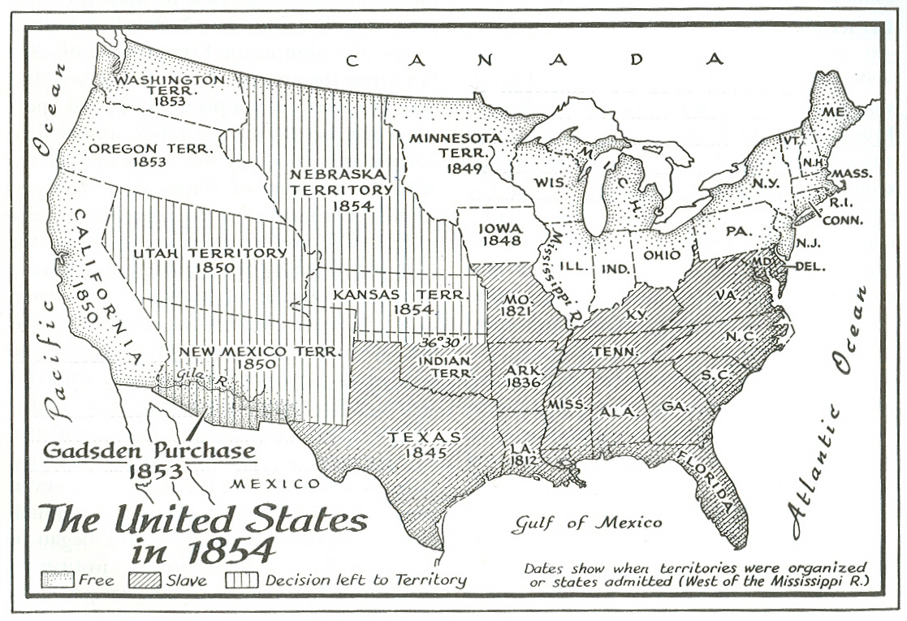

Slide 11
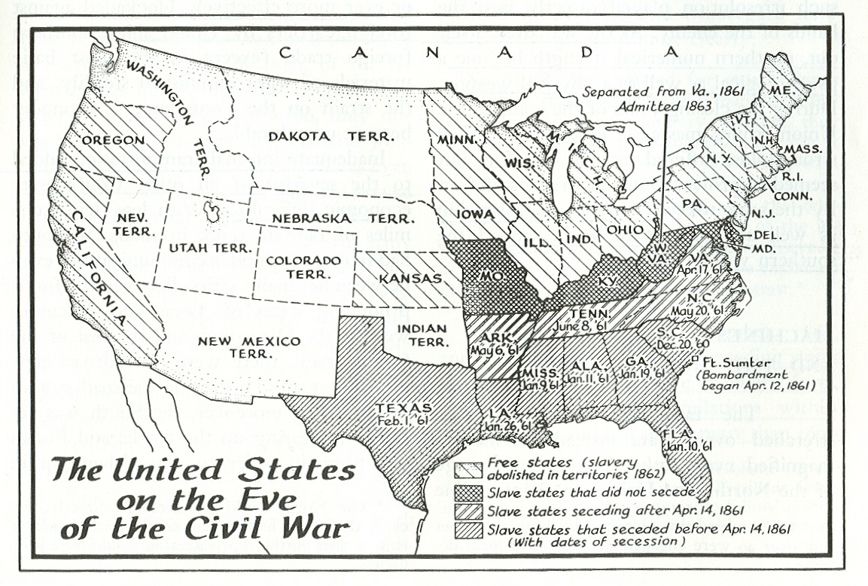

Slide 12
The Election of 1824
Popular Electoral
Vote Vote
-------------------------
Andrew Jackson 151,287 99
John Quincy Adams 111,811 84
William H. Crawford 47,417 41
Henry Clay 47,707 37

Slide 13
The election was thrown into the House of Representatives. Under the 12th Amendment – a response to the 1800 election (the road to hell is paved with good intentions!) – if no one got a majority of the electoral votes for President the top 3 went to the House and the balloting was by State. This eliminated Clay. Crawford had a stroke in 1823 and a relapse in 1824 and he was not a serious choice.

Slide 14
Clay backed Adams and he was elected –
13 States for Adams (CT, IL, KY, LA, ME, MD,
MA, MO, NH, NY, OH, RI, VT),
7 for Jackson (AL, IN, MS,
NJ, PA, SC, TN),
4 Crawford (DE, GA, NC, VA).
Adams then chose Clay (OH, MO, KY)
as his Secretary of State.
States that “betrayed” Jackson – IL, MD, NC, LA.

Slide 15
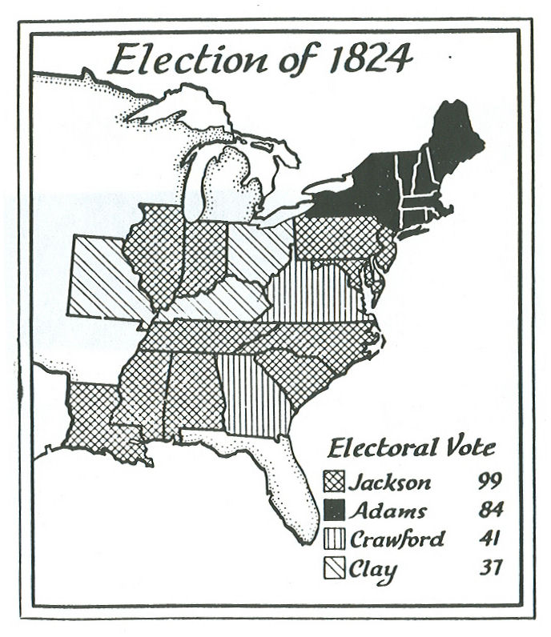

Slide 16
The Election of 1828
Popular Electoral
Vote Vote
-------------------------
Andrew Jackson 638,348 178
John Quincy Adams 507,440 83
22 of 24 States had Popular Election of Electors

Slide 17
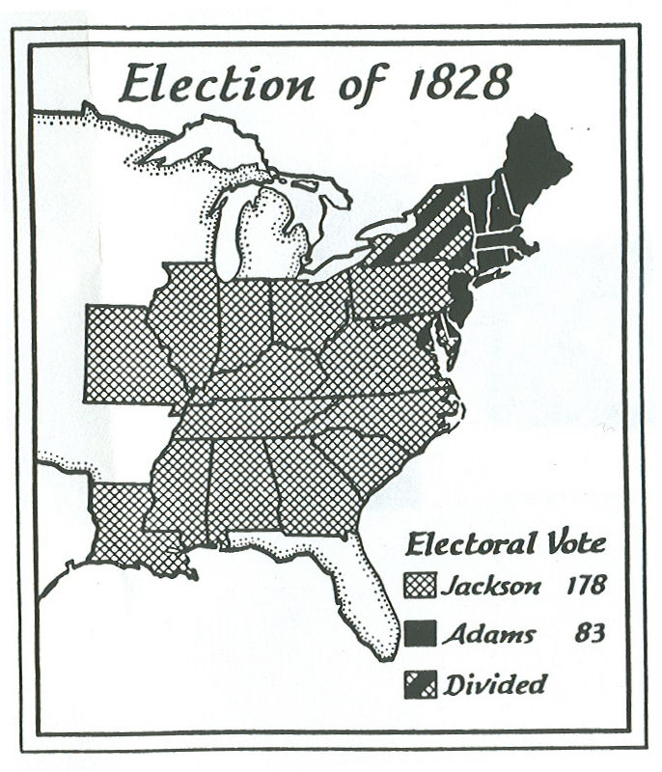

Slide 18
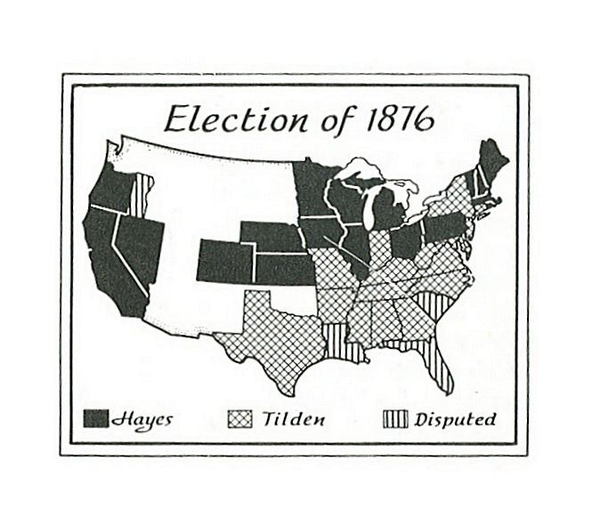

Slide 19
