Slide 1
The Impact of the War of 1812
18 June 1812 to 14 December 1814 [8 January 1815]

Slide 2
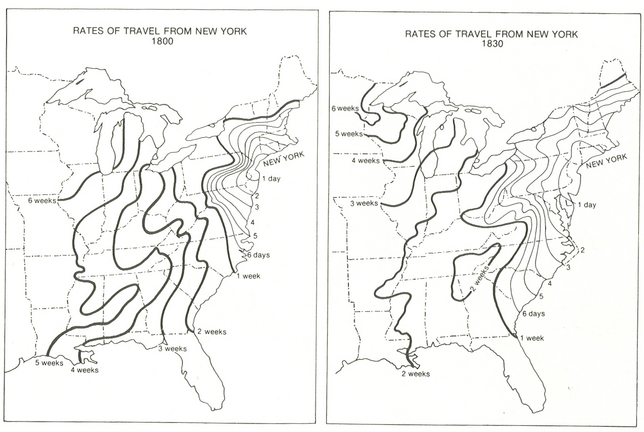

Slide 3
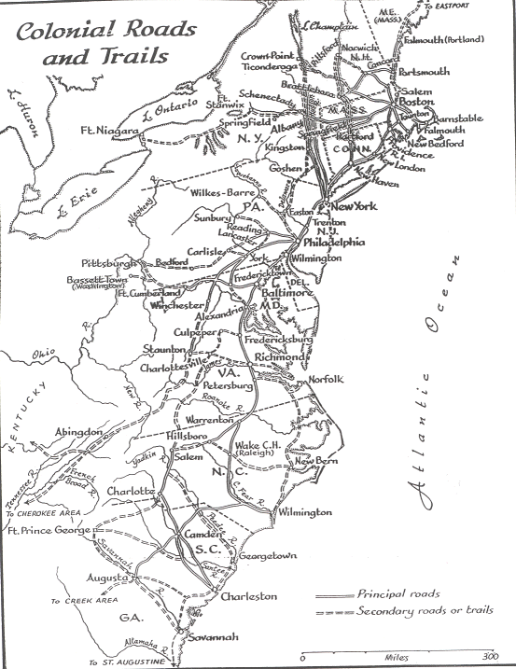

Slide 4
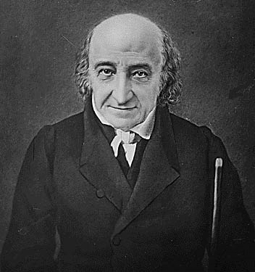
Abraham Alfonse Albert Gallatin
(January 29, 1761 – August 12, 1849)
Cleaned up Daguerreotype
Treasury Secretary 1801 - 1814

Slide 5
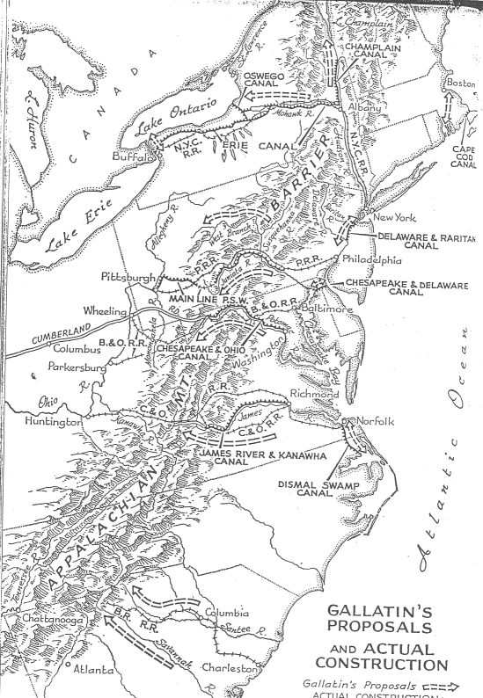

Slide 6
The Erie Canal
Constructed 1817 - 1825

Slide 7
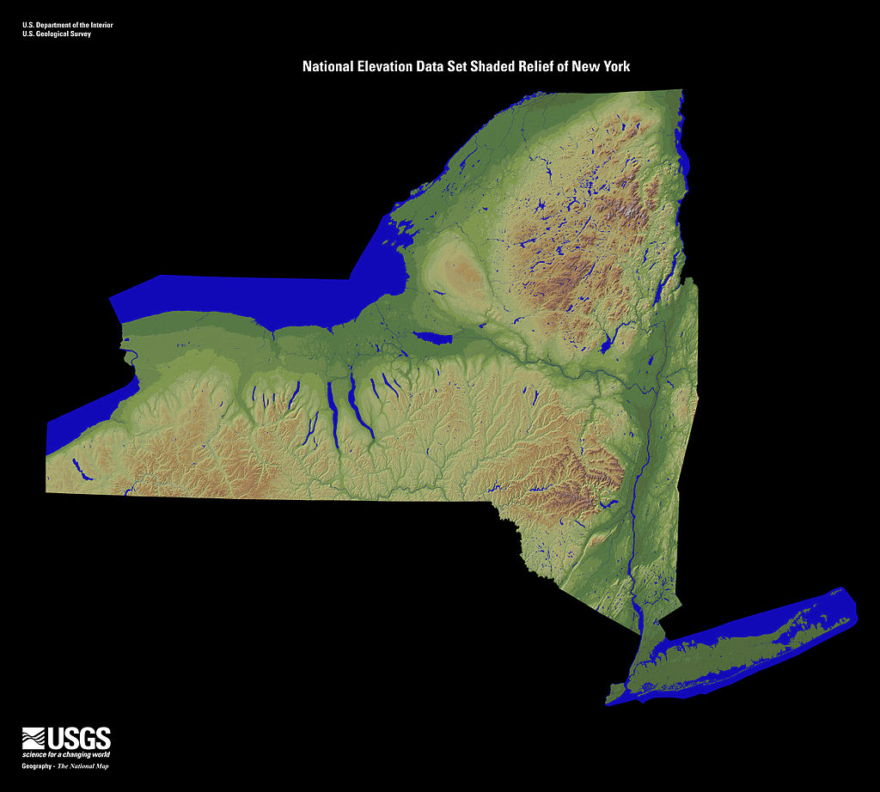

Slide 8
363 miles long, 83 locks, about 655 feet of elevation in the locks (up and down).
The annual net gain on the Erie Canal over its first decade of operation, 1826 – 1835, was about 8 percent of its total construction cost per year!

Slide 9
The Erie Canal helped make New York City such a large trading center that it accounted for 50 percent of all U.S. foreign trade and duties collected.

Slide 10
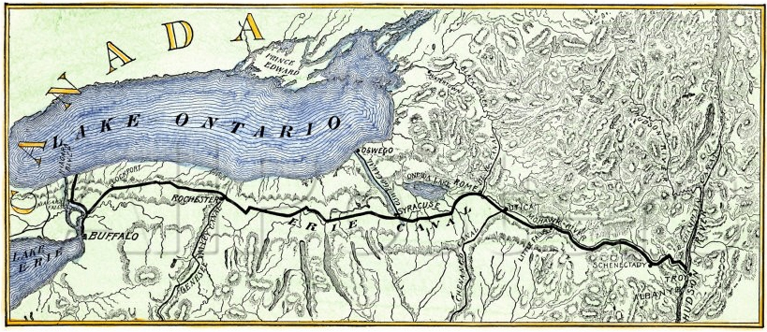

Slide 11
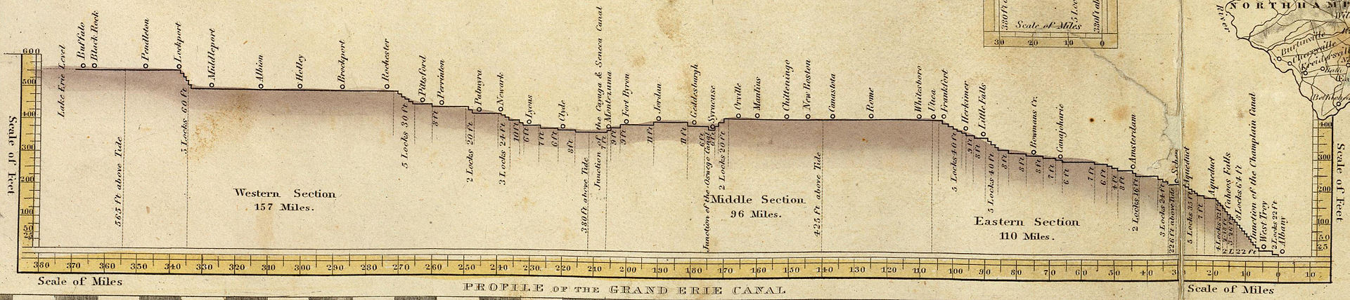

Slide 12
Transportation costs from Buffalo to New York
City in 1817 when construction began on the Erie
Canal were three times the market value of a
bushel of wheat and six times that of a bushel
of corn. Small wonder that upstate New York
commodities were not being shipped in large
quantities to New York City!

Slide 13
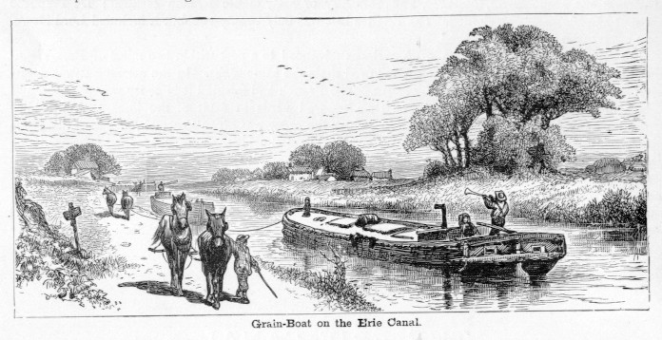

Slide 14
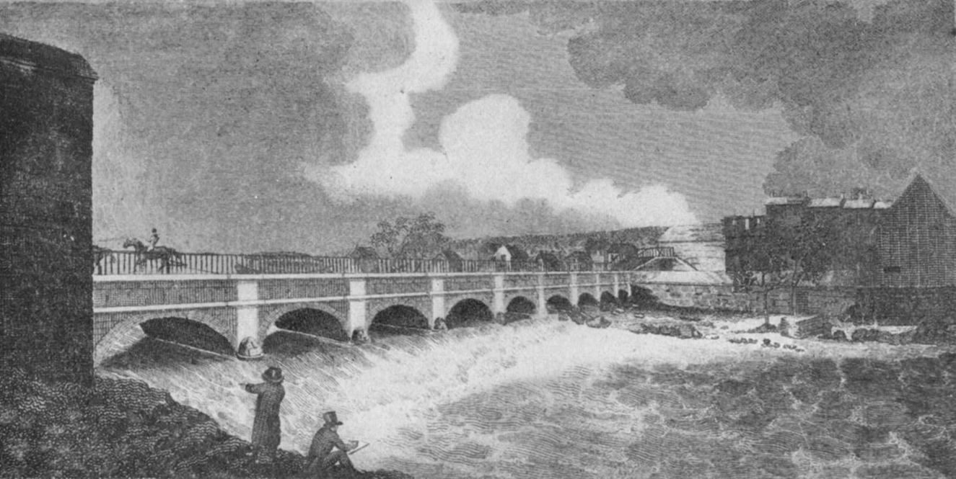
Aqueduct Across Genesee River in Rochester, NY

Slide 15
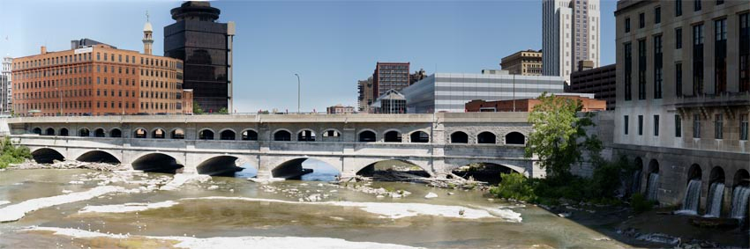
Current Appearance of Aqueduct
Across the Genesee River

Slide 16
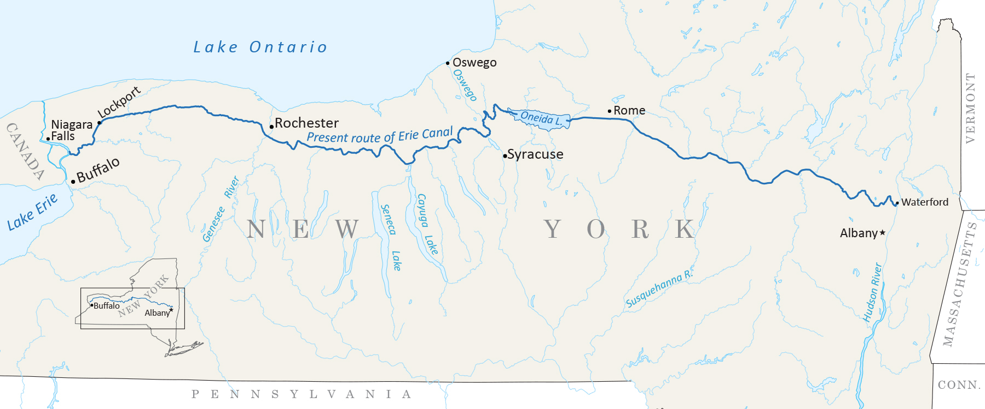
Current Route of Erie (Barge) Canal

