Slide 1
The Election of 1800
The First Peaceful Transfer of Power From One Party to Another in History

Slide 2
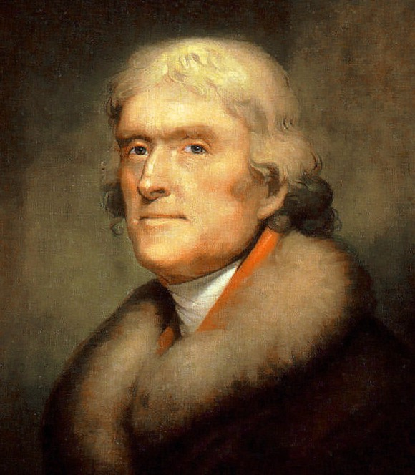

Slide 3
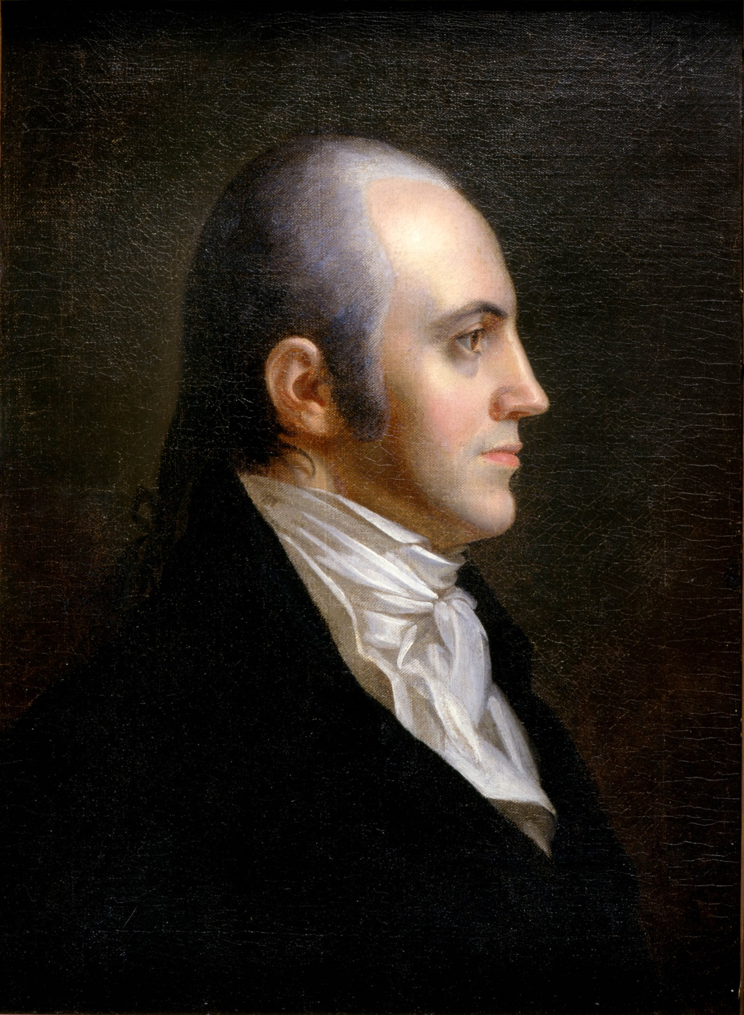

Slide 4
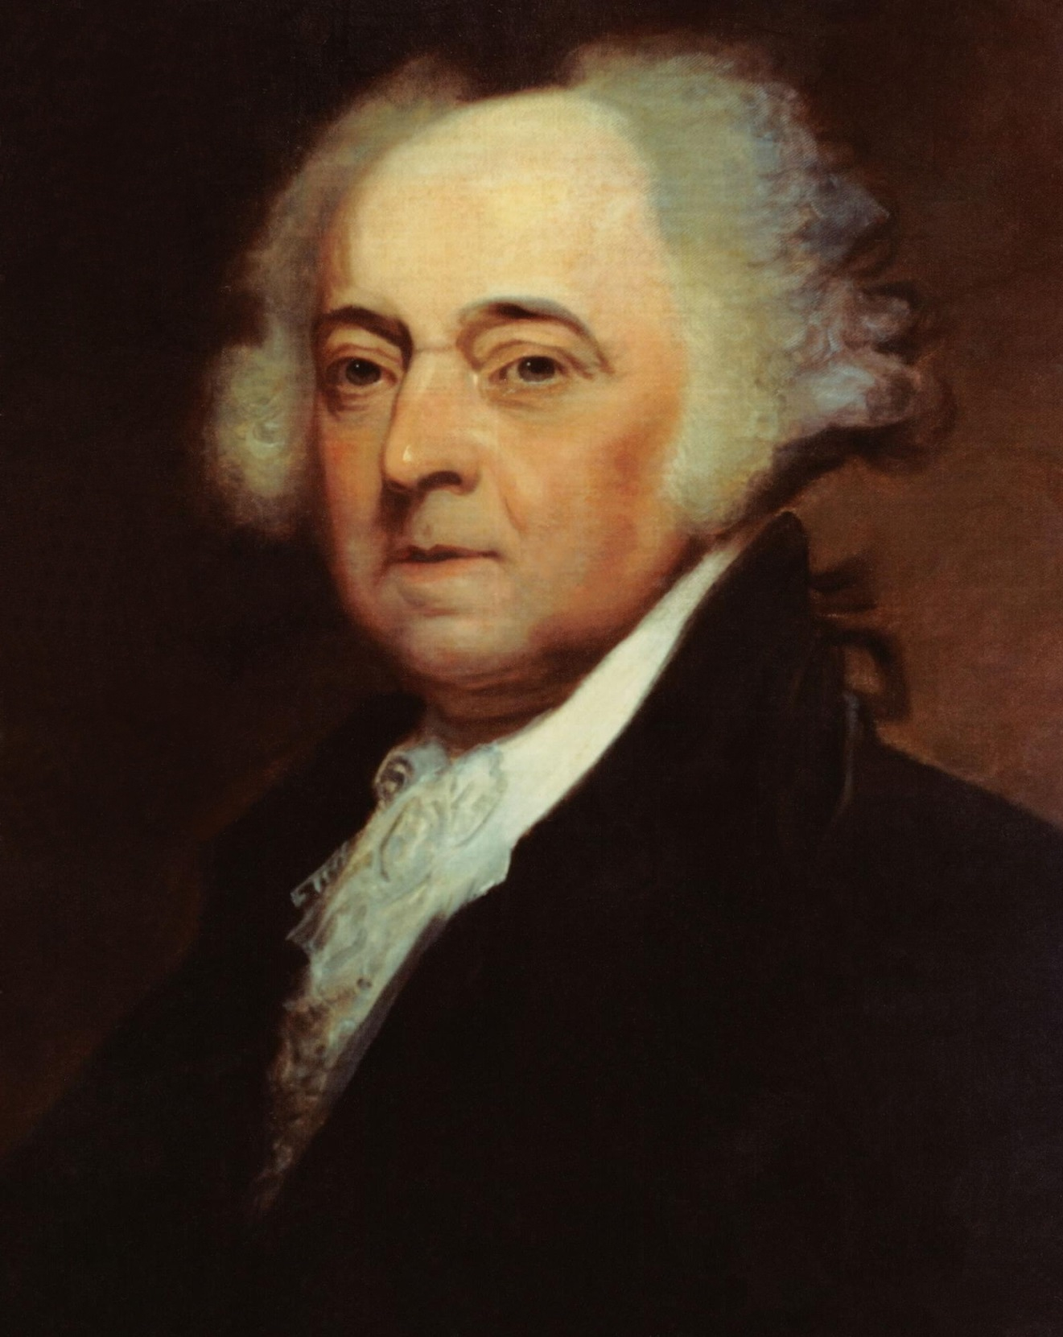

Slide 5
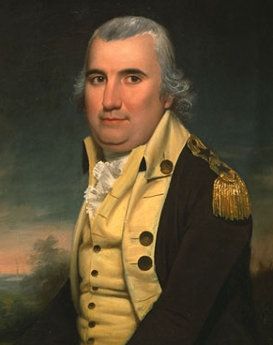

Slide 7
  Balloting started 11 February 1801 – Under original Constitution “if such Number be a Majority of the whole Number of Electors appointed; and if there be more than one who have such Majority, and have an equal Number of Votes, then the House of Representatives shall immediately chuse by Ballot one of them for President.” Voting was by States and a majority of States was necessary for election.

Slide 8
    First 35 Ballots – Jefferson 8 States;
    Burr 6 States; 2 States Undecided
    17 February 1801 – Some Federalists abstain
    within State delegations:
    Jefferson 10 States; Burr 4 States; 2
    undecided. Federalists in Vermont and
    Maryland abstained within their states and
    the States went over to Jefferson.

Slide 9
