Slide 1
Foreign Policy and the “Pop-Gun” Republic
1790-1799

Slide 2
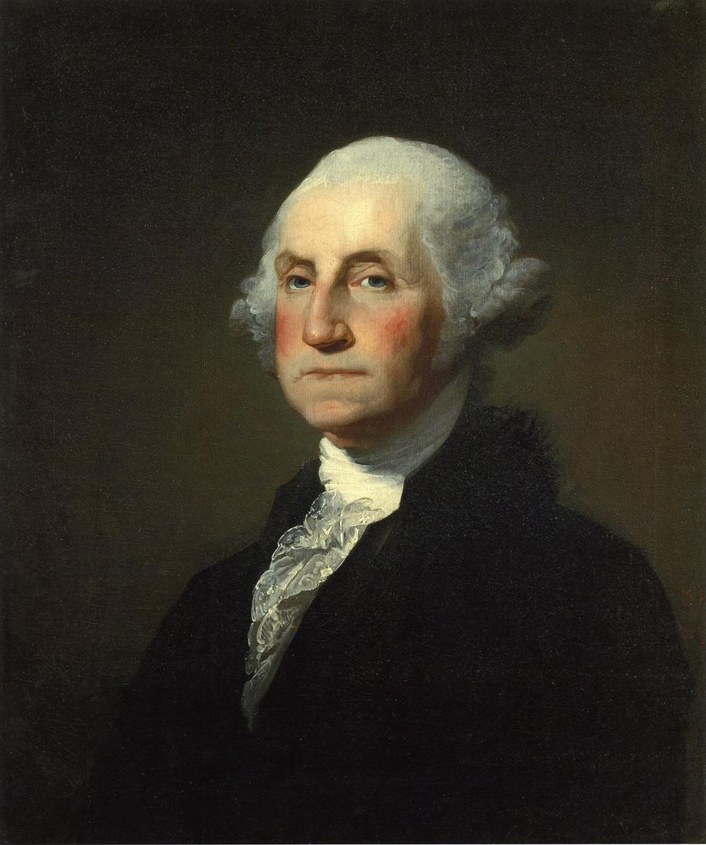

Slide 3


Slide 4
1790 – Lafayette sent Washington the key to the Bastille –
Americans were enthusiastic about French Revolution.
However, even before the execution of Louis XVI on 21 January 1793 and Marie Antoinette on 16 October 1793,
John Adams criticized the French Unicameral
legislature and other leveling features of the
French Revolution.

Slide 5
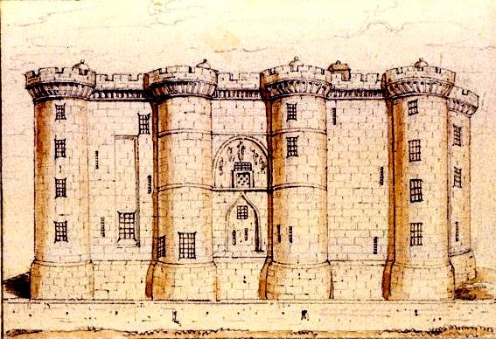

Slide 6
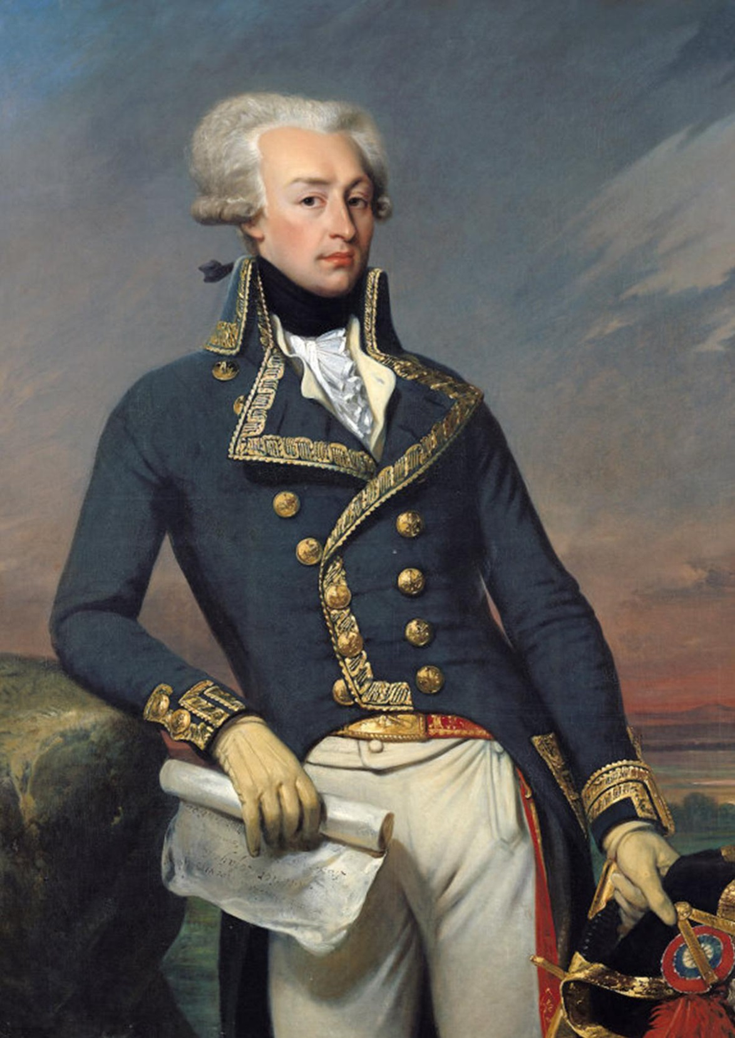

Slide 7
Adams (p.275 Hofstadter, Miller, & Aaron): “It is not to flatter the passions of the people … to tell them that in a single assembly they will act as arbitrarily as any despot, but it is a sacred truth … that a sovereignty in a single assembly must necessarily and will certainly be exercised by a majority, as tyrannically as any sovereignty was ever exercised by kings or nobles. And if a balance of passions and interests is not scientifically concerted, the present struggle in Europe will be little beneficial to mankind, and produce nothing but another thousand years of feudal fanaticism, under new and strange names.” (1793)

Slide 8
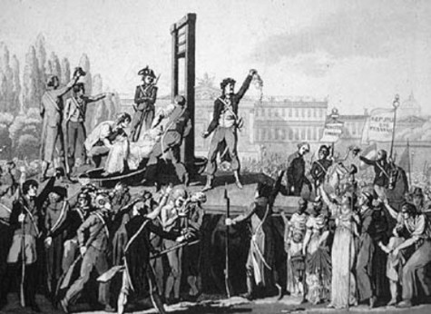

Slide 9
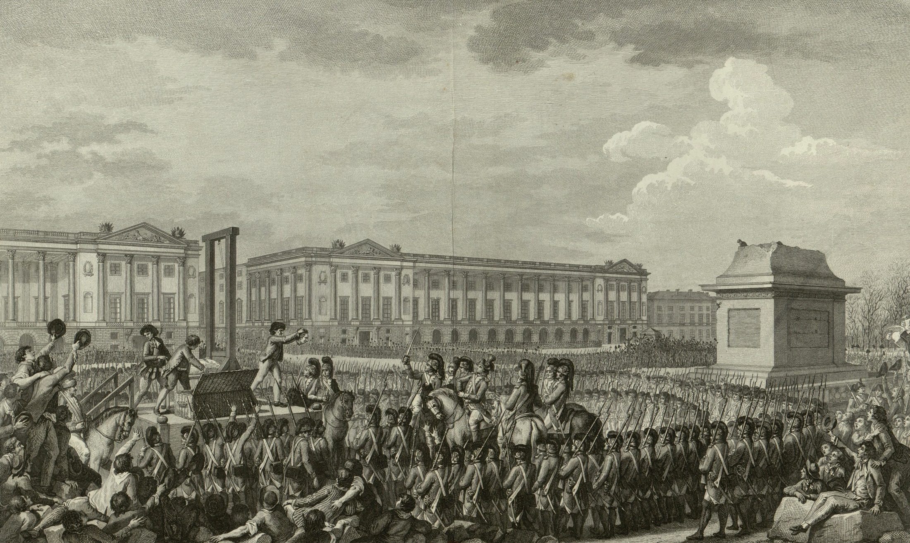

Slide 10
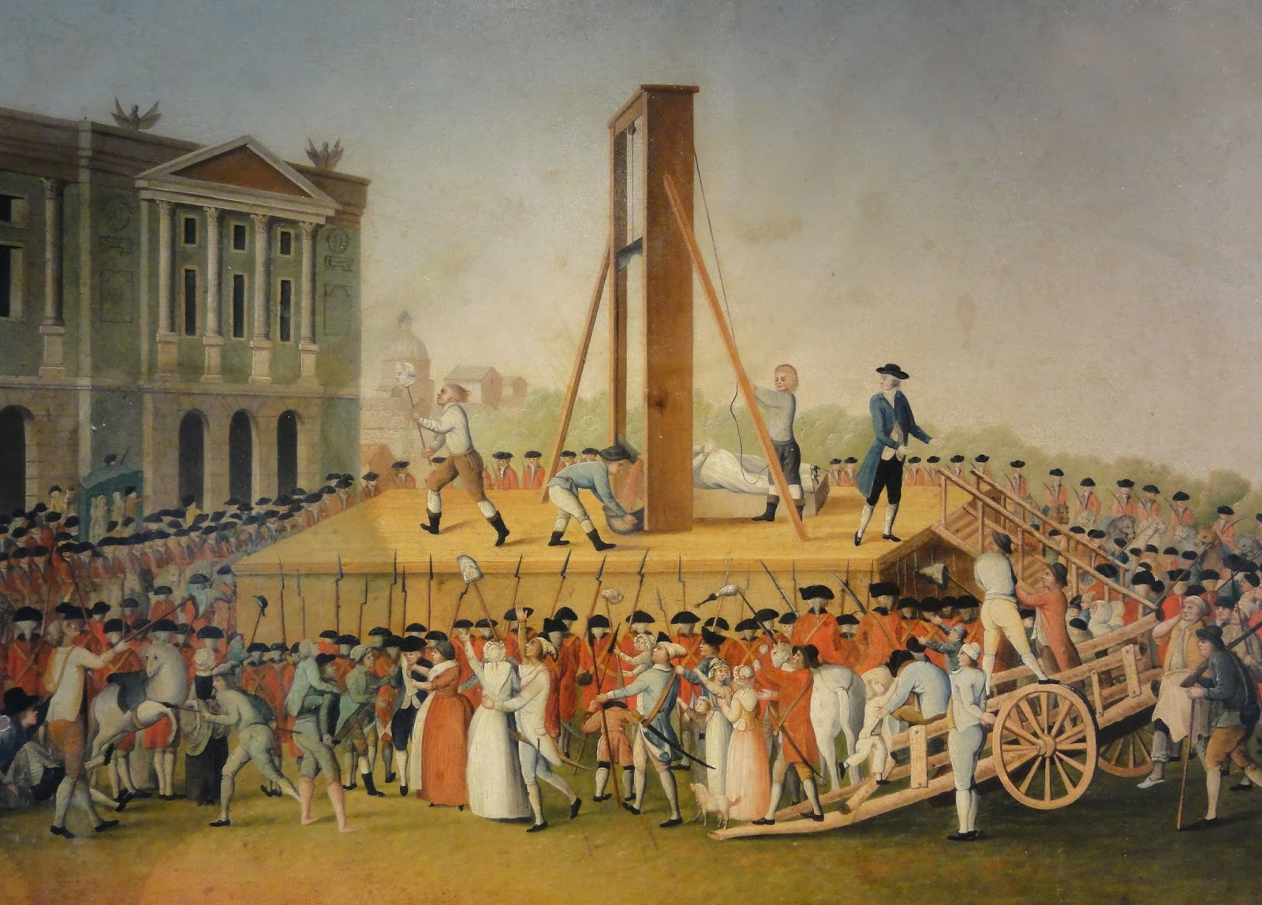

Slide 11
By 1792 French were at War with Britain. By a
1778 Treaty, U.S. had to defend French West Indies
and receive prizes captured at sea by French
privateers.
By 1793 Conservative (Federalist) opinion had turned
against France.
Jeffersonians, though horrified by the executions,
reaffirmed their dislike of Monarchs and monarchy
and voiced their confidence in the people of France.

Slide 12
On 22 April 1793 President Washington issued a neutrality
proclamation – the U.S. would not participate in French
Wars. Jefferson argued that the 1778 Treaty was valid
under international law and only Congress could declare
neutrality (the news of the executions in France and
the break out of Wars in early 1793 did not reach U.S.
until April 1793 because of westerly gales in the
North Atlantic).

Slide 13
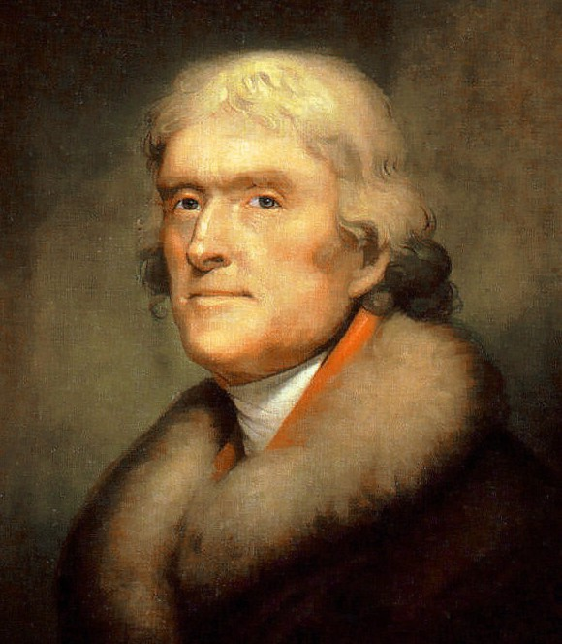

Slide 14
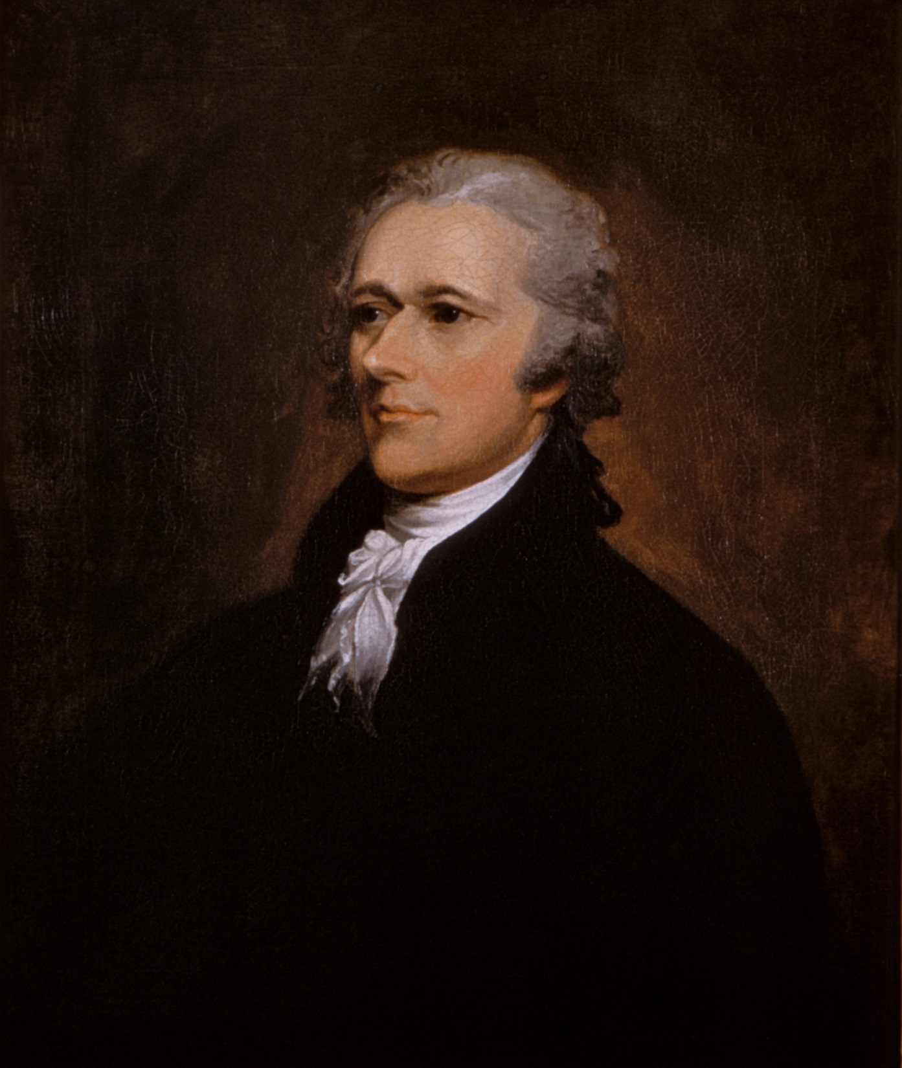

Slide 15
Jefferson argued that only Congress could declare
War hence G.W. could not declare neutrality.
Hamilton argued that the 1778 Treaty died with
the King. Washington was determined to keep the
infant (and largely HARMLESS) nation out of War.

Slide 16
The European War tied up the belligerents’
merchant ships and increased their need for
food, arms, and equipment.
The U.S. was a BIG WINNER – commercial ships
did a booming business. France opened the
West Indies to Neutral States and U.S. made
BIG MONEY.

Slide 17
Britain retaliated quickly. They regarded
trade as simply an arm of War. In November
1793 they decreed that all shipping to or
from French colonies would be subject to
British seizure. They subsequently seized
300 American ships and impressed many
seamen into British Navy.

Slide 18
British began stopping ships anywhere on
the high seas and conducting searches.
New England traders still made BIG BUCKS –
just a cost of doing business – and it
stimulated ship building industry.

Slide 19
The Jeffersonians called for an EMBARGO and
it was passed by Congress in early 1794.
However, the Embargo hurt New England
merchants more than it hurt the British.

Slide 20
However, British did back off some in
March, 1794. Washington then sent John
Jay to England (16 April 1794, Chief
Justice!) to negotiate a treaty:
British to surrender N.W. posts.
British to pay for seized ships.
Accept U.S. right to be neutral –
This was realistic because we could
Have sided with France

Slide 21
Jay’s Treaty (agreed to 19 November 1794 –
approved by the Senate 25 June 1795
by 20-10 vote, exactly 2/3rds) – Became
a political HOT POTATO –
Britain did surrender the N.W. Posts
On other two points, no concessions.

Slide 22
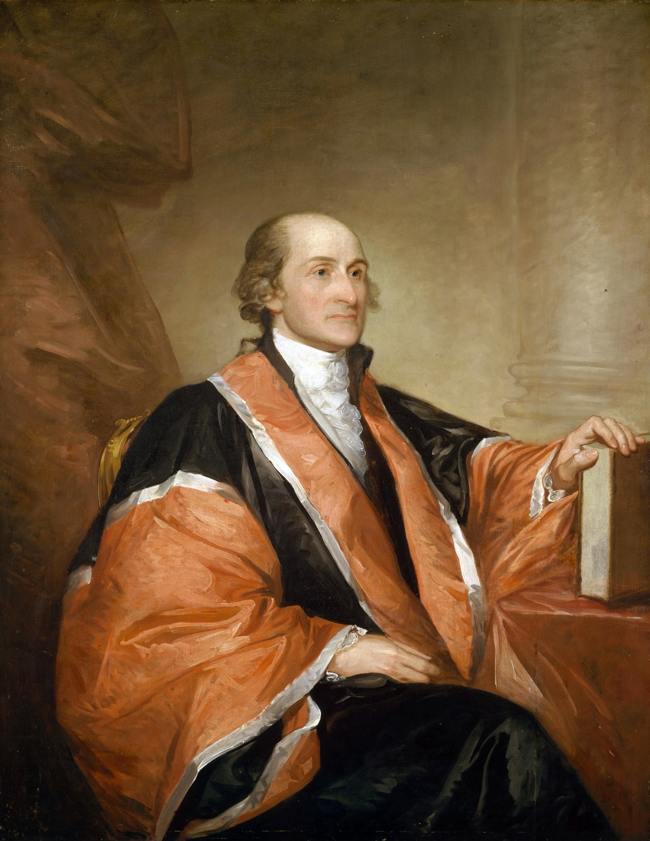

Slide 23
French Reaction – Were outraged by Jay’s
Treaty. France now began to attack U.S.
ships headed for British ports. By March,
1797 (John Adams’ inauguration), the French
had captured 300 U.S. ships!

Slide 24
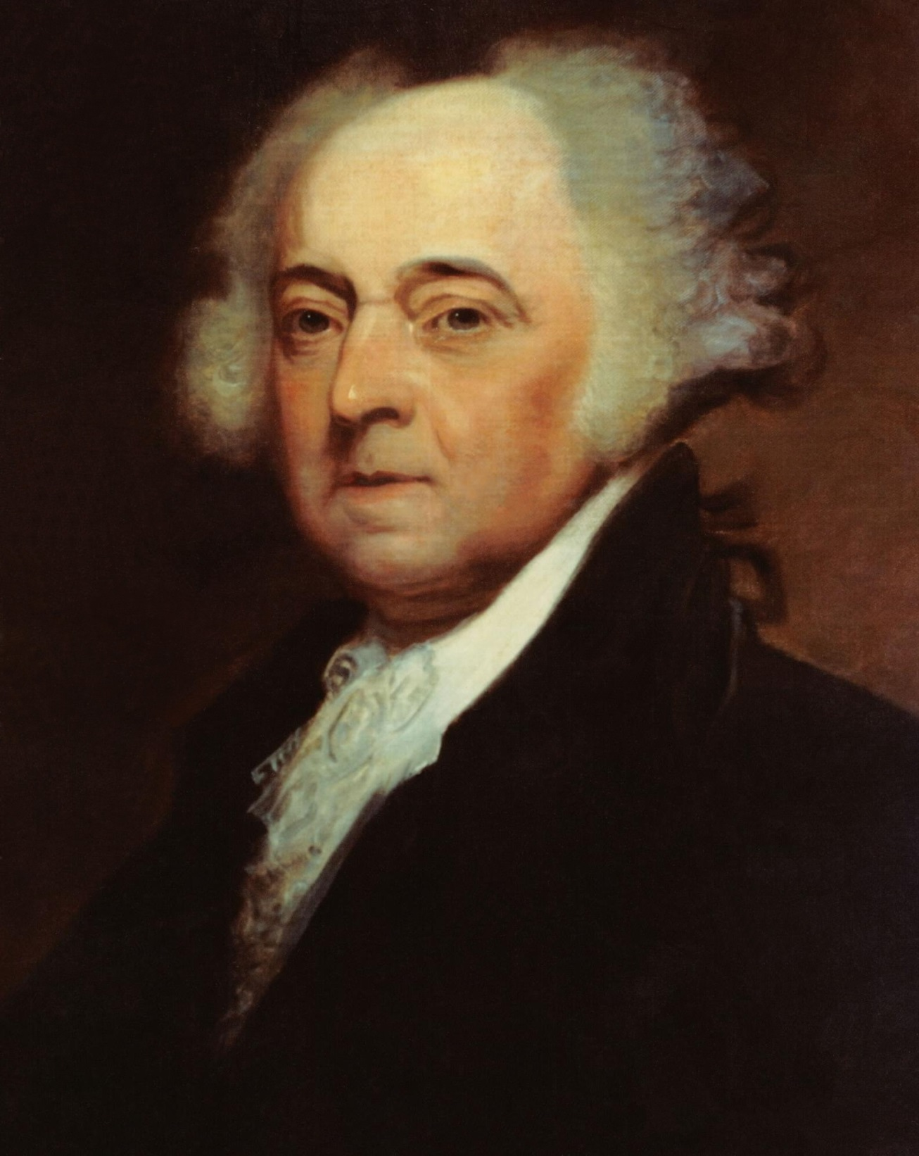

Slide 25
Adams tried negotiating with France –
XYZ Affair (1797-98) – “Millions for
Defense not One Cent for Tribute”
– XYZ were subordinates of Talleyrand,
foreign minister of Directory ruling
France – they demanded bribes –
Americans were outraged!

Slide 26
Congress finally voted money for the
expansion of the Navy in 1798 and 1799 and
created Navy Department.
U.S. also repudiated treaty with France.
1798-1799 undeclared naval War but Adams
would not support a formal declaration
of War!
A wise and brave act!!

