Slide 1
Madison’s Federalist #10
Political and Economic Reality

Slide 2
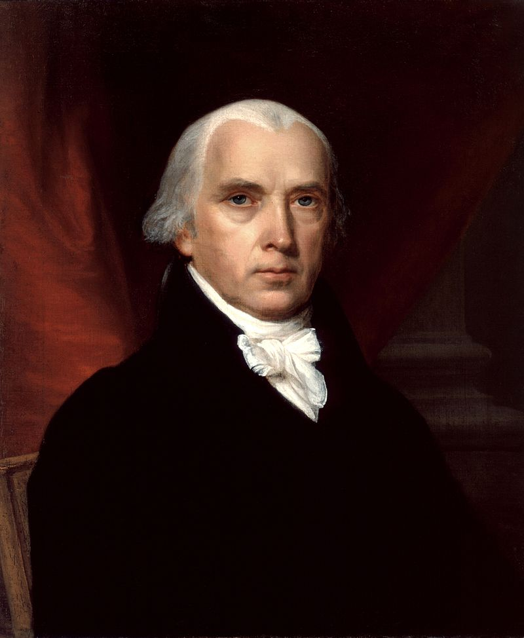
James Madison
16 March 1751 – 28 June 1836

Slide 3
Madison’s Federalist #10 – Cures For Faction – Essentially Reconciled the Actual Politics in the Colonies with an Ideal – Republican Government.

Slide 4
    HOW DO YOU CONTROL THE VIOLENCE OF FACTIONS?
    Remove Causes
        Destroy Liberty
        2. Make Everyone the Same

Slide 5
    B. Control the Effects (How do you Protect Minority
    from the Majority?)
        Faction is Minority (No Problem)
        Faction is Majority
          a. Pure Democracy (VERY BAD)
          b. Small Republic
          c. Large Republic --
            i) With large Republic more able people to be Representatives;
            ii) Larger Constituencies Dampen Down Factions

Slide 6
    Problems With The Argument
        Tension in Argument – He wanted Energetic Government – How was that going to happen and still guard against majority Tyranny?
        2. Why do you need Separation of Powers if a Large Republic takes care of the Problem?

Slide 7
Conceptions of Party (Hofstadter, pp. 16-33):
1) Hamiltonian View (British) -- parties are evils and the only proper one is one which eliminates all parties;
2) Madisonian -- parties are the price one pays for liberty, they can be checked but not eliminated. View that of Hume. Jefferson & Adams had same view;
3) Burkean (Van Buren) -- parties inevitable & good--no important American thinker took this view at the time of the writing of #10.

Slide 8
    People hold Opinions with Passion -- "the former will be the objects to which the latter will attach themselves." In the extreme case of a mass movement:
"the facts on which the true believer bases his
conclusions must not be derived from his experience or
observation but from holy writ ... it is startling to realize how much unbelief is necessary to make belief possible. What we know as blind faith is sustained by innumerable unbeliefs" (Eric Hoffer, The True Believer, 1951, p.79).

Slide 9
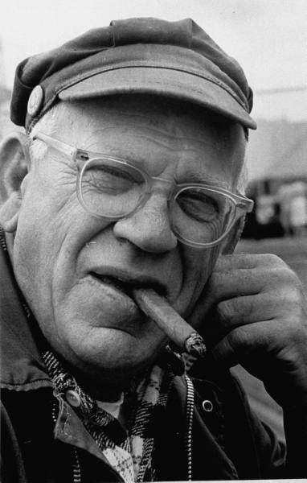
Eric Hoffer
25 July 1898 – 21 May 1983

Slide 10
The various and unequal distributions of property (broadly defined) divides the citizenry into classes and these form the bases of politics.
The Founders (Jefferson, Washington, Monroe, Adams,
Madison, etc.) all believed this. Liberty meant
  Freedom of Speech
  Freedom of Association
  Private Property Rights in Land
  Government Protection of Private Property Rights in General
e. …and all the Rights Listed in the First 10 Amendments to the Constitution

