Slide 1
Topic 1 Part 1
The English Context

Slide 2
The English Context -- American Institutions are English
1. Political -- Representative Government; Separation of Powers; the Common Law
2. Economic -- Private Property Rights Enforced by Government are necessary for long-run, real, per-capita income growth.
3. General Theme -- The interaction of Private Property Rights and Representative Democracy.

Slide 3


Slide 4
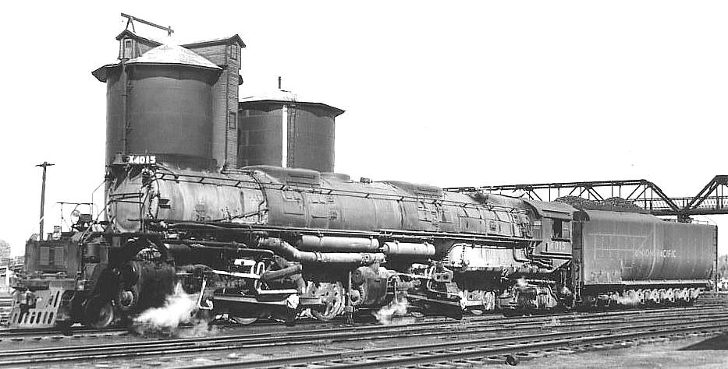

Slide 5
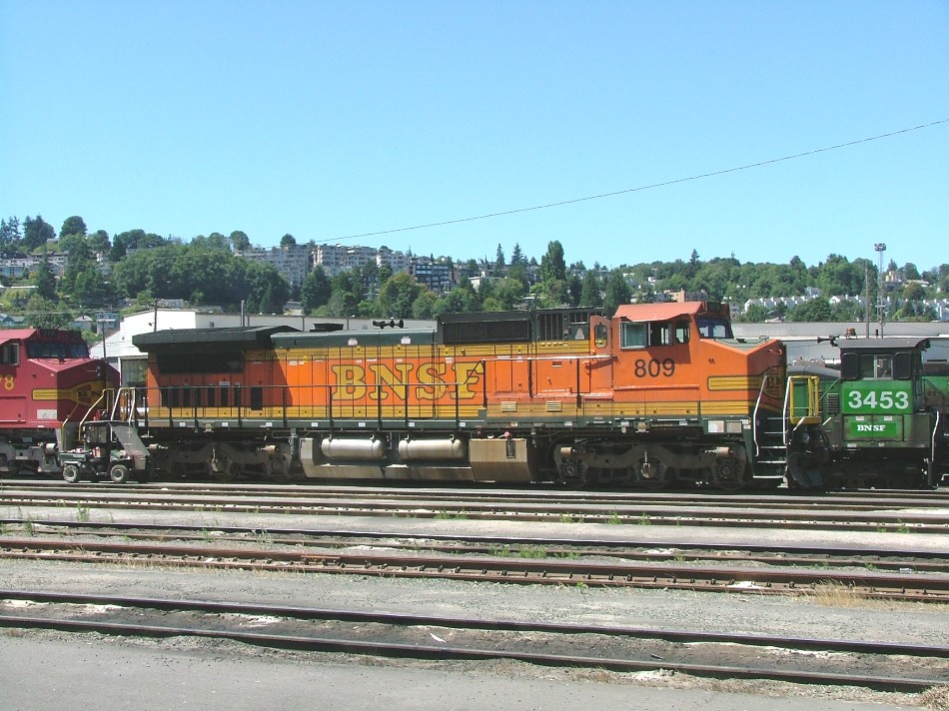

Slide 6
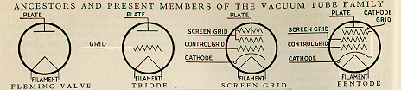
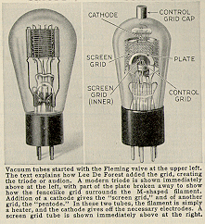

Slide 7
The interaction of Private Property Rights and Representative Democracy is dynamic and produces feedback effects between the Political System and the Economic System. 1. Inventors and Entrepreneurs Create things! These creations produce Unanticipated Structural Changes in the Economy and the social system!
2. These Unanticipated Structural Changes Generate Massive Ripple Effects in the Economic and Political Systems.
3. These Ripple Effects Produce a Political Response.

Slide 8
4. The Political Reponses produces a Feedback into the Economic System by altering the structure of incentives.
5. The Nature of the Political Response is shaped by Ideology. The Glue that binds together the members of a Political Party is provided by a set of beliefs about what is "good" -- Who gets what, who should rule.
6. The Effects of Shocks Go Both Ways -- There can be Political Shocks -- War -- that produce Economic Change.

