Slide 1
Polarization Overview: 2016
Part 2
The Position of the USA in the World 1947 – 2000s

Slide 2
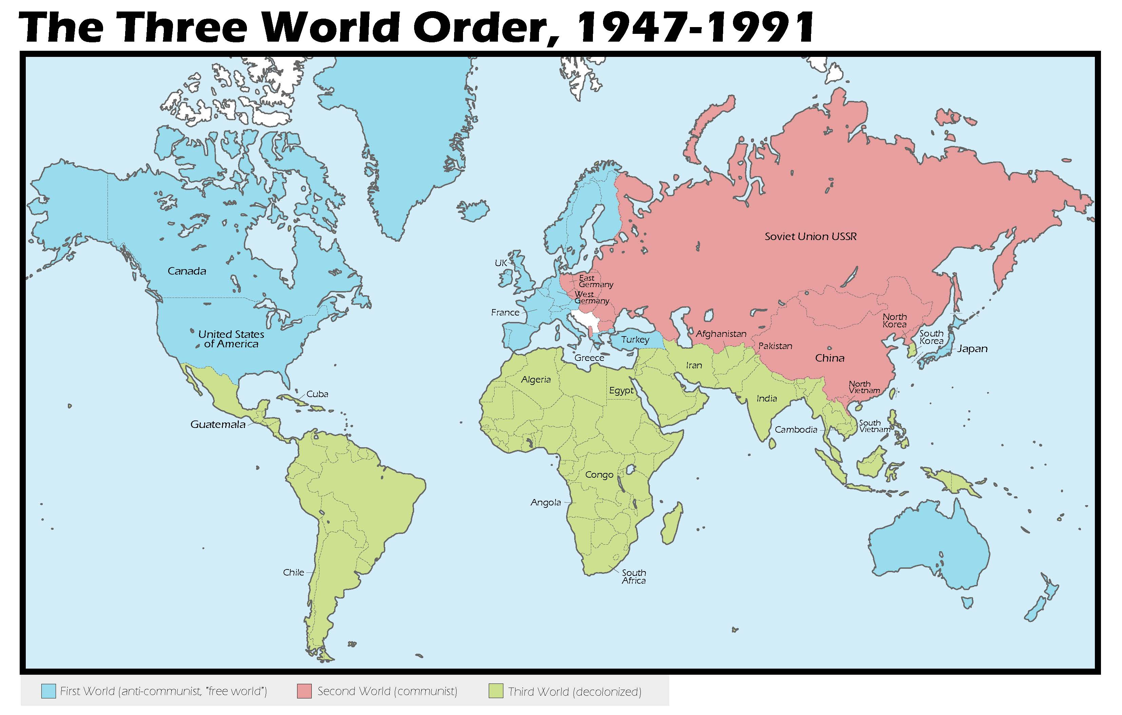

Slide 3
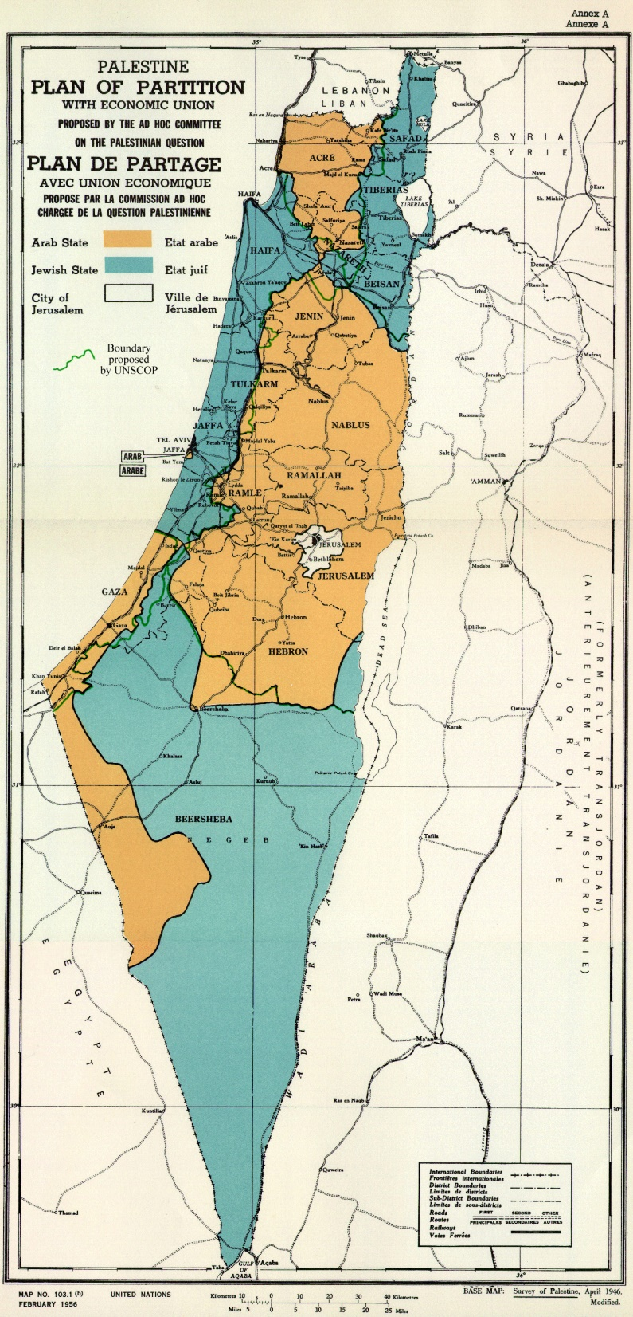

Slide 4
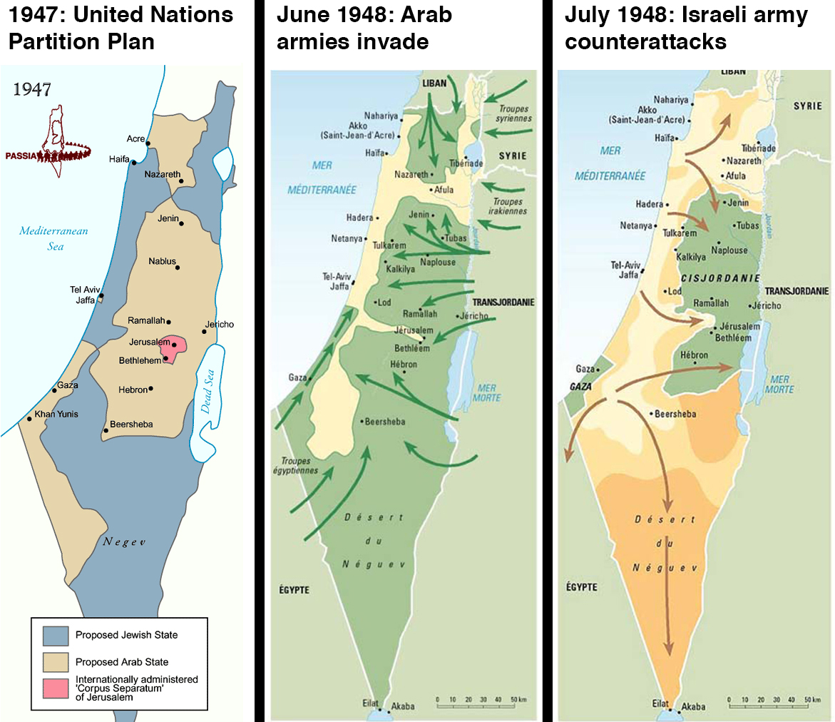

Slide 5
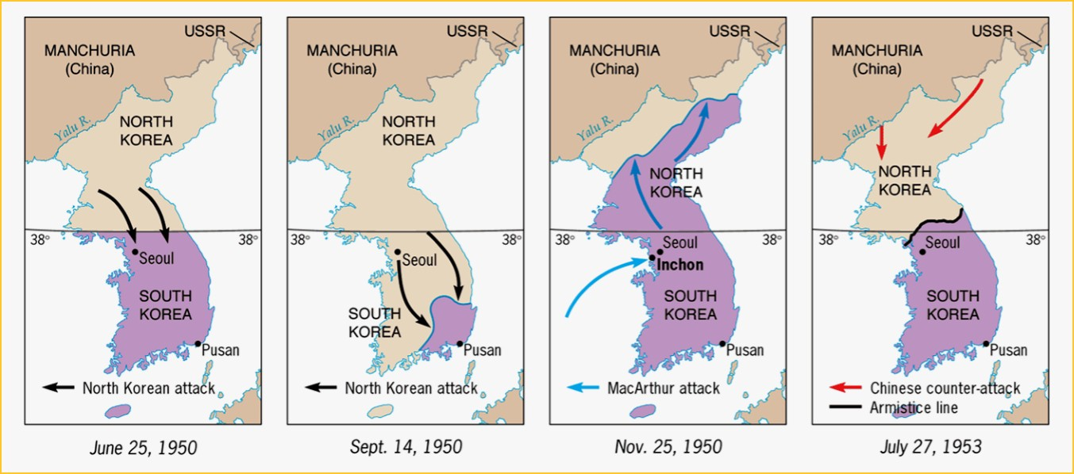

Slide 6
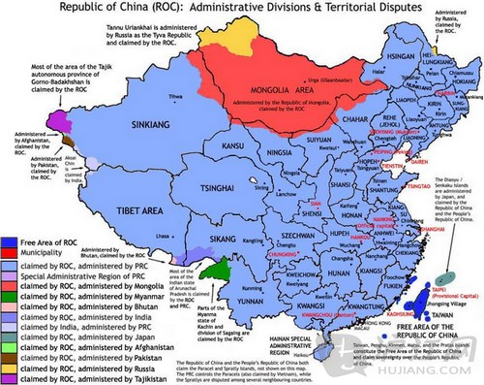

Slide 7
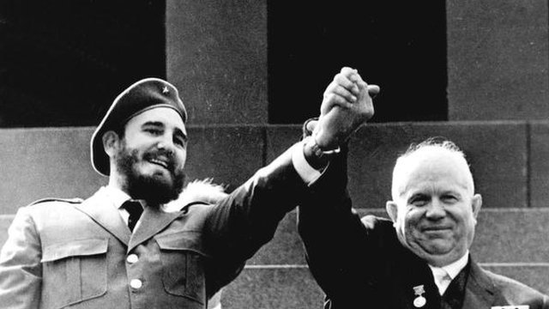
Fidel Castro and Nikita Khrushchev

Slide 8
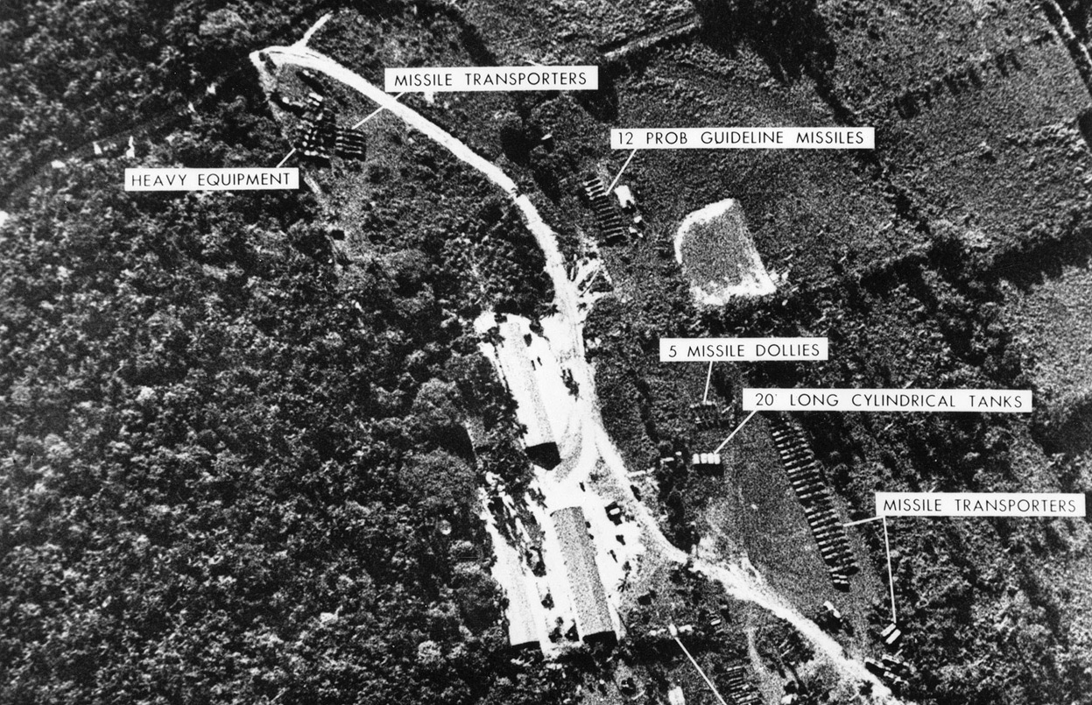
The Cuban Missile Crisis: 16 October 1962 – 28 October 1962

Slide 9
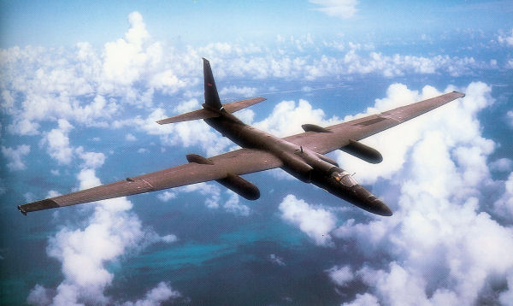
U2 Spy Plane – Top Speed 500mph, Altitude 70,000 feet

Slide 10
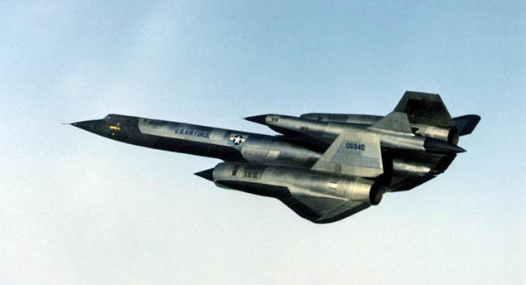
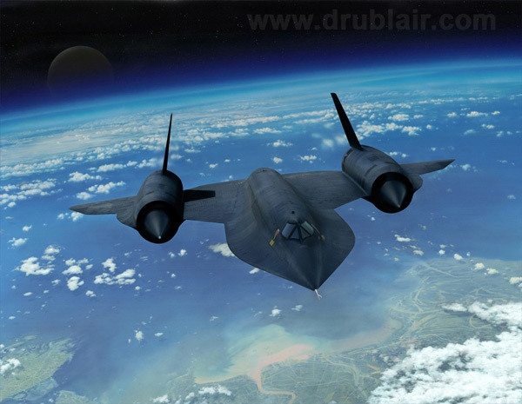
SR71 – Top Speed 2,200mph
Altitude 85,000 feet

Slide 11
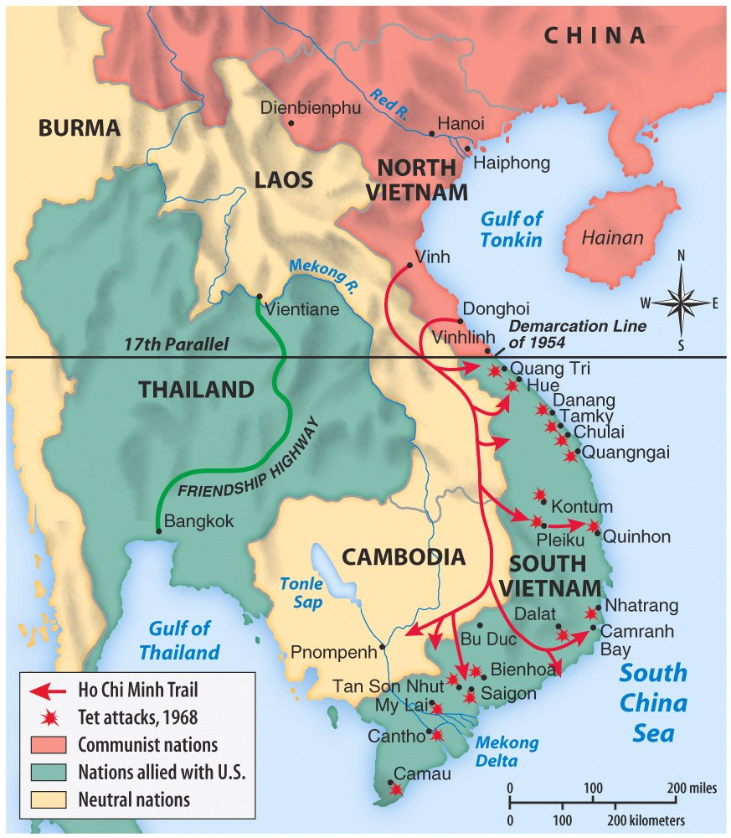

Slide 12
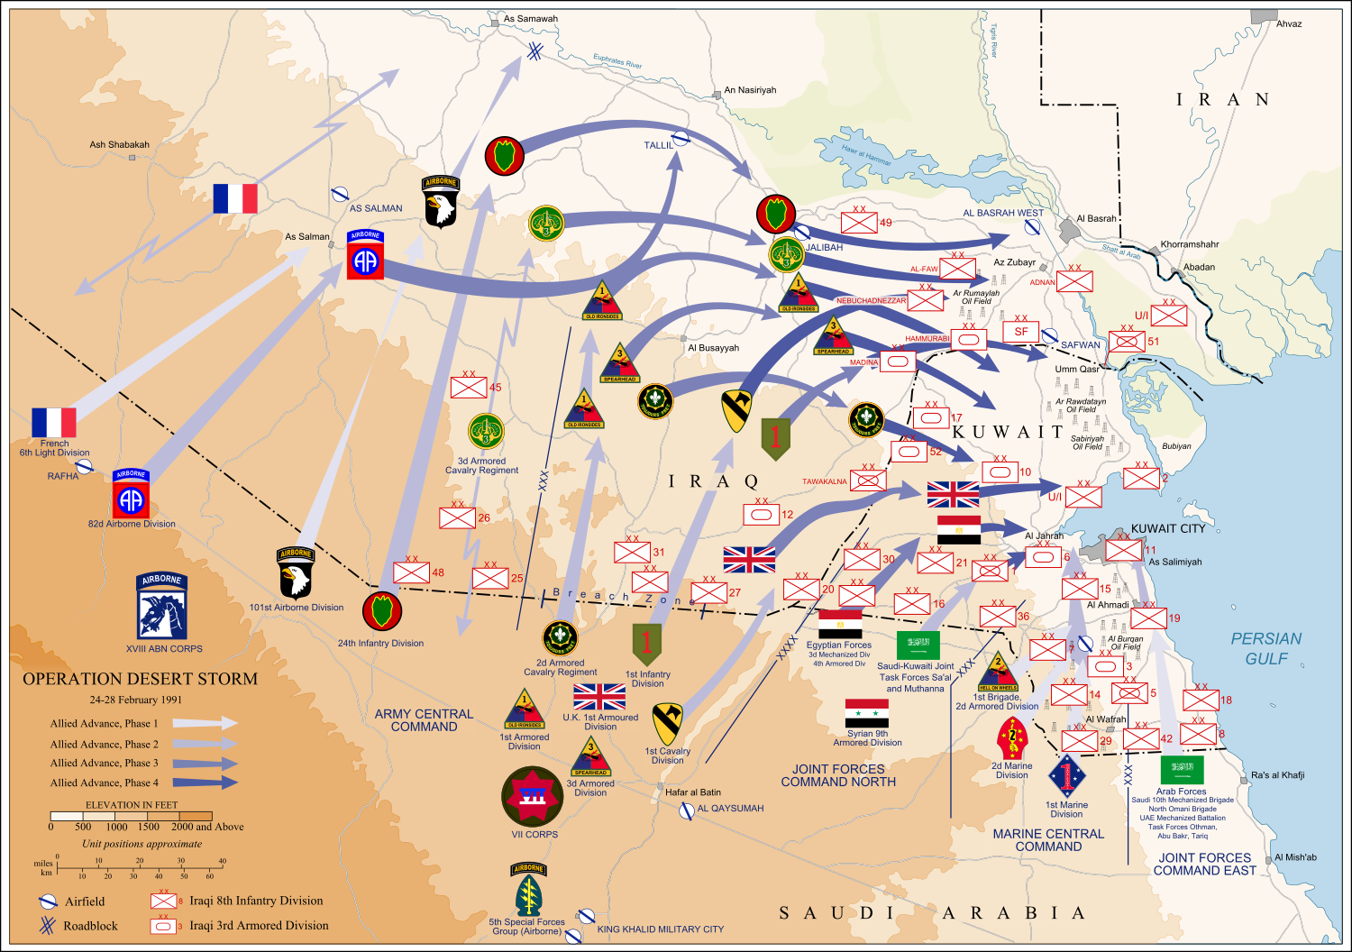
The First Gulf War: 2 August 1990 – 28 February 1991 (Image by Jeff Dahl, Wikipedia)

Slide 13
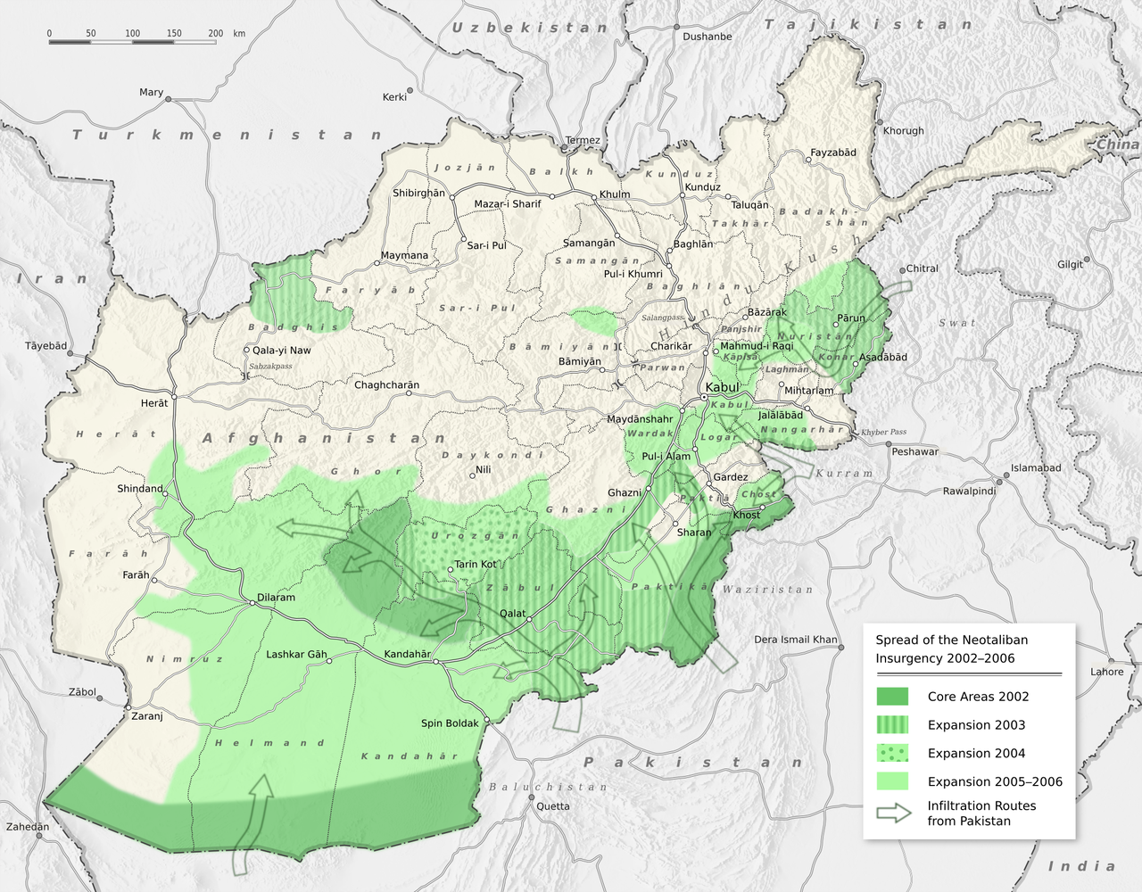

Slide 14
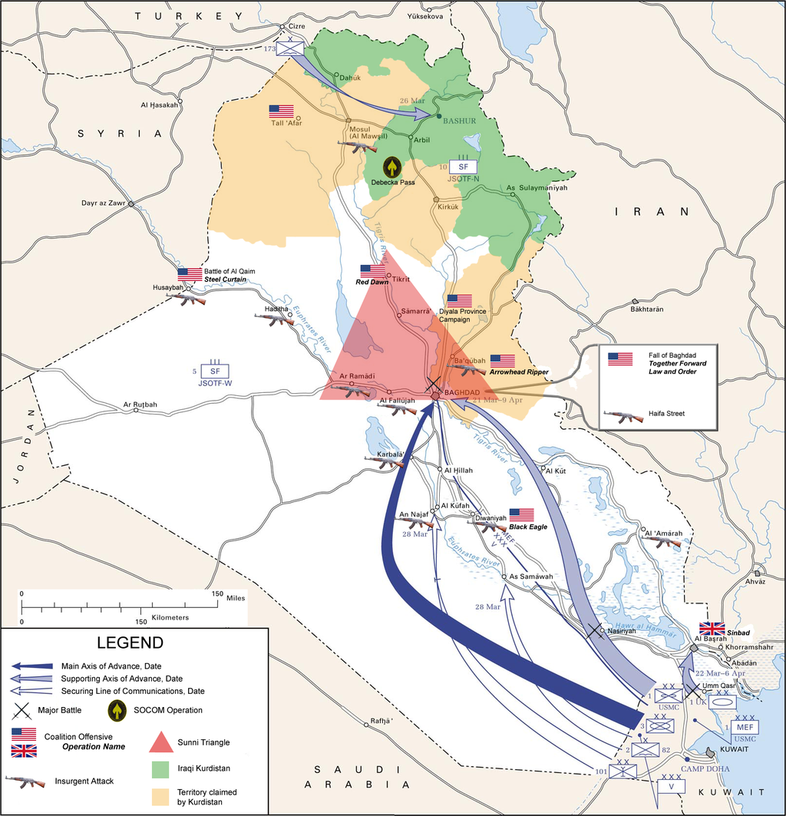
Iraq War 2003 – 2007 (Map by A Duran for Wikipedia)

