Slide 1
Polarization Overview
What we know and What we do not know

Slide 2
Political Polarization can be:
1. Political Party Polarization – The two major political parties are far apart on the major issues of the time.
2. Elite Polarization– Cultural, political, economic elites can be polarized while the mass public is not. Example, late 1980s into the 1990s.
3. Mass Polarization– The mass public can be polarized and the political parties are not. Example, 1830s – 1850 on the issue of Slavery.

Slide 3
Polarization 2014: Clearly 1, 2, and 3.
It is the defining characteristic of our political system.

Slide 4
How do we Measure Political Polarization?
1. The primary evidence of elite political polarization comes from analysis of the voting patterns of members of the U.S. House of Representatives and Senate. Very Long Time Series.
2. We also have striking evidence from campaign contributions data that go back to the 1970s. Work done by Adam Bonica of Stanford.
3. Survey Data is the primary way we measure mass polarization – PROBLEM – Surveys only go back into the 1950s and many only back into the 1970s.

Slide 5
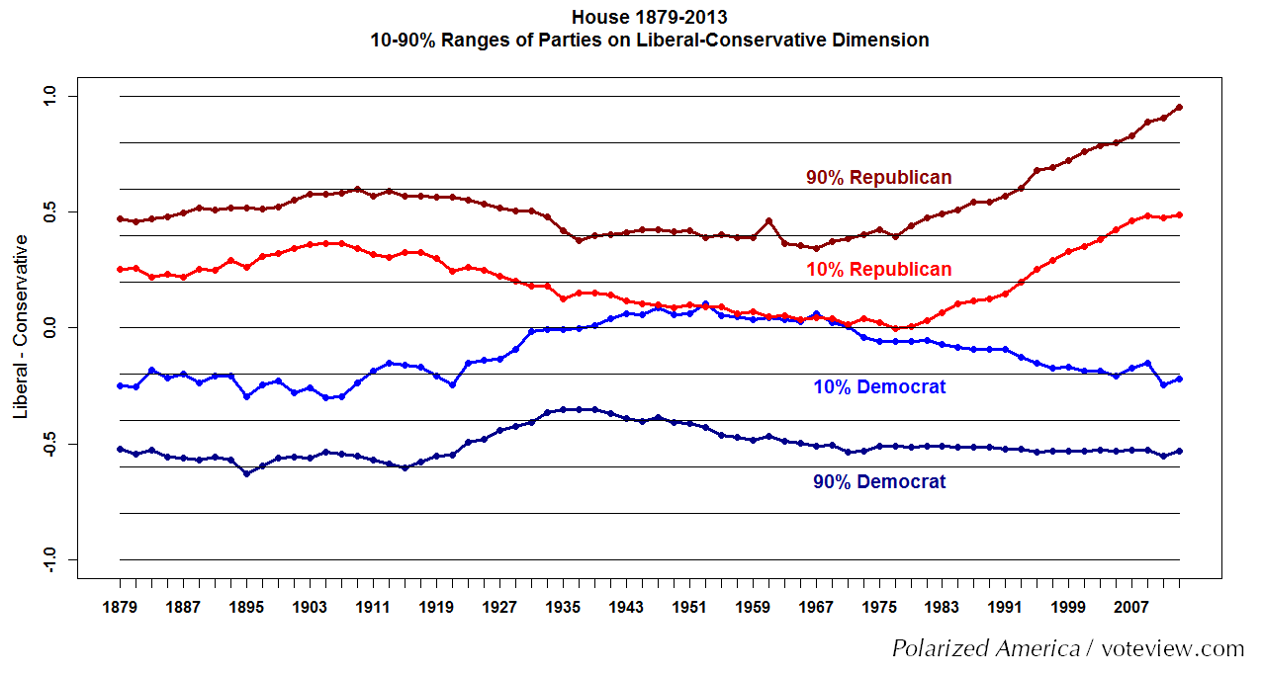

Slide 6
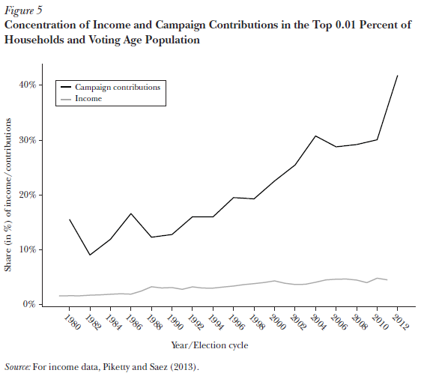

Slide 7
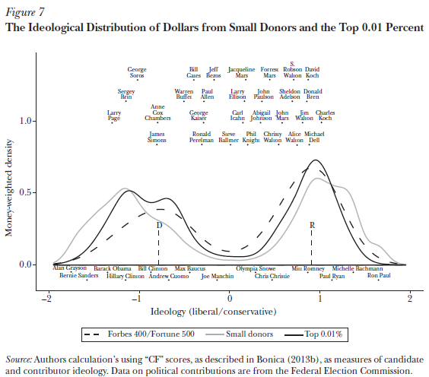

Slide 8
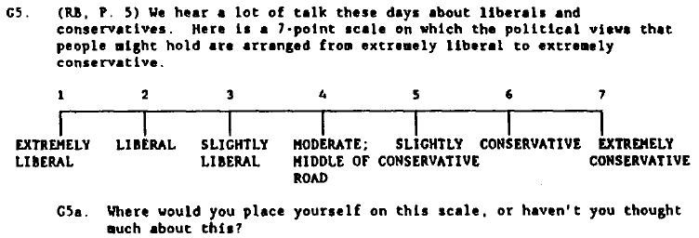

Slide 9
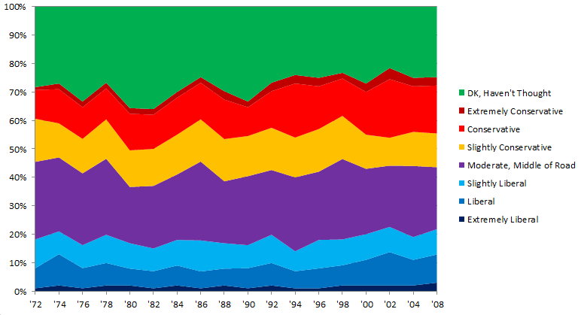

Slide 10
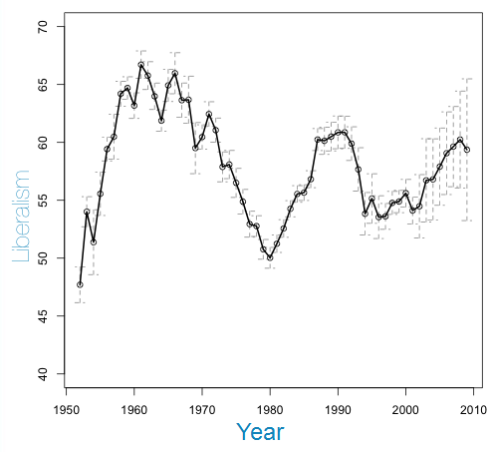
Public Mood James Stimson, UNC

Slide 11
4. Elections Data – Patterns within the Results of Congressional and Presidential Elections

Slide 12
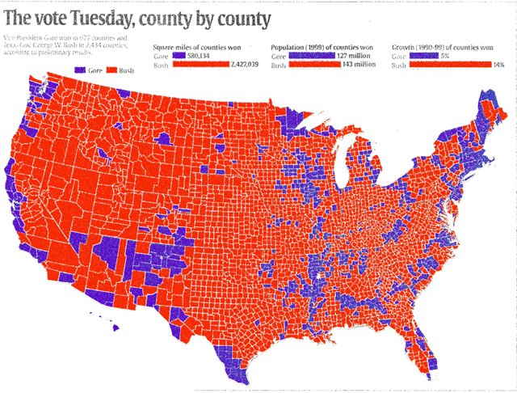
2000 Presidential Election Red for Bush, Blue for Gore

Slide 13
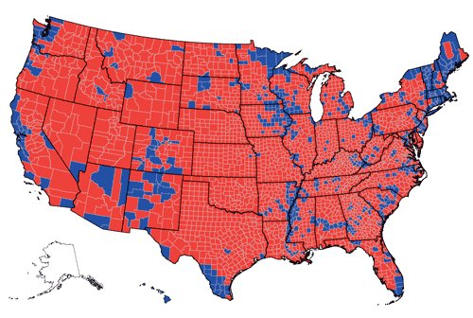
2004 Presidential Election Red for Bush, Blue for Kerry

Slide 14
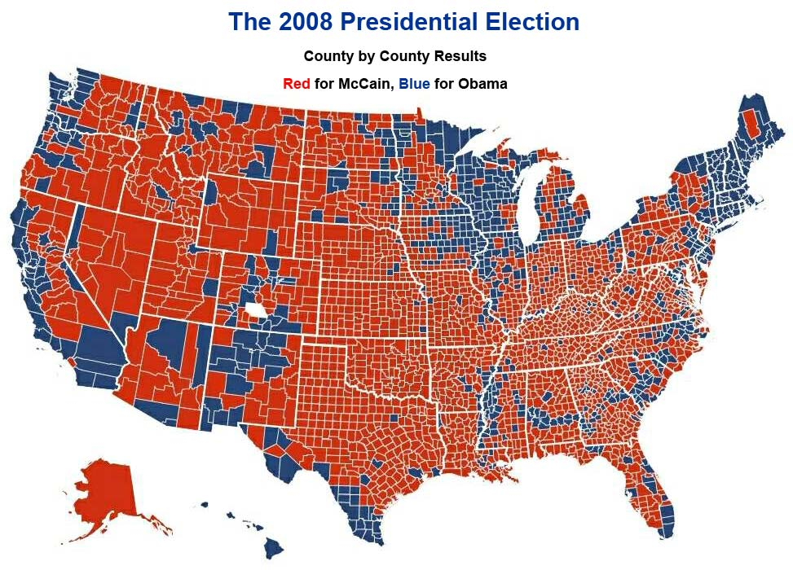

Slide 15
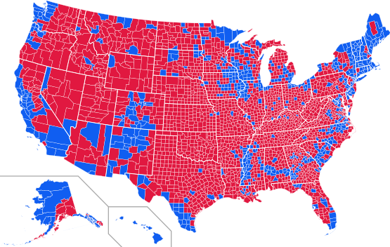
2012 Presidential Election
Blue for Obama, Red for Romney

Slide 16
What Causes Political Polarization? Not Clear.
1. In the 20th Century Political polarization, income inequality, and immigration increased dramatically in the United States from the mid-late 1970s to 2014. These increases followed an equally dramatic decline in these three social indicators over the first seven decades of the twentieth century.

Slide 17
2. It is more difficult to find the causes of polarization than to reject them because social, economic, and political phenomena are mutually causal. For example, immigration might lead to policies that increase economic inequality if immigrants are at the bottom of the income distribution and do not have the right to vote.

