Slide 1
The Public Policy Consequences of Political Polarization
The Financial Crisis 2007-2008 and the Great Recession

Slide 2
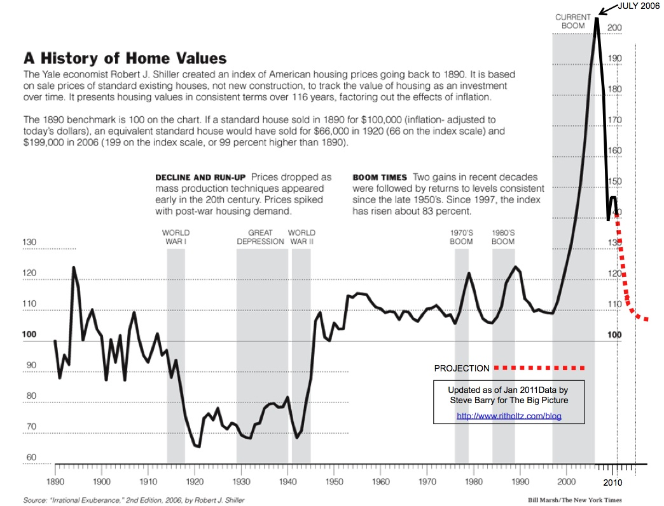

Slide 3
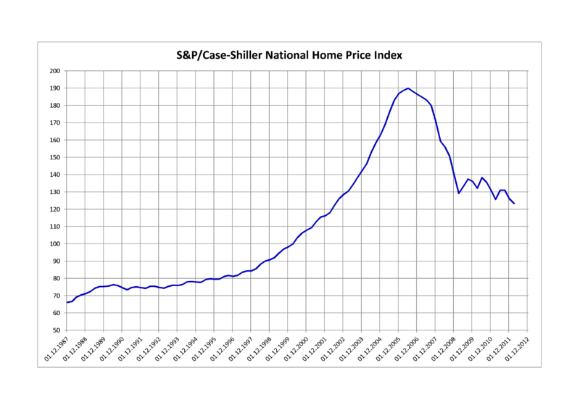

Slide 4
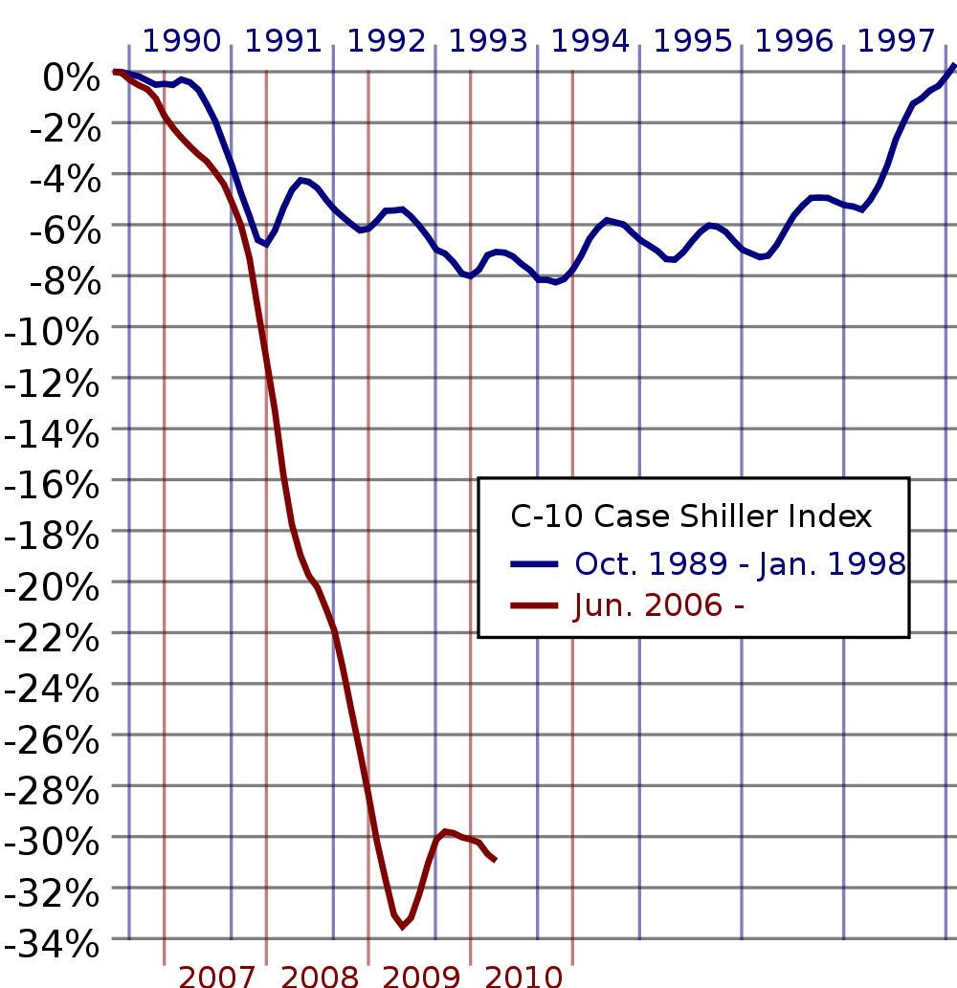

Slide 5
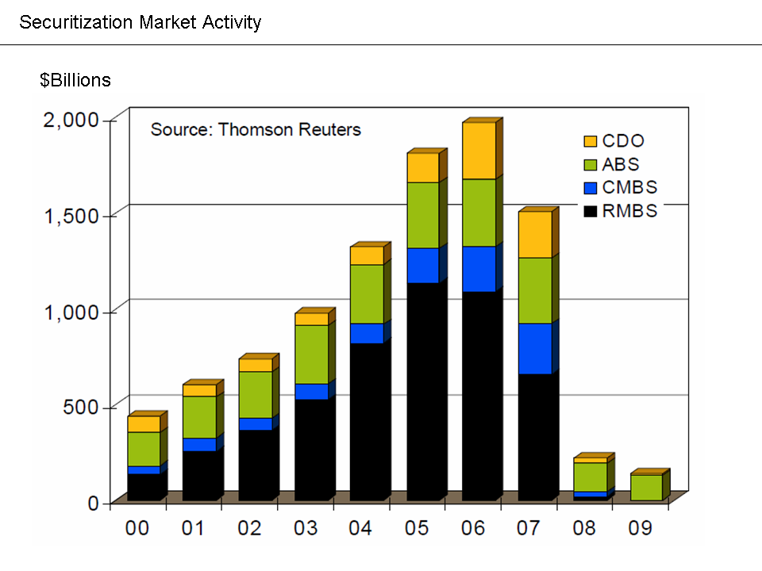

Slide 6
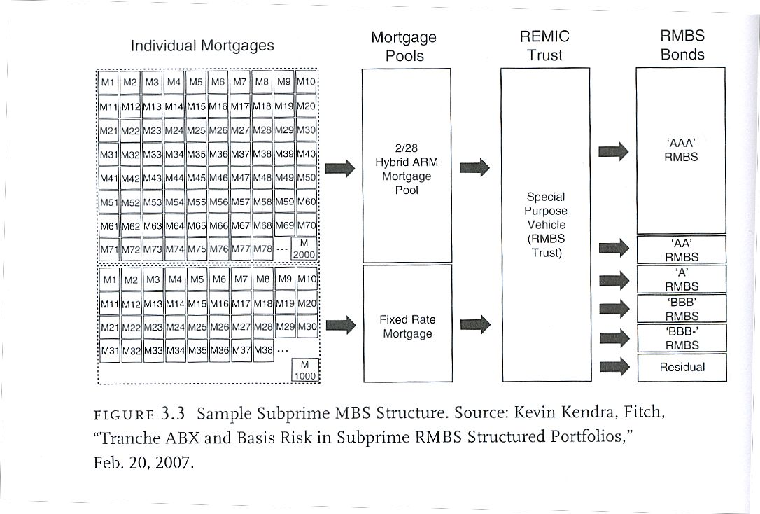

Slide 7
1. Securitization, plus … 2. Huge World Capital Surplus produced … The Shadow Banking System

Slide 8
When the Housing Bubble Popped it triggered a classic Bank Run. Only it was a Run on the Shadow Banking System. This Brought the Economy Down.

Slide 9
Who is to Blame for the Financial Meltdown and the Great Recession?

Slide 10
1. Congress – Slowly deregulated the financial system. 2. Presidents Carter to Obama – Their choices for cabinet officers, regulatory agencies, and their advisors. 3. Banks and Financial Companies – “Infectious Greed” and “Irrational Exuberance.” 4. The Rating Agencies – Moody’s, Standard & Poor’s, Fitch. 5. The American Elite who served on various boards of directors and directly benefited from the Bubble.

Slide 11
What is a Bubble??
“This Dance Can go on Forever”
Basically – “If it is too good to be true…..it ain’t”

Slide 12
Asset Bubbles and Political Bubbles are shaped by: Ideologies (Beliefs); Institutions; and Interests

Slide 13
Economic Bubbles
Stock Market c. 1927 – 1929.
“Irrational Exuberance”
Dot Com Bubble in the late 1990s.
New Information Economy was emerging. “Bricks and Mortar” will be a thing of the past.
Housing Bubble late 1990s – 2006.
Globalization and a Savings Glut from Developing countries could drive interest rates to permanently low levels.

Slide 14
Political Bubbles
Stock Market c. 1927 – 1929.
Not the Government’s Business.
Dot Com Bubble late 1990s
If the information economy is the wave of the future it would be Luddism to tighten standards for public offerings or pricing of stock options.
Housing Bubble late 1990s – 2006.
Markets self-correct (rational expectations). If savings glut reduces interest rates it would be folly for monetary policy to interfere.

Slide 15
Almost Everyone Believes……
THIS TIME IS DIFFERENT!

Slide 16
The Ideologies at Work in the latest Crisis
Free Market Conservatism
Fundamentalist Free Market Conservatism
Egalitarianism

Slide 17
Institutions (the 2nd “I”)
Political Institutions –
Regulatory Structures --

Slide 18
Interests (the 3rd “I”)
Well organized, resourceful groups, such as those in the financial sector, are often able to exploit ideological allies and institutional structures to produce policy benefits for themselves.

Slide 19
How the Two Types of Bubbles Differ
They are similar during the Bubble phase because of beliefs
There are important differences when the Bubble pops:
Economic expectations can change dramatically and decisively in a short time.
Political beliefs change very slowly because of ideological rigidity. IN THE CURRENT CRISIS THIS WAS EXACERBATED BY POLITICAL POLARIZATION.

Slide 20
The Three Pillars of the Financial Crisis
Bad paper widely written in the form of sub-prime mortgages.
These sub-prime mortgages were securitized and given high ratings. The securities were then pushed to investors around the world.
These securities were insured by Credit Default Swaps.

Slide 21
1. Securitization, plus … 2. Huge World Capital Surplus produced … The Shadow Banking System

Slide 22
Securitization and the Shadow Banking System
These securities (along with many other securities – private & Fannie Mae and Freddie Mac) were used as collateral in the Shadow Banking System.
Sale and Repurchase Market (“REPO”) – The essence of “Shadow” Banking. Shadow Banks (1) do not take deposits; (2) provide credit and liquidity; (3) no access to central bank funding or the FDIC.

Slide 23
“REPO” Market
This Market only works if you have access to Collateral that is seen as “Good as Gold.”
The Collateral must be SAFE – so safe that you do not have to worry about it or make much of an effort to investigate it.

