Slide 1
Fiorina Chapter 10
Changes in American Politics Since 1960

Slide 2
Fiorina: Chapter 10 -- Changes in American Politics Since 1960
The Ascendance of the Purists at the Expense of the Professionals.
The Expansion of Government
The Rise of Participatory Democracy
The Hijacking of American Democracy

Slide 3
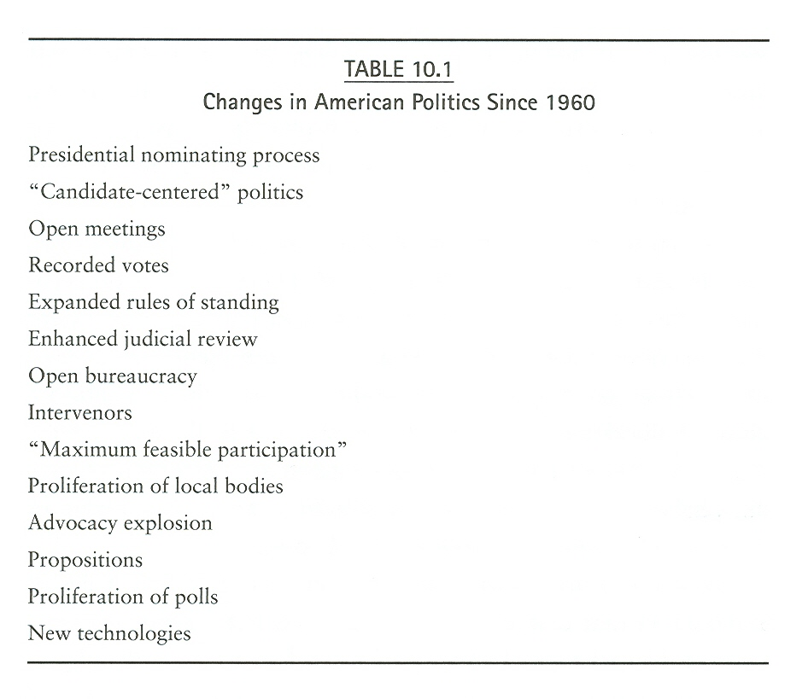

Slide 4
Is The United States Really Polarized?
Elite Polarization – Yes. The Evidence is Overwhelming
Mass Polarization – Not Necessarily, but the Partisans are very Polarized

Slide 5
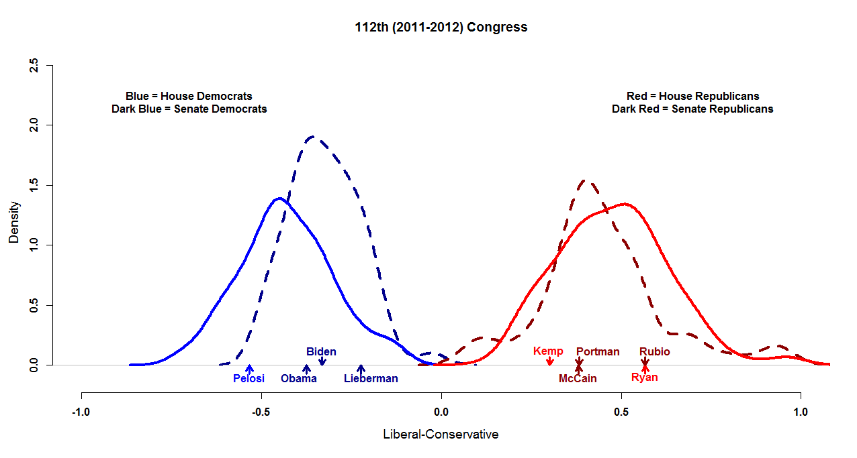

Slide 6
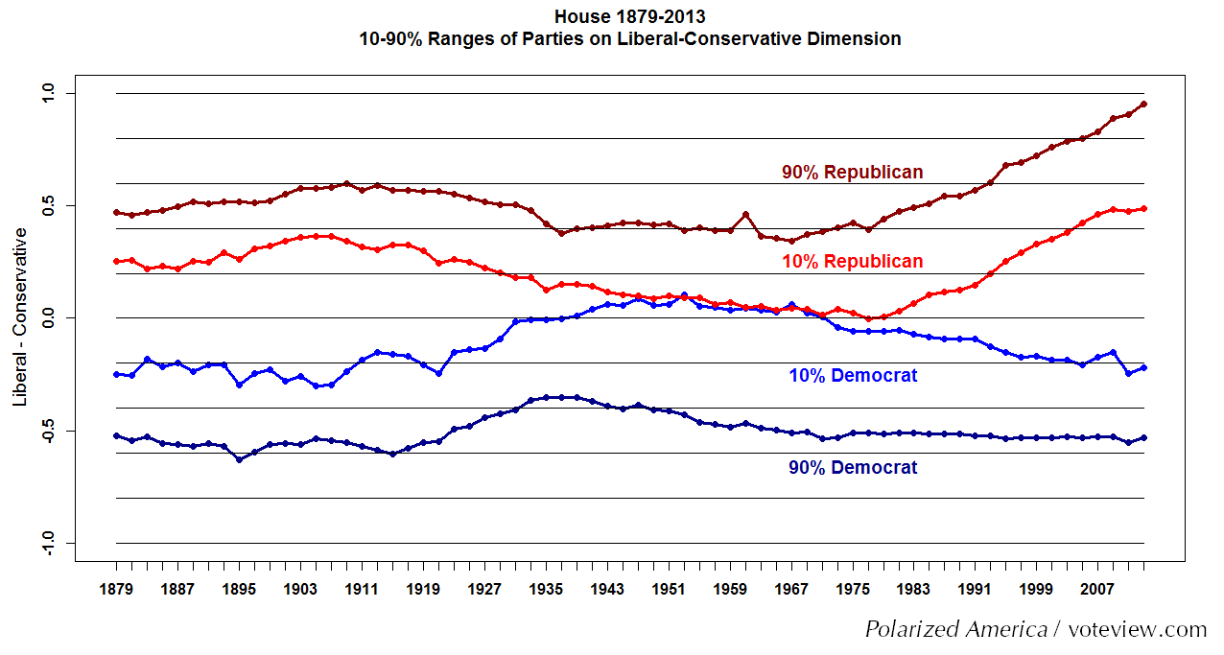

Slide 7
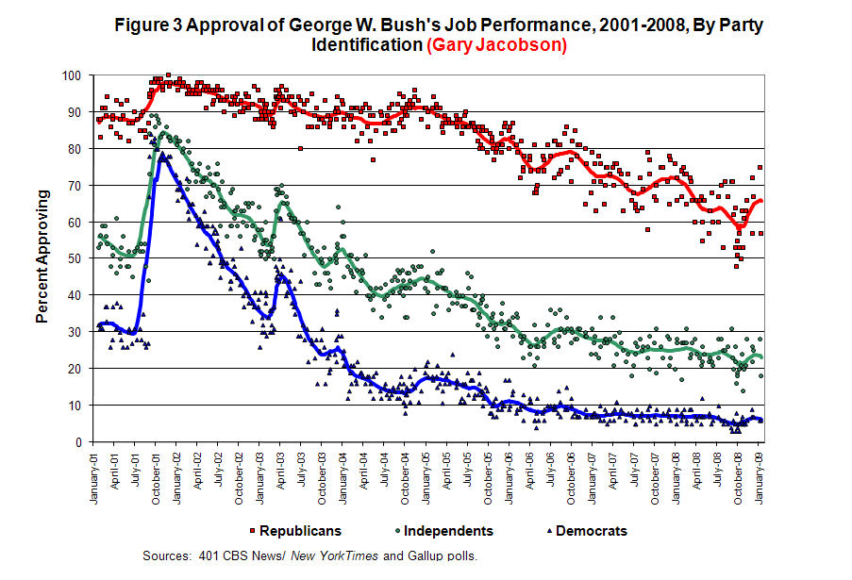

Slide 8
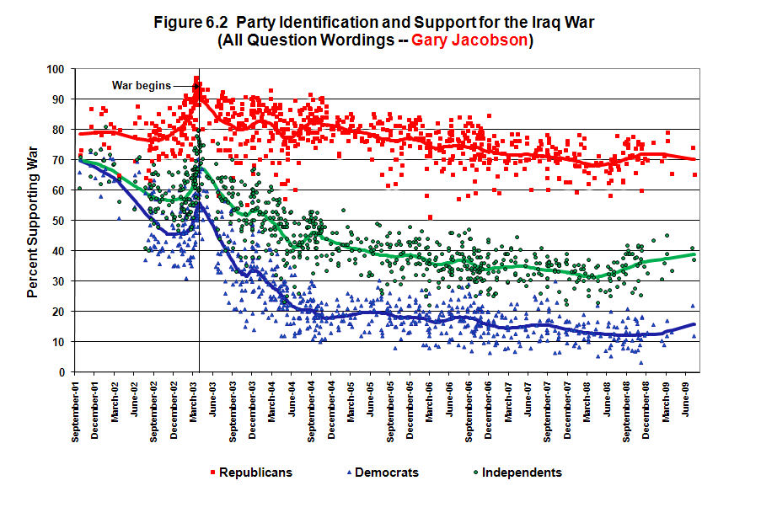

Slide 9
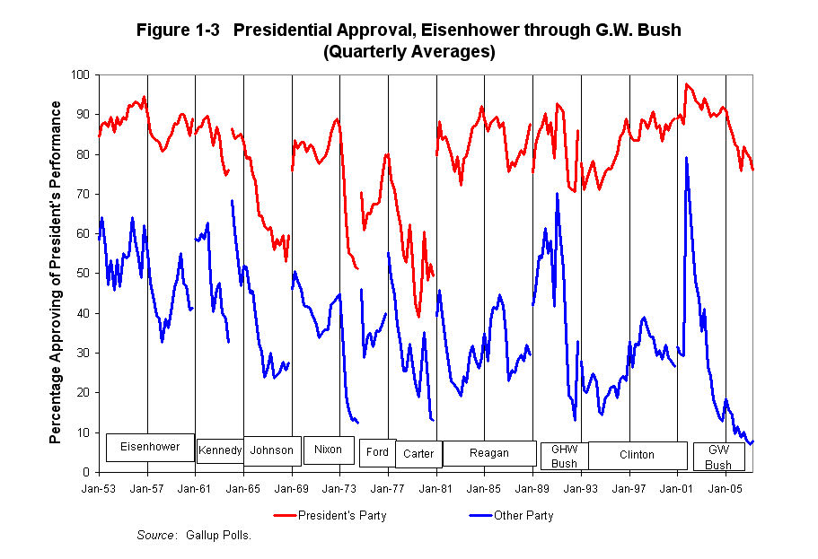

Slide 10
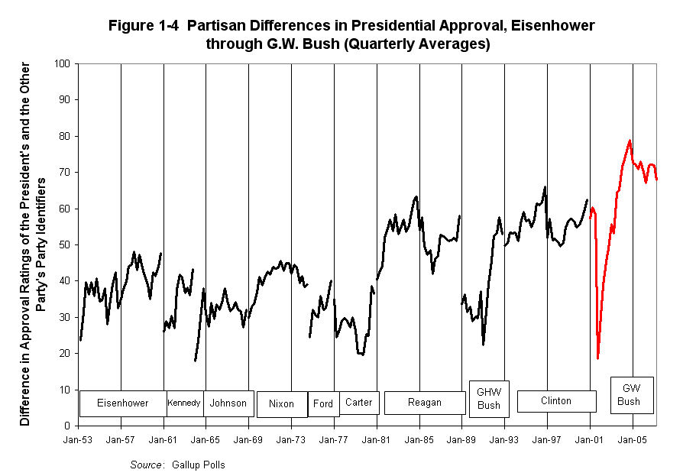

Slide 11
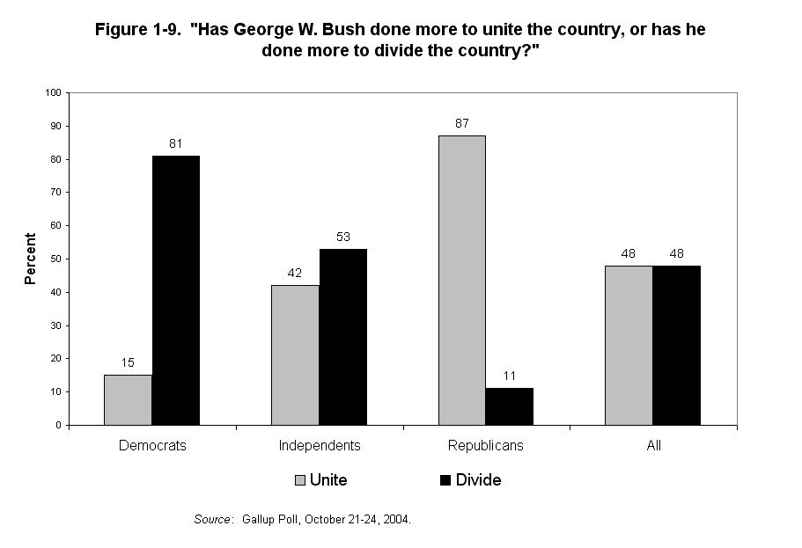

Slide 13
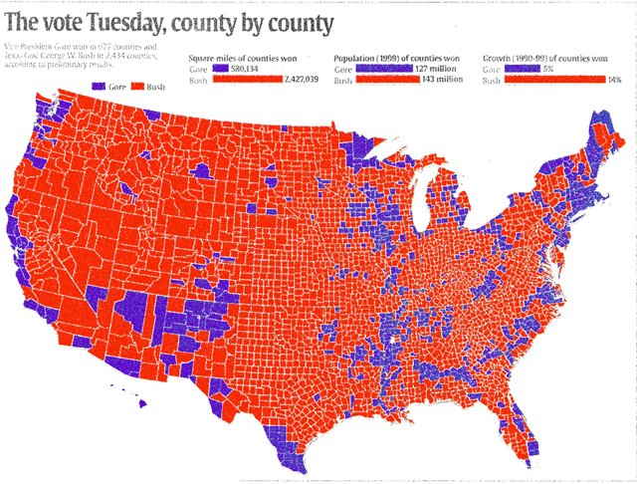
2000 Presidential Election

Slide 14
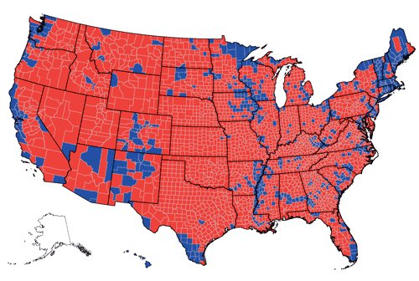
2004 Presidential Election

Slide 15
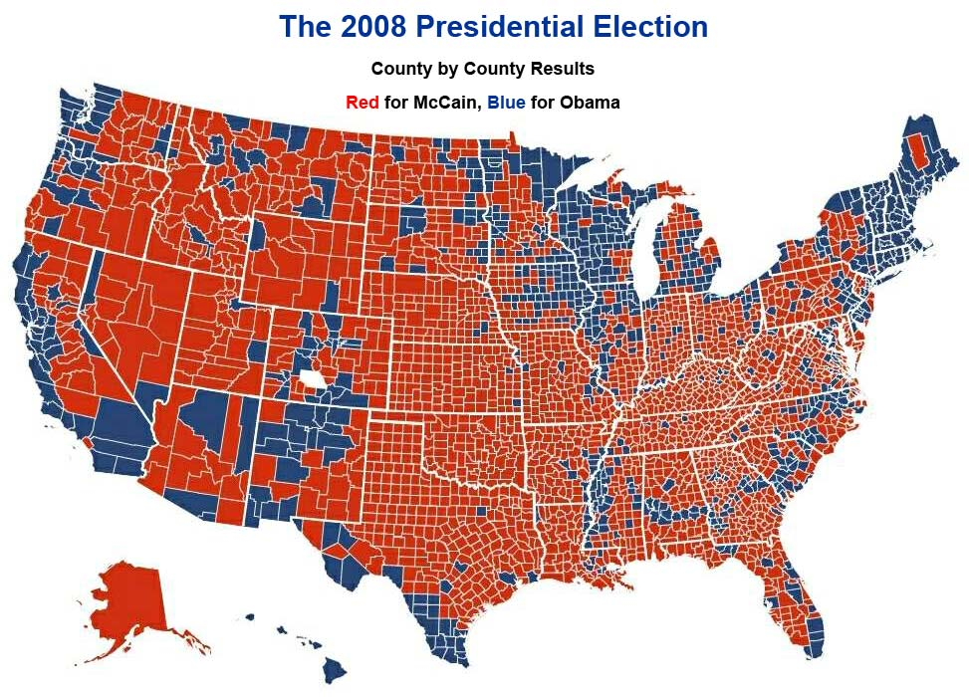

Slide 16
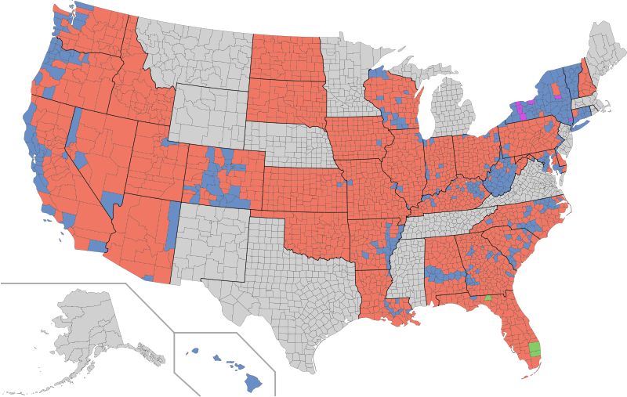
2010 Senate Elections by County

Slide 17
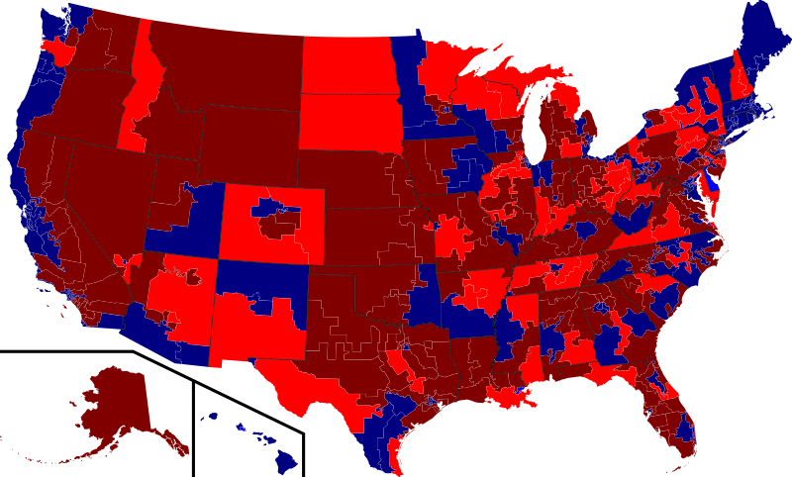
2010 HOUSE ELECTIONS BY CONGRESSIONAL DISTRICT

Slide 18
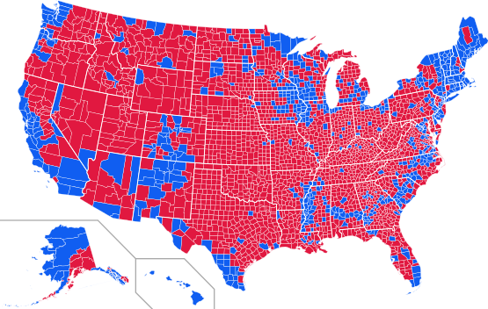
2012 Presidential Election
Blue for Obama, Red for Romney

Slide 19
