Slide 1
The Partisan Sort
Chapter 7
The Impact of the Sorted

Slide 2
“Although there has been a large increase in sorting, there has been only a modest increase in polarization. So while the electorate is much better sorted today than it was a generation ago, it is only slightly more polarized, and much of that increased polarization is a direct result of sorting” (p.120).
That is: Party-Driven Sorting > Ideological-Driven Sorting.

Slide 3
Table 7.1 – 1992-94-96 Panel – If people are sorting this should result in a voter:
Being more likely to support their party’s Presidential candidate; and
Less Split Ticket Voting

Slide 4
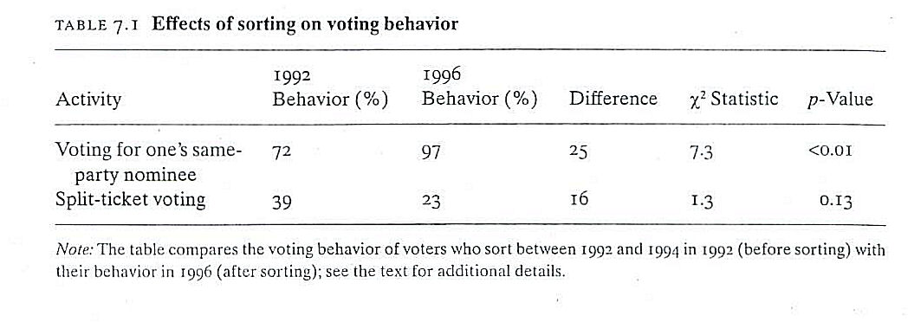

Slide 5
Table 7.2 – 1992-94-96 Panel – Affective Polarization: If people are sorting this should result in a voter giving a higher feeling thermometer rating to her party relative to the opposite party.

Slide 6
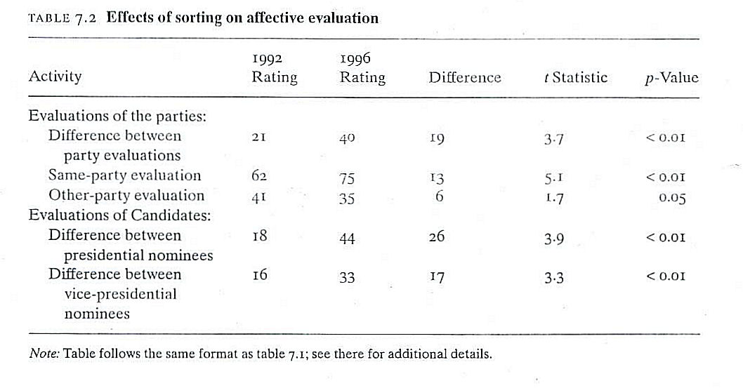

Slide 7
Table 7.3 – 1992-94-96 Panel – Constraint (Converse, 1964): If people are sorting this should result in a voter adopting the issue positions of her Party.

Slide 8
