Slide 1
The Partisan Sort
Chapter 6
How Voters Sort

Slide 2
  Party Driven Sorting – You adjust your ideological beliefs to fit with your partisanship.
  Ideology Driven Sorting – You change your partisanship to fit with your ideological beliefs.

Slide 3
  Party Driven Sorting – A Conservative Democrat becomes a Liberal Democrat.
  Ideology Driven Sorting – A Conservative Democrat becomes a Conservative Republican.

Slide 4
  Party Driven Sorting
      Partisanship is very stable over time.
      Partisanship is a useful cue for low information voters.
      Party ID provides citizens with a powerful heuristic to use to understand the political world and the issues of the day (p. 111).

Slide 5
  Ideology Driven Sorting
      Ideology is less stable over time.
      However, Party ID can be seen as a “running tally” of a person’s experiences with the parties. These experiences can change (e.g., Harry Truman vs. George McGovern).
      In contrast to the party-driven model of sorting, it is ideology and related issue positions, not partisanship, that are the dominant causal factor (p. 111).

Slide 6
  Hypothesis: Given the power and stability of party ID, only a coherent and well-developed belief system should lead to ideology-driven partisan change. I therefore expect ideology-driven sorting to be limited to highly politically sophisticated respondents (p. 113).

Slide 7
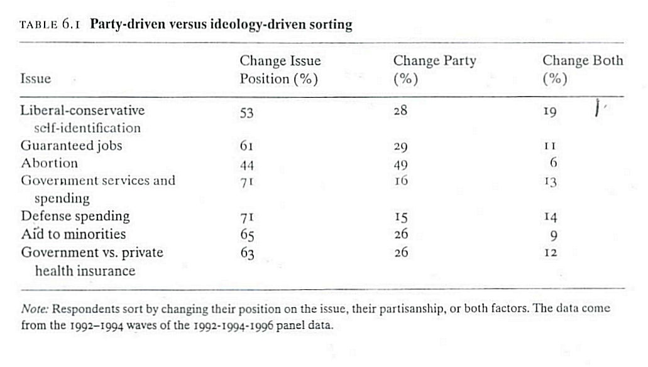

Slide 8
Overall, Party-Driven Sorting: “When individuals bring their party ID and ideology into alignment with each other, they seem to move their ideology, regardless of the political environment or level of elite polarization” (p. 115)
There is some evidence that Ideology-Driven Sorting was important in the White South in the 1970s.

