Slide 1
The Partisan Sort
Chapter 3: Have Voters Sorted?

Slide 2
  Definition of Awareness (Information) – D < R

Slide 3
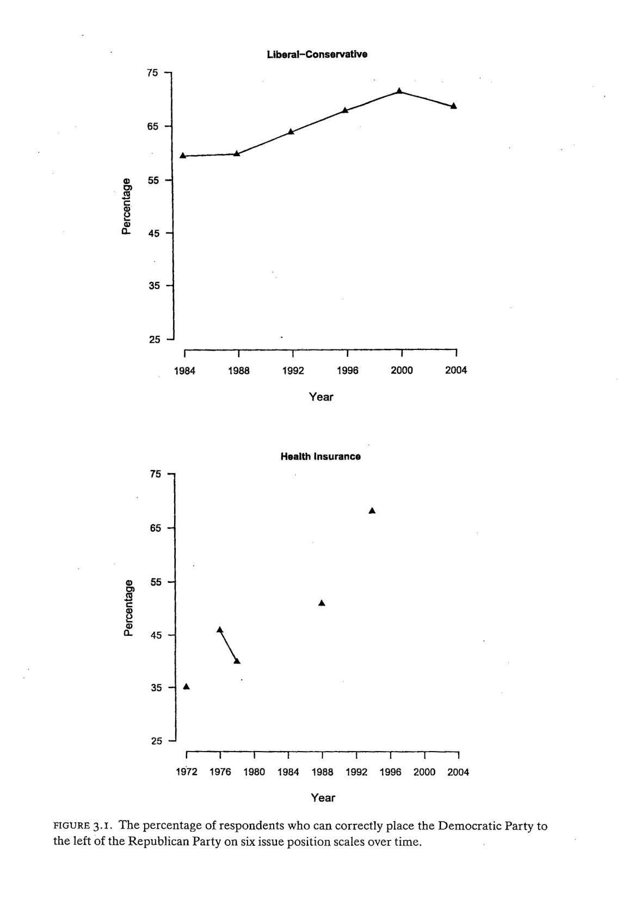
PERCENT AWARE

Slide 4
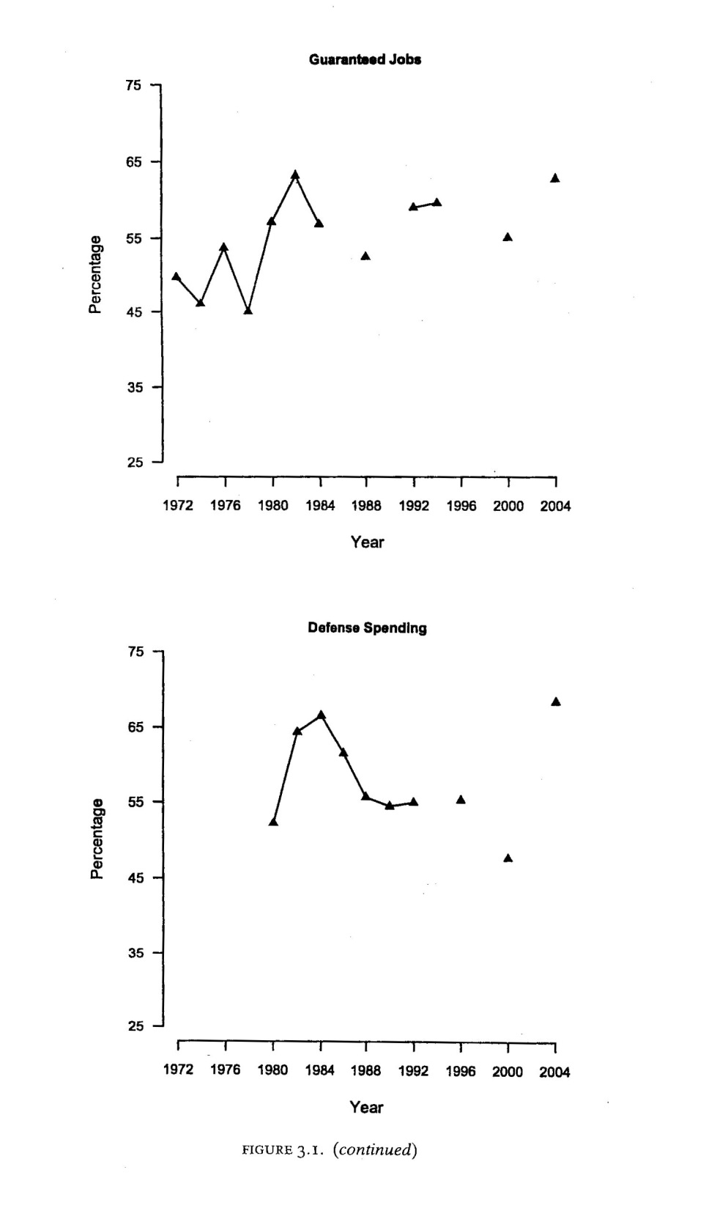
PERCENT AWARE

Slide 5
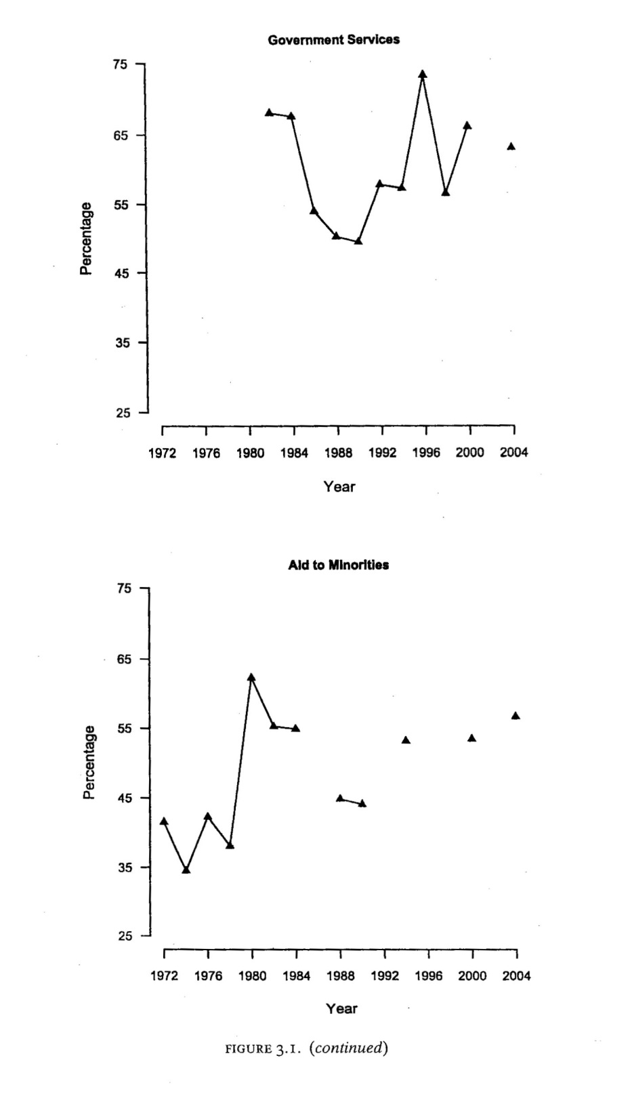
PERCENT AWARE

Slide 6
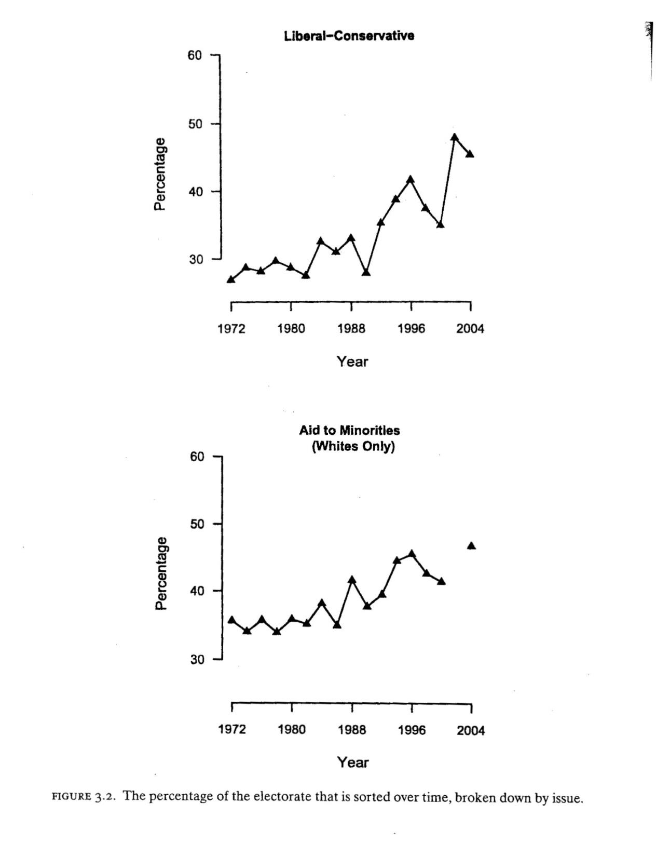
PERCENT SORTED

Slide 7
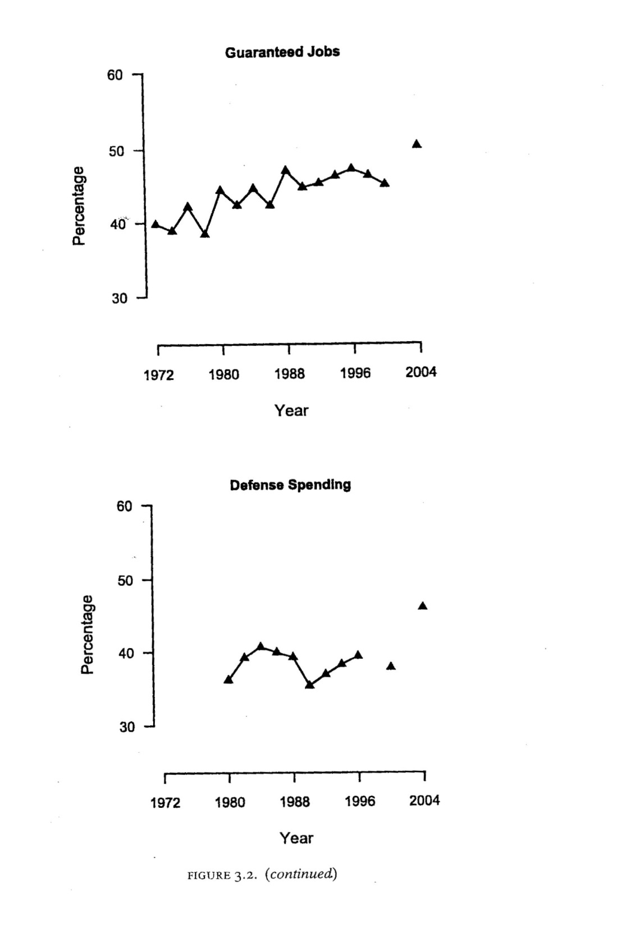
PERCENT SORTED

Slide 8
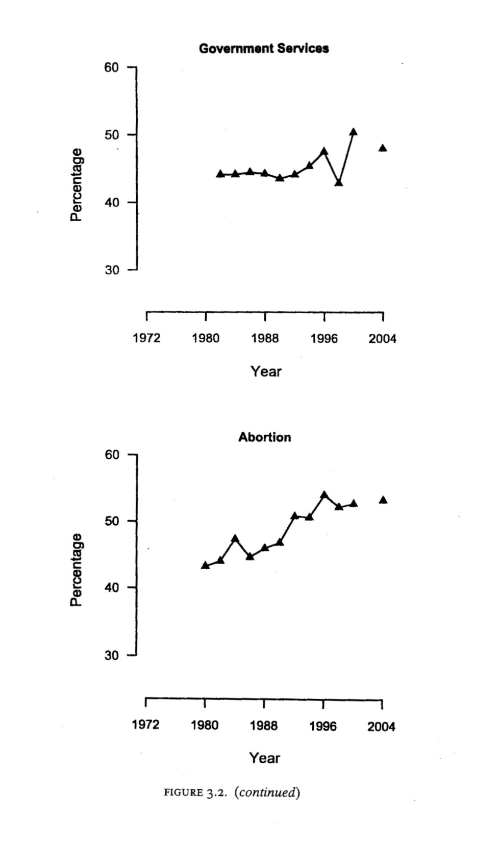
PERCENT SORTED

Slide 9
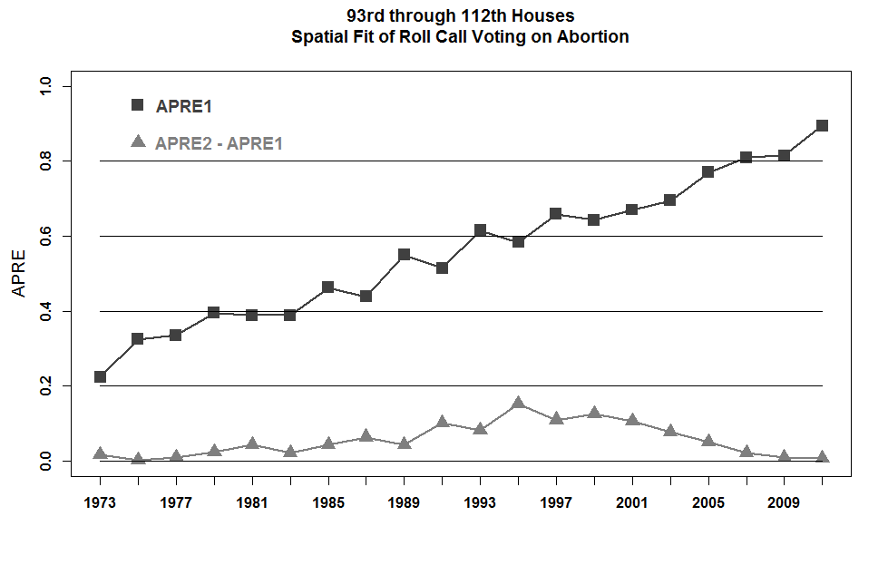

Slide 10
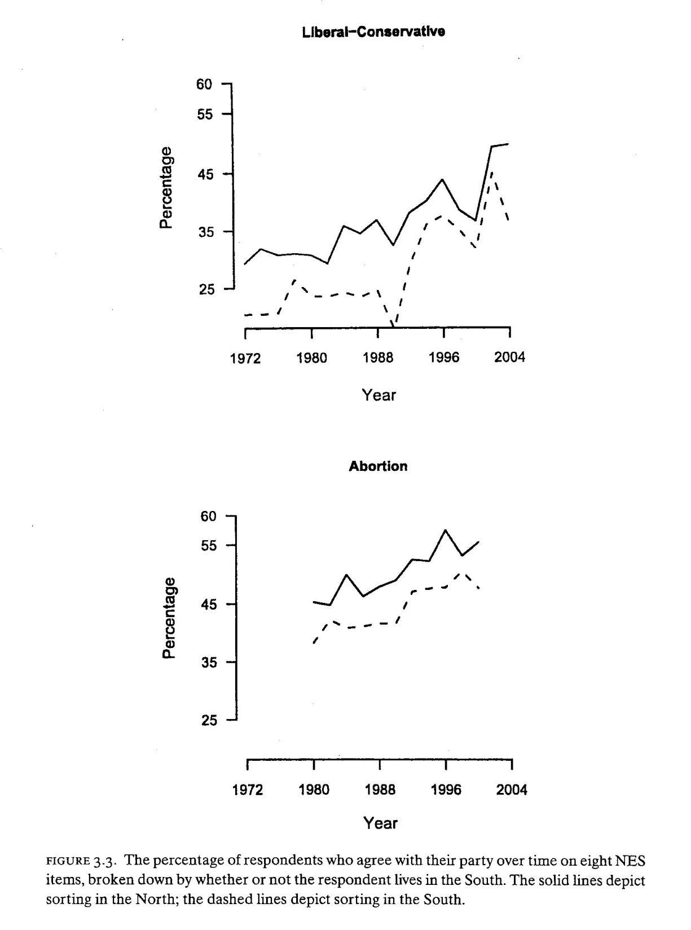
PERCENT AGREE WITH PARTY – N vs. S

Slide 11
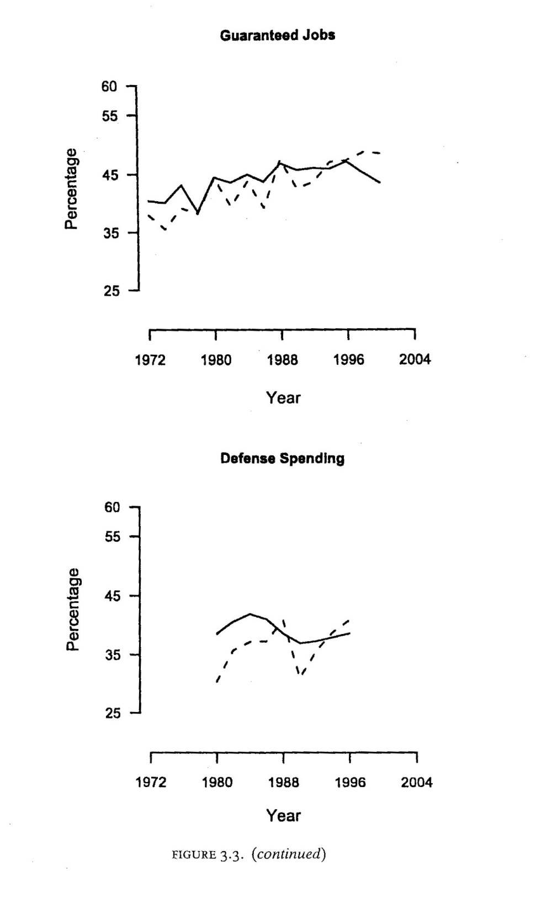
PERCENT AGREE WITH PARTY – N vs. S

Slide 12
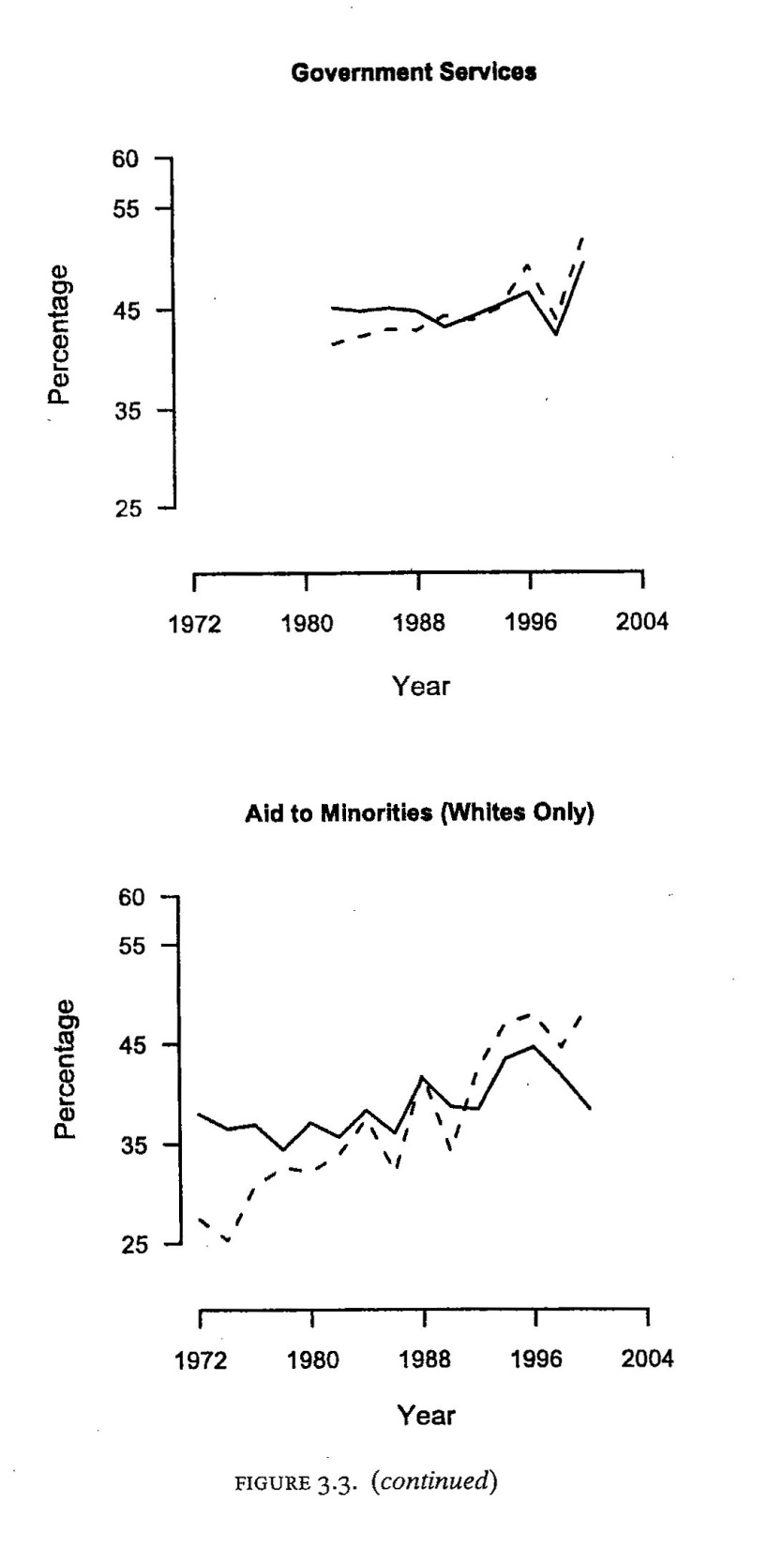
PERCENT AGREE WITH PARTY – N vs. S

Slide 13
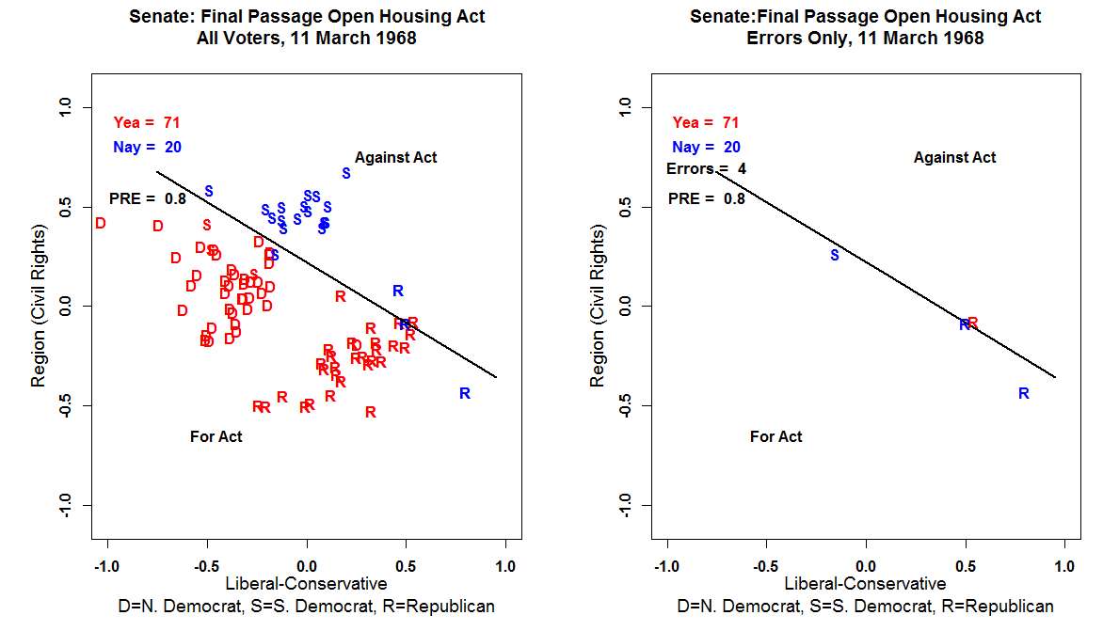

Slide 14
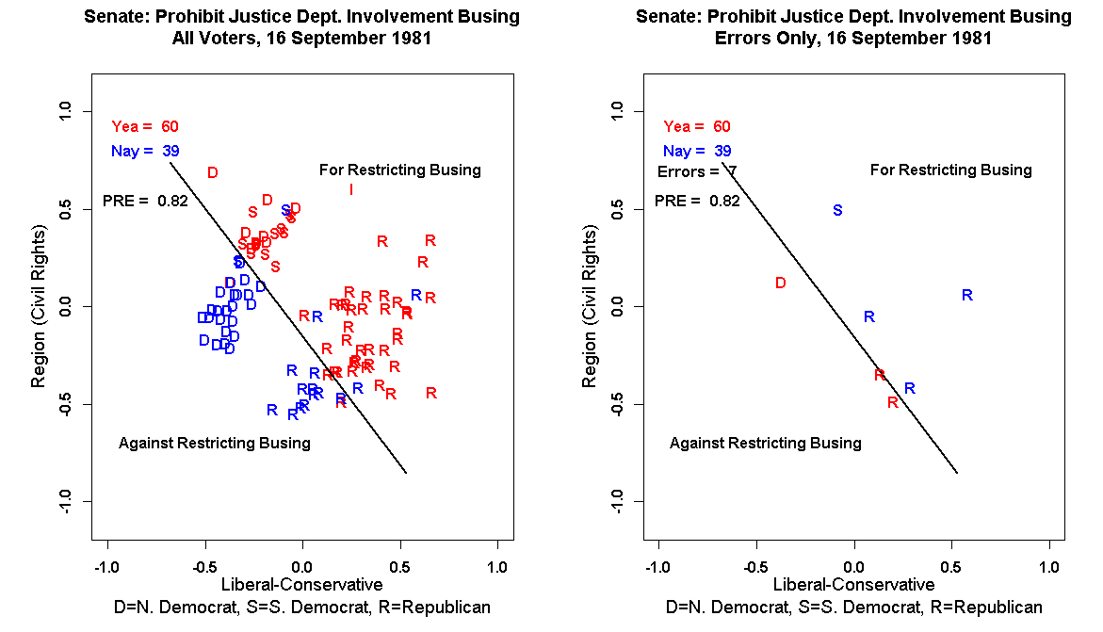

Slide 15
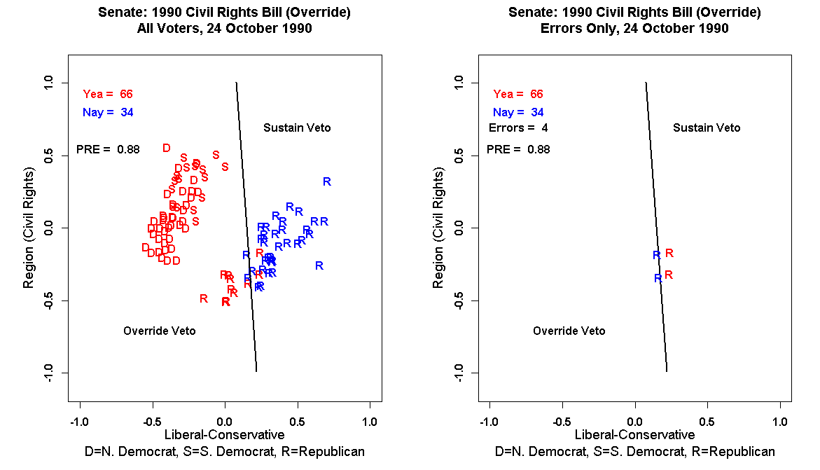

Slide 16
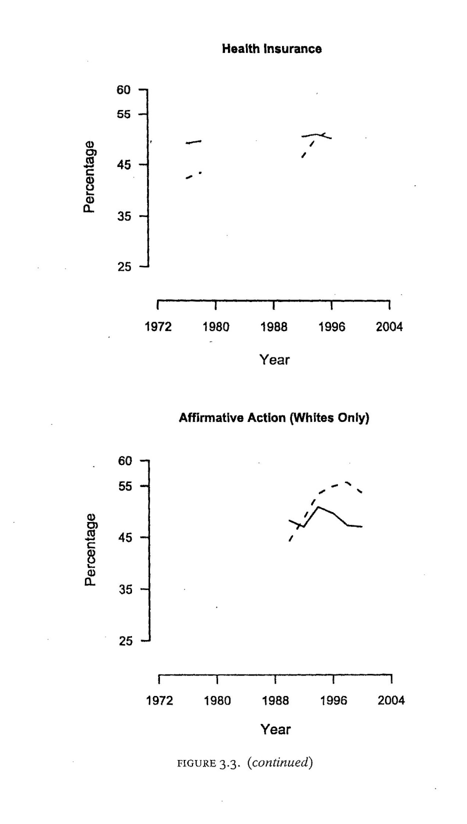
PERCENT AGREE WITH PARTY – N vs. S

Slide 17
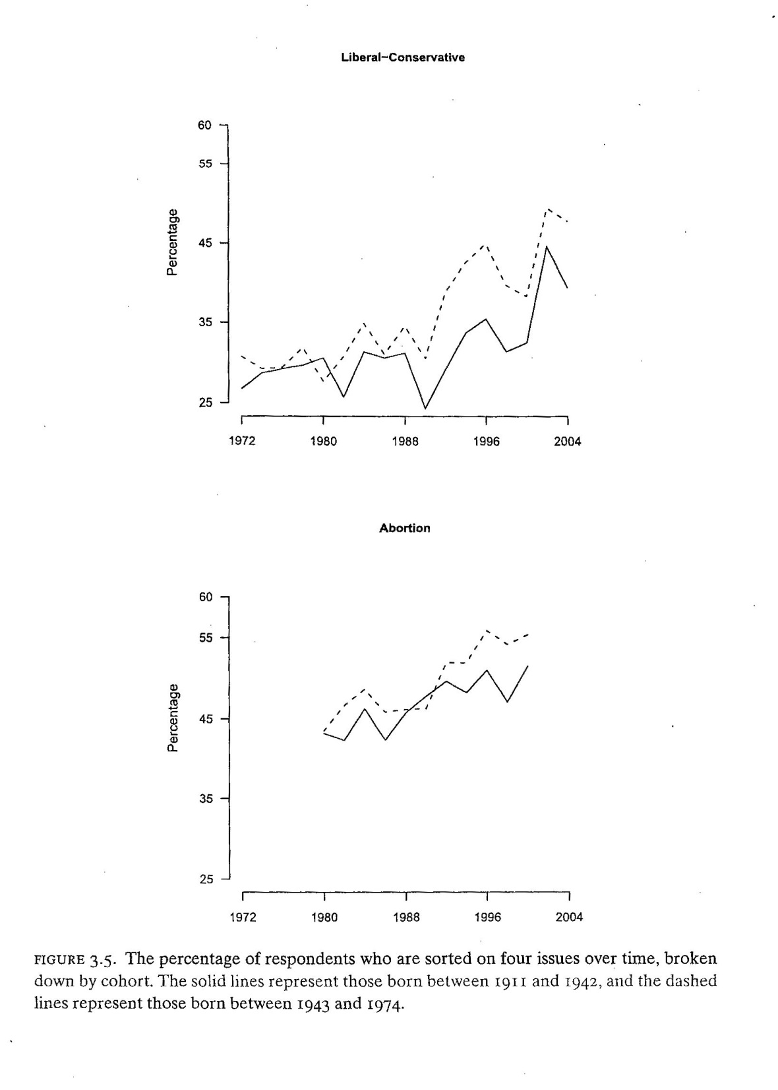
PERCENT SORTED BY AGE COHORT

Slide 18
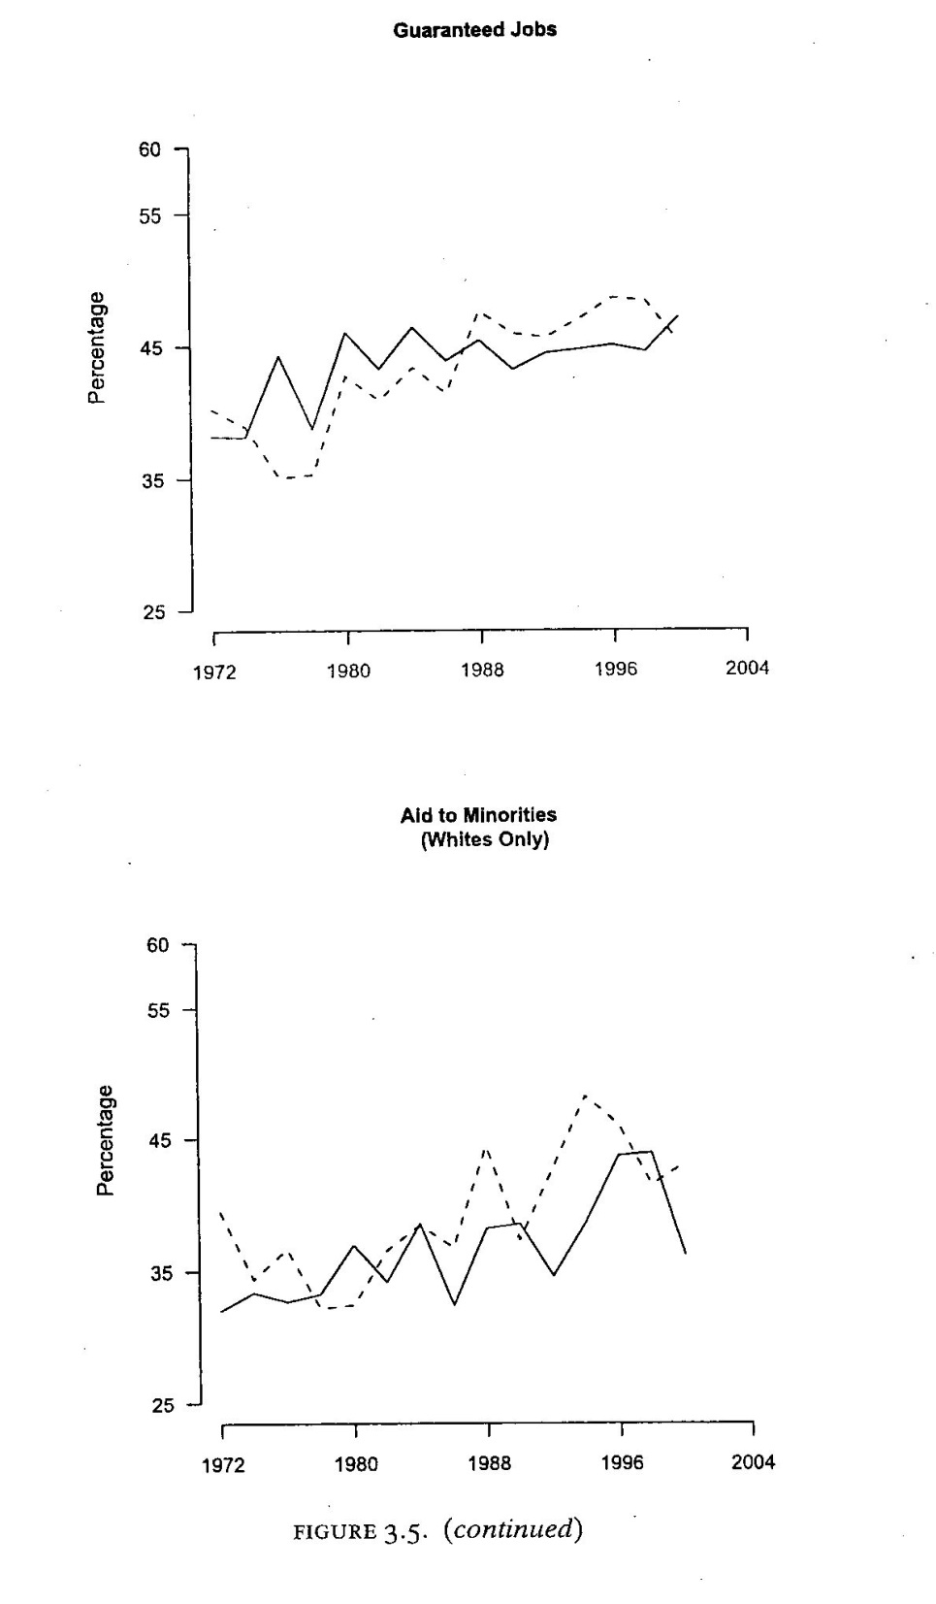
PERCENT AGREE WITH PARTY – N vs. S

Slide 19
  Abortion From GSS: Allow Abortion if:
      Life & Health of Mother is in Danger
      Rape
      Birth Defects
      Poor & Cannot afford another child
      Married and does not want more children
      Not married & does not want to marry the Father

Slide 20
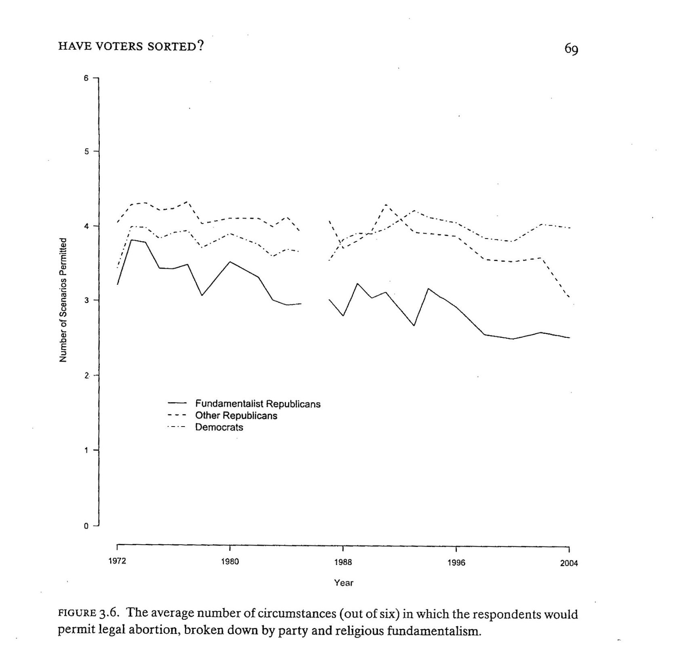
NUMBER OF
CIRCUMSTANCES

Slide 21
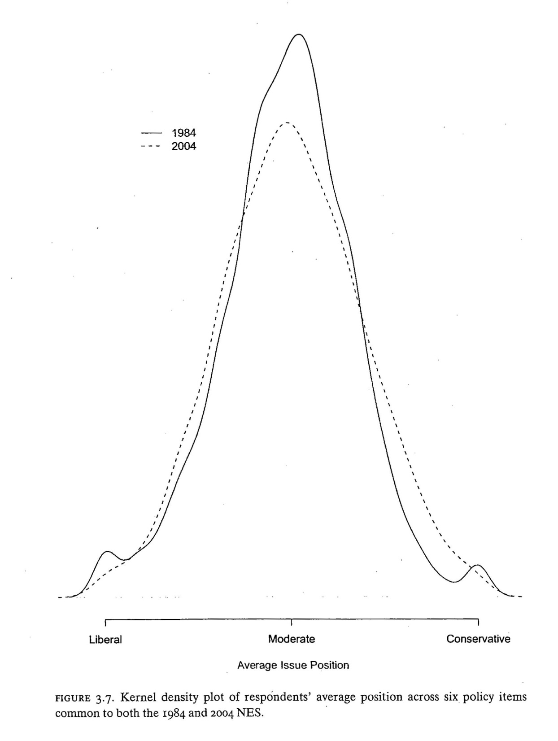

Slide 22
“Moderates”/”Independents” May Not Be Well Informed

Slide 23
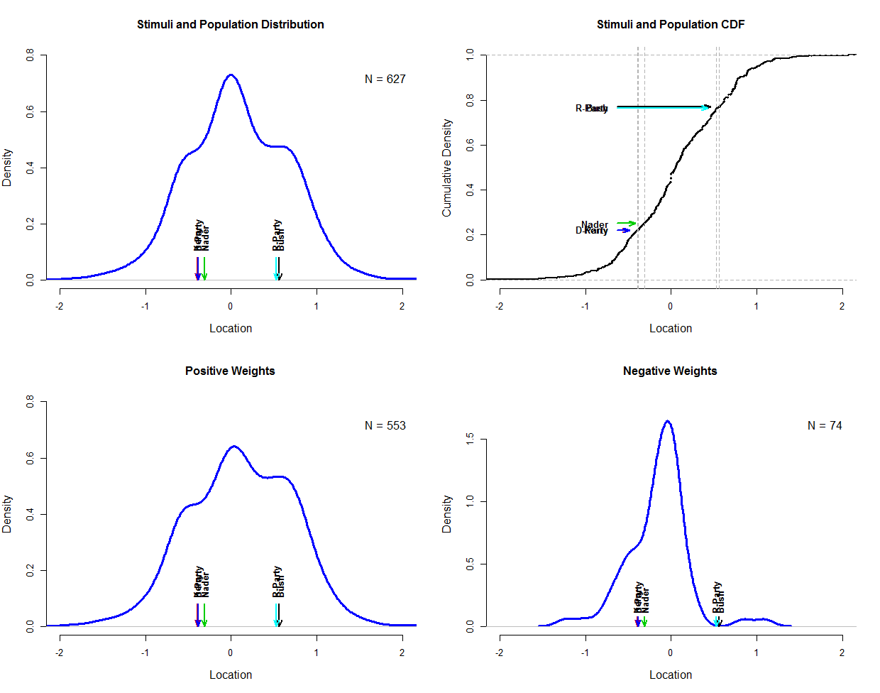

Slide 24
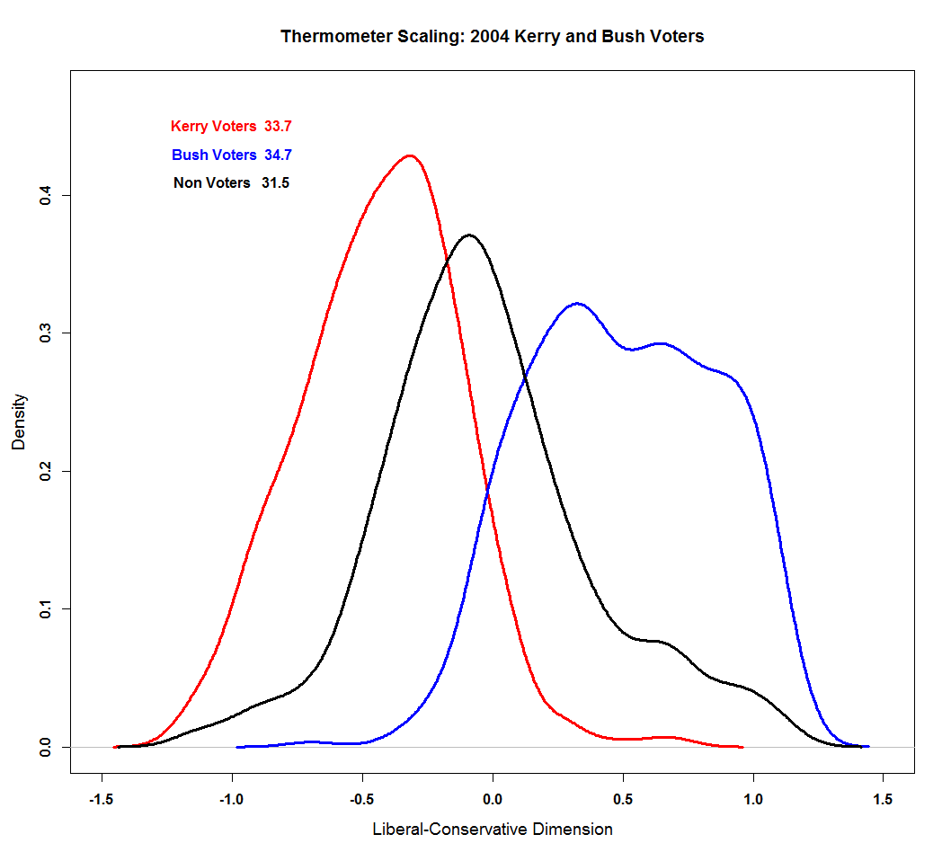

Slide 25
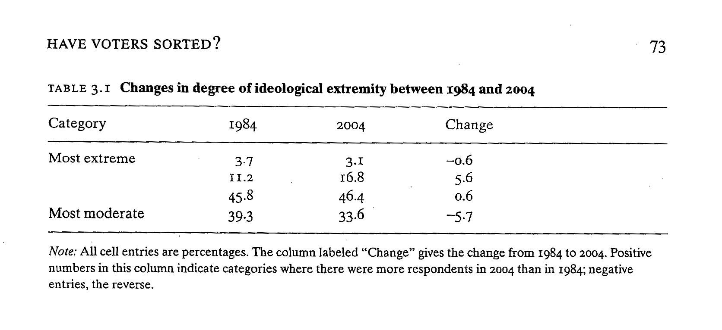

Slide 26
