Slide 1
Income Inequality Overview
How has the USA Economy performed Since World War II?

Slide 3
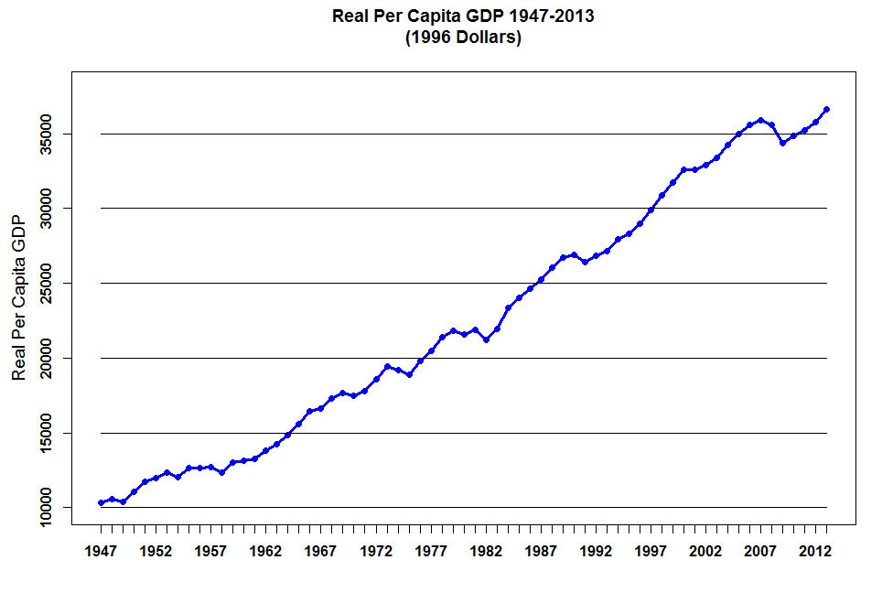

Slide 7
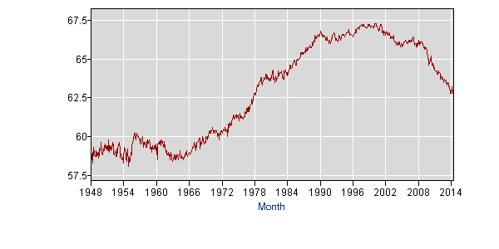
Labor Force Participation Rate: 1948-2014

Slide 9
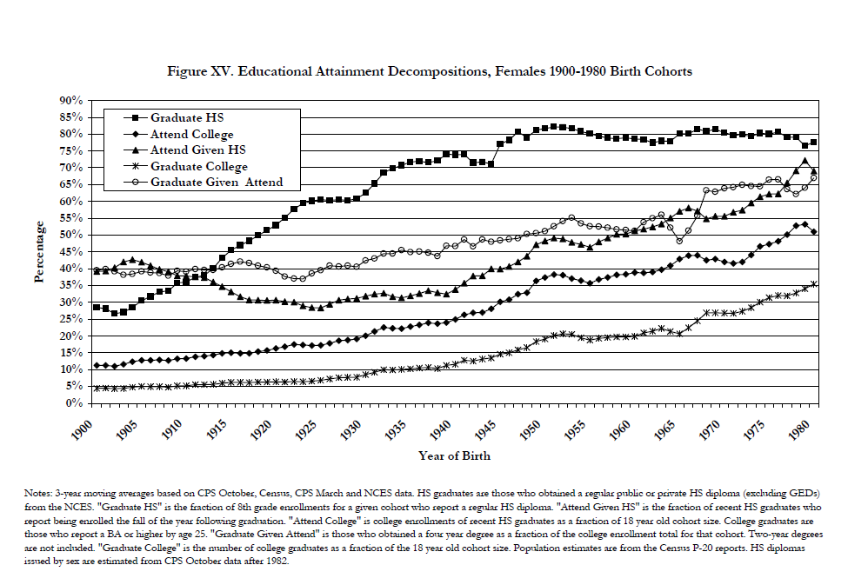

Slide 10
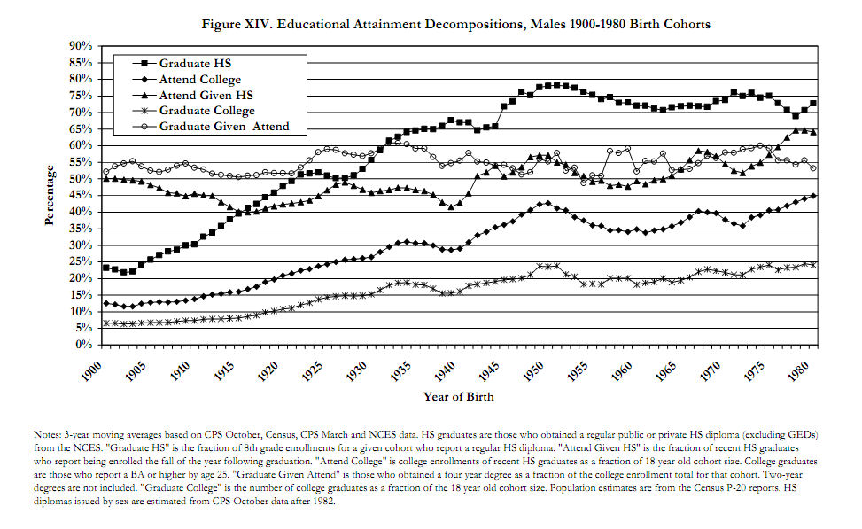

Slide 11
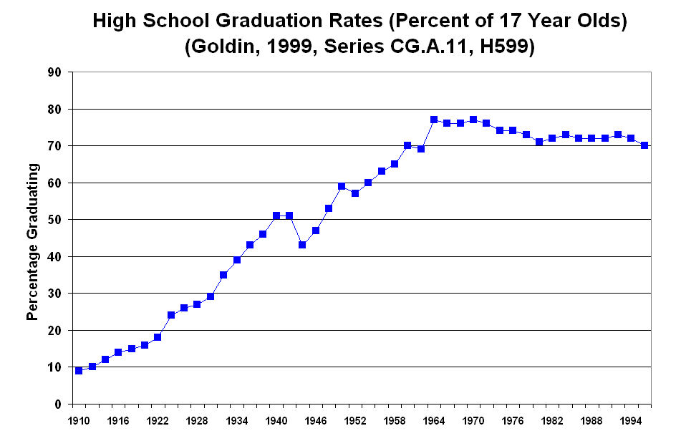

Slide 12
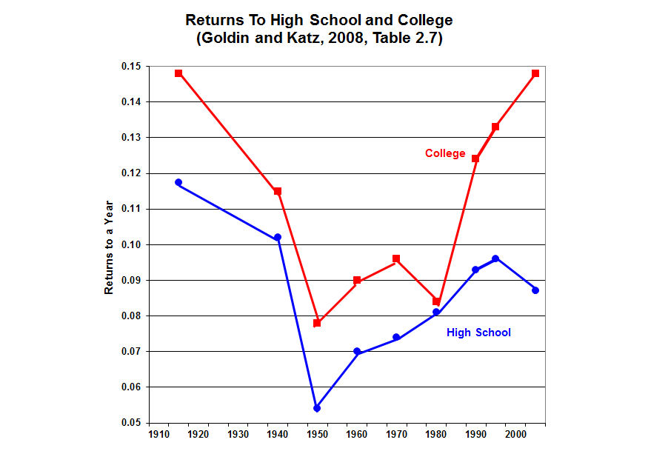

Slide 13
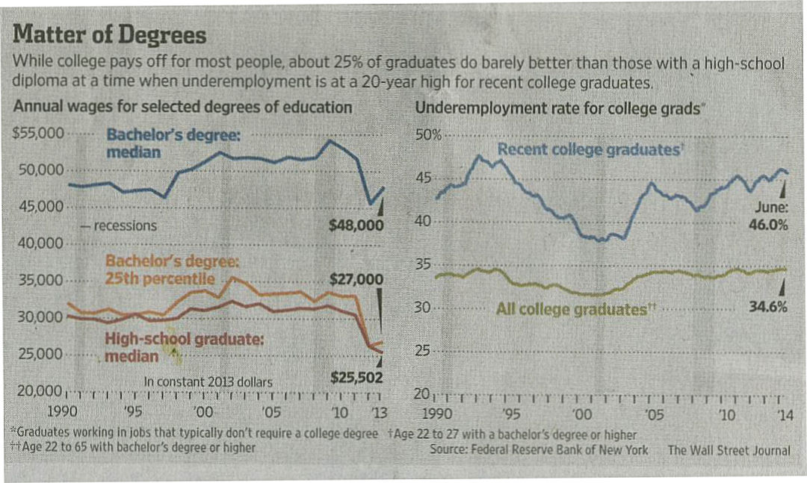

Slide 14
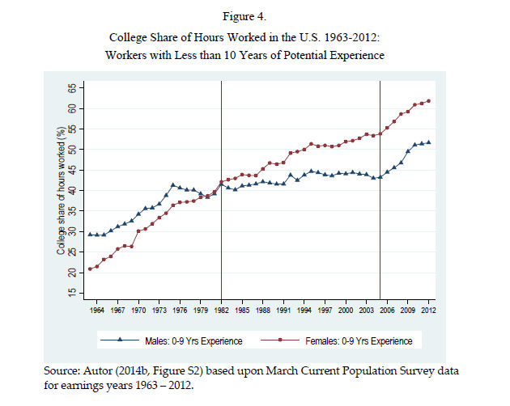

Slide 15
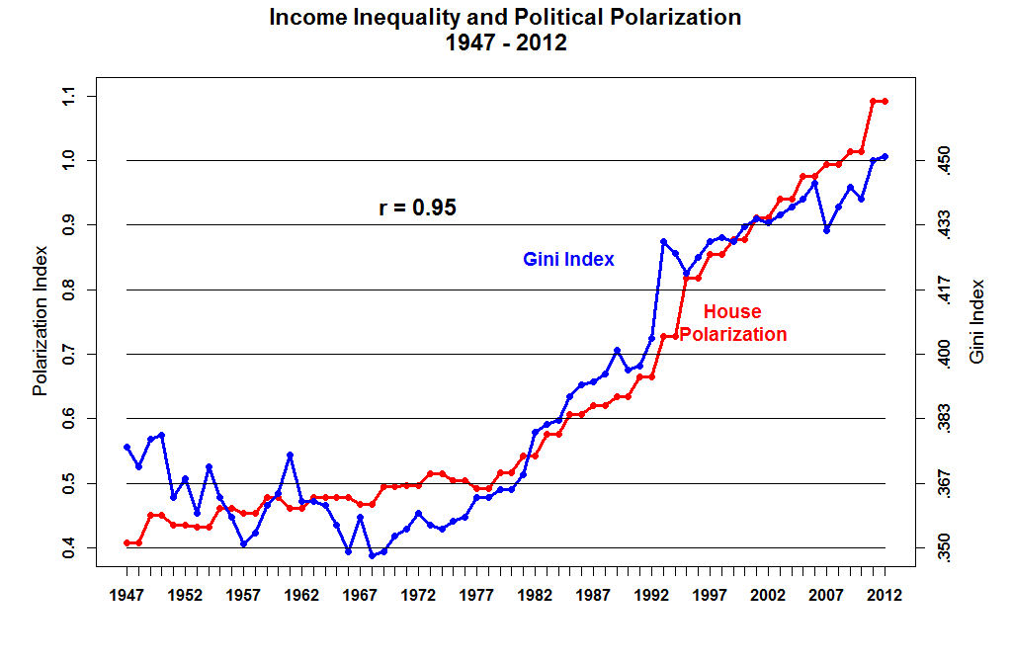

Slide 16
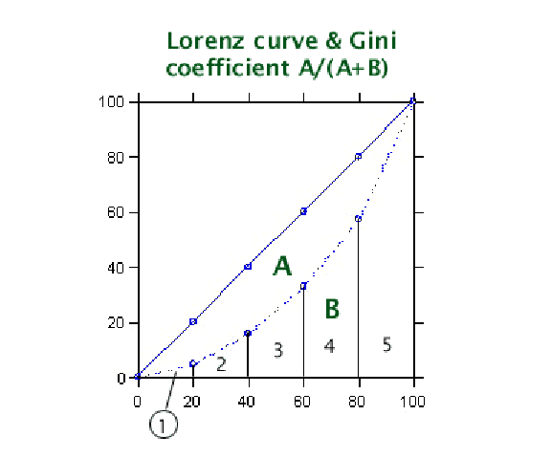

Slide 17
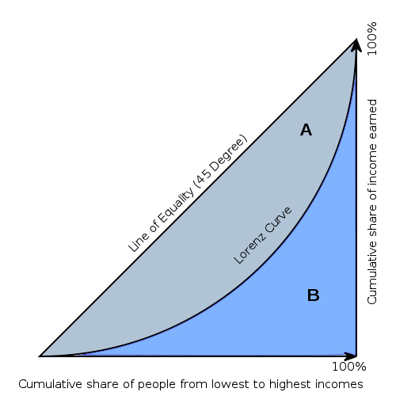

Slide 18
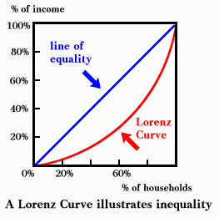

Slide 19
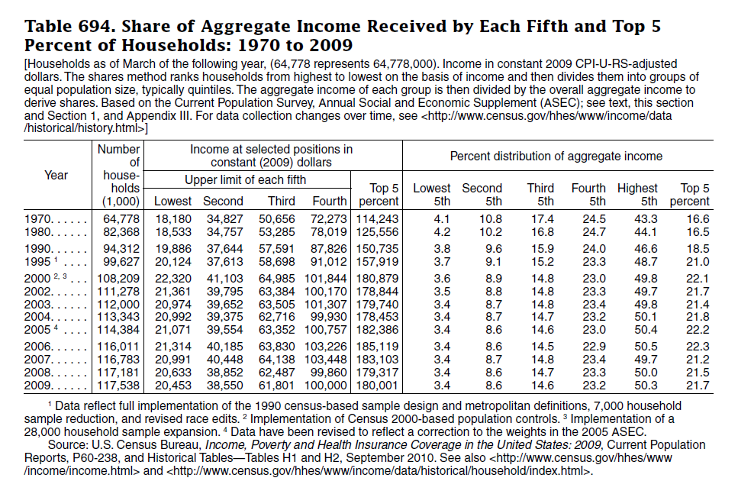

Slide 20
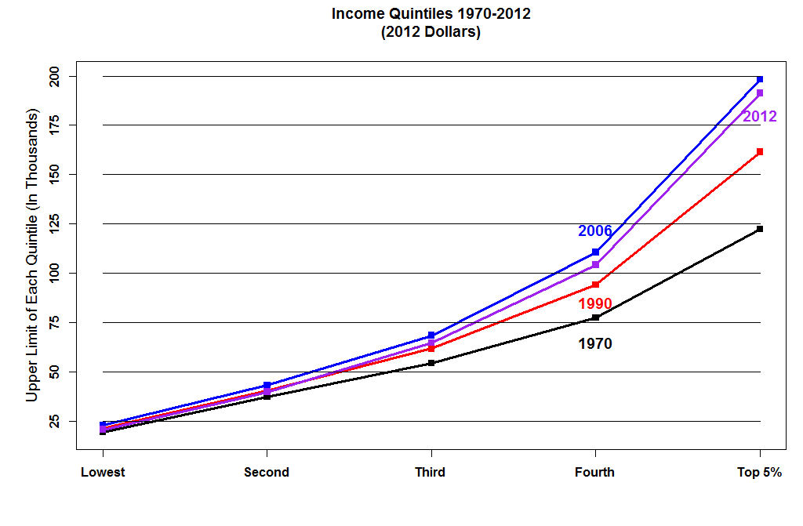

Slide 21
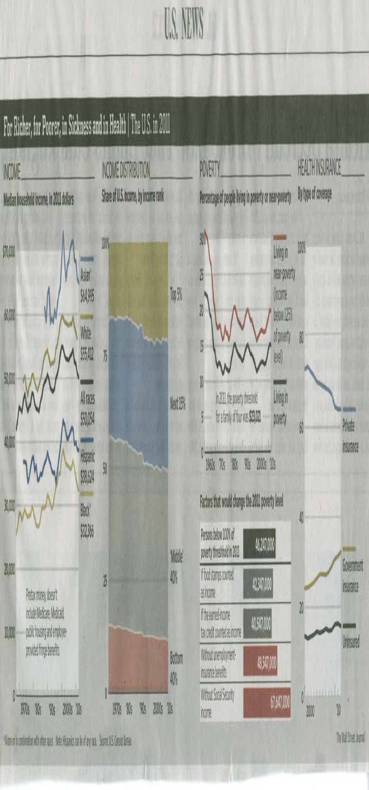

Slide 22
Size of Adjusted Gross Income
All returns: 2011 | 145,370,240 | 100.0
No adjusted gross income | 2,450,924 | 1.7
$1 under $5,000 | 10,692,838 | 7.4
$5,000 under $10,000 | 12,386,716 | 8.5
$10,000 under $15,000 | 12,925,831 | 8.9
$15,000 under $20,000 | 11,880,059 | 8.2
$20,000 under $25,000 | 10,210,706 | 7.0
$25,000 under $30,000 | 8,987,613 | 6.2
$30,000 under $40,000 | 14,520,079 | 10.0
$40,000 under $50,000 | 10,983,973 | 7.6
$50,000 under $75,000 | 18,949,278 | 13.0
$75,000 under $100,000 | 11,926,401 | 8.2
$100,000 under $200,000 | 14,755,766 | 10.2
$200,000 under $500,000 | 3,801,641 | 2.6
$500,000 under $1,000,000 | 597,525 | 0.4
$1,000,000 under $1,500,000 | 134,907 | 0.1
$1,500,000 under $2,000,000 | 55,986 | [2]
$2,000,000 under $5,000,000 | 79,363 | 0.1
$5,000,000 under $10,000,000 | 19,189 | [2]
$10,000,000 or more | 11,445 | [2]

Slide 23
2011: Accumulated from Smallest Size of Adjusted Gross Income
No adjusted gross income | 2,450,924 | 1.7
$1 under $5,000 | 10,692,838 | 7.4
$1 under $10,000 | 23,079,555 | 15.9
$1 under $15,000 | 36,005,386 | 24.8
$1 under $20,000 | 47,885,444 | 32.9
$1 under $25,000 | 58,096,150 | 40.0
$1 under $30,000 | 67,083,763 | 46.1
$1 under $40,000 | 81,603,842 | 56.1
$1 under $50,000 | 92,587,815 | 63.7
$1 under $75,000 | 111,537,092 | 76.7
$1 under $100,000 | 123,463,493 | 84.9
$1 under $200,000 | 138,219,259 | 95.1
$1 under $500,000 | 142,020,900 | 97.7
$1 under $1,000,000 | 142,618,425 | 98.1
$1 under $1,500,000 | 142,753,332 | 98.2
$1 under $2,000,000 | 142,809,318 | 98.2
$1 under $5,000,000 | 142,888,681 | 98.3
$1 under $10,000,000 | 142,907,871 | 98.3
$1 or more | 142,919,316 | 98.3
All returns | 145,370,240 | 100.0

Slide 24
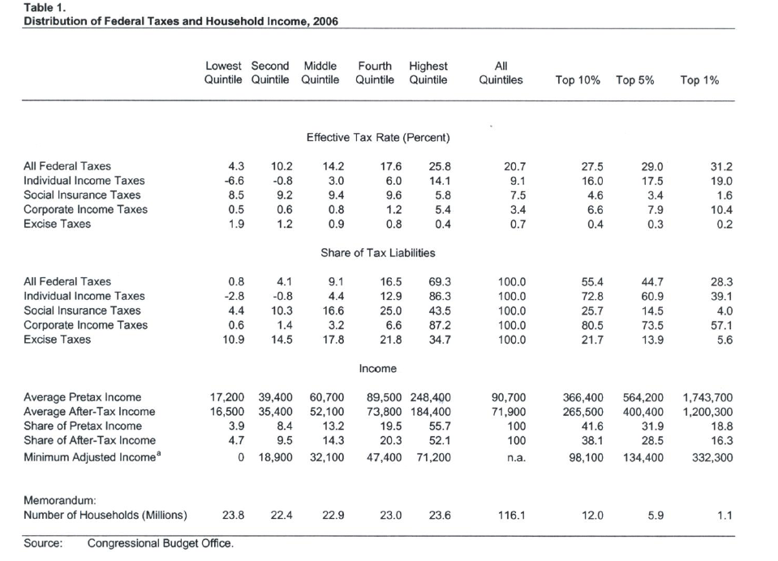

Slide 26
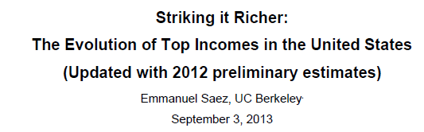
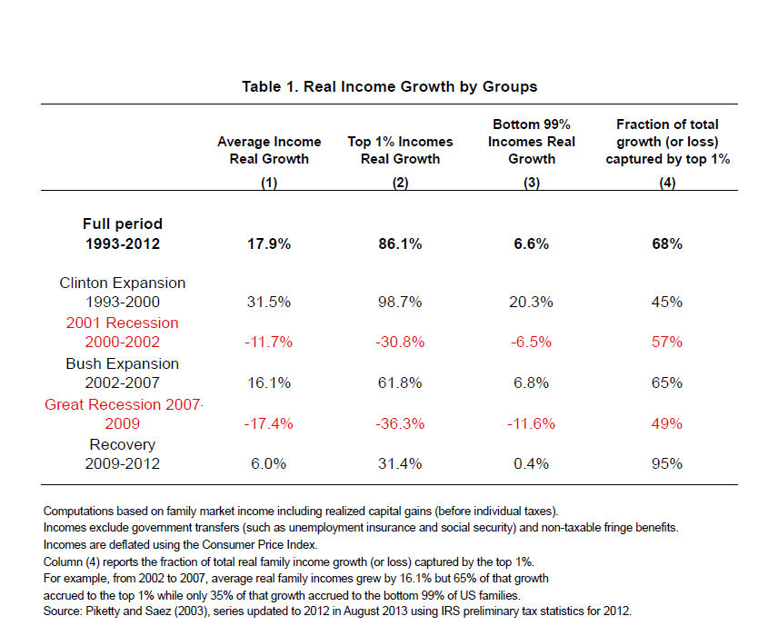

Slide 27
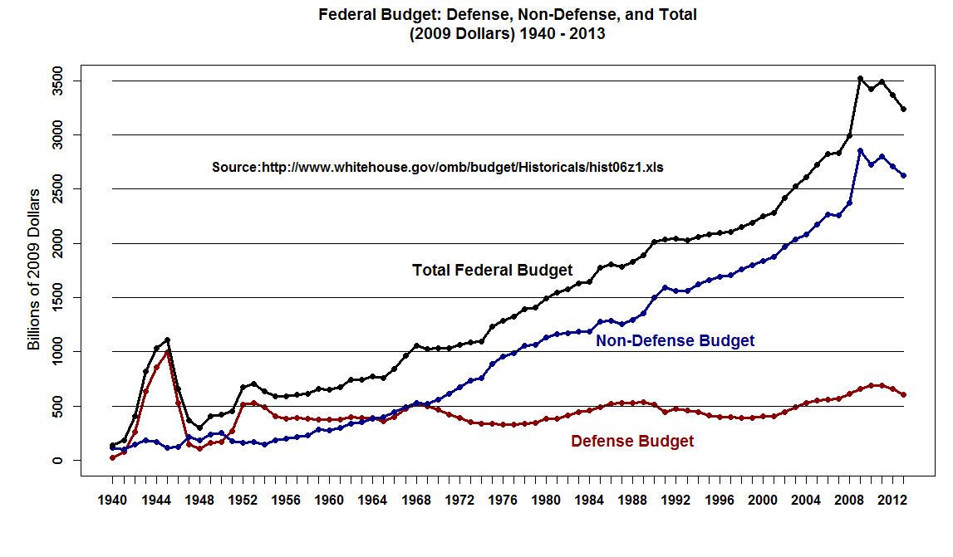

Slide 28
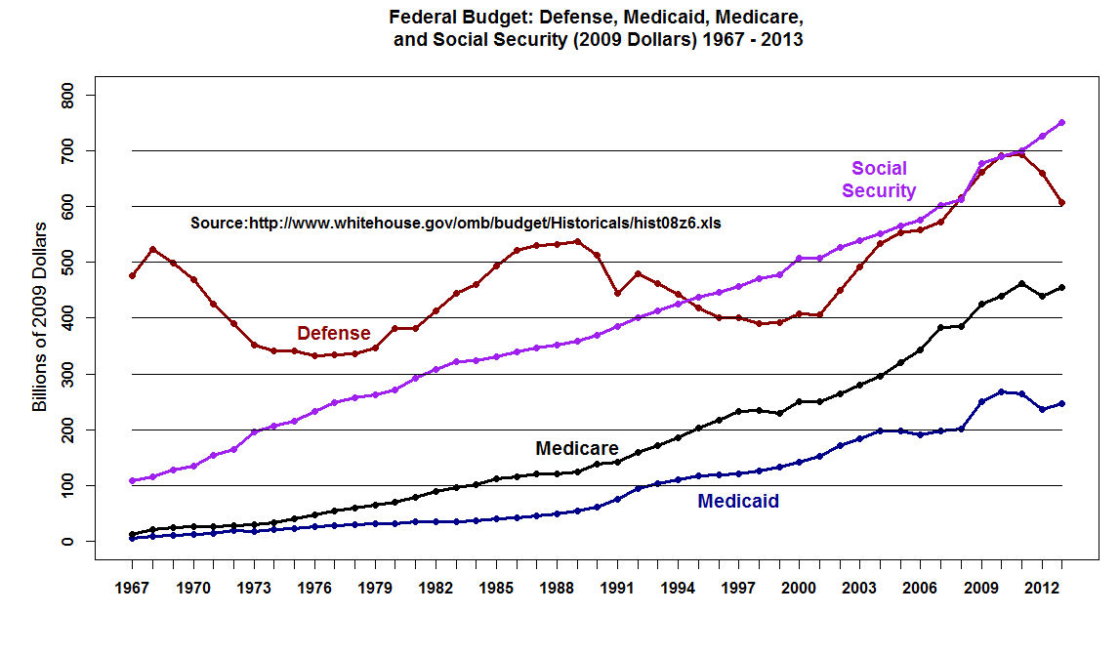

Slide 29
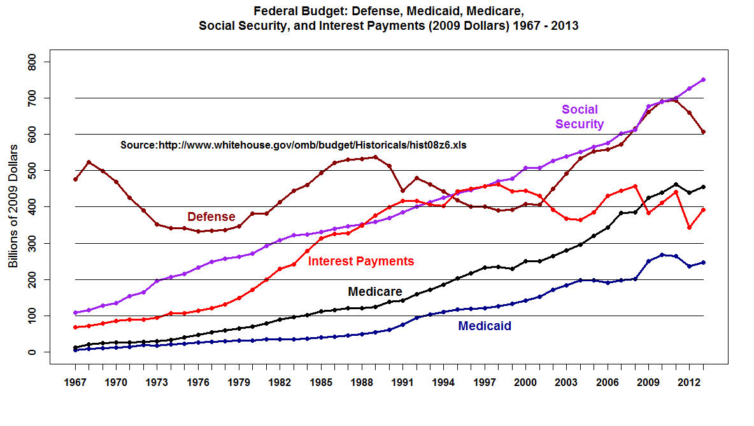

Slide 30
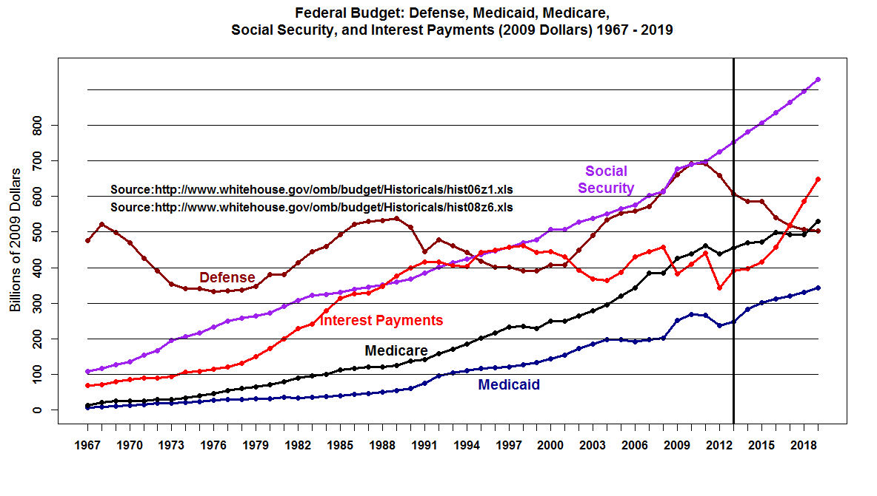

Slide 31
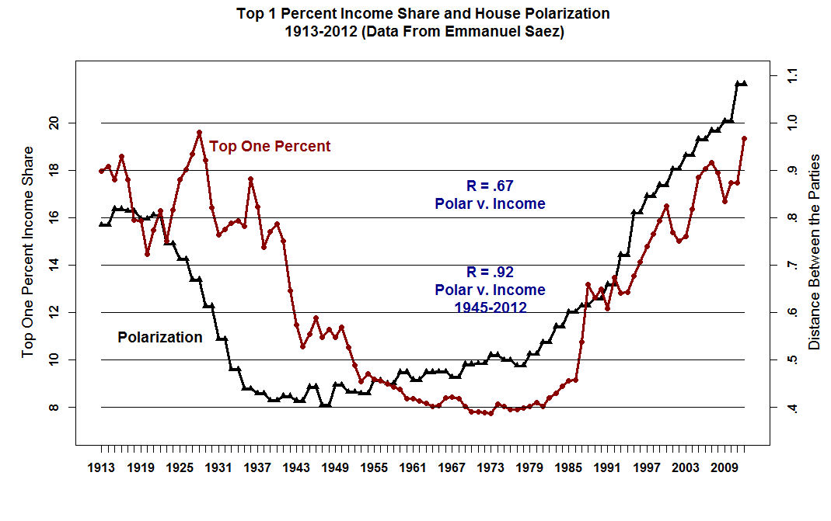

Slide 33
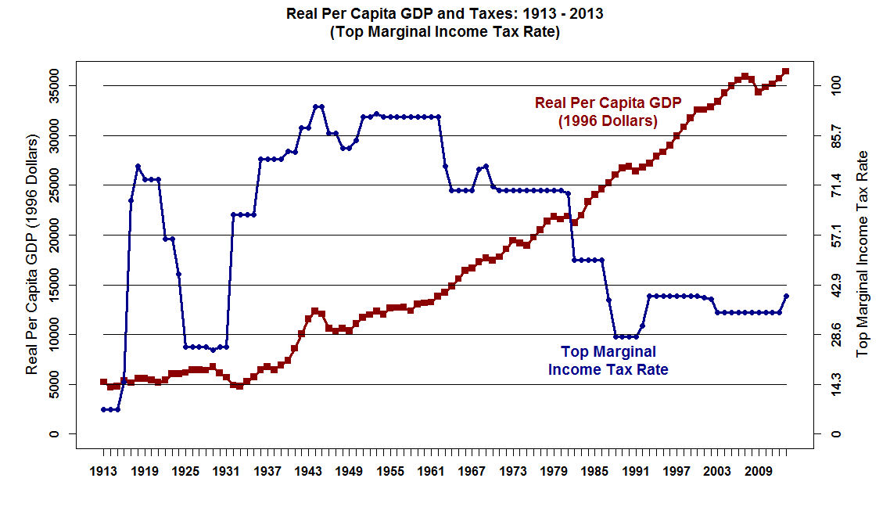

Slide 35
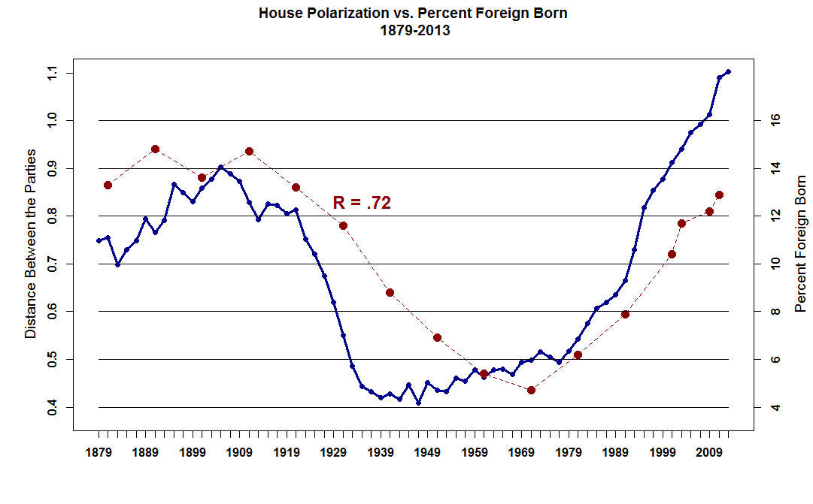

Slide 36
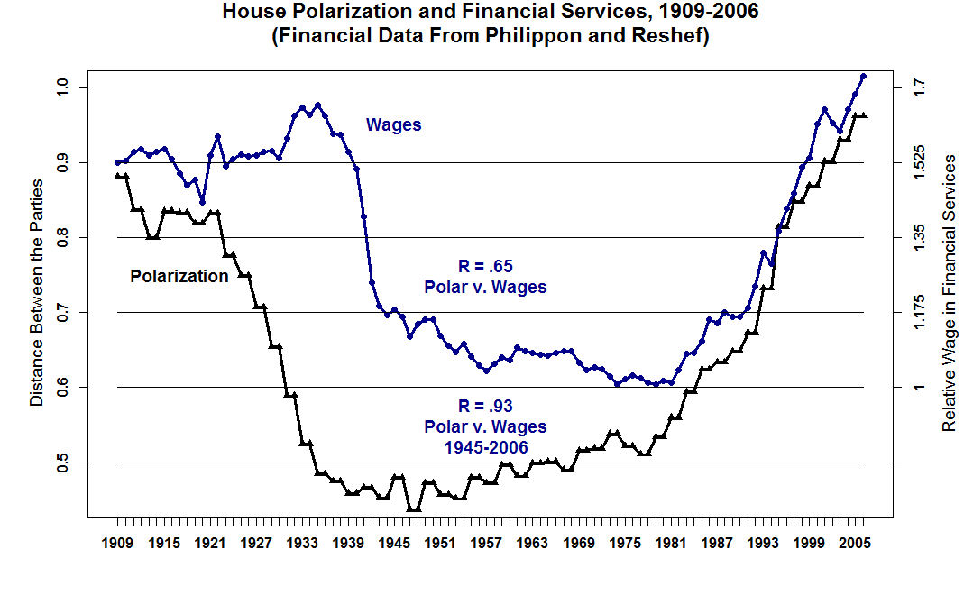

Slide 37
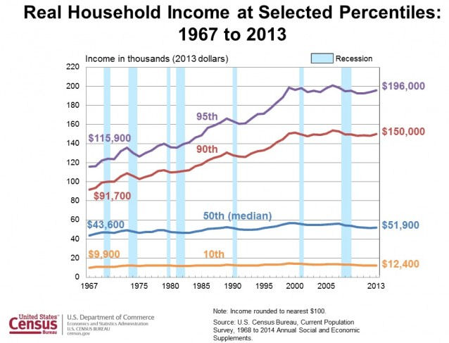

Slide 38
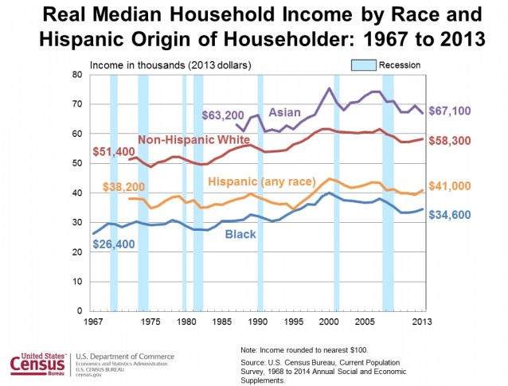

Slide 39
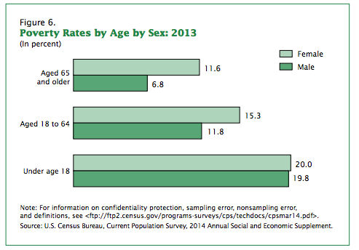

Slide 40
