Slide 1
Measuring Ideology
What Congressional Roll Call Votes Can Teach us About American Political-Economic History

Slide 2
Driving Distances Between 11 Cities
ATLANTA 0000 2340 1084 715 481 826 1519 2252 662 641 2450
BOISE 2340 0000 2797 1789 2018 1661 891 908 2974 2480 680
BOSTON 1084 2797 0000 976 853 1868 2008 3130 1547 443 3160
CHICAGO 715 1789 976 0000 301 936 1017 2189 1386 696 2200
CINCINNATI 481 2018 853 301 0000 988 1245 2292 1143 498 2330
DALLAS 826 1661 1868 936 988 0000 797 1431 1394 1414 1720
DENVER 1519 891 2008 1017 1245 797 0000 1189 2126 1707 1290
LOS ANGELES 2252 908 3130 2189 2292 1431 1189 0000 2885 2754 370
MIAMI 662 2974 1547 1386 1143 1394 2126 2885 0000 1096 3110
WASHINGTON 641 2480 443 696 498 1414 1707 2754 1096 0000 2870
CASBS 2450 680 3160 2200 2330 1720 1290 370 3110 2870 0000

Slide 3
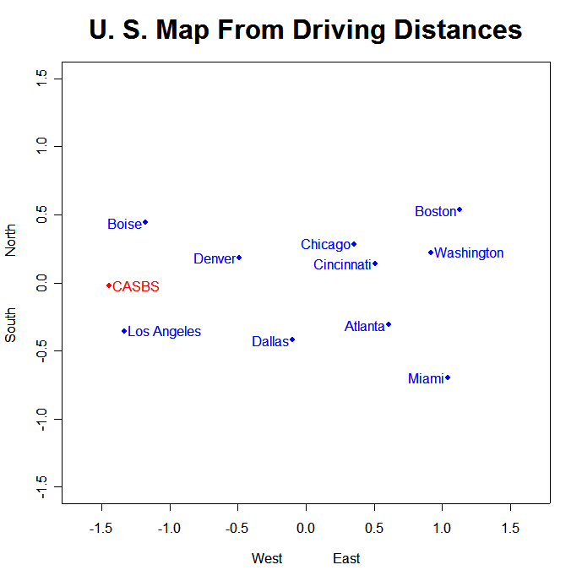

Slide 4
Table 2.2 Disagreement Scores for 108th Senate
Bush Sess. Shel Murk. Stev Kyl McCa Pryor Linc Boxer Fein
Bush (R-US) 0.000 0.048 0.111 0.130 0.084 0.024 0.169 0.687 0.634 0.925 0.852
Sessions (R-AL) 0.048 0.000 0.087 0.132 0.108 0.059 0.193 0.743 0.705 0.874 0.813
Shelby (R-AL) 0.111 0.087 0.000 0.099 0.084 0.117 0.228 0.694 0.661 0.822 0.757
Murkowski (R-AK) 0.130 0.132 0.099 0.000 0.064 0.144 0.235 0.672 0.639 0.797 0.733
Stevens (R-AK) 0.084 0.108 0.084 0.064 0.000 0.125 0.224 0.680 0.649 0.826 0.761
Kyl (R-AZ) 0.024 0.059 0.117 0.144 0.125 0.000 0.172 0.771 0.738 0.884 0.820
McCain (R-AZ) 0.169 0.193 0.228 0.235 0.224 0.172 0.000 0.692 0.672 0.747 0.723
Pryor (D-AR) 0.687 0.743 0.694 0.672 0.680 0.771 0.692 0.000 0.074 0.180 0.177
Lincoln (D-AR) 0.634 0.705 0.661 0.639 0.649 0.738 0.672 0.074 0.000 0.208 0.177
Boxer (D-CA) 0.925 0.874 0.822 0.797 0.826 0.884 0.747 0.180 0.208 0.000 0.089
Feinstein (D-CA) 0.852 0.813 0.757 0.733 0.761 0.820 0.723 0.177 0.177 0.089 0.000

Slide 5
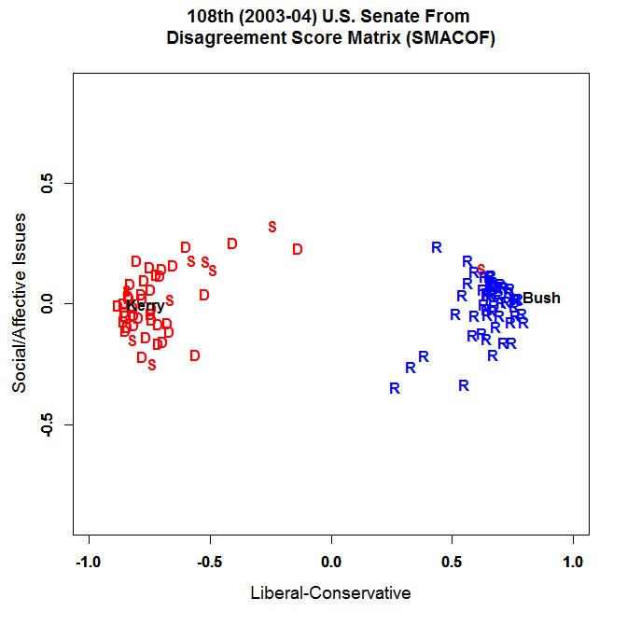

Slide 6
Table 2.3 Disagreement Scores for 90th Senate
LBJ Spar. Hill Grue. Bart Hayd Fann Fulb McCl Kuch Murp
Johnson (D-US) 0.000 0.389 0.490 0.476 0.349 0.300 0.629 0.550 0.574 0.278 0.574
Sparkman (D-AL) 0.389 0.000 0.101 0.490 0.350 0.150 0.344 0.297 0.211 0.360 0.372
Hill (D-AL) 0.490 0.101 0.000 0.470 0.372 0.214 0.302 0.293 0.191 0.432 0.355
Gruening (D-AK) 0.476 0.490 0.470 0.000 0.238 0.417 0.565 0.313 0.510 0.456 0.556
Bartlett (D-AK) 0.349 0.350 0.372 0.238 0.000 0.296 0.523 0.306 0.437 0.363 0.501
Hayden (D-AZ) 0.300 0.150 0.214 0.417 0.296 0.000 0.426 0.307 0.314 0.365 0.468
Fannin (R-AZ) 0.629 0.344 0.302 0.565 0.523 0.426 0.000 0.416 0.215 0.378 0.124
Fulbright (D-AR) 0.550 0.297 0.293 0.313 0.306 0.307 0.416 0.000 0.327 0.472 0.430
McClellan (D-AR) 0.574 0.211 0.191 0.510 0.437 0.314 0.215 0.327 0.000 0.430 0.275
Kuchel (R-CA) 0.278 0.360 0.432 0.456 0.363 0.365 0.378 0.472 0.430 0.000 0.324
Murphy (R-CA) 0.574 0.372 0.355 0.556 0.501 0.468 0.124 0.430 0.275 0.324 0.000

Slide 7
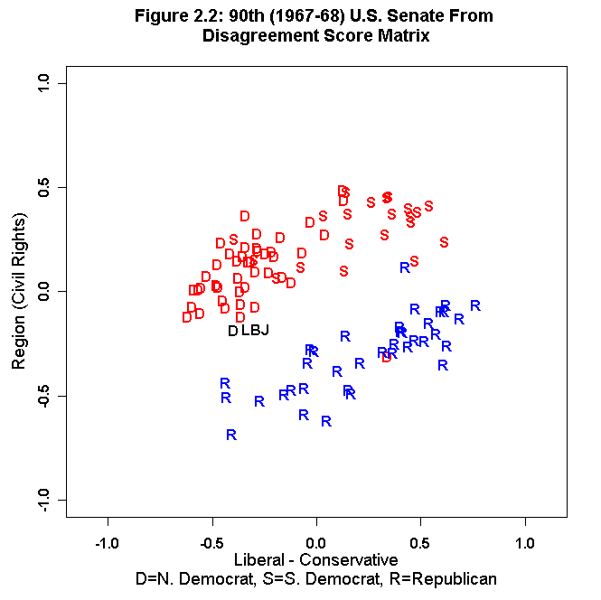

Slide 8
Table 2.4 Driving Distances as an Unfolding Problem
Houston NYC Orlando Portland St Louis San Diego
Atlanta 790 850 430 2660 570 2150
Boise 1820 2490 2640 430 1670 980
Boston 1830 210 1300 3140 1210 2880
Chicago 1090 810 1150 2120 290 2090
Cincinnati 1150 470 1000 2430 320 2290
Dallas 250 1560 1100 2040 660 1350
Denver 1030 1790 1880 1260 860 1100
Los Angeles 1540 2790 2430 960 1840 130
Miami 1190 1330 230 3260 1230 2680
Washington 1370 240 850 2780 860 2600
San Francisco 1890 2960 2850 670 2150 490

Slide 9
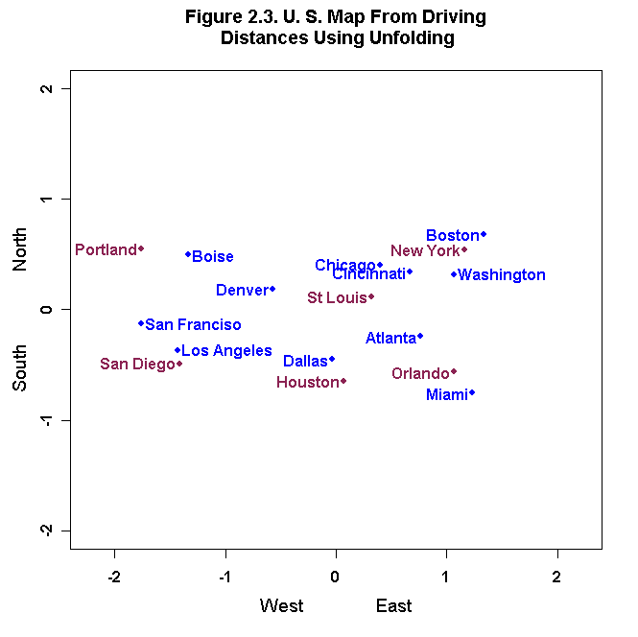

Slide 10
Table 2.4: Roll Call Voting as an Unfolding Problem
Roll Call 1 2 3 4 5 6 7 8 9 10 11 12 13 14 15 16 17 18 19 20 ETC.
Johnson (D-US) N Y
Sparkman (D-AL) N Y N N Y N Y Y N N Y N N N Y Y
Hill (D-AL) N Y N N Y N Y Y Y Y Y Y Y Y N N Y Y
Gruening (D-AK) N Y N Y N Y N N N N Y Y N Y Y
Bartlett (D-AK) N Y N N Y Y Y N N N Y N Y Y Y Y Y N Y
Hayden (D-AZ) N N Y Y N Y Y Y N N Y N Y Y Y N N Y Y
Fannin (R-AZ) N Y N Y Y N Y Y N Y Y N Y Y Y Y N N N N
Fulbright (D-AR) N Y N Y N Y N N Y
McClellan (D-AR) N Y N N Y N Y Y Y N Y Y Y Y Y N N Y
Kuchel (R-CA) Y N Y Y Y N Y N N N N N Y N Y N Y N
Murphy (R-CA) N Y N Y Y N Y Y N N Y Y Y N Y Y N N N N

Slide 11
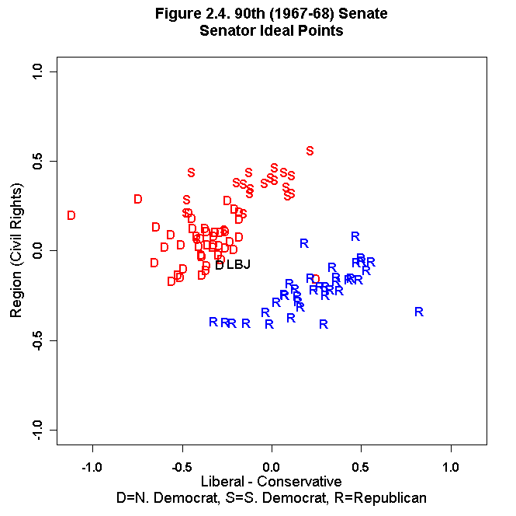

Slide 12
The NOMINATE (Nominal Three-Step Estimation)Voting Model
Each Legislator is represented by a Point
Each Roll Call Vote is represented by two points,
  one corresponding to the Yea Outcome,
  and one corresponding to the Nay Outcome
Legislators vote Probabilistically for the closest Outcome

Slide 13
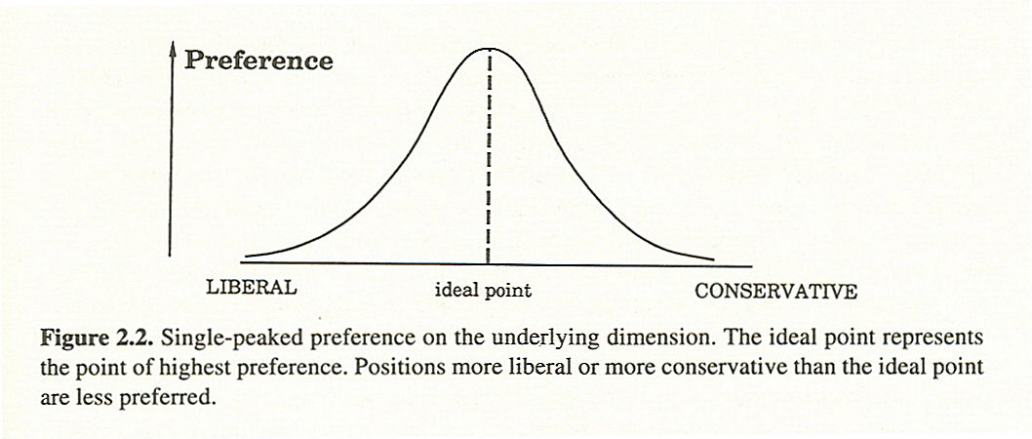

Slide 14
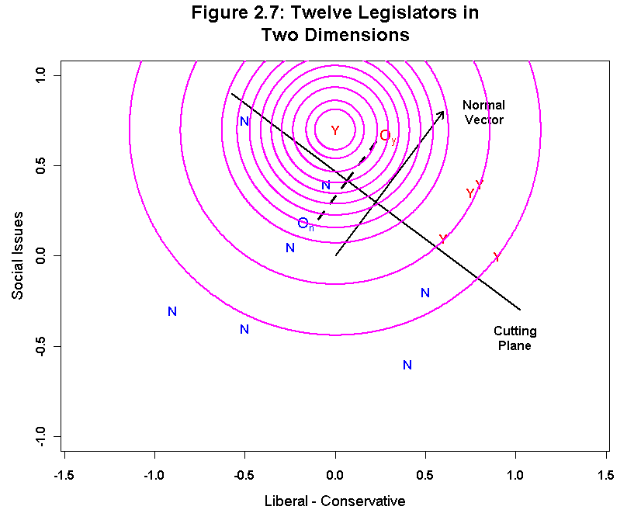

Slide 15
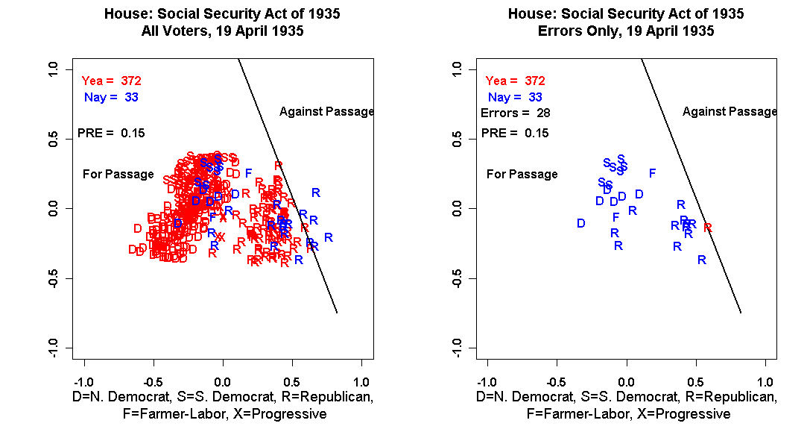

Slide 16
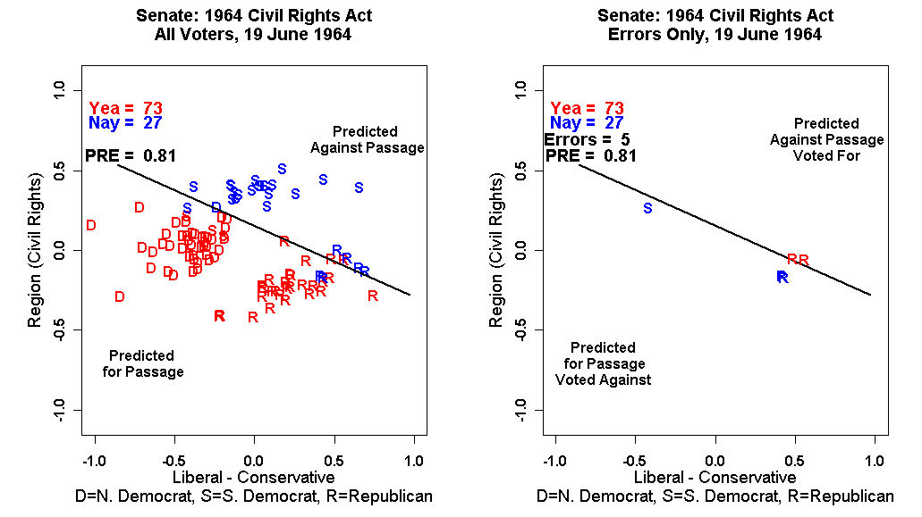

Slide 17
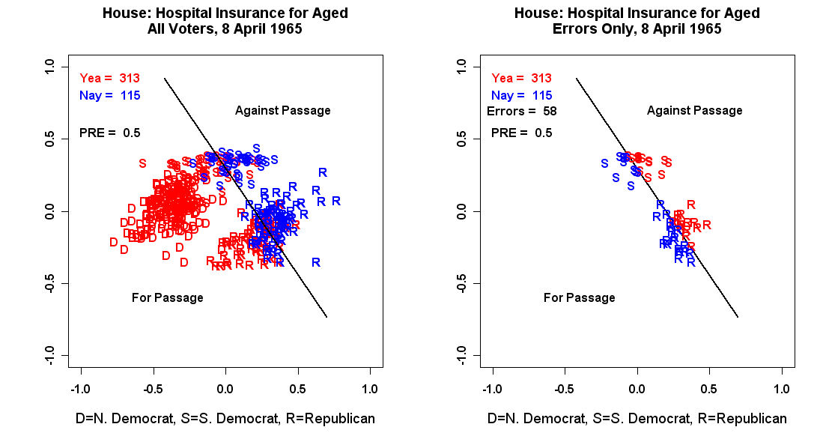

Slide 18
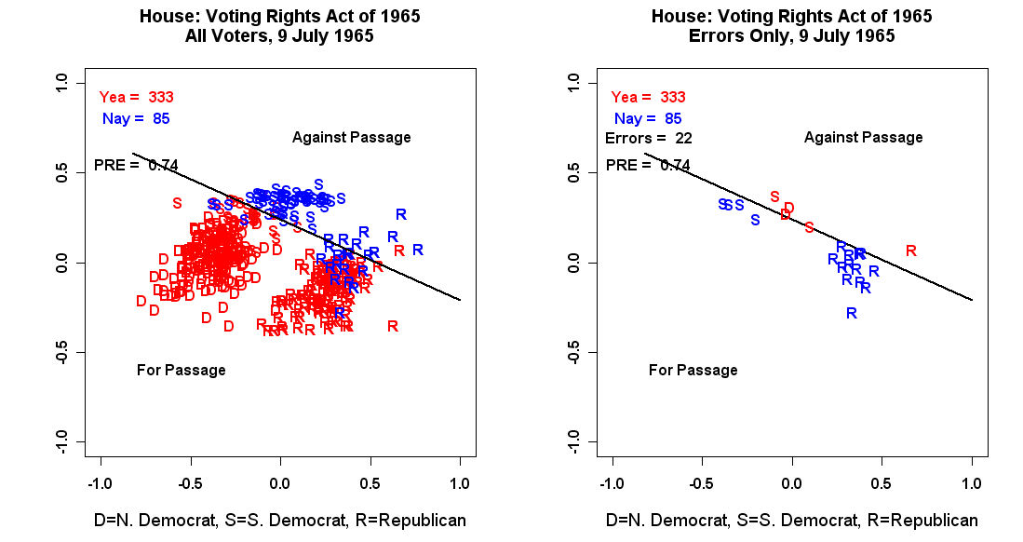

Slide 19
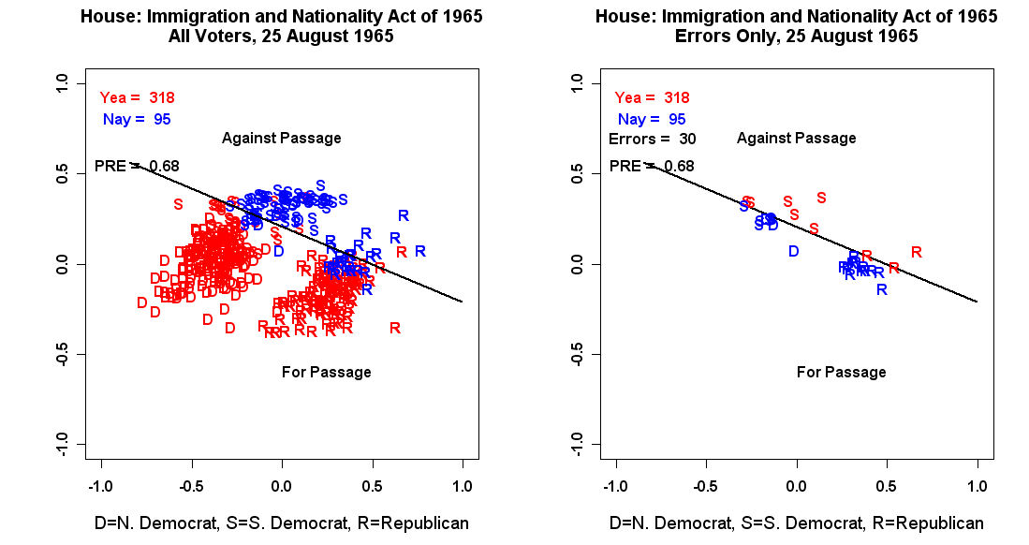

Slide 20
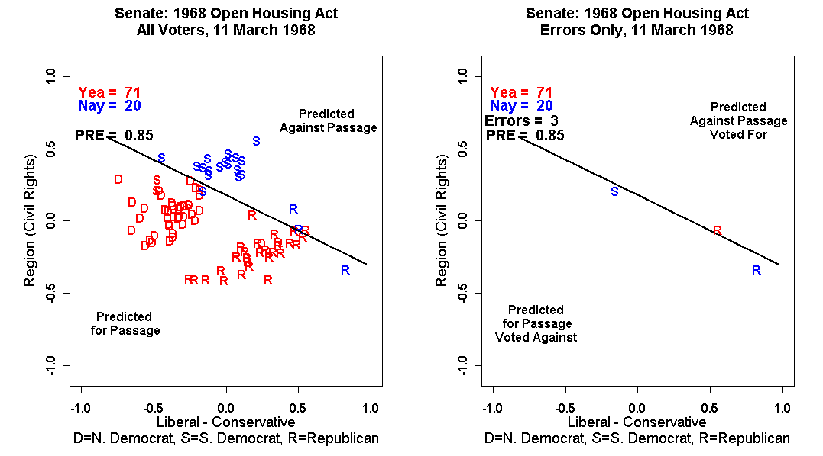

Slide 21
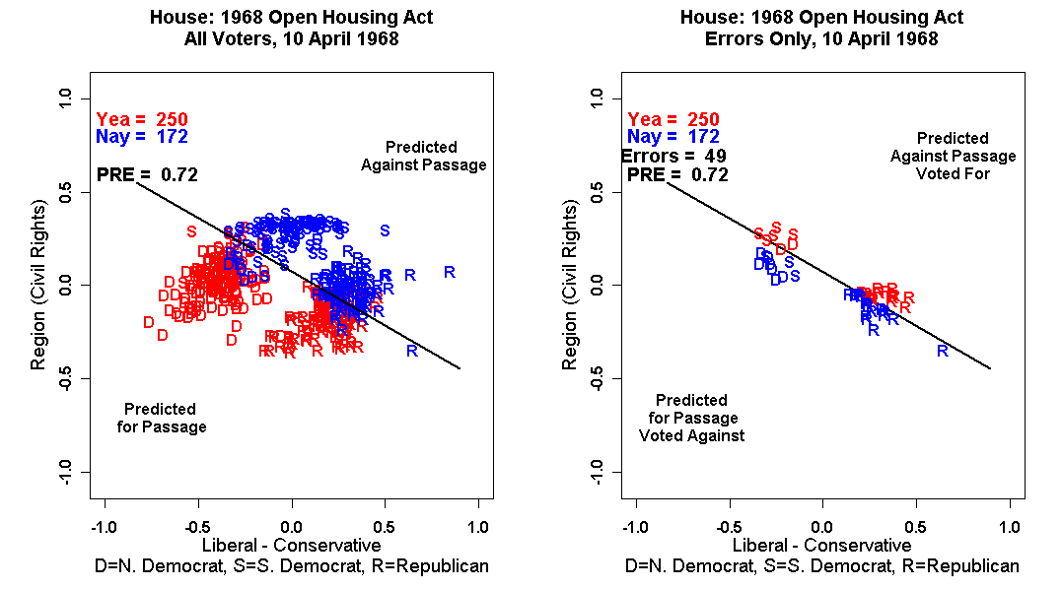

Slide 22
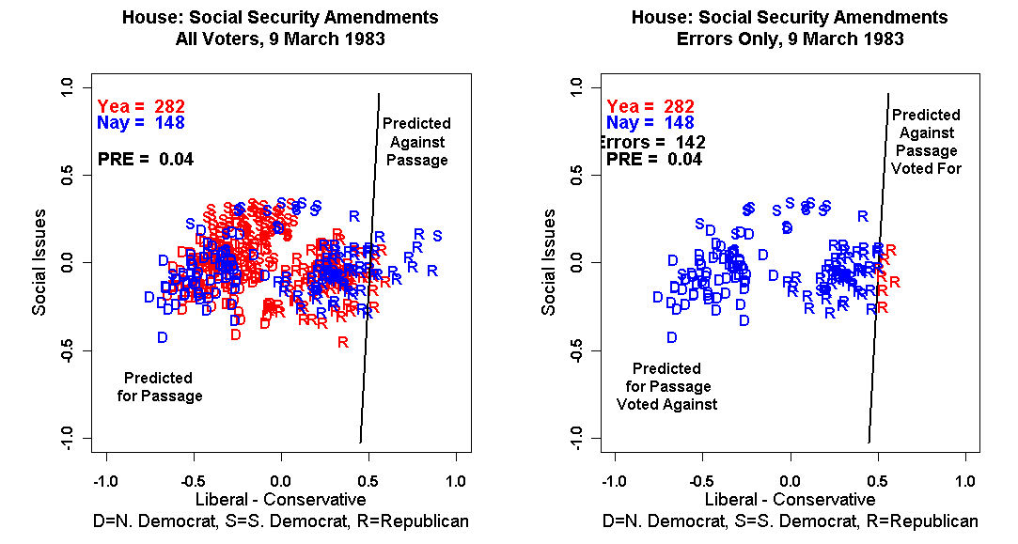

Slide 23
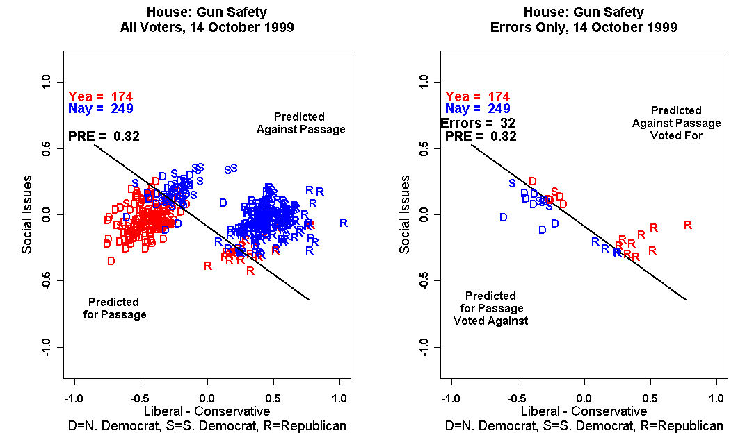

Slide 24
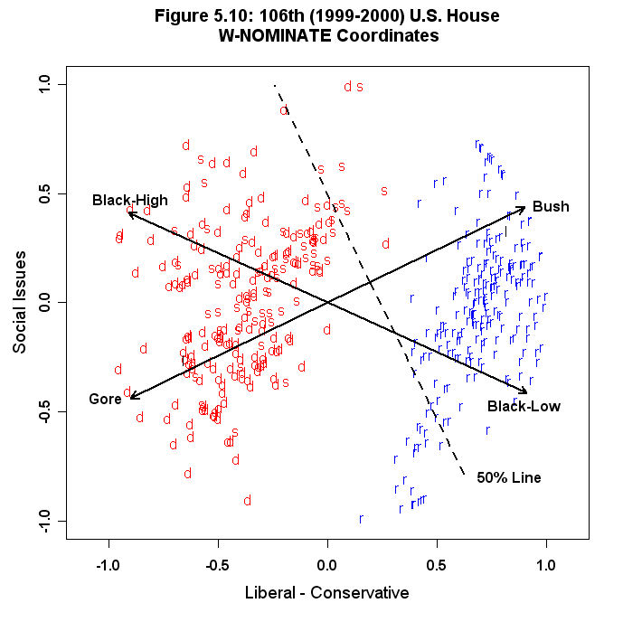

Slide 25
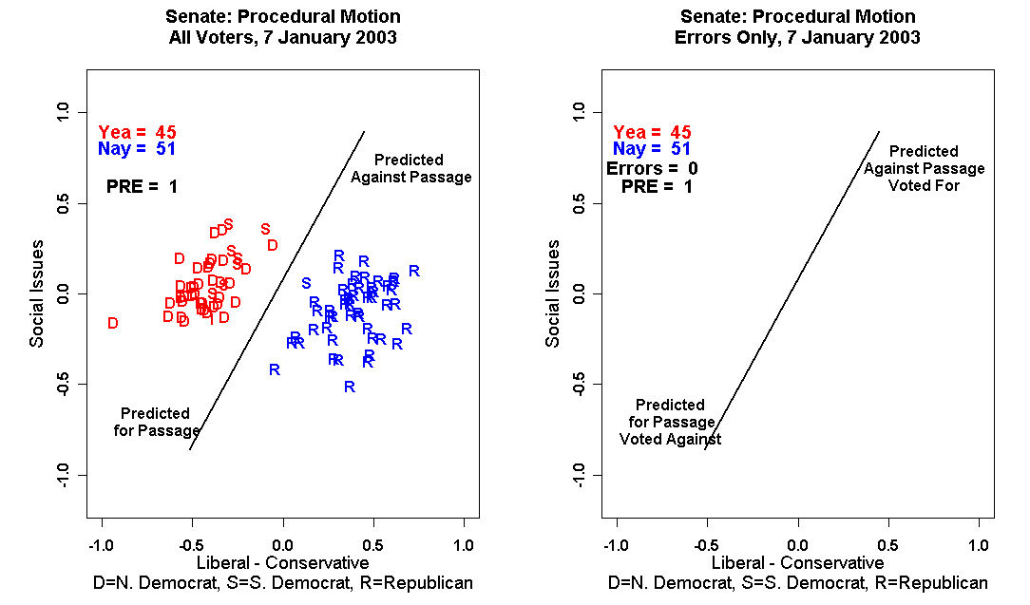

Slide 26
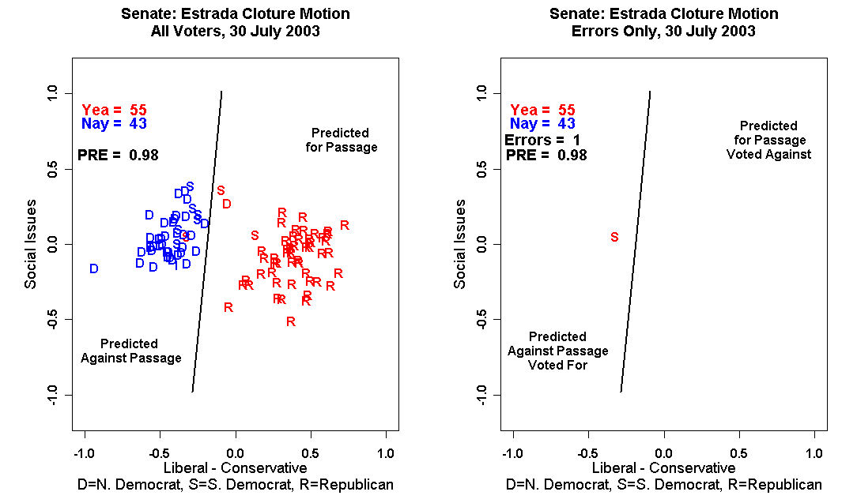

Slide 27
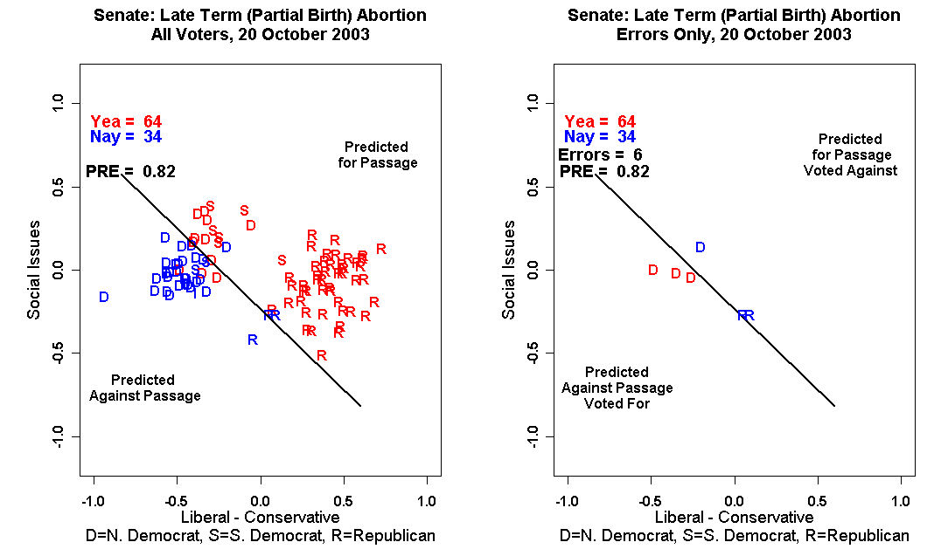

Slide 28
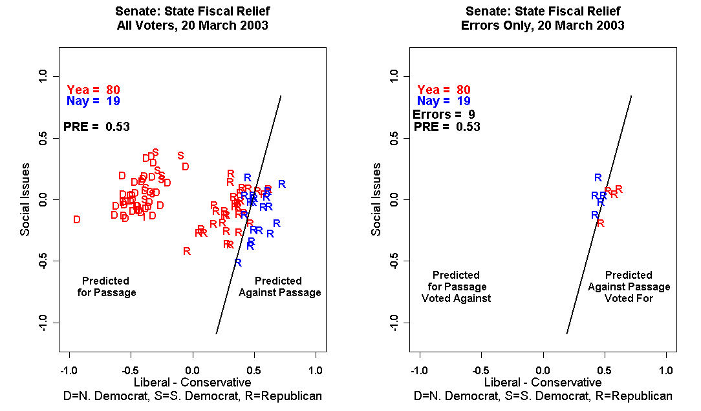

Slide 29
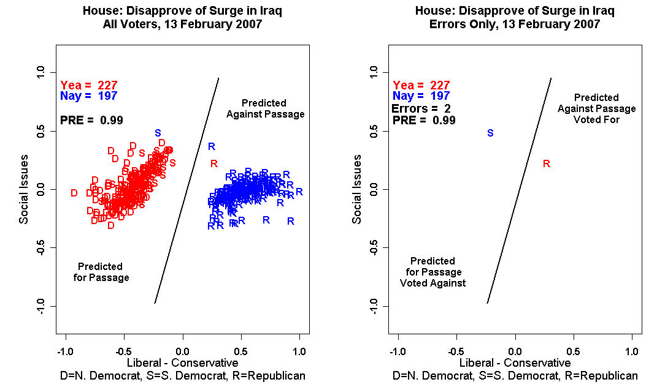

Slide 30
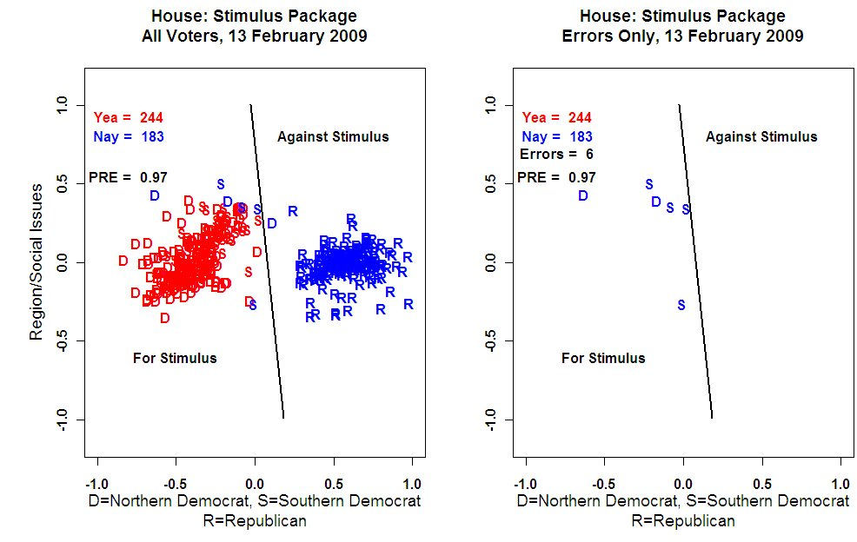

Slide 31
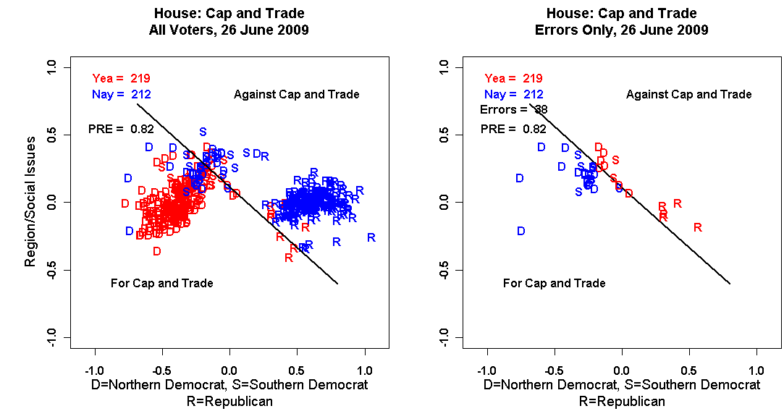

Slide 32
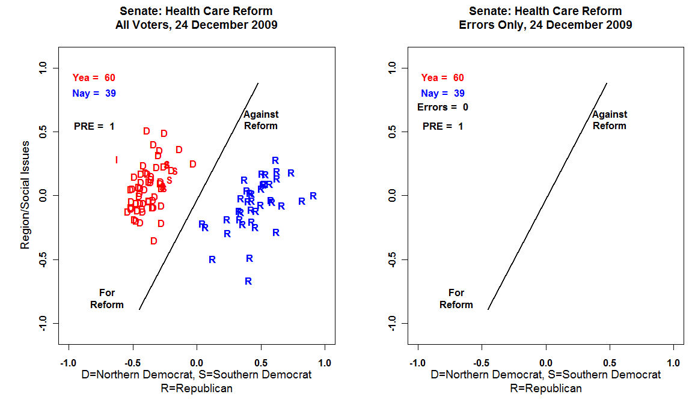

Slide 33
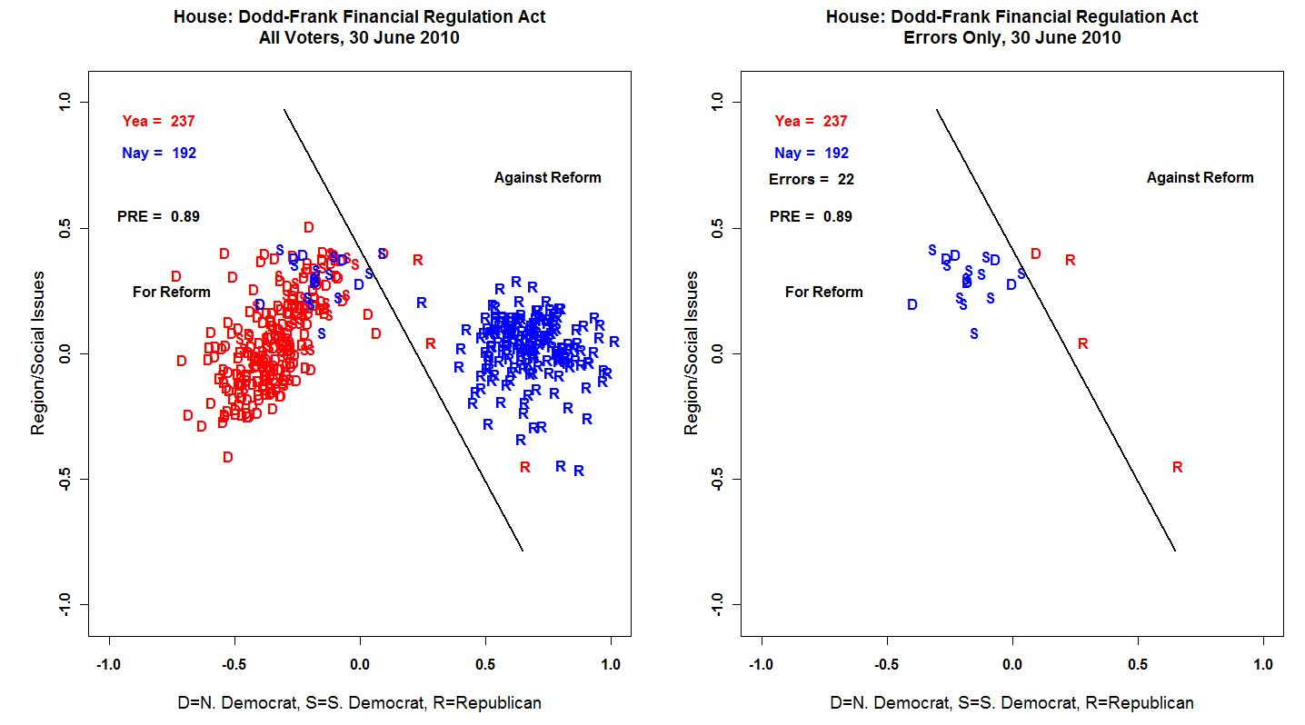

Slide 34
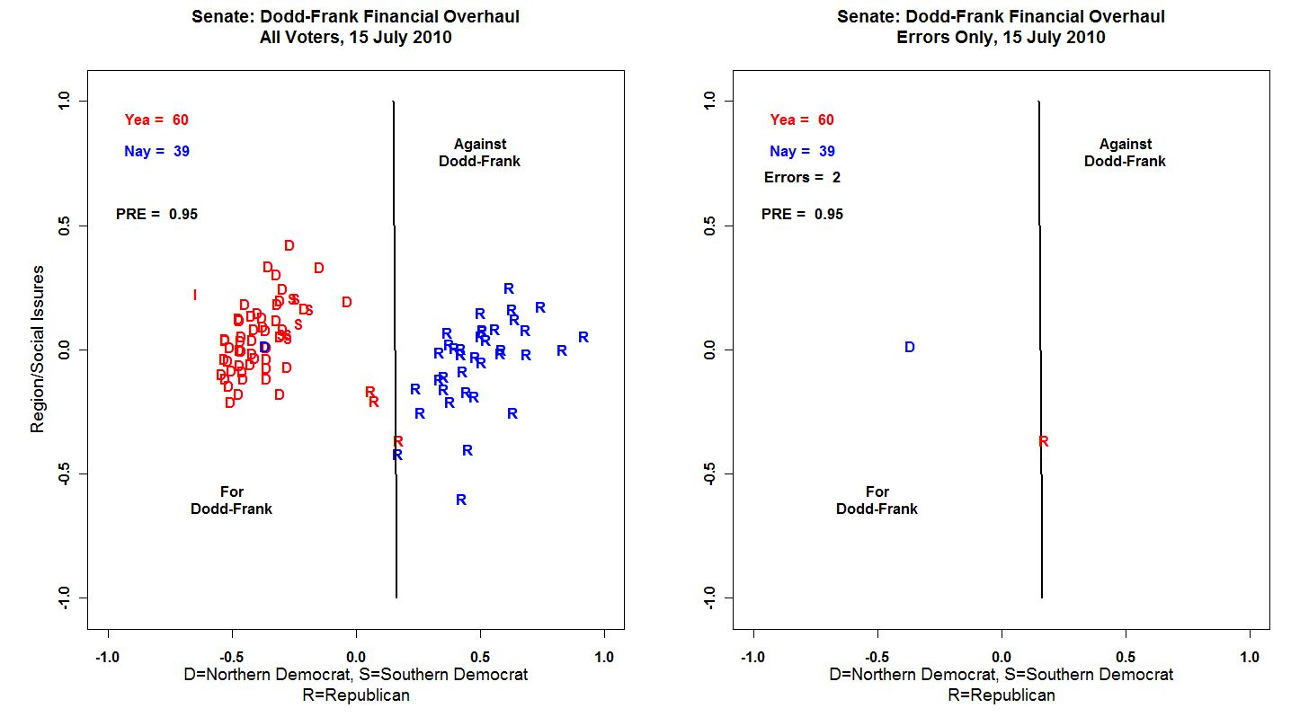

Slide 35
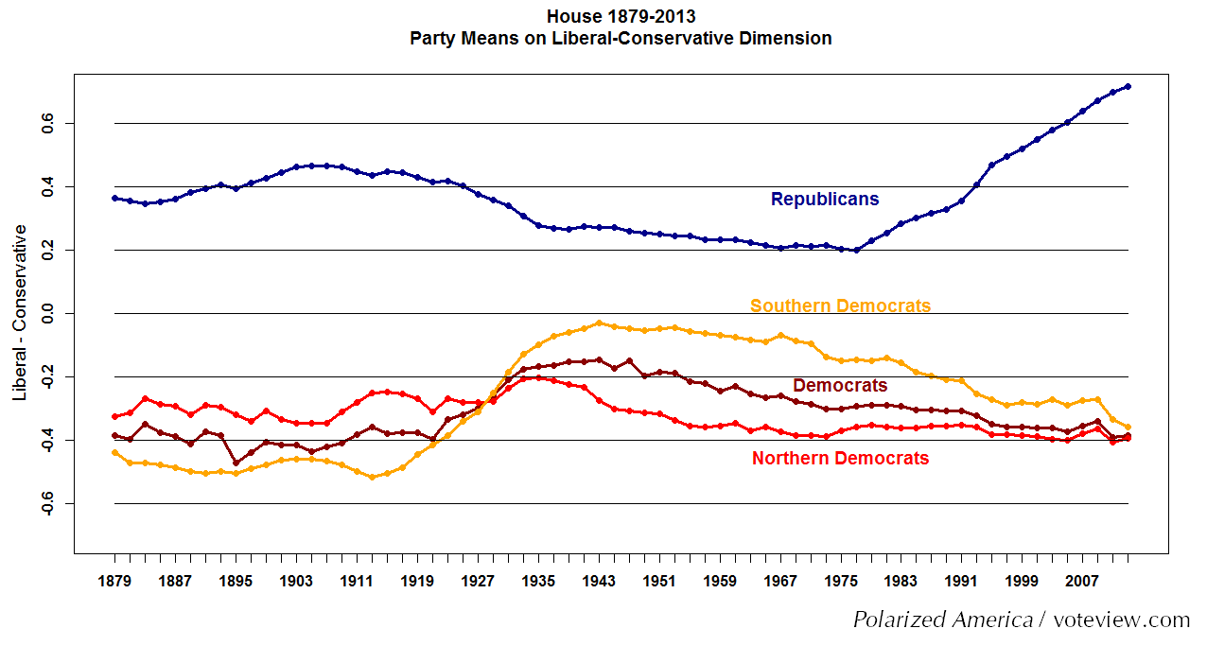

Slide 36
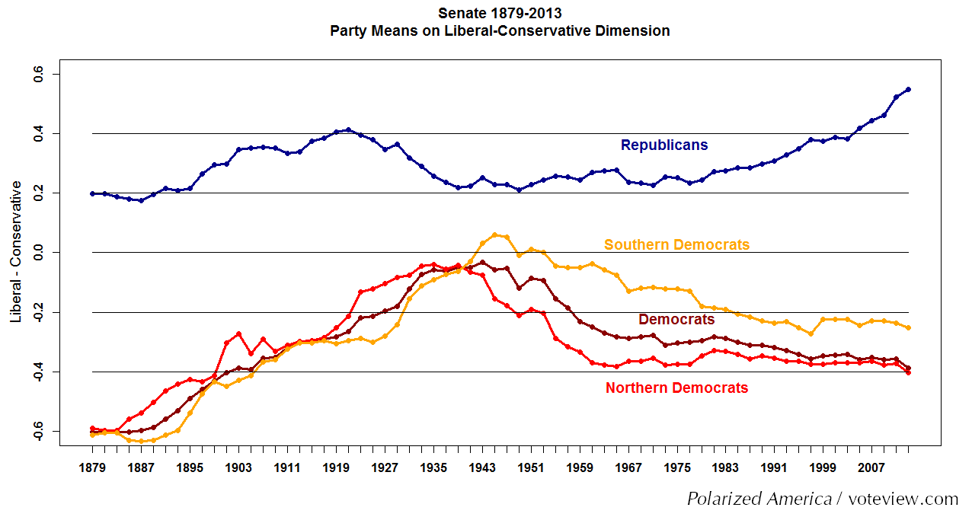

Slide 37
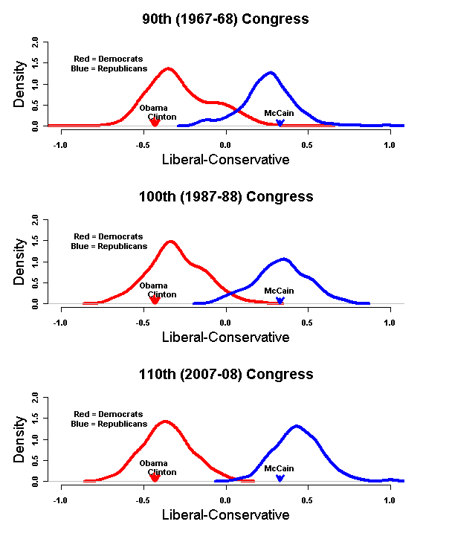

Slide 38
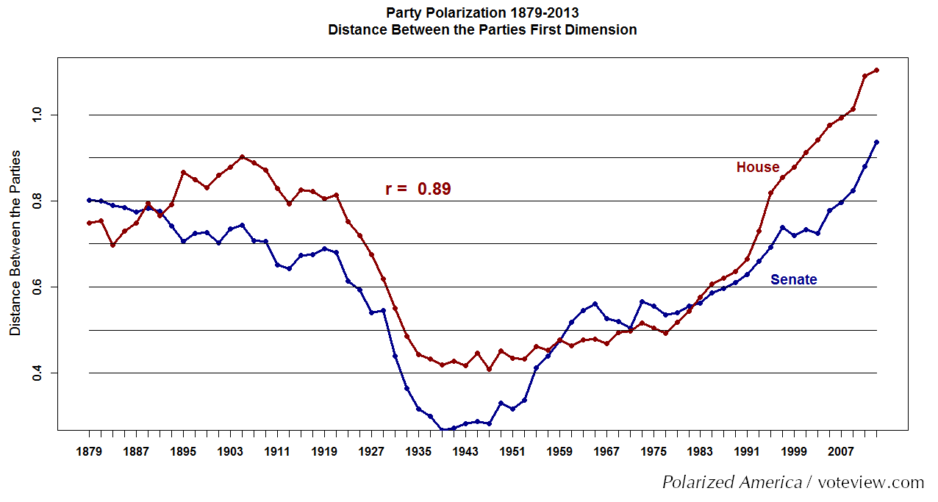

Slide 39
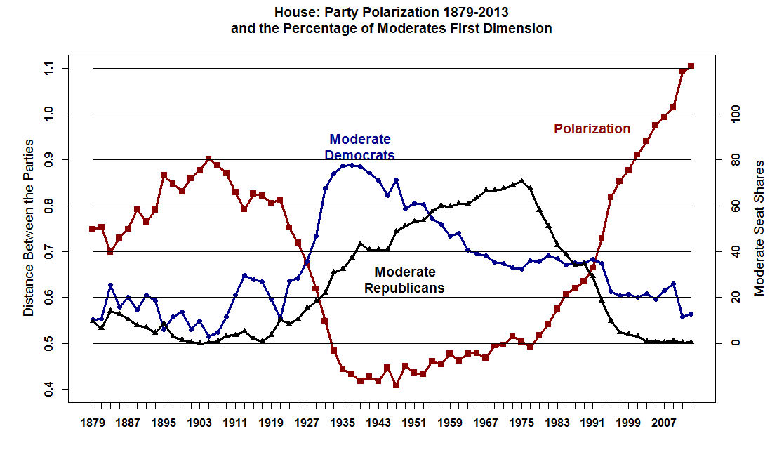

Slide 40
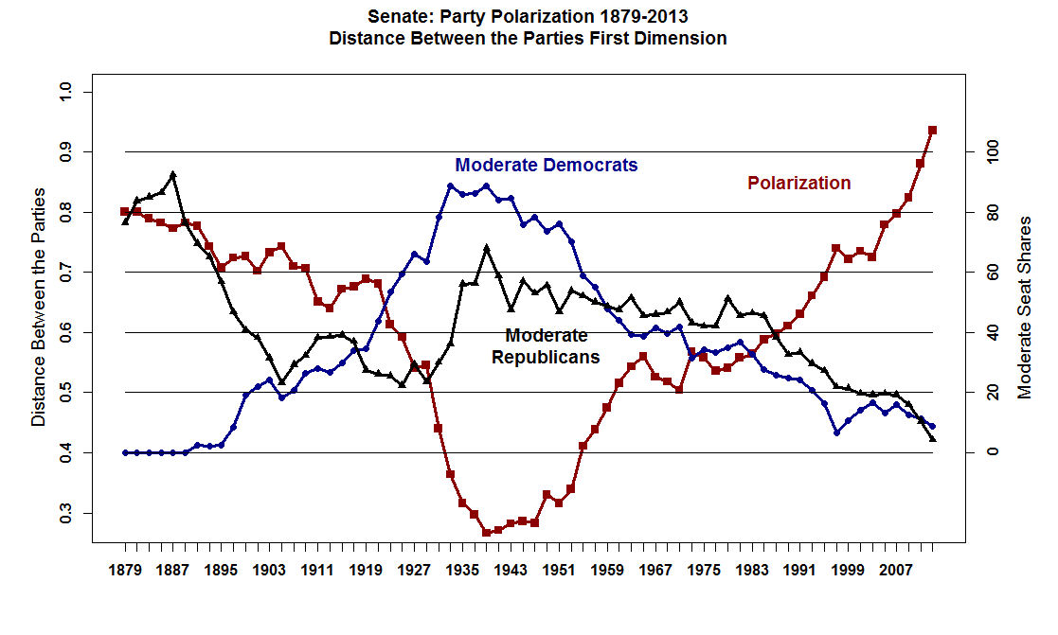

Slide 41
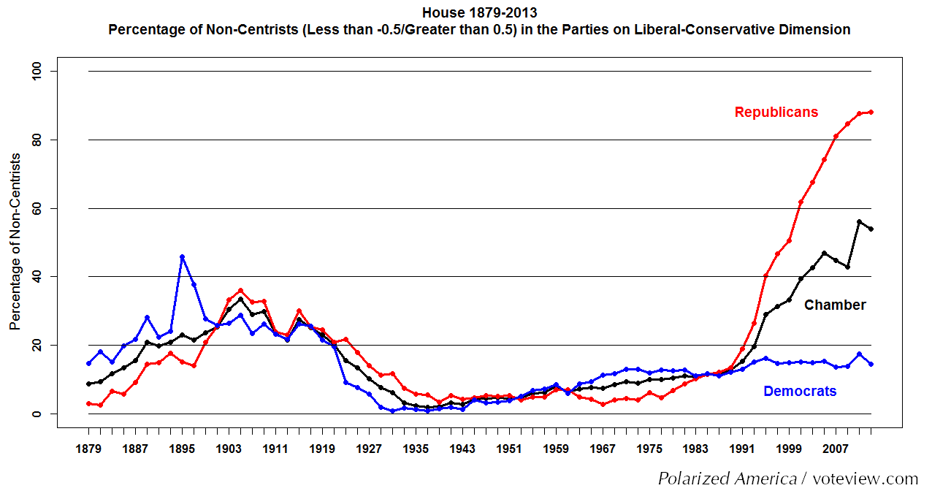

Slide 42
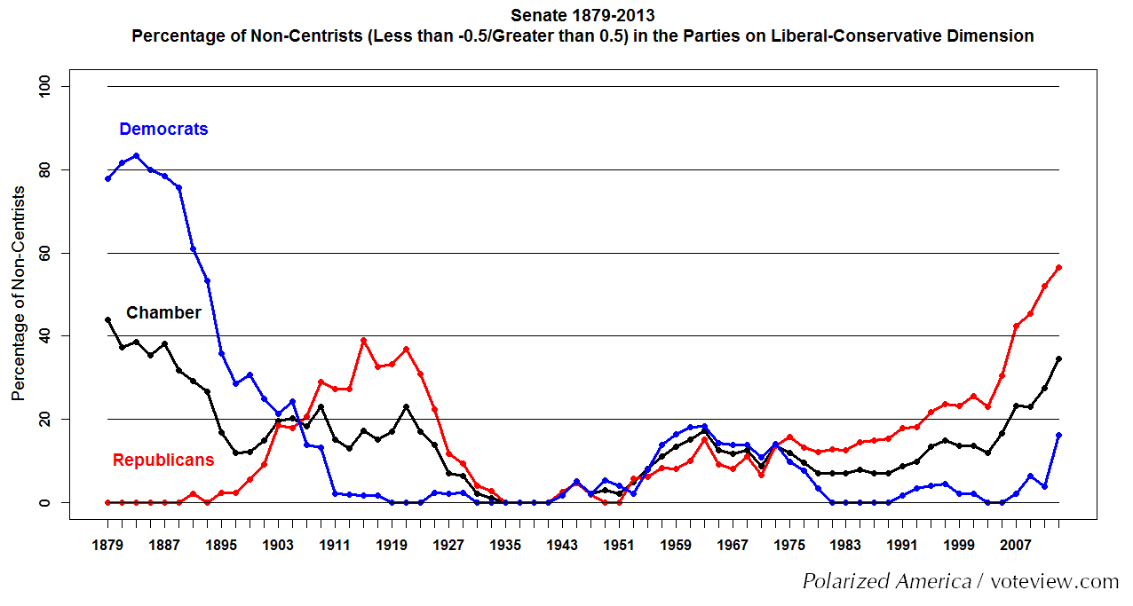

Slide 43
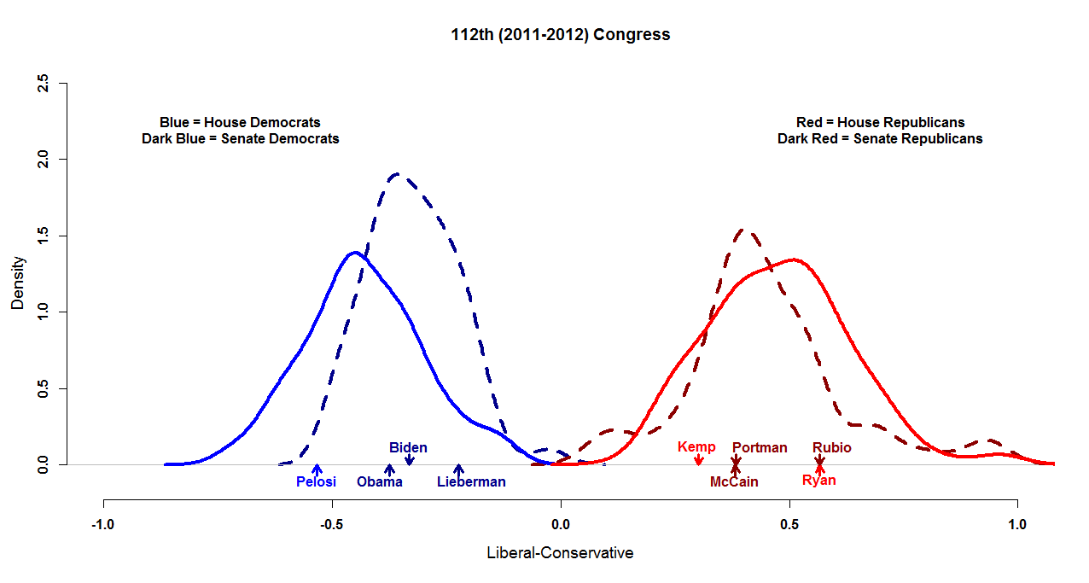

Slide 45
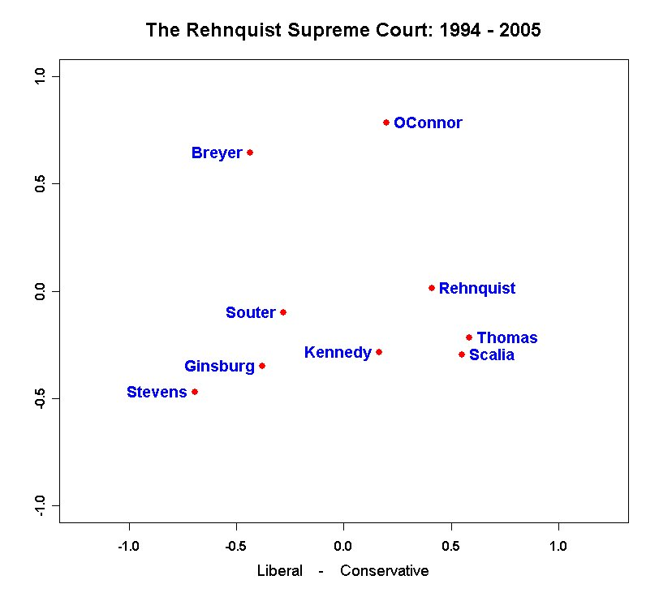
The Configuration below accounts for 96.95 percent of 2,624 total choices on 263 non-unanimous decisions.

Slide 46
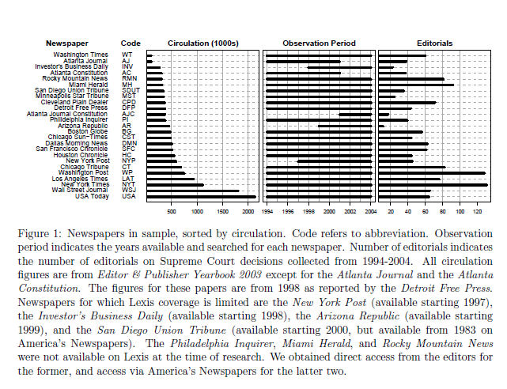
Ho, Daniel E. and Kevin M. Quinn. 2008. “Measuring
Explicit Political Positions of Media." Quarterly Journal
of Political Science. 3: 353-377.

Slide 47
