Slide 1
Is Immigration To Blame?
Immigration and Income Inequality

Slide 2
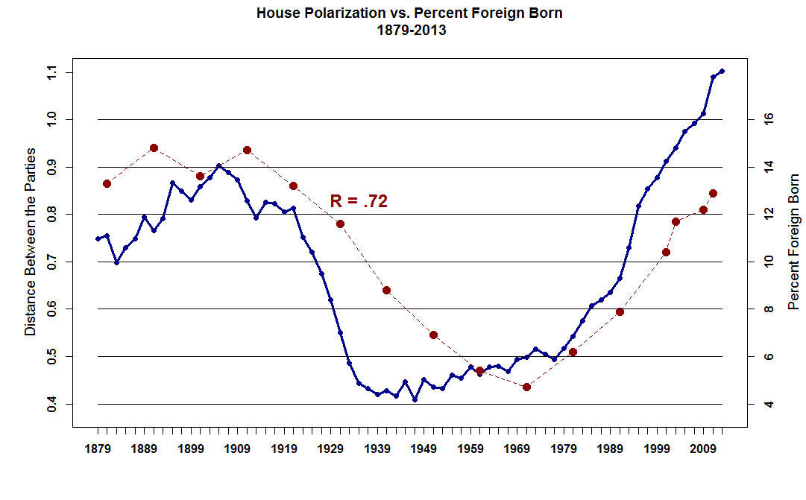

Slide 3
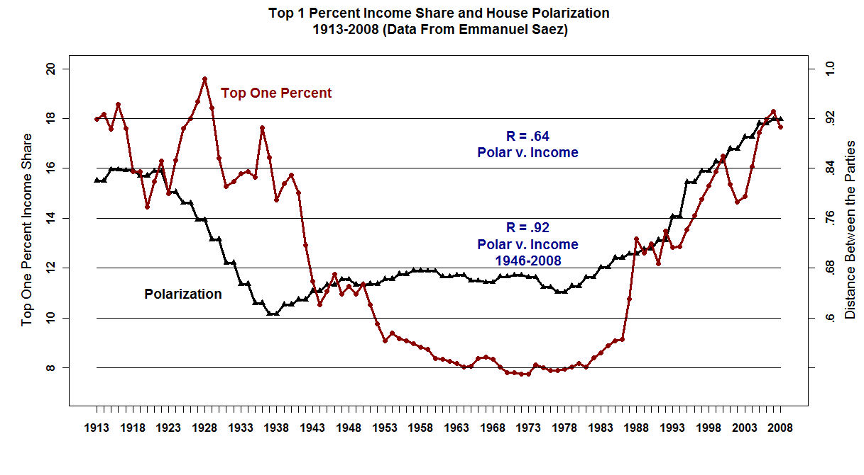

Slide 4
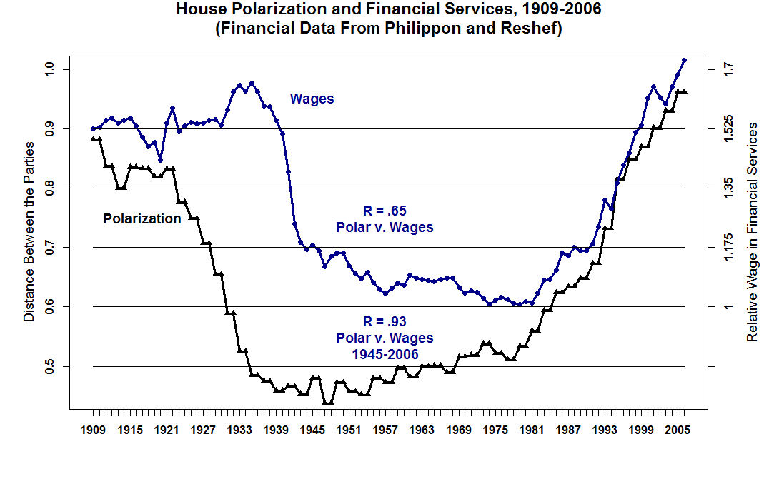

Slide 5
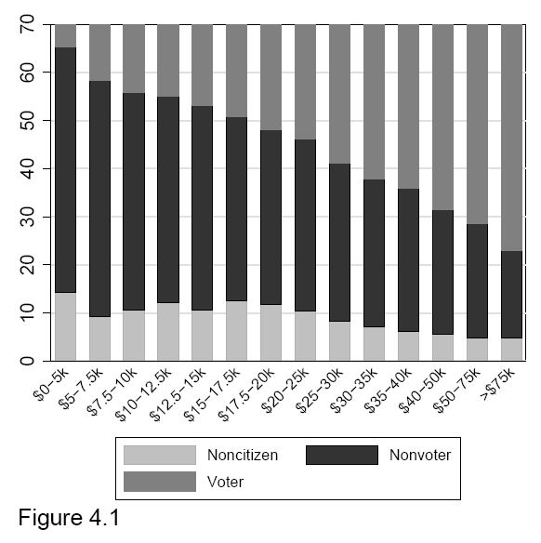

Slide 6
In PA we (MPR) work with the income distributions of (1) voters, (2) non-voting citizens, and (3) non-citizens.
For each of the three groups and for the entire sample, we estimate (1) mean income and (2) median income using the estimated mean and variance of a two-parameter log-normal distribution.

Slide 7
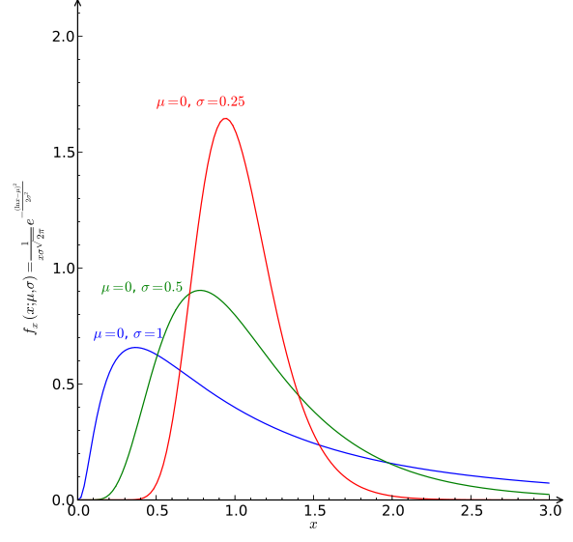
The Log-Normal Distribution. The Distribution in Blue is a good approximation for the distribution of income.

Slide 8
Consider the ratio of median income to mean income. As this ratio falls, there should be more pressure to redistribute. As the median voter’s income falls relative to the mean, the voter’s share of the initial pie falls and the voter through the ballot box will seek to get a larger piece, even if the total pie shrinks.

Slide 9
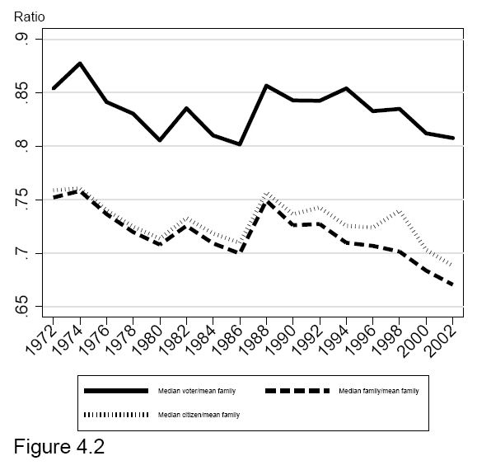

Slide 10
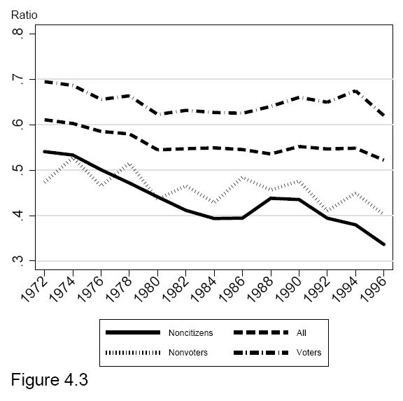
RATIO OF 50th CENTILE/80th CENTILE OF INCOME DISTRIBUTION BY GROUP
50th CENTILE OF GROUP/80th CENTILE ALL FAMILIES

Slide 11
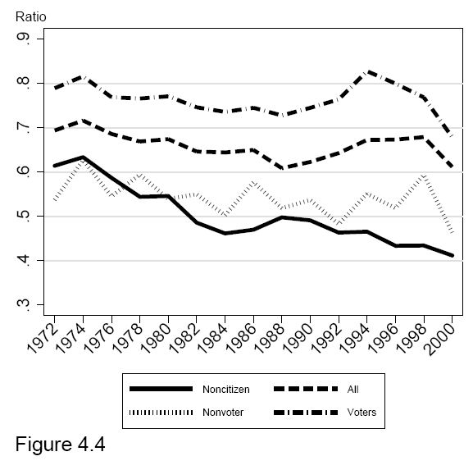
RATIO OF 50th CENTILE/72nd CENTILE OF INCOME DISTRIBUTION BY GROUP
50th Centile of Group/72nd Centile all Families

Slide 12
Turnout has not declined
Voters = 51.23 +0.042(Year -1972) + 14.38(Pres. Year)
(44.71) (0.69) (13.67)
Equation replicates McDonald and Popkin, Freeman

Slide 13
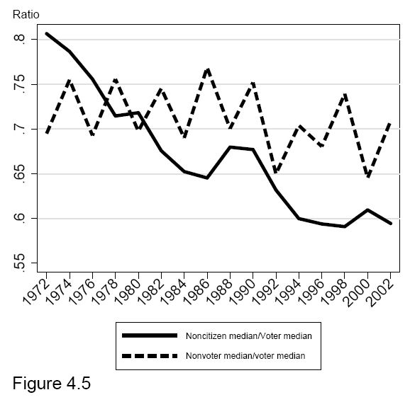

Slide 14
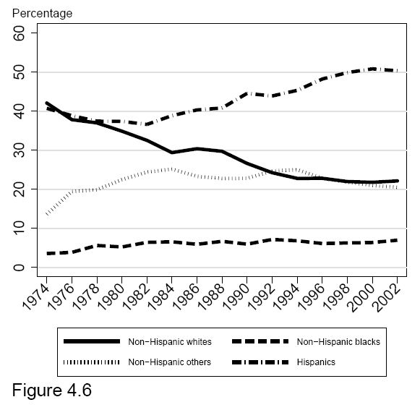
Ethnic Composition of Non-Citizens

Slide 15
(MPR) The median income voter’s incentive to redistribute has not increased as overall economic inequality has risen. The increase in inequality has been partially offset by immigration that has changed the location of citizens in the income distribution. Those ineligible to vote are substantially poorer than the eligible.
(MPR) Immigration cannot have been a driving force in the onset of the increase in income inequality and political polarization. In the early 1970s, non-citizens were quite a small share of the population of the United States, and their income profiles were close to those of citizens.

Slide 16
3. (Noah) – By 2011 net traffic of people back and forth across the Mexican border was zero. Fertility in Mexico has fallen sharply to about 2.0 so the “surplus” population that can be exported to the USA is disappearing. (Fertility rates have also fallen sharply in Central America.)
4. (Noah) – Illegal Immigrates have only had a minor effect on the wages of unskilled workers.

