Slide 1
The Price of Inequality (Preface) and The Great Divergence Chapters 1 - 3
The Great Compression and the Great Divergence

Slide 2
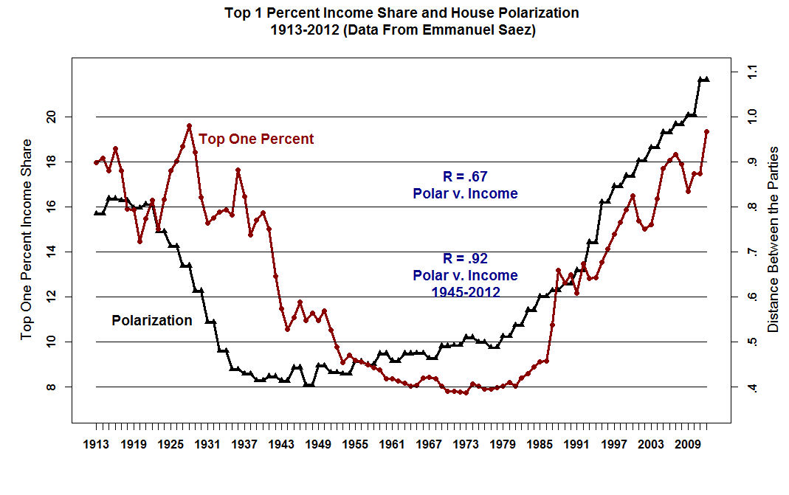

Slide 3
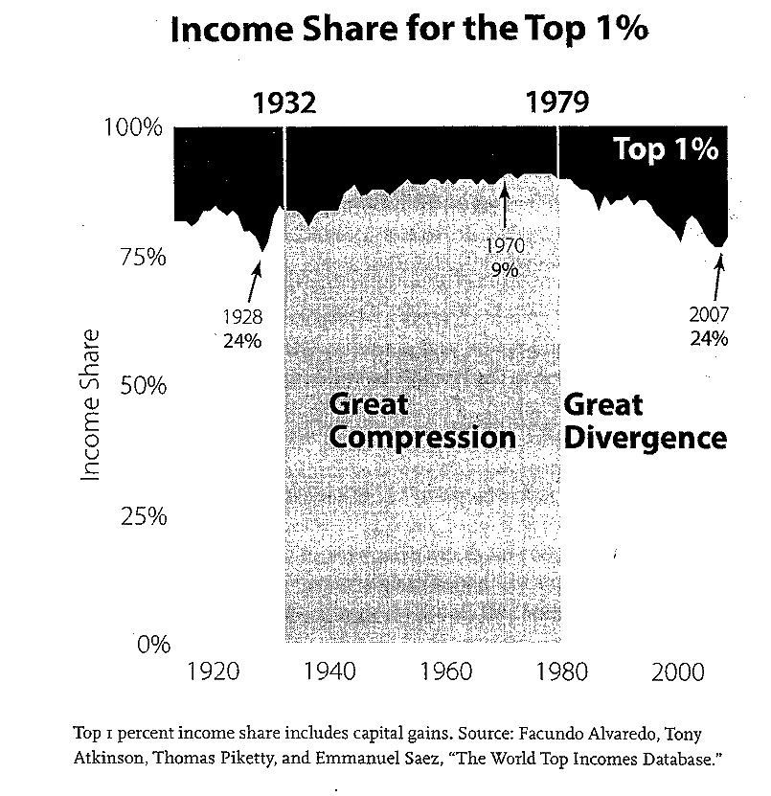

Slide 4
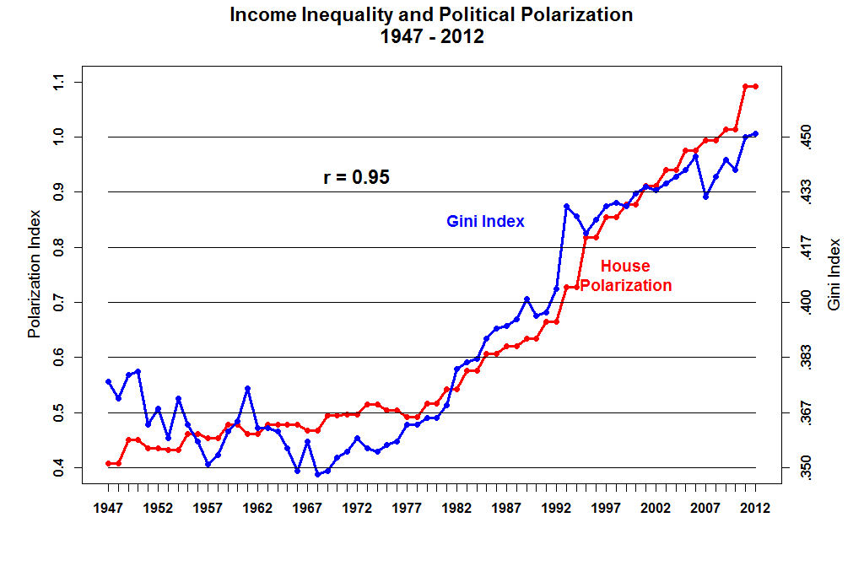

Slide 5
Stiglitz -- Preface
Romney is a Bad Person!!
However, the Federal Reserve Supports his major complaints!

Slide 6
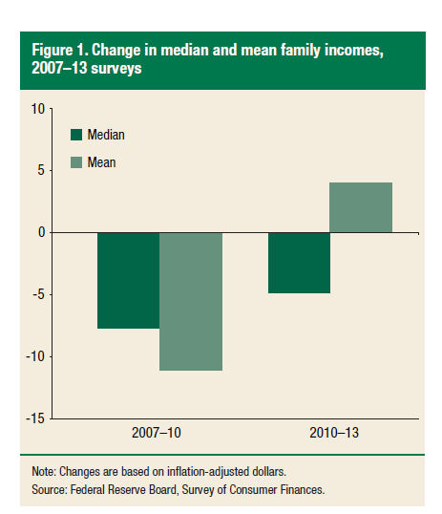

Slide 7
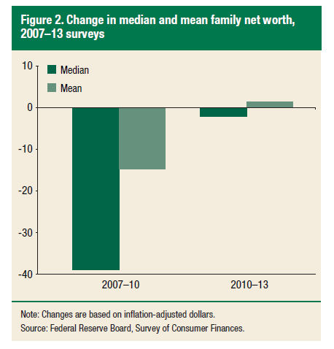

Slide 8
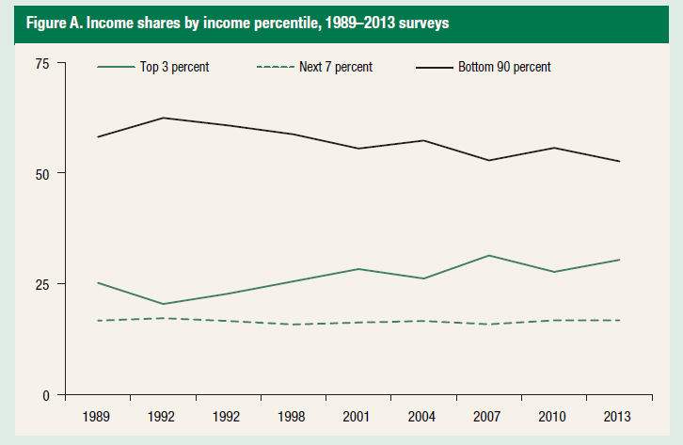

Slide 9
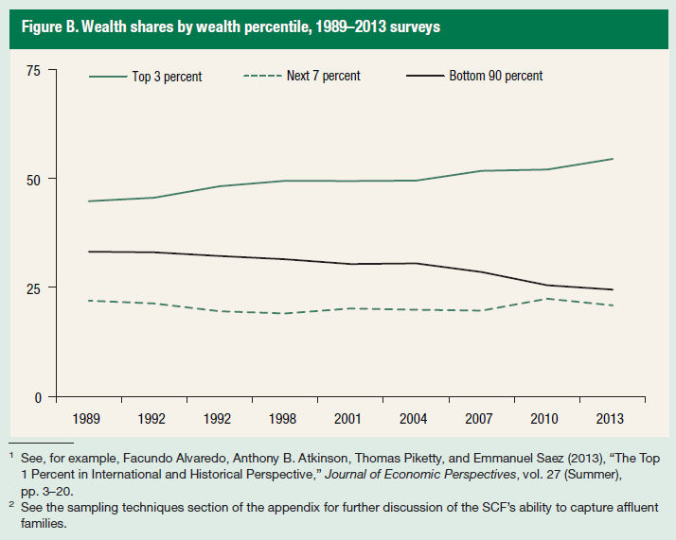

Slide 10
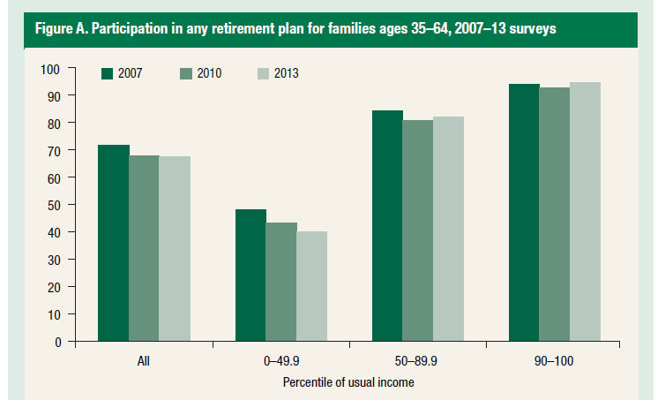

Slide 11
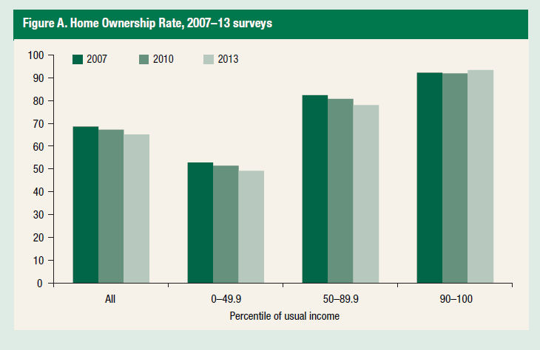

Slide 12
GD Chapter 3: The Usual Suspects
1. Discrimination Against Blacks and Women
2. Greater Risk of Job Loss
3. Shifts in Marriage Patterns
4. Single Parent Households and Illegitimacy

Slide 13
Women and Blacks Make Less than White Males
What is seldom noted is that Asian Men and Women make more than their White and Black Counterparts in every occupation.

Slide 14
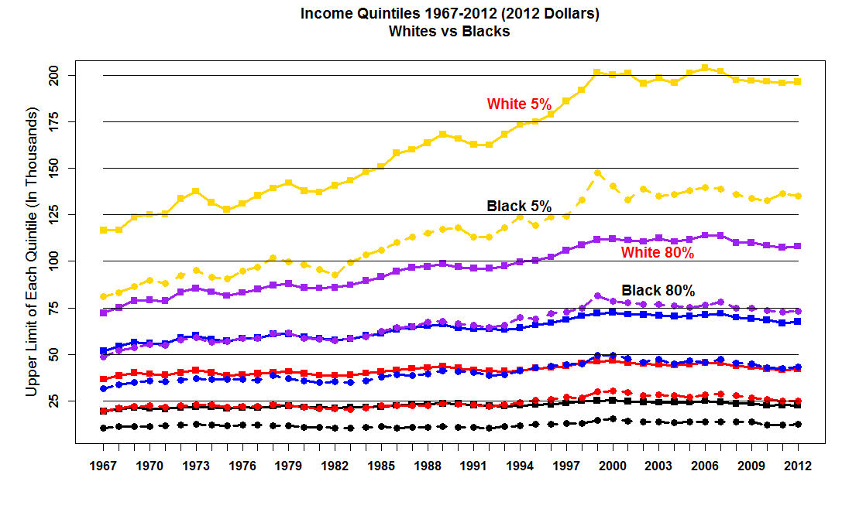

Slide 15
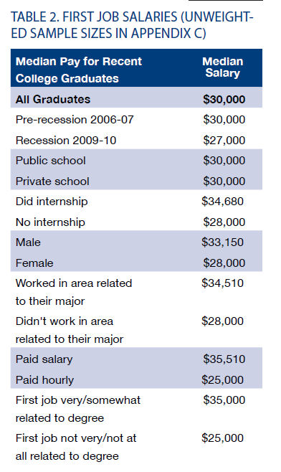

Slide 16
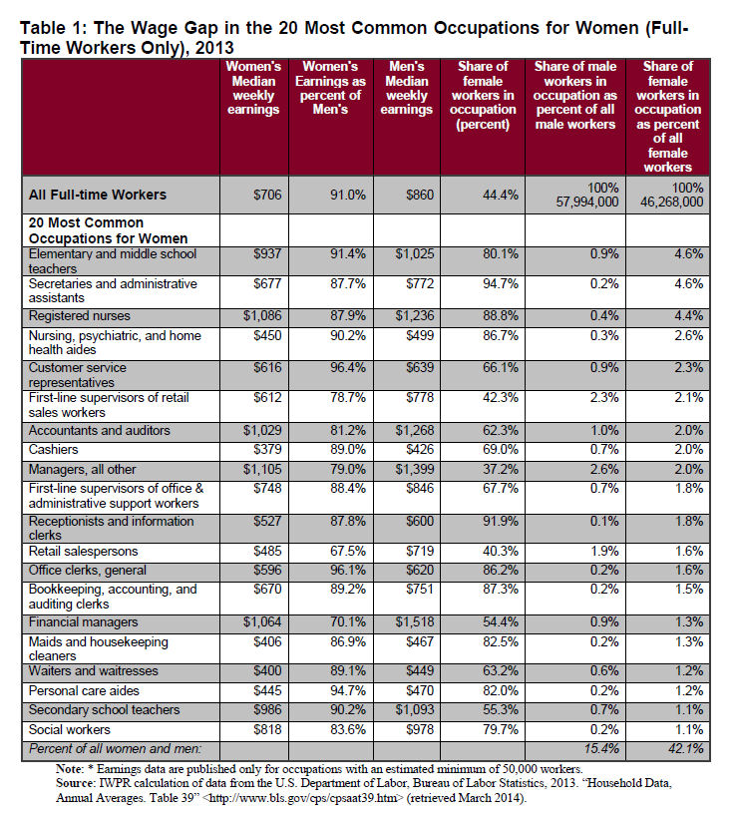

Slide 17
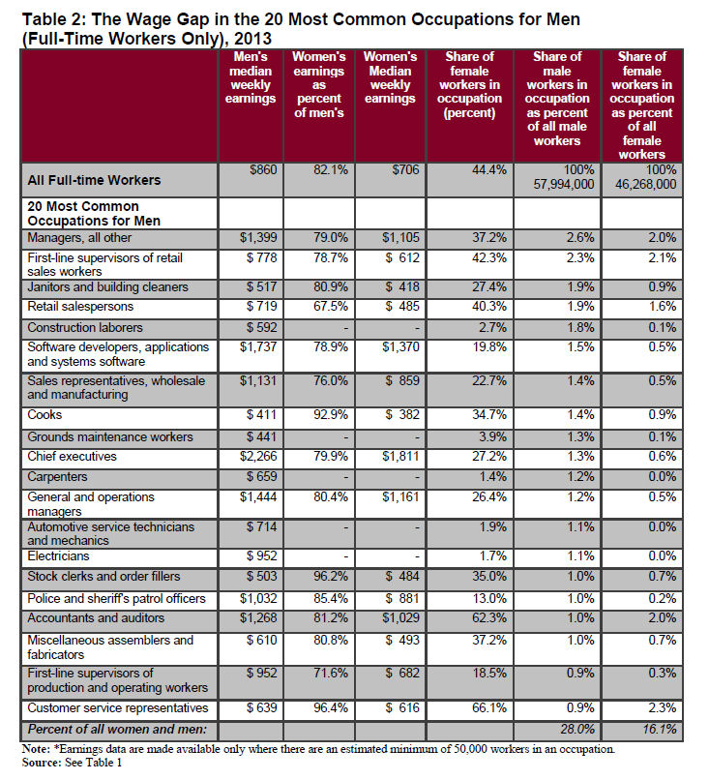

Slide 18
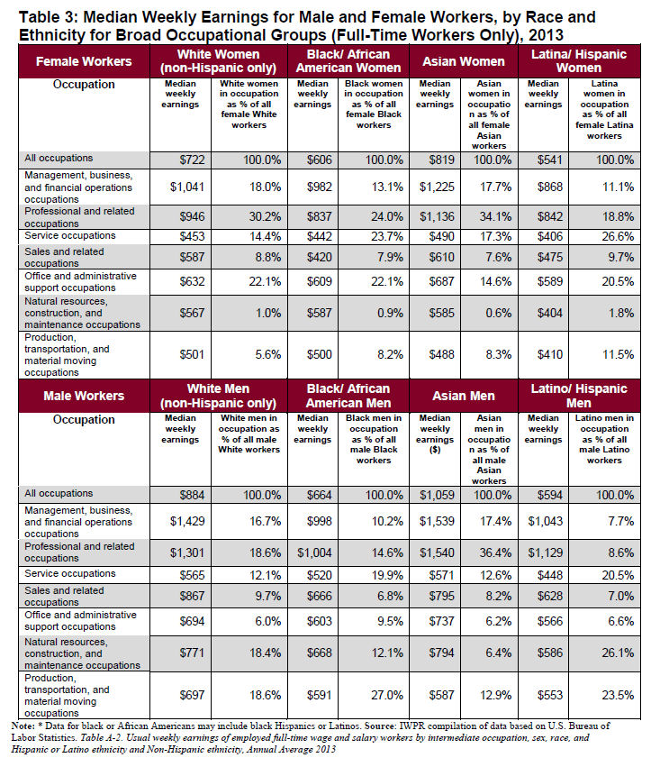

Slide 19
Women are Better Educated than Men
Women now make up 57% of Undergraduates in the USA and this percentage appears to be increasing.

Slide 20
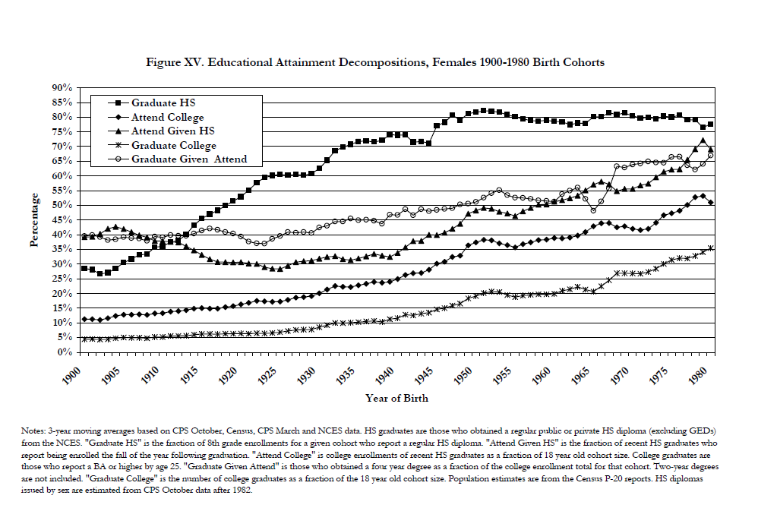

Slide 21
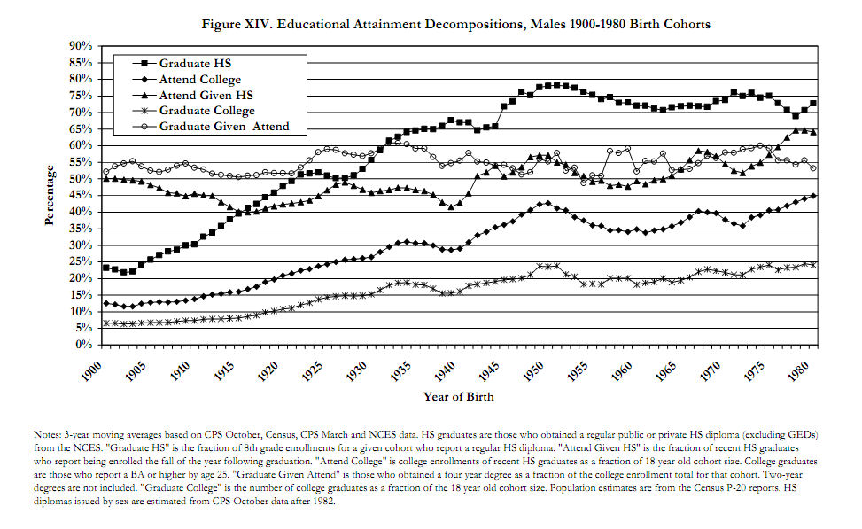

Slide 22
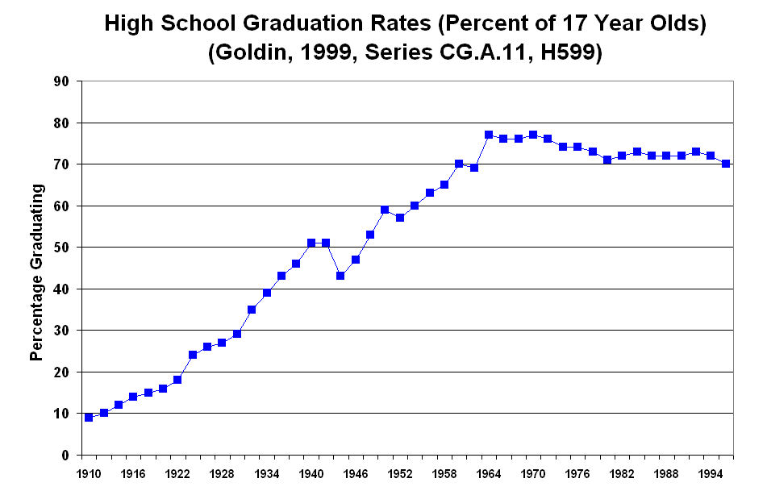

Slide 23
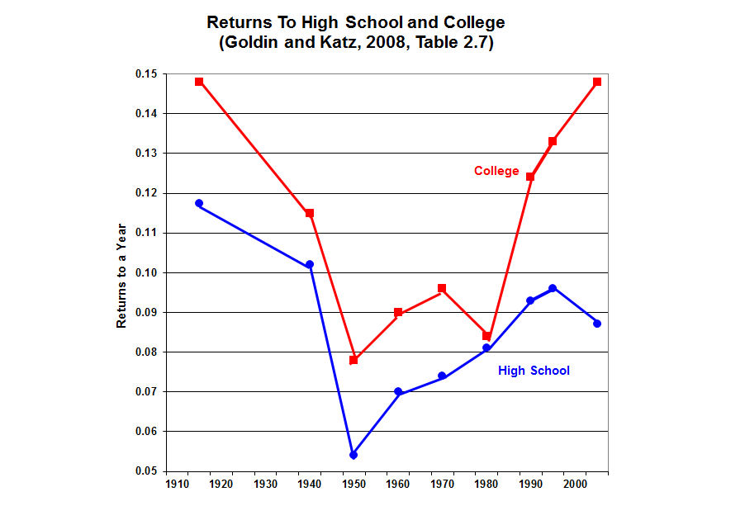

Slide 24
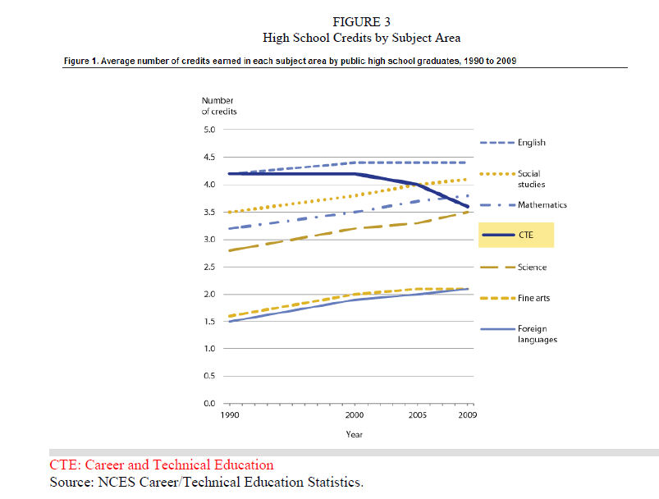

Slide 25
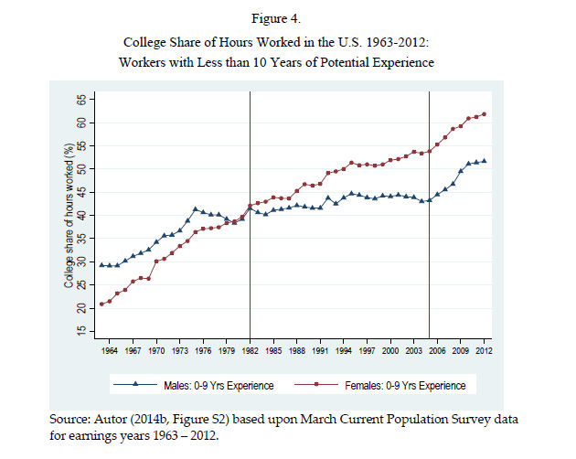

Slide 26
The Rise of Assortative Mating
People increasingly marry people whose incomes and/or education are roughly at the same level as their own. This tends to increase inequality.

Slide 27
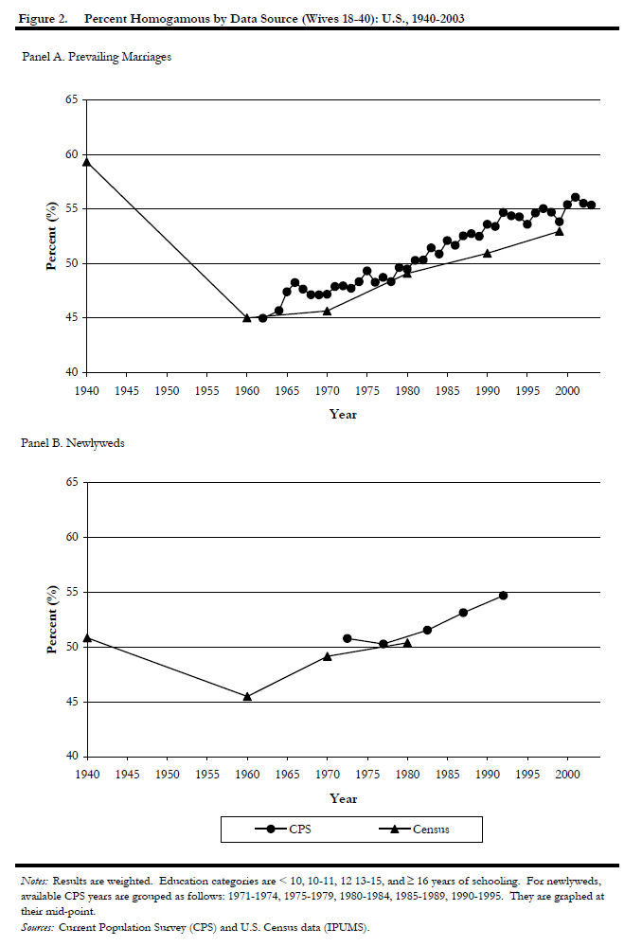
UCLA CA Center for Population Research, WP CCPR-017-05

Slide 28
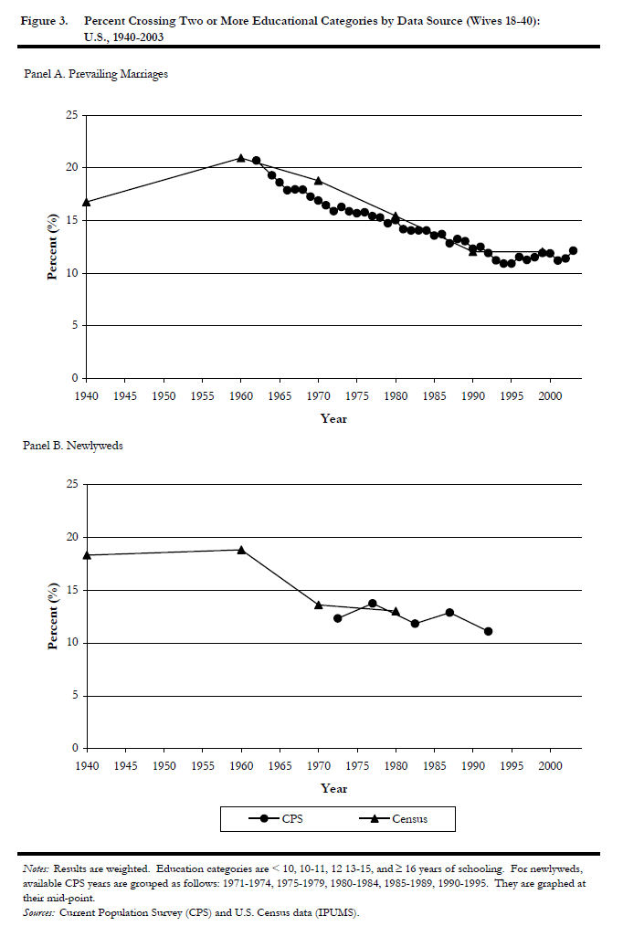
UCLA, CA Center for Population Research, WP CCPR-017-05

Slide 29
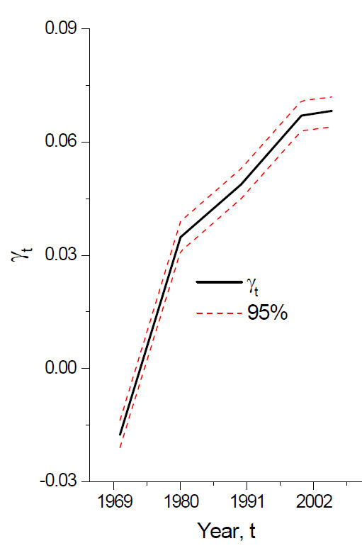
Marry Your Like, NBER WP 19829, Figure 1

Slide 30
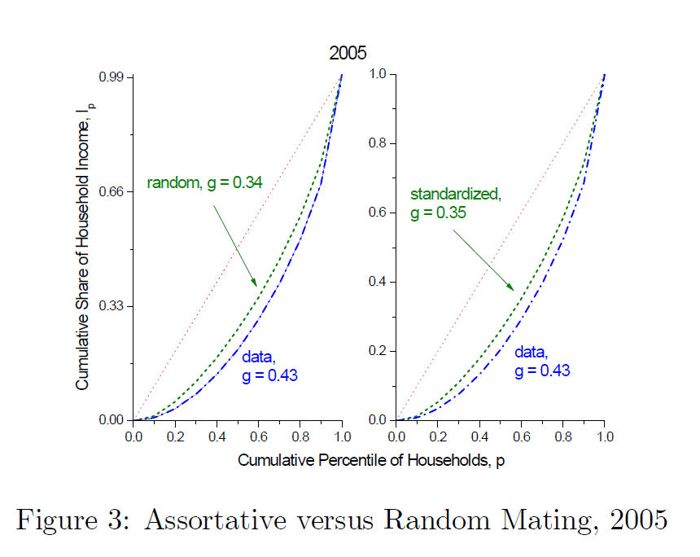
Marry Your Like, NBER WP 19829

Slide 31
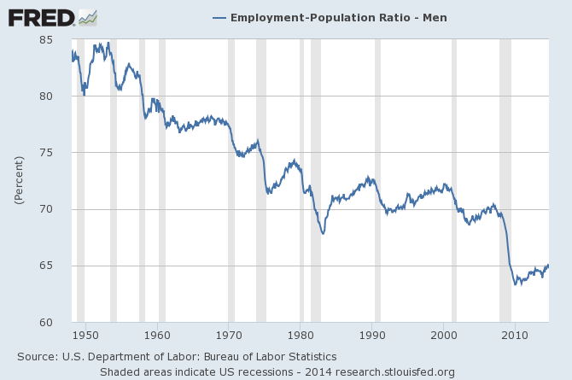

Slide 32
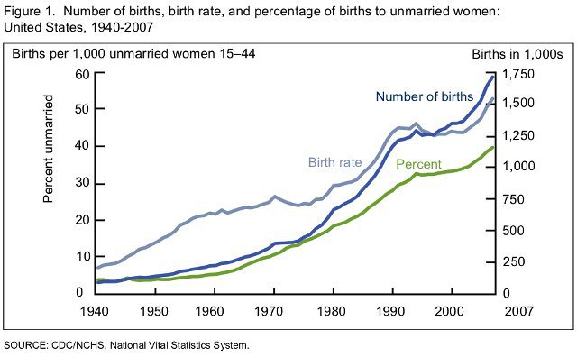

Slide 33
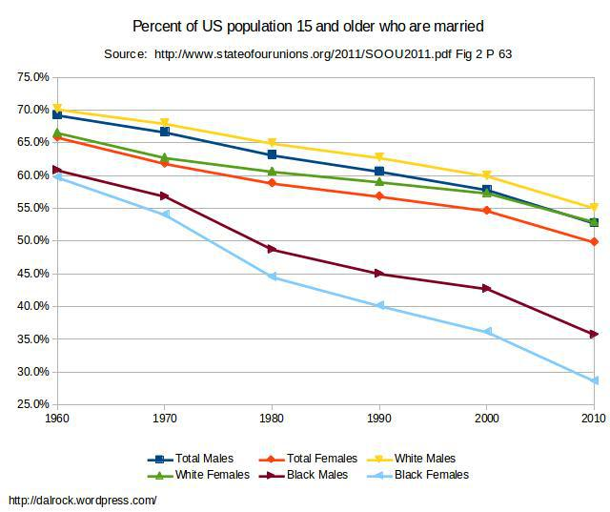

Slide 34
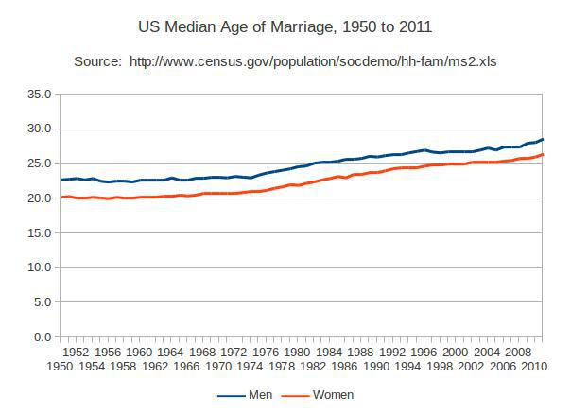

Slide 35
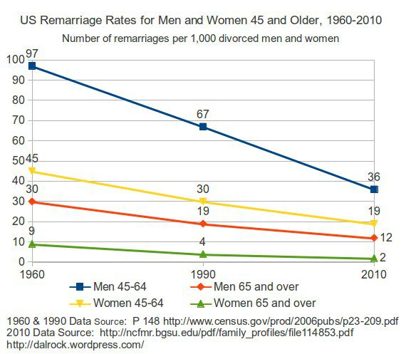

Slide 36
Greater Risk of Job Loss
Indirect Evidence, the Rise of non-Business Bankruptcies

Slide 37
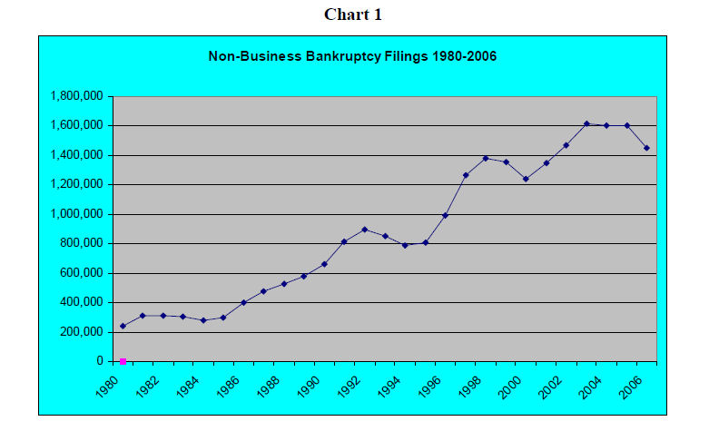

Slide 38
Marriage, Divorce, and Births to Unmarried Women
Abortion is going down but Births to Unmarried Women are going up

Slide 39
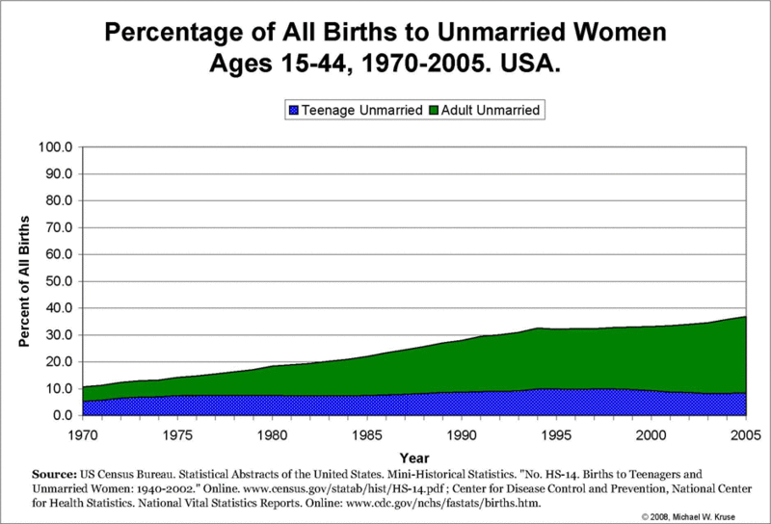

Slide 40
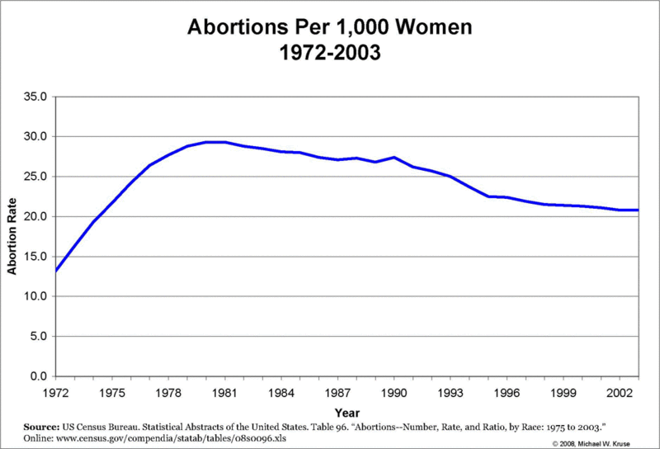

Slide 41
