Slide 1
Is Globalization To Blame?
Globalization, Free Trade, and Income Inequality

Slide 2
GLOBALIZATION

Slide 3
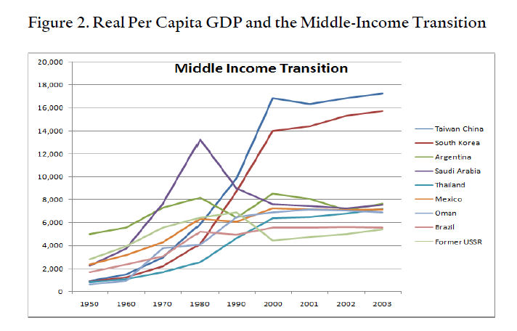

Slide 4
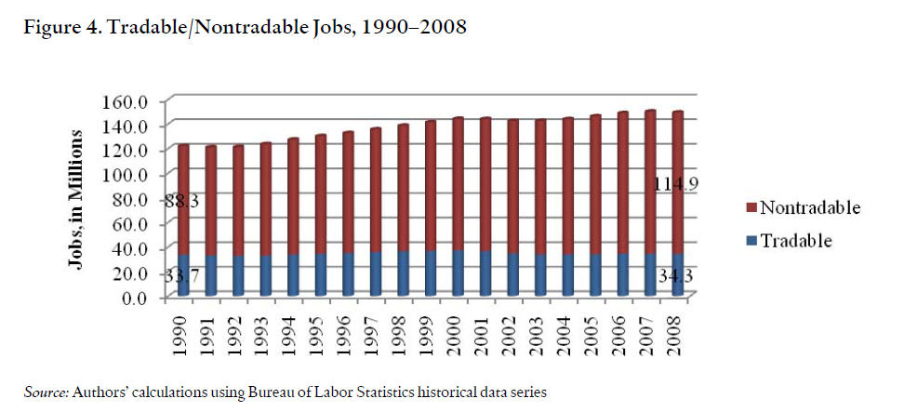

Slide 5
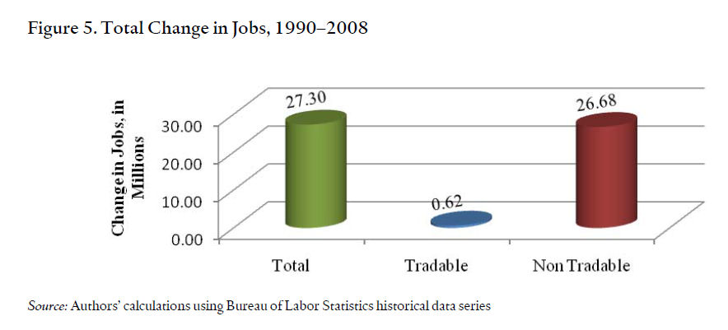

Slide 6
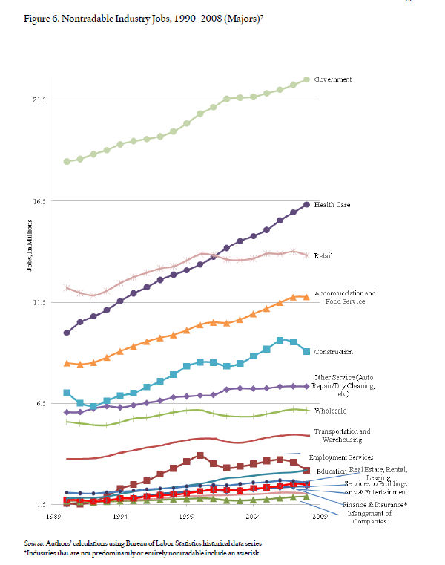

Slide 7
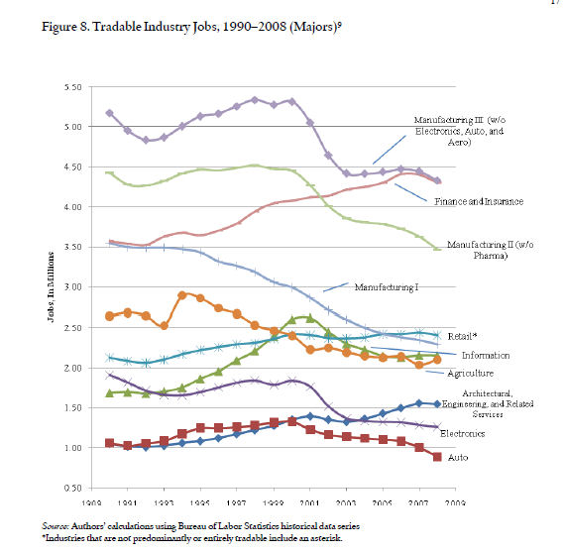

Slide 8
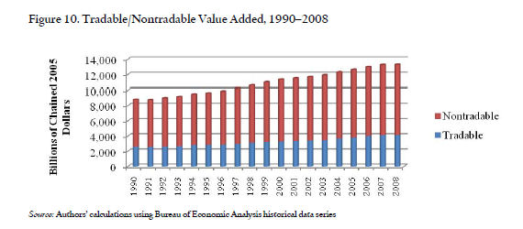

Slide 9
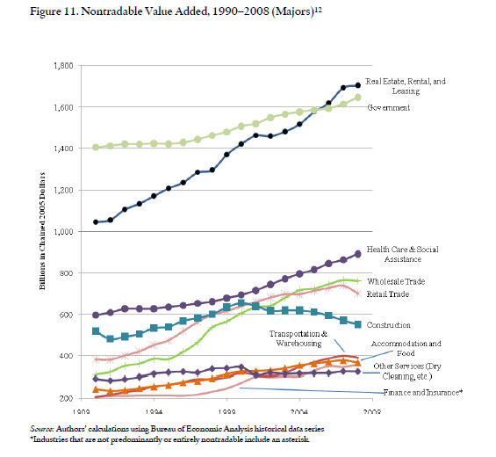

Slide 10
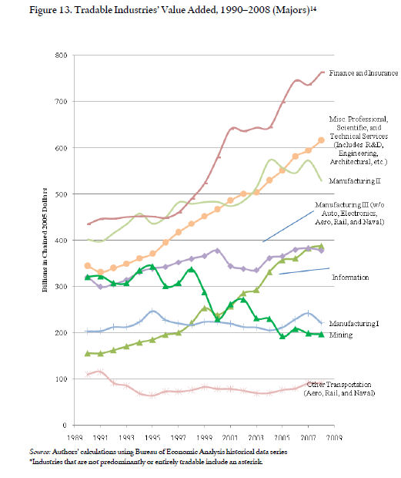

Slide 11
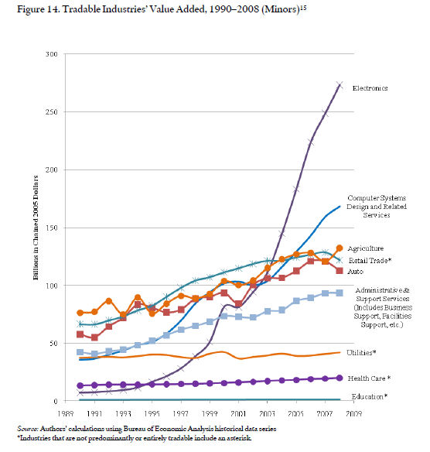

Slide 12
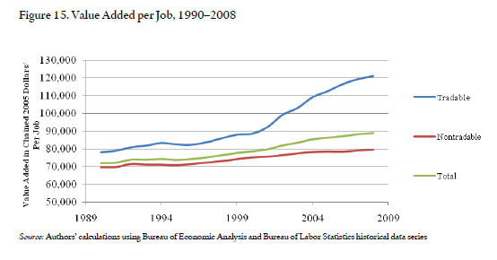

Slide 13
EDUCATION

Slide 14
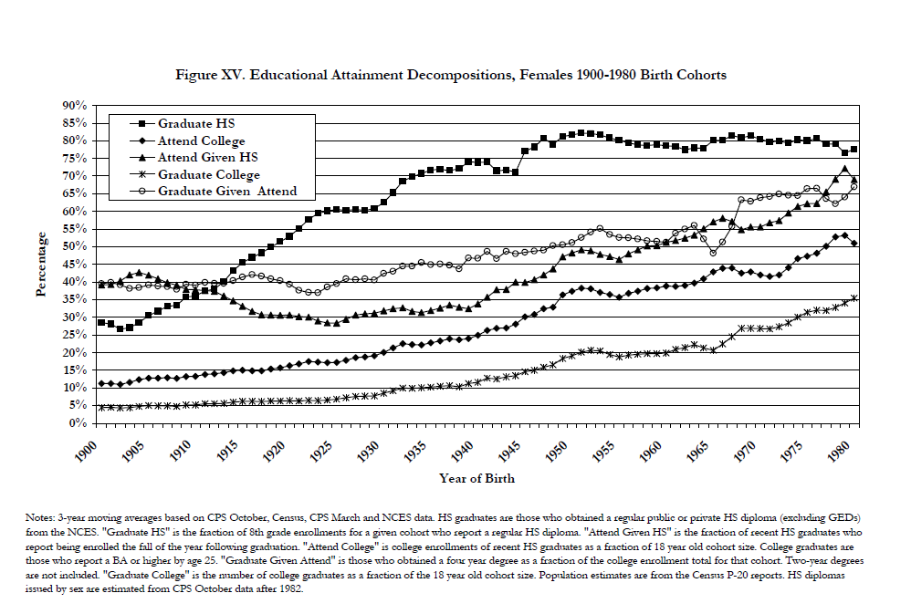

Slide 15
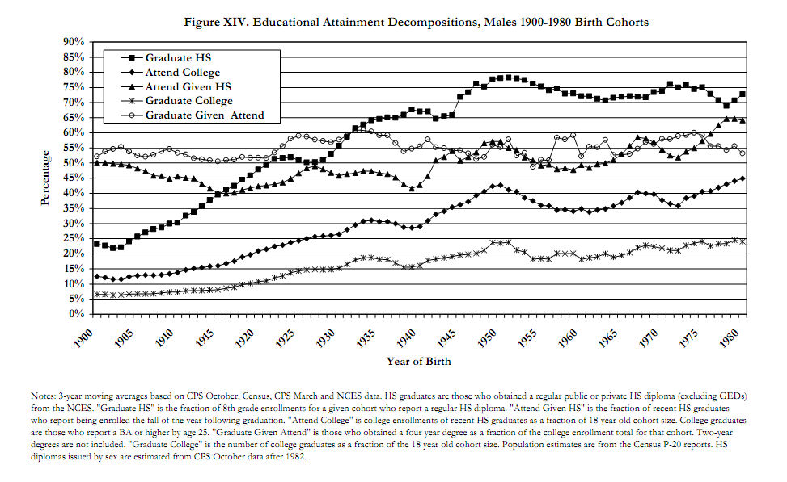

Slide 16
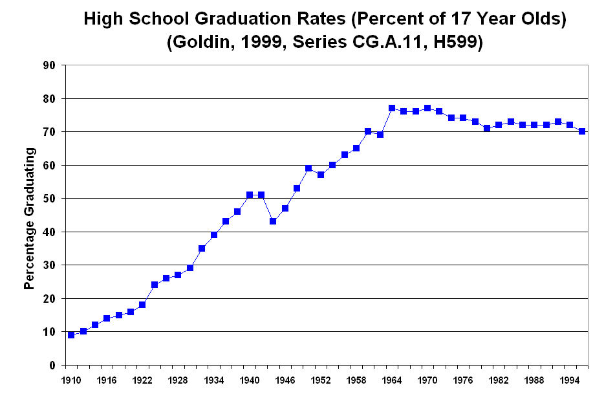

Slide 17
For every 100 women getting a BA/BS Degree, 77 Men Do.
For every 100 women getting a MA/MS Degree, 66 Men Do.

Slide 18
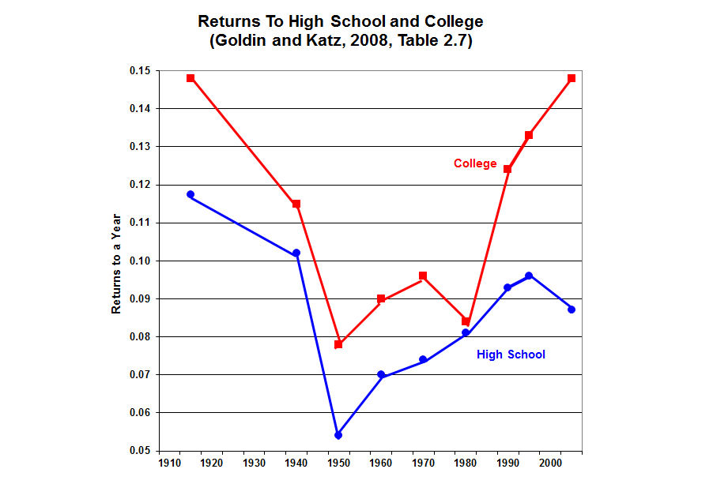

Slide 19
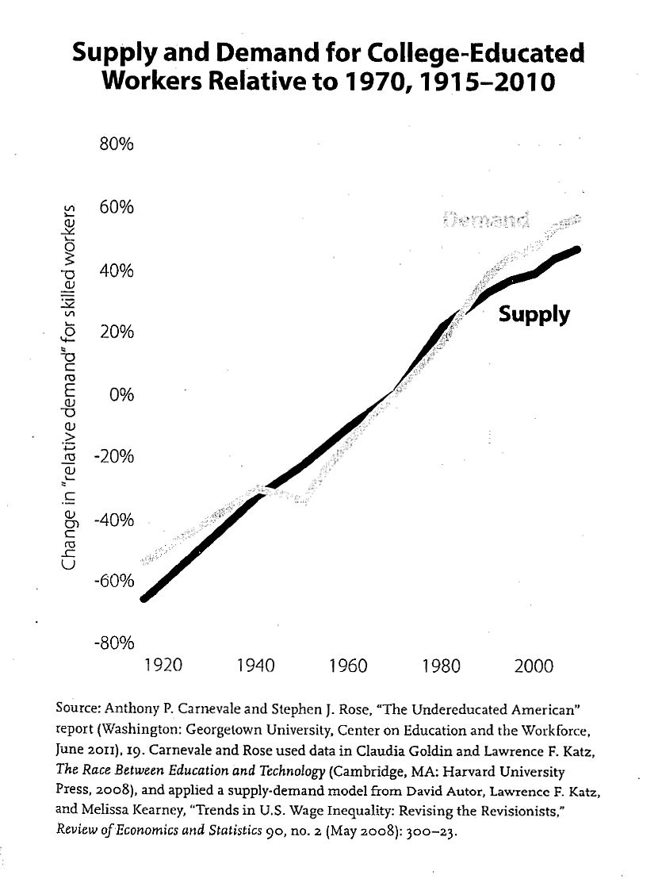

Slide 20
Most Valuable Bachelor’s Degrees: 1) Biomedical Engineering ($53.8 start, $97.8 mid-career); 2) Computer Science; 3) Applied Mathematics; 4) Software Engineering; 5) Environmental Engineering; 6) Civil Engineering; 7) Geology; 8) Management Information Systems; 9) Petroleum Engineering; 10) Applied Mathematics; 11) Mathematics; 12) Construction Management; 13) Finance; 14) Physics; 15) Statistics.

Slide 21
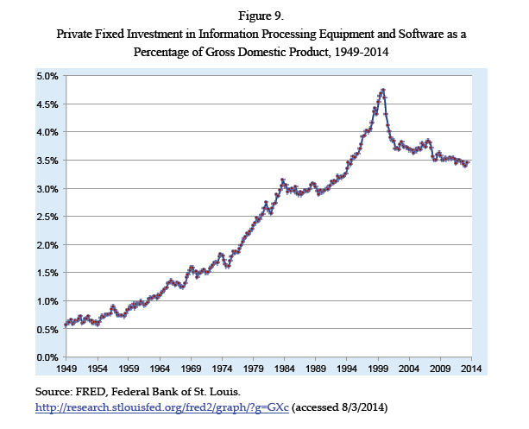

Slide 22
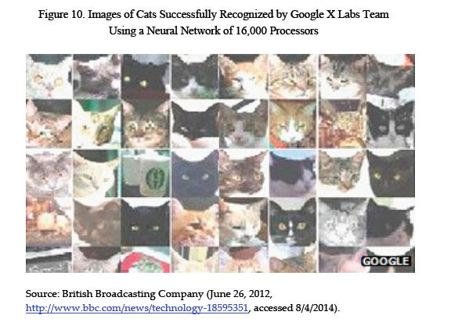

Slide 23
WHAT PUBLIC POLICIES NEED TO CHANGE TO ADDRESS THE PROBLEM OF AN INSUFFICIENTLY SKILLED WORKFORCE?

Slide 24
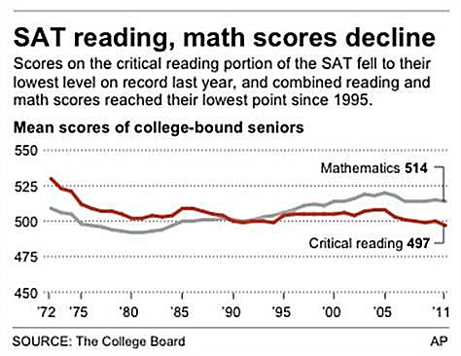

Slide 25
