Slide 1
Income Inequality Overview
Income Distribution Over Time

Slide 2
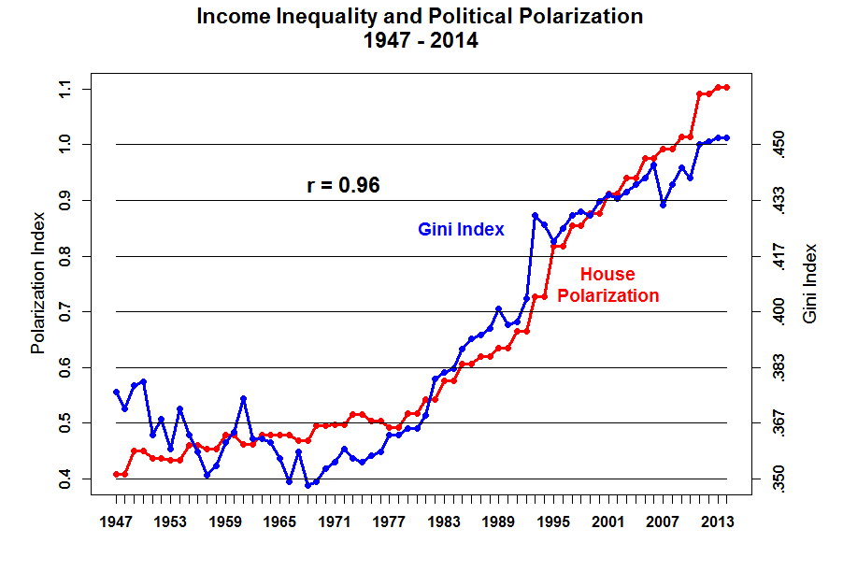

Slide 3
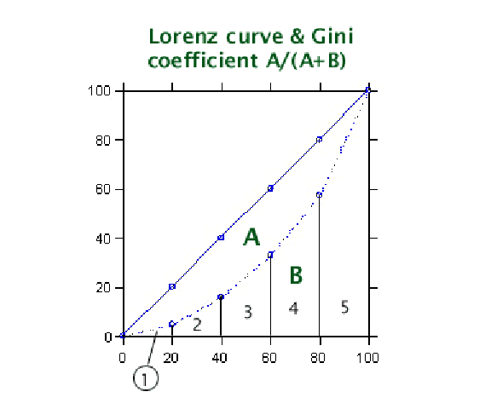

Slide 4
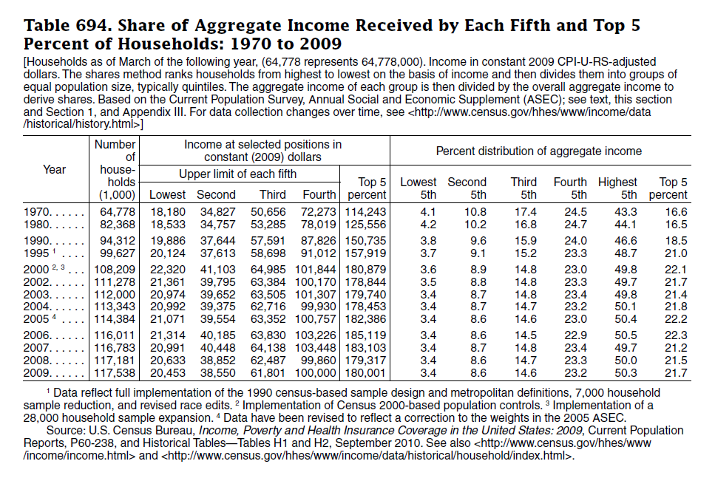

Slide 5
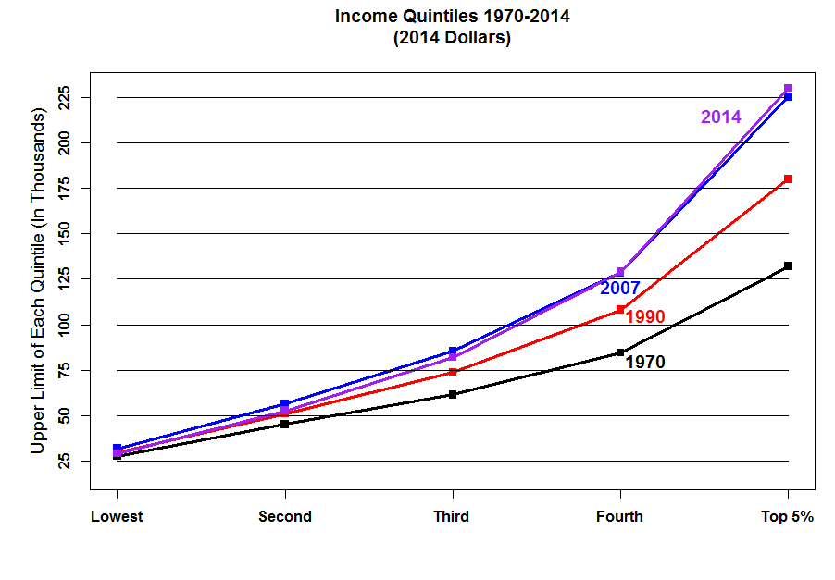

Slide 6
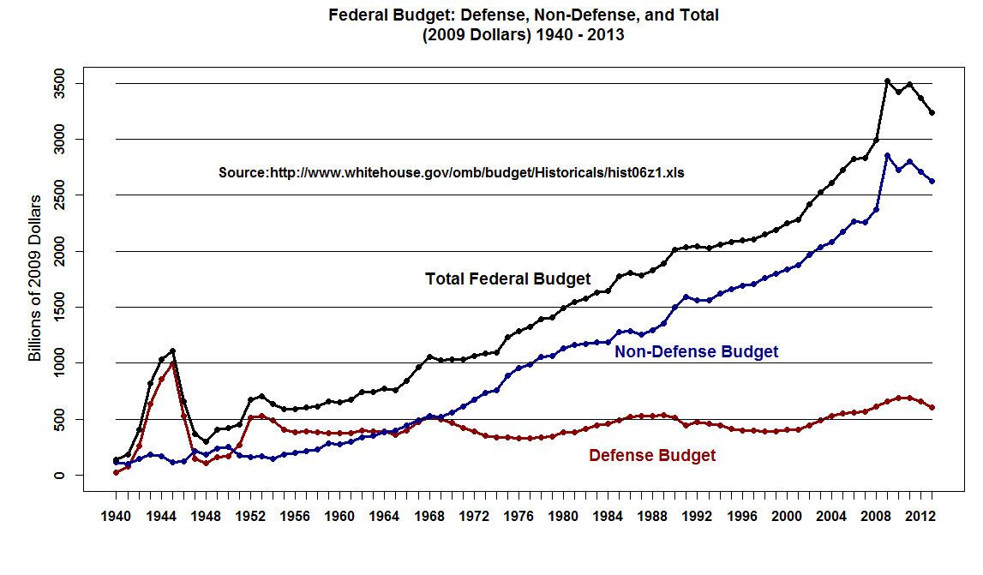

Slide 7
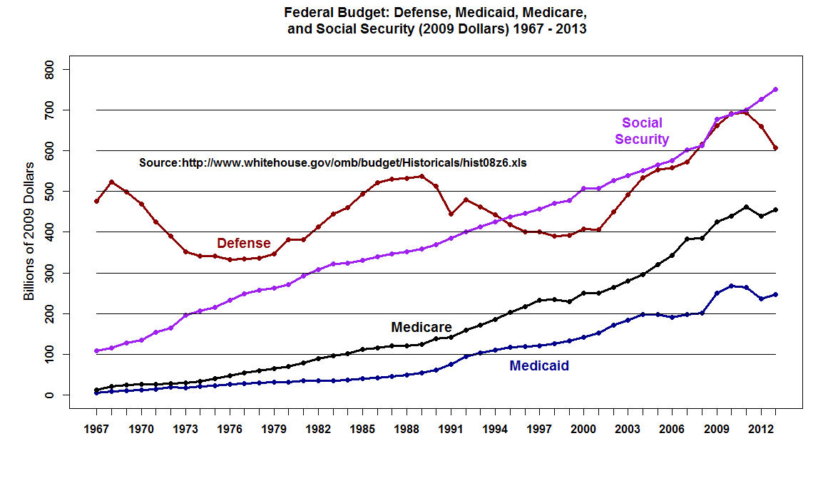

Slide 8
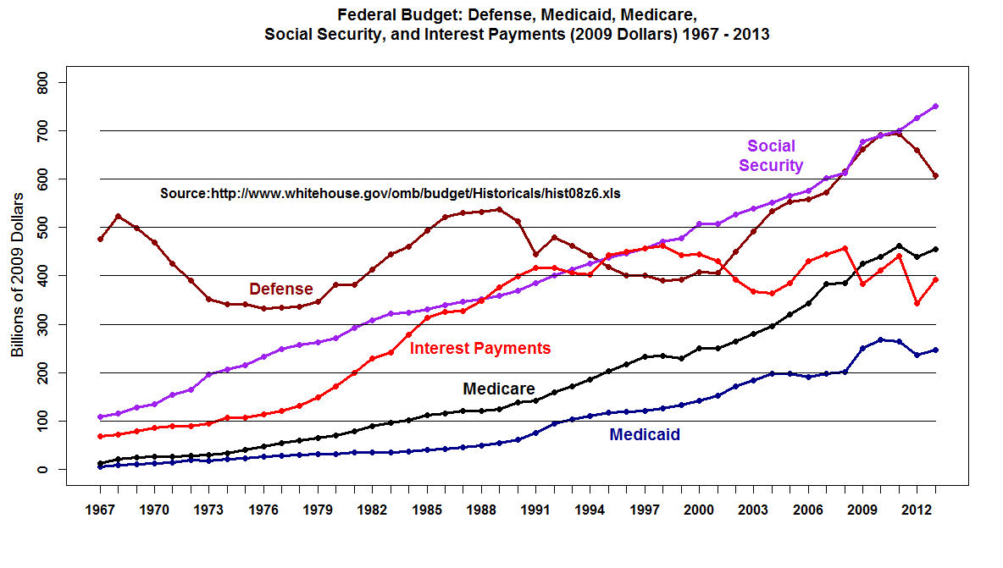

Slide 9
Size of adjusted gross income
All returns 2013 | 147,351,299 | 100.0
No adjusted gross income | 2,113,013 | 1.4
$1 under $5,000 | 10,608,111 | 7.2
$5,000 under $10,000 | 12,030,388 | 8.2
$10,000 under $15,000 | 12,503,345 | 8.5
$15,000 under $20,000 | 11,621,535 | 7.9
$20,000 under $25,000 | 10,125,285 | 6.9
$25,000 under $30,000 | 8,809,515 | 6.0
$30,000 under $40,000 | 14,473,606 | 9.8
$40,000 under $50,000 | 11,279,394 | 7.7
$50,000 under $75,000 | 19,229,309 | 13.0
$75,000 under $100,000 | 12,574,107 | 8.5
$100,000 under $200,000 | 16,425,446 | 11.1
$200,000 under $500,000 | 4,488,110 | 3.0
$500,000 under $1,000,000 | 724,251 | 0.5
$1,000,000 under $1,500,000 | 156,269 | 0.1
$1,500,000 under $2,000,000 | 64,236 | [2]
$2,000,000 under $5,000,000 | 91,128 | 0.1
$5,000,000 under $10,000,000 | 21,412 | [2]
$10,000,000 or more | 12,839 | [2]

Slide 10
Accumulated from smallest size of adjusted gross income
No adjusted gross income 2013 | 2,113,013 | 1.4
$1 under $5,000 | 10,608,111 | 7.2
$1 under $10,000 | 22,638,499 | 15.4
$1 under $15,000 | 35,141,844 | 23.8
$1 under $20,000 | 46,763,379 | 31.7
$1 under $25,000 | 56,888,664 | 38.6
$1 under $30,000 | 65,698,179 | 44.6
$1 under $40,000 | 80,171,785 | 54.4
$1 under $50,000 | 91,451,180 | 62.1
$1 under $75,000 | 110,680,489 | 75.1
$1 under $100,000 | 123,254,596 | 83.6
$1 under $200,000 | 139,680,042 | 94.8
$1 under $500,000 | 144,168,152 | 97.8
$1 under $1,000,000 | 144,892,403 | 98.3
$1 under $1,500,000 | 145,048,672 | 98.4
$1 under $2,000,000 | 145,112,908 | 98.5
$1 under $5,000,000 | 145,204,036 | 98.5
$1 under $10,000,000 | 145,225,448 | 98.6
$1 or more | 145,238,287 | 98.6
All returns | 147,351,299 | 100.0

Slide 11
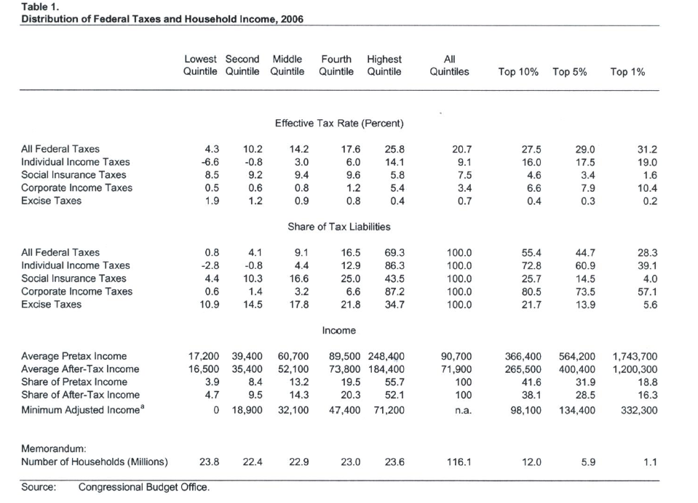

Slide 13
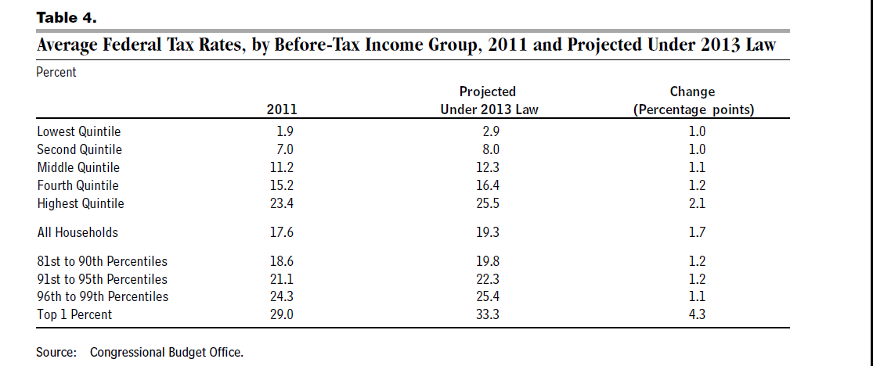

Slide 14
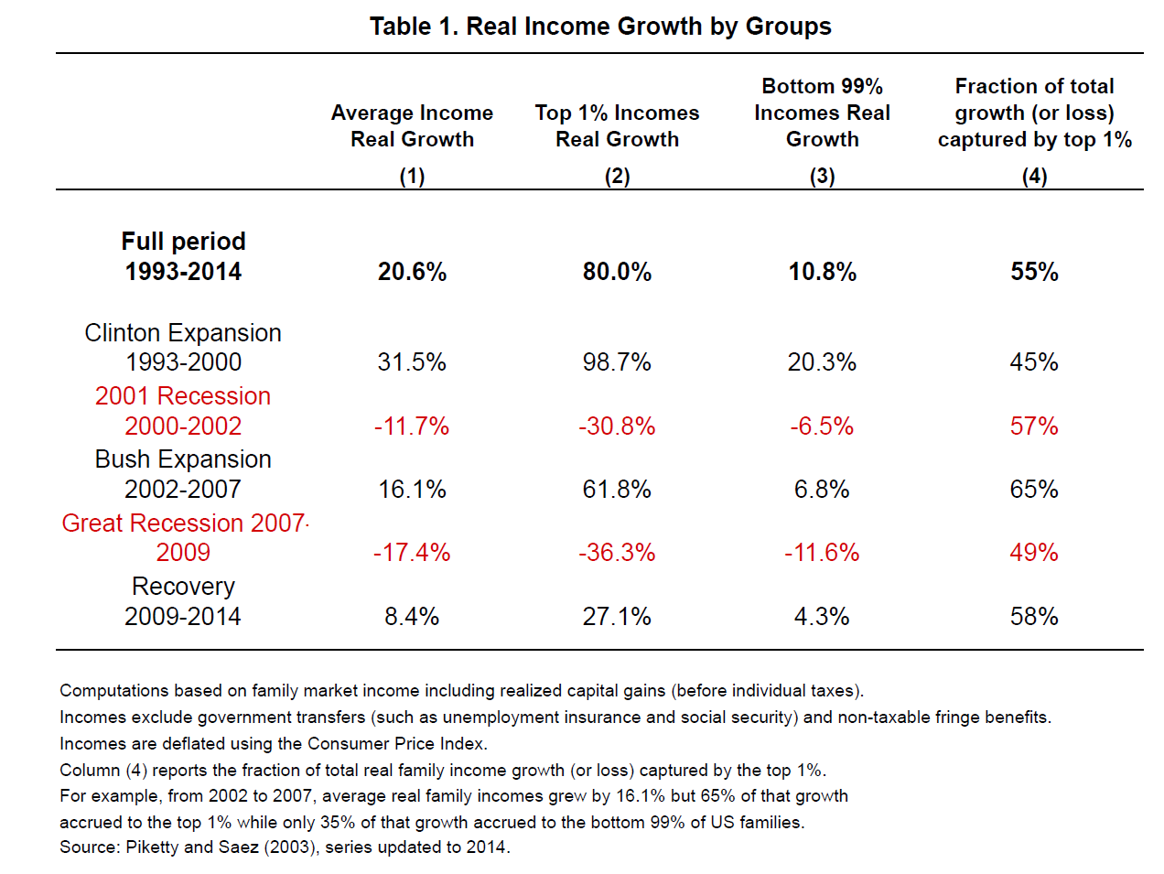

Slide 15
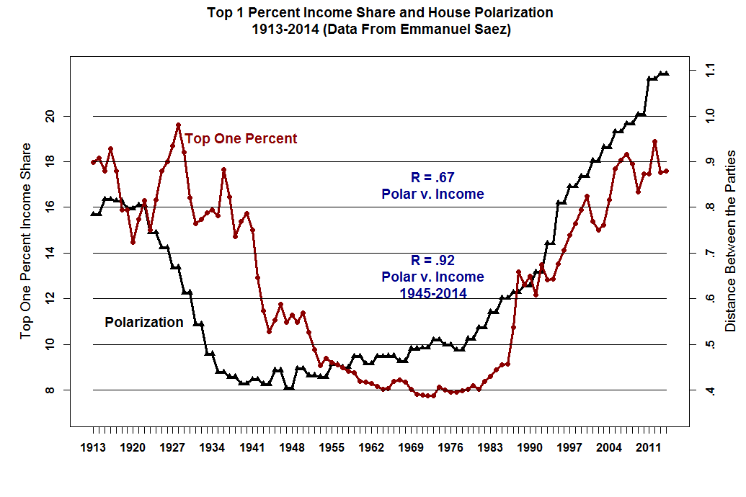

Slide 16
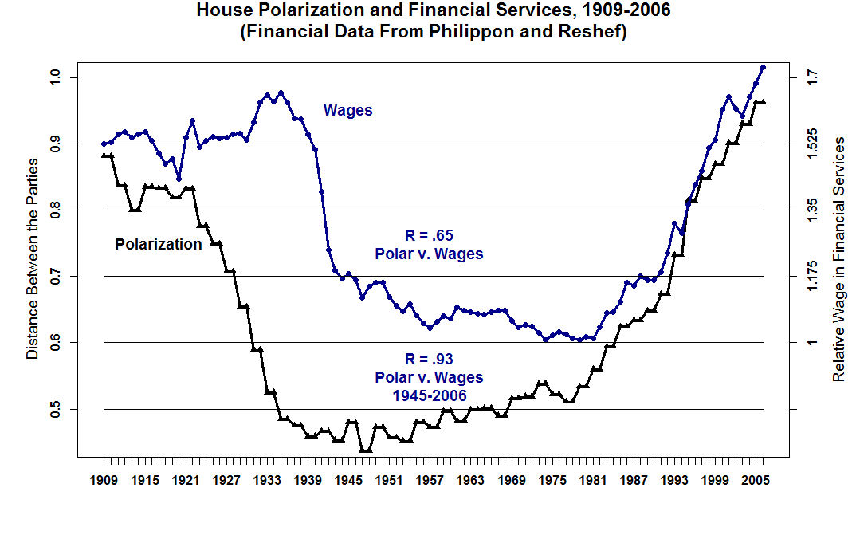

Slide 17
“Exploding Wealth Inequality in the U.S.”, Emmanuel Saez and Gabriel Zucman, Washington Center for Equitable Growth

Slide 18
