Slide 1
Fiorina Chapter 6
A Closer Look at Homosexuality

Slide 2
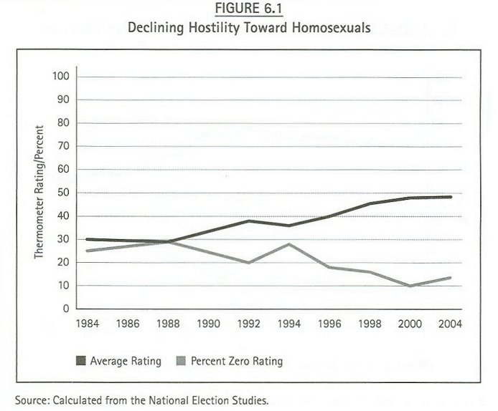

Slide 3
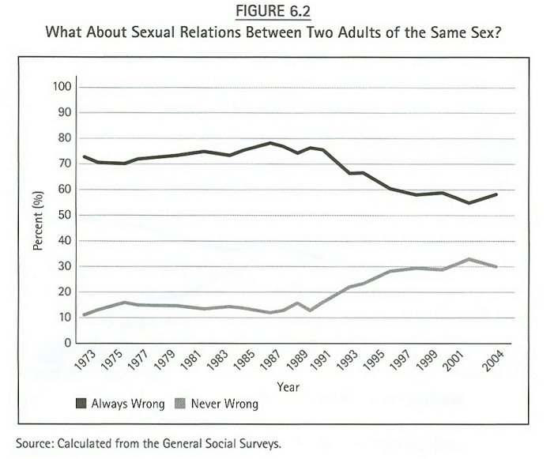

Slide 4
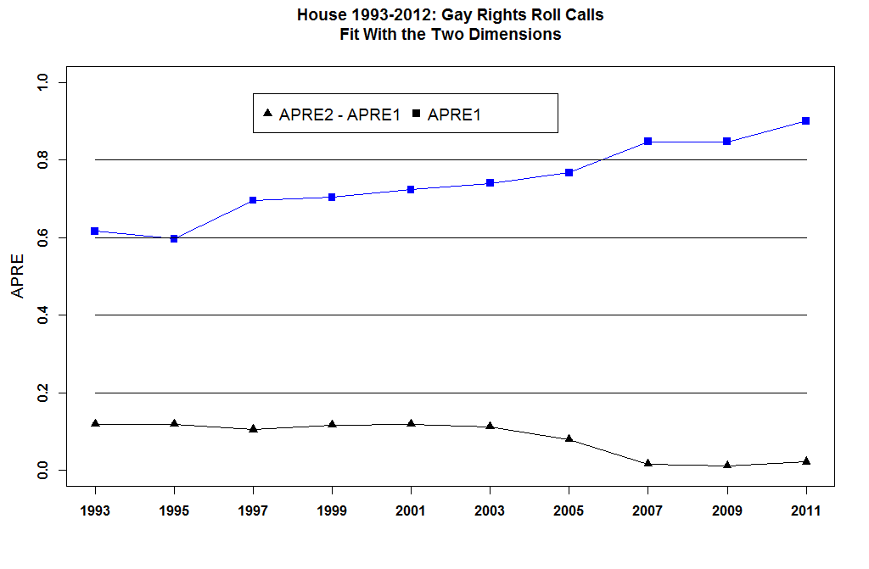

Slide 5
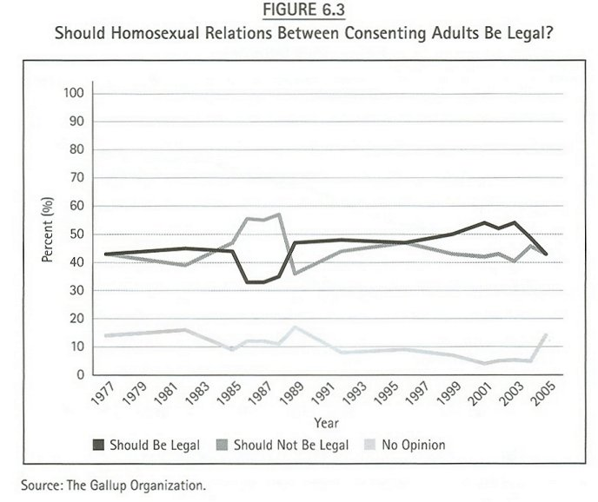

Slide 6
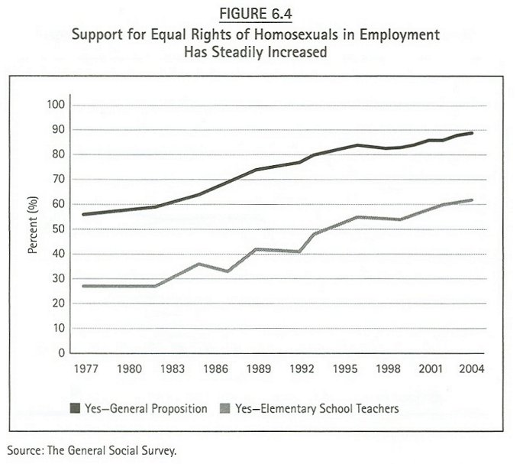

Slide 7
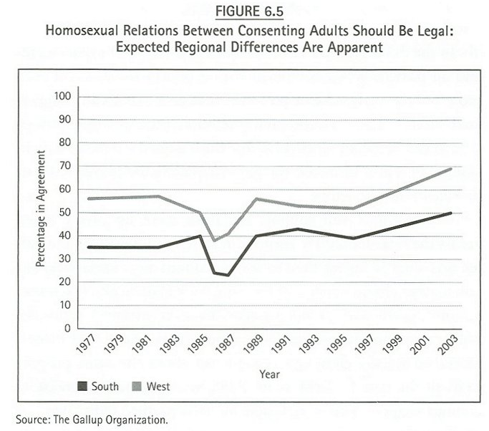

Slide 8
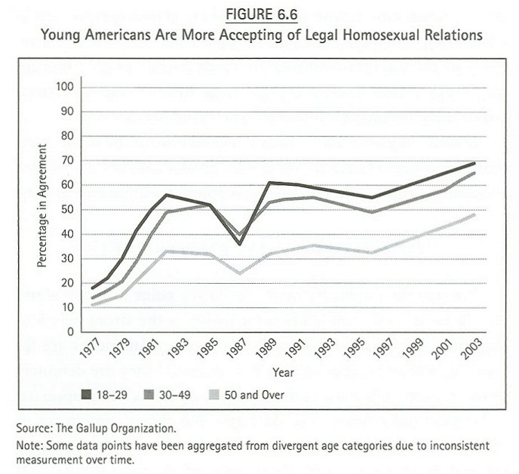

Slide 9
CBS News/New York Times Poll. Sept. 8-12, 2012. N=1,301 adults nationwide. Margin of error ± 3.
 |  |  |  |  |  | .
"Do you think it should be legal or not legal for same-sex couples to marry?"
 |  |  |  |  |  | .
 |  | Legal | Not legal | Unsure
 |  | % | % | %
 | 9/8-12/12 | 51 | 41 | 7
 | 7/11-16/12 | 46 | 44 | 10

Slide 10
AP-National Constitution Center Poll conducted by GfK Roper Public Affairs & Corporate Communications. Aug. 16-20, 2012. N=1,006 adults nationwide. Margin of error ± 3.9.
 |  |  |  |  |  | .
"Should couples of the same sex be entitled to the same government benefits as married couples of the opposite sex, or should the government distinguish between them?"
 |  |  |  |  |  | .
 |  | Entitled to the same | Distinguish between | Unsure | Refused
 |  | % | % | % | %
 | 8/16-20/12 | 63 | 32 | 4 | 1
 | 8/18-22/11 | 57 | 40 | 2 | 1
 | 8/11-16/10 | 58 | 38 | 3 | 1
 | 9/3-8/09 | 54 | 42 | 4 | 1
 | 8/22-29/08 | 51 | 43 | 4 | 1
 |  |  |  |  |  | .
 |  |  |  |  |  | .

Slide 11
Washington Post/Kaiser Family Foundation Poll. July 25-Aug. 5, 2012. N=3,130 adults nationwide. Margin of error ± 2.
 |  |  |  |  |  | .
"Do you think it should be legal or illegal for gay and lesbian couples to get married?" 2005 & 2010-2012: "gay and lesbian." 2009: "gay and lesbian" asked of half the sample, "homosexual" asked of half the sample. Other years: "homosexual."
 |  |  |  |  |  | .
 |  | Legal | Illegal | Unsure
 |  | % | % | %
 | 7/25 - 8/5/12 | 53 | 42 | 5
 | 5/17-20/12 | 53 | 39 | 8
 | 3/7-10/12 | 52 | 43 | 5
 | 7/14-17/11 | 51 | 45 | 4
 | 3/10-13/11 | 53 | 44 | 3
 | 2/4-8/10 | 47 | 50 | 3
 | 4/21-24/09 | 49 | 46 | 5
 | 5/31 - 6/4/06 | 36 | 58 | 5
 | 8/25-28/05 | 39 | 58 | 3
 | 3/4-7/04 | 38 | 59 | 3
 | 2/18-22/04 | 39 | 55 | 6
 | 1/15-18/04 | 41 | 55 | 4
 | 9/03 | 37 | 55 | 7

Slide 12
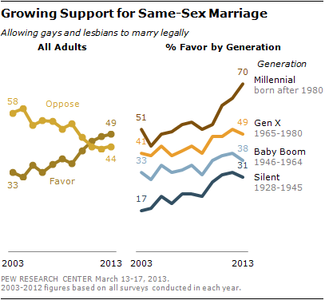

Slide 13
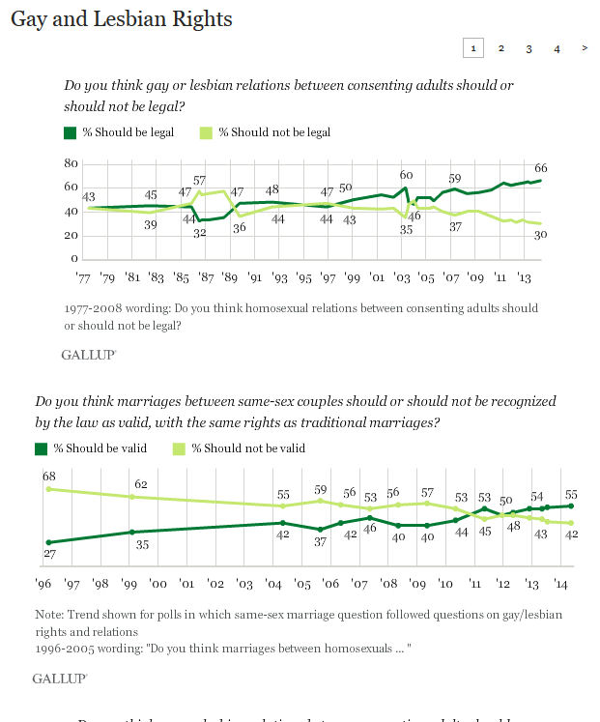

Slide 14
