Slide 1
Fiorina Chapters 1 and 2
Elections and Polarization

Slide 2
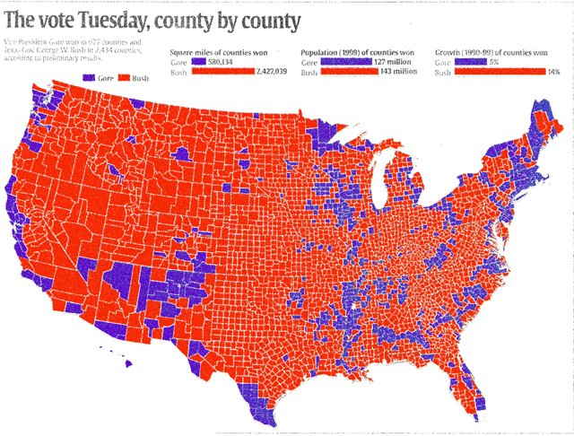
2000 Presidential Election

Slide 3
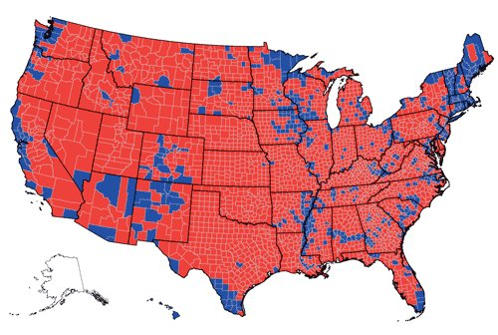
2004 Presidential Election

Slide 4
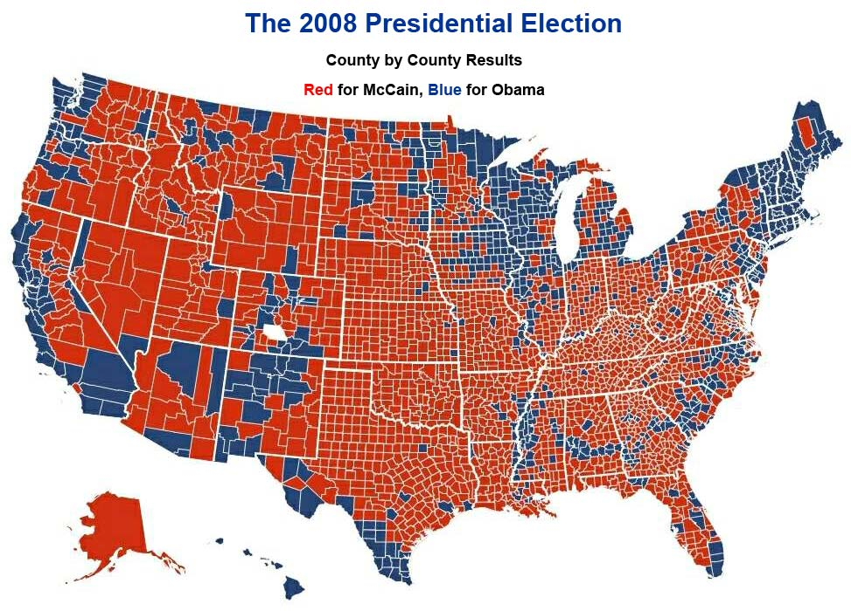

Slide 5
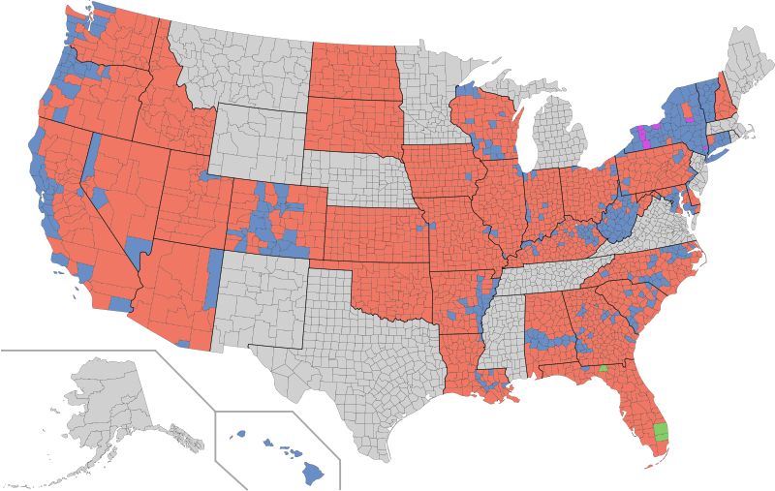
2010 Senate Elections by County

Slide 6
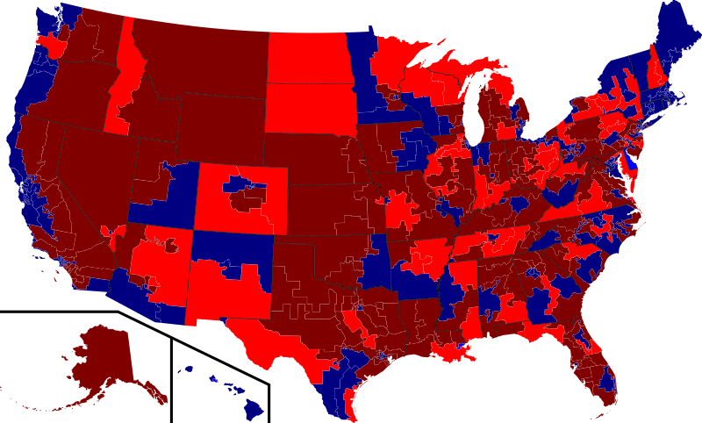
2010 HOUSE ELECTIONS BY CONGRESSIONAL DISTRICT

Slide 7
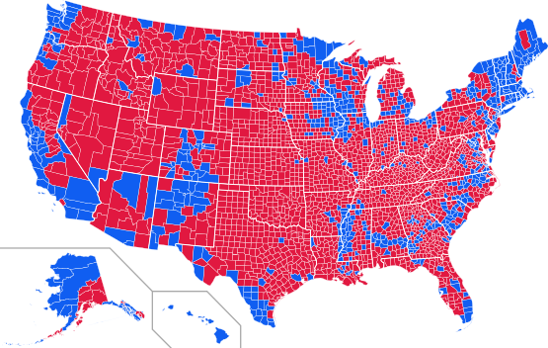
2012 Presidential Election
Blue for Obama, Red for Romney

Slide 8
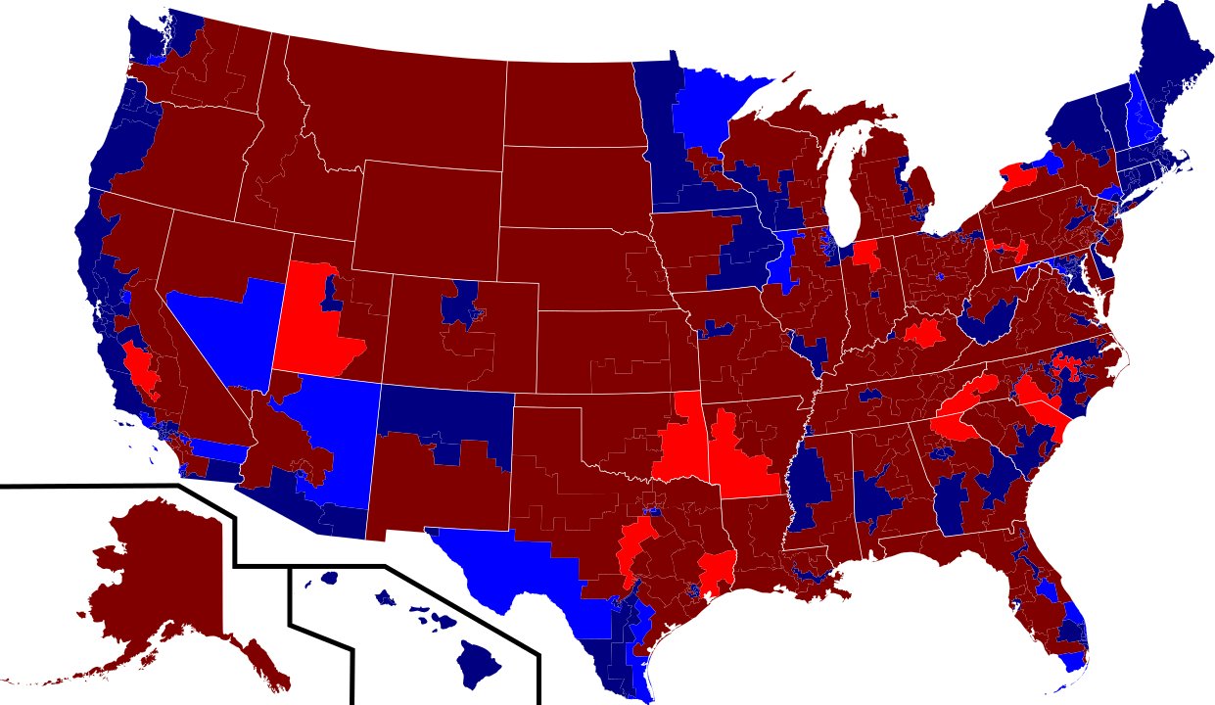

Slide 9
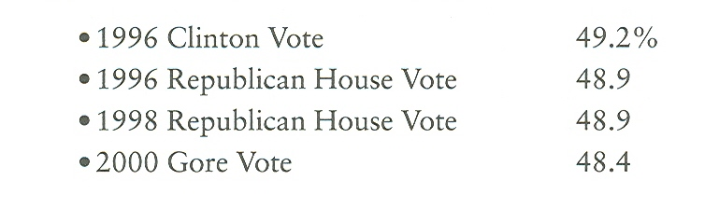
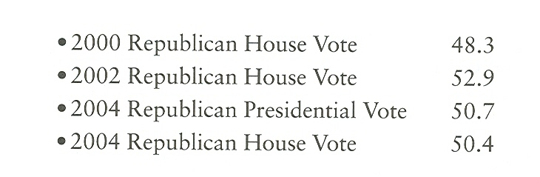
2006 Republican House Vote 44.1
2008 Republican House Vote 42.5
2008 Republican Presidential Vote 45.7
2010 Republican House Vote 51.6
2012 Republican House Vote 47.6
2012 Republican Presidential Vote 47.2

Slide 10
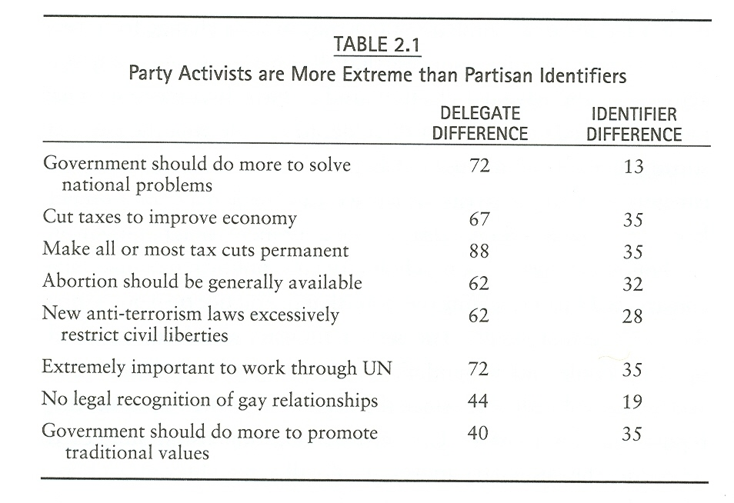

Slide 12
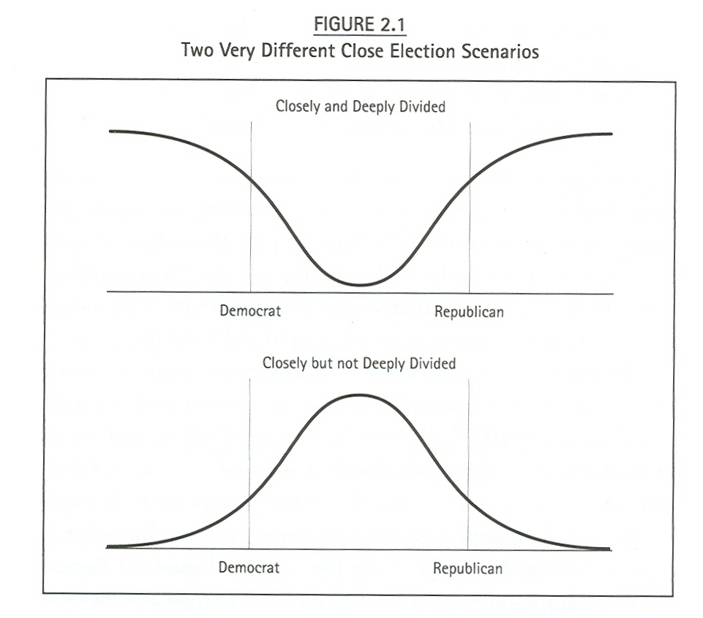

Slide 13
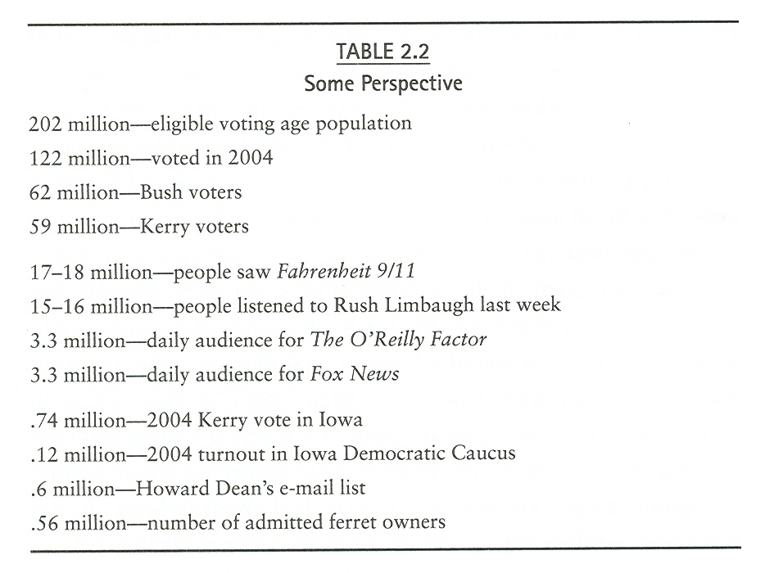
2012 – 62,611,756 Obama; 59,134,500 Romney
2008 – 69,498,516 Obama; 59,948,323 McCain
2012: VEP 221,925,820

Slide 14
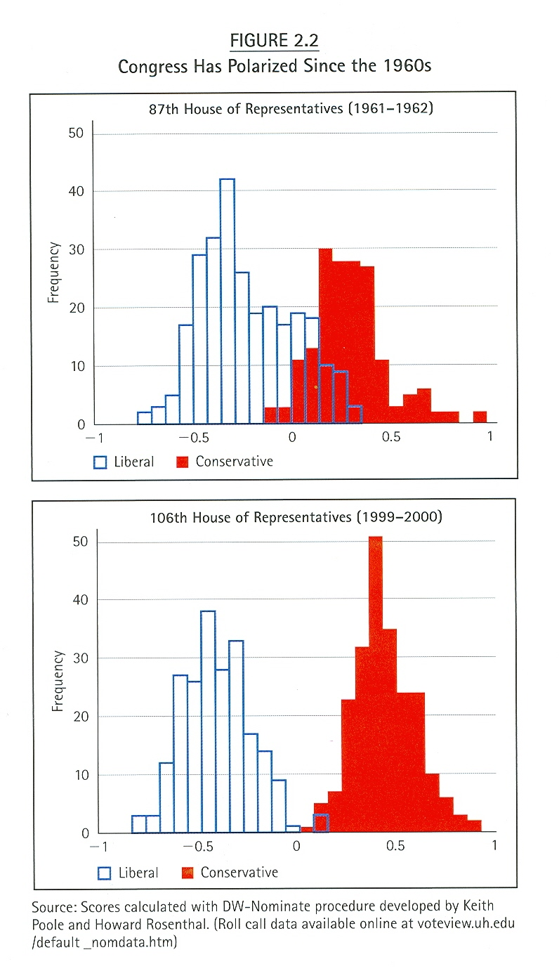

Slide 15
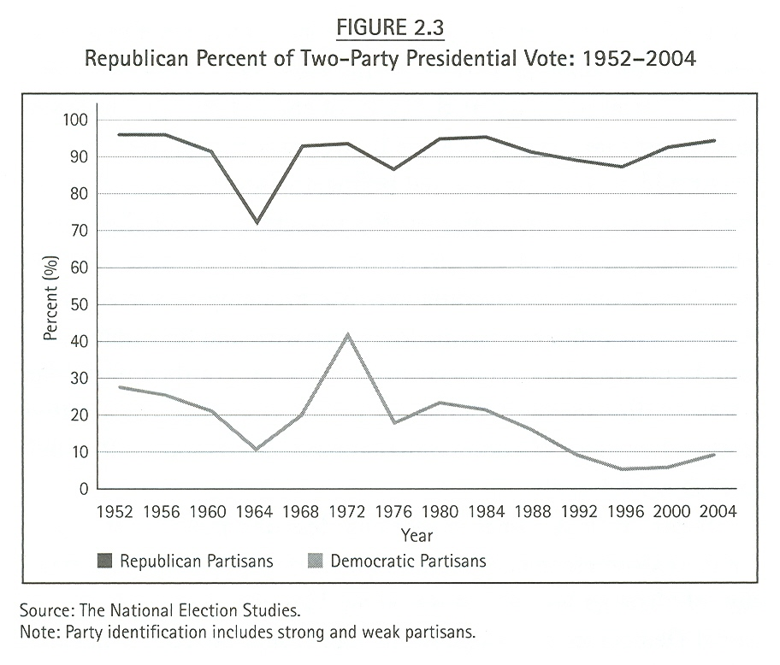

Slide 16
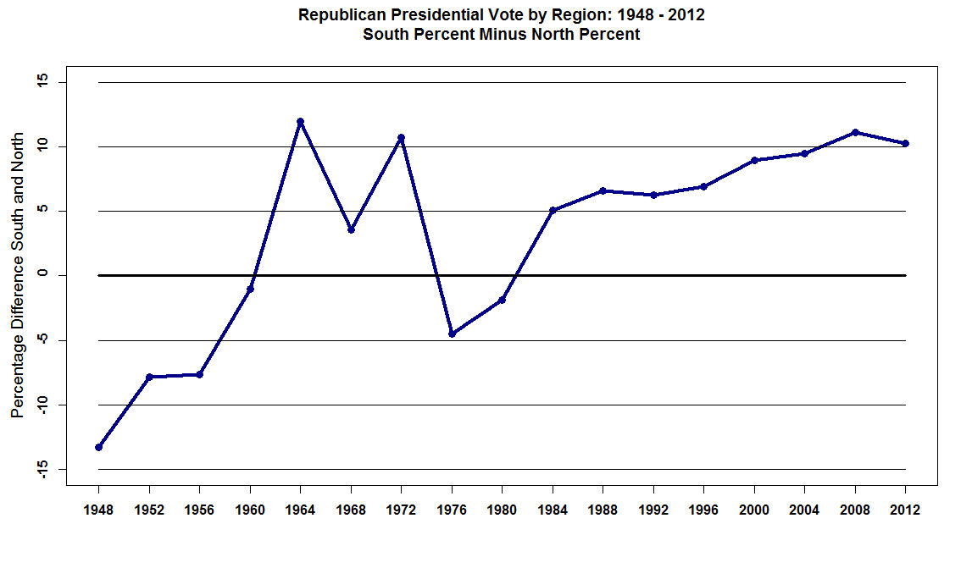

Slide 17
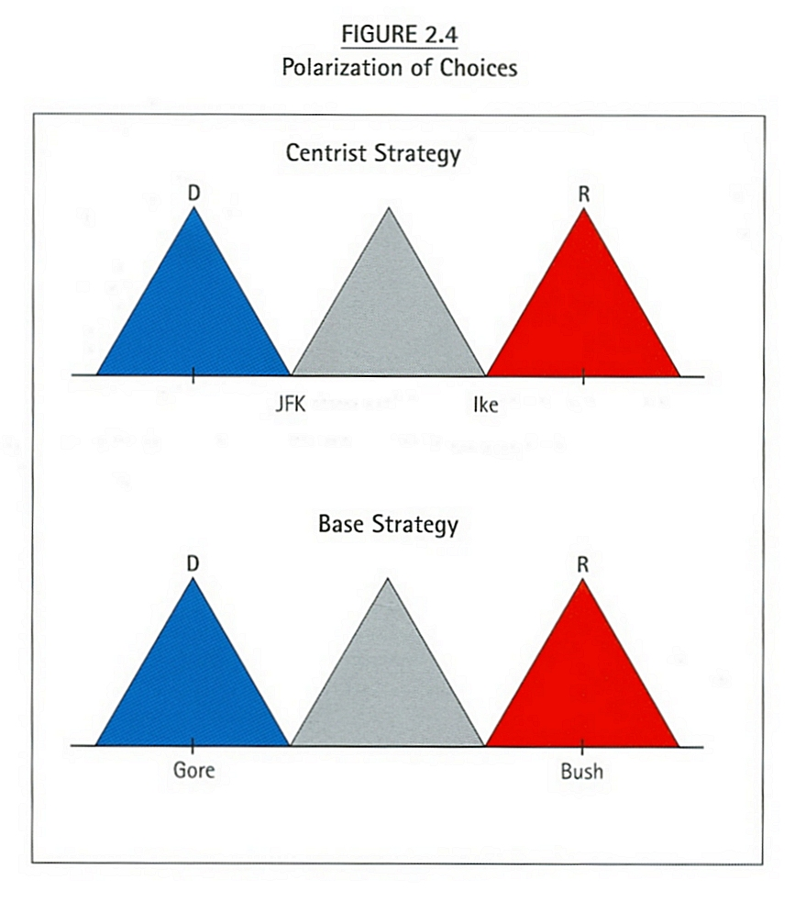

Slide 18
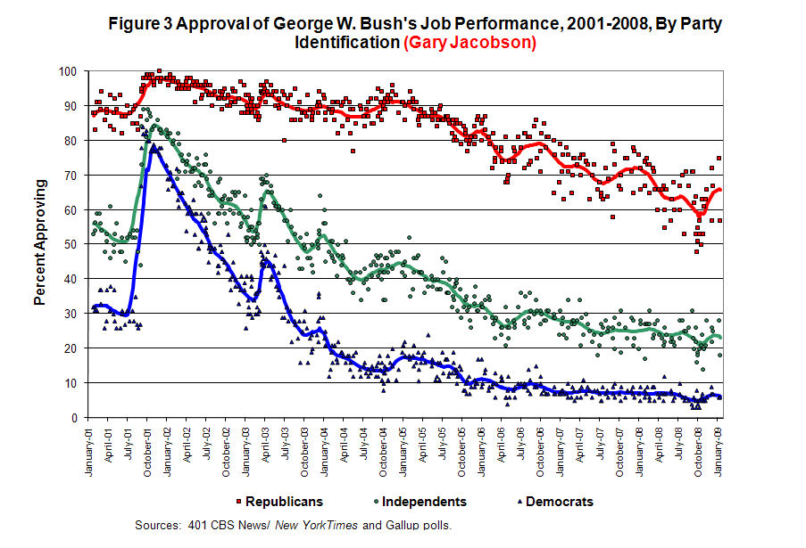

Slide 19
